Slide 1

Identifying and Classifying Data-Driven Messages
January 23, 2018
Justin Murphy
Assistant Professor
University of Southampton
jmrphy.net
@jmrphy
A lightning talk on some work in progress

Slide 2
Do data increase the probability a message will be shared?

Slide 3
Research Design
Conceptually distinguish data-driven messages
Manually code a sample of messages
Train a classifier
Classify a new, larger sample of interest
Test if data increases sharing

Slide 4
What is a data-driven message?
“A message the primary point of which is based on a formal dataset.”
Excludes joking or tangential references to data
Excludes quotidian use of numbers

Slide 5
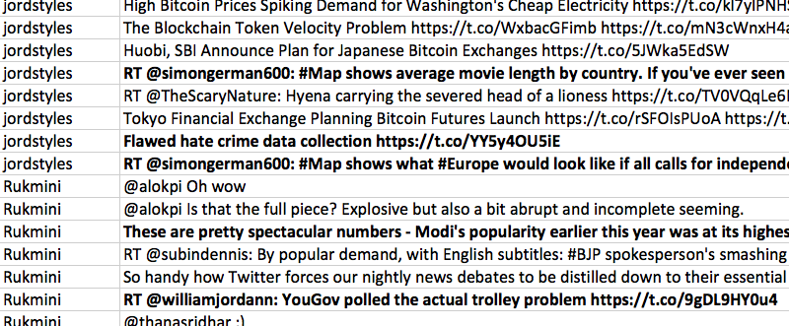
Coding data-driven messages

Slide 6
Training a classifier
Split sample into training and test
doc2vec
Logistic regression with cross validation

Slide 7
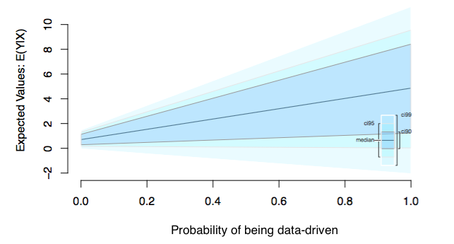
Estimating the effect of data on sharing

Slide 8


Thanks! Feel free to get in touch.
Justin Murphy
j.murphy@soton.ac.uk
jmrphy

