Slide 1
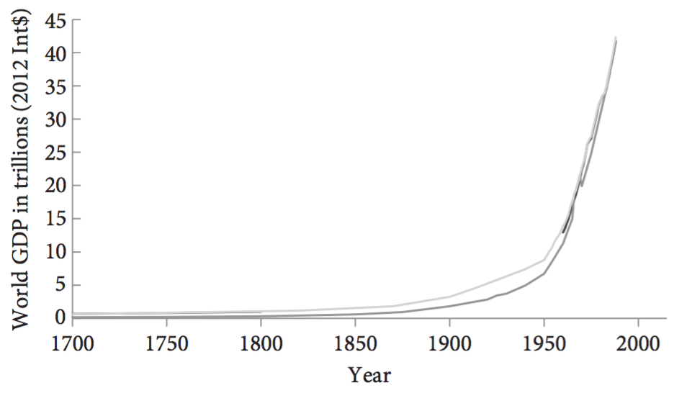
Bostrom, Nick. 2014. Superintelligence: Paths, Dangers, Strategies. Oxford: Oxford University Press.

Slide 2
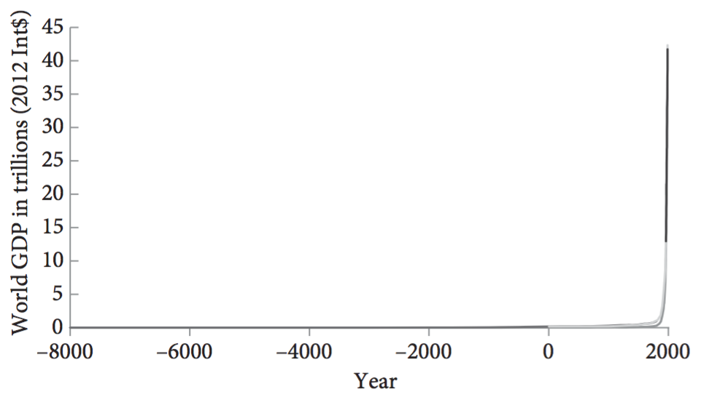
Bostrom, Nick. 2014. Superintelligence: Paths, Dangers, Strategies. Oxford: Oxford University Press.

Slide 3
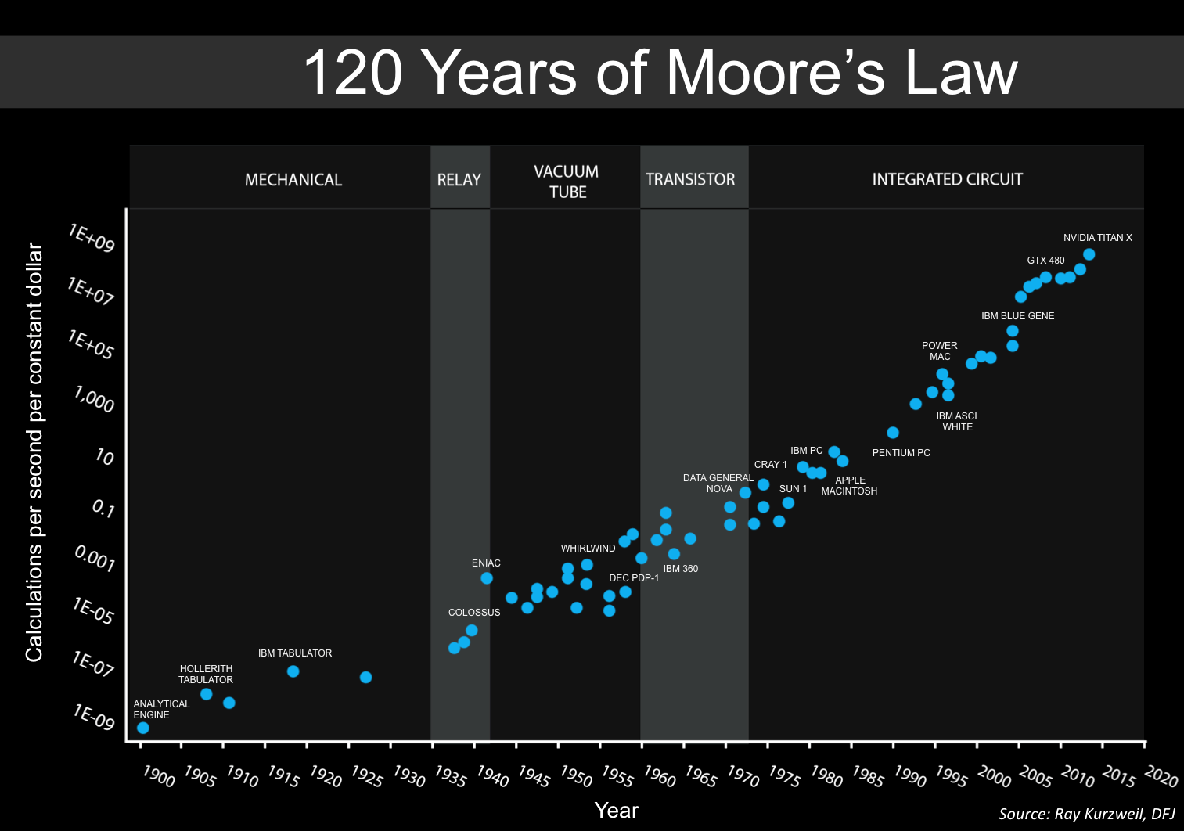
Jurvetson, Steve. 2016. An updated version of Moore's Law over 120 Years (based on Kurzweil’s graph). https://commons.wikimedia.org/w/index.php?curid=55002144

Slide 4
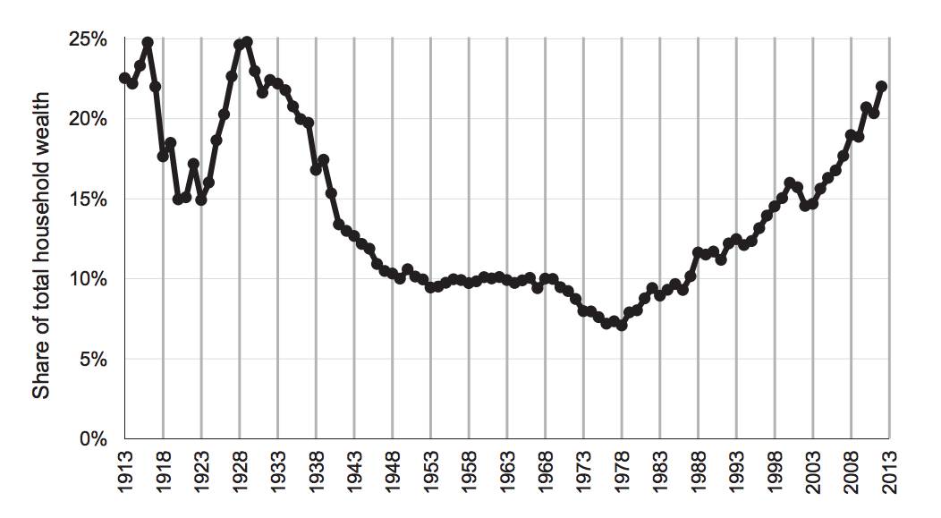
Saez, Emmanuel, and Gabriel Zucman. 2016. “Wealth Inequality in the United States since 1913: Evidence from Capitalized Income Tax Data.” The Quarterly Journal of Economics 131(2): 519–78.

Slide 5
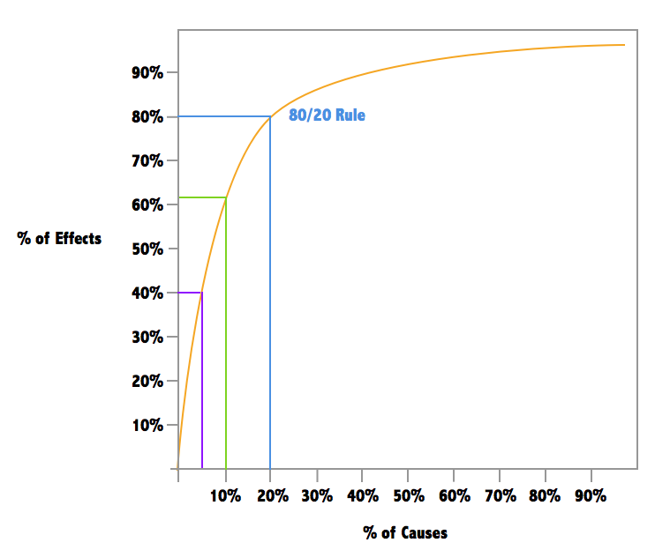
"Demystifying the 80/20 Rule." 2014. Sandglaz Blog. http://blog.sandglaz.com/demystifying-8020-rule-apply-workplace-productivity/ (September 24, 2017).

Slide 6
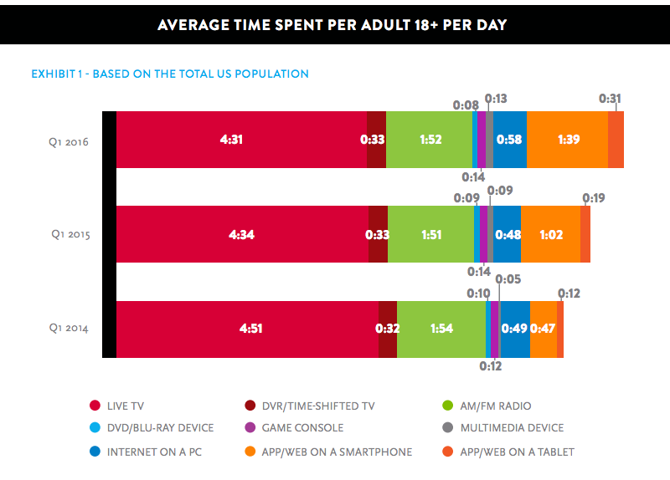
Lynch, John. 2016. “The Average American Watches so Much TV It’s Almost a Full-Time Job.” Business Insider.

Slide 7
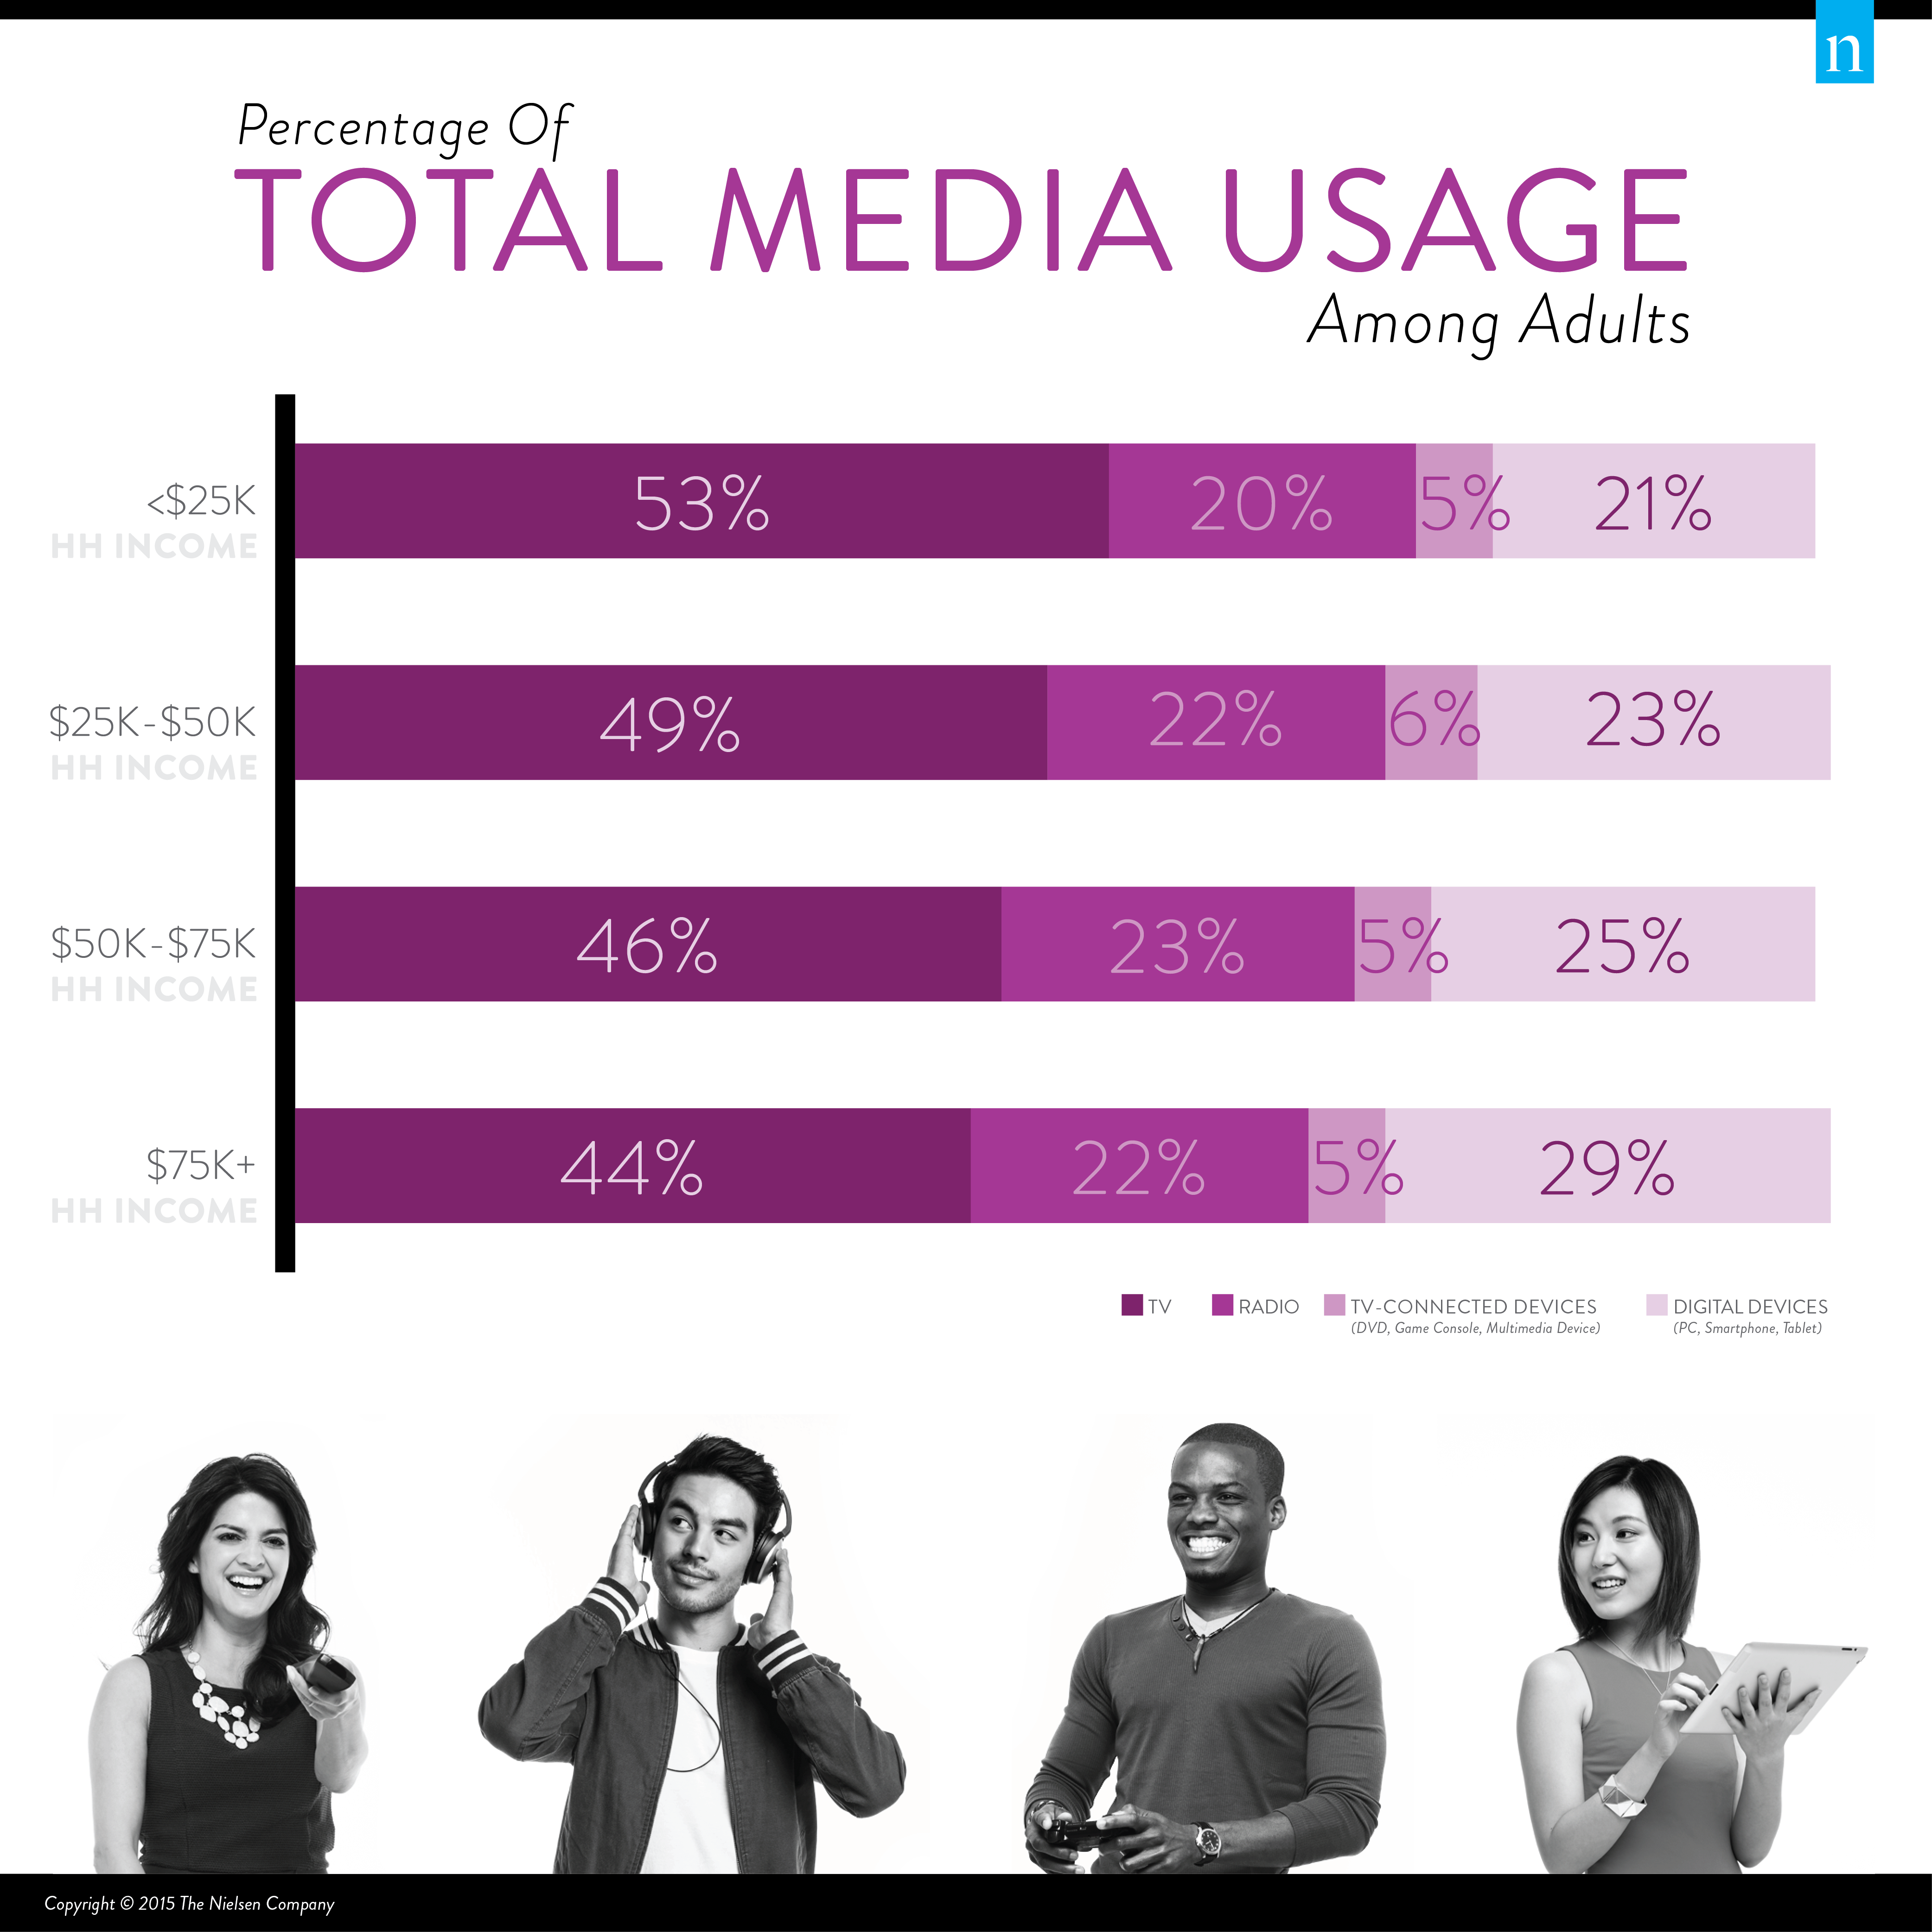
Nielsen. 2015. “All About the Benjamins: When It Comes to Media Habits, Income Level Is a Key Factor.” Newswire.

Slide 8
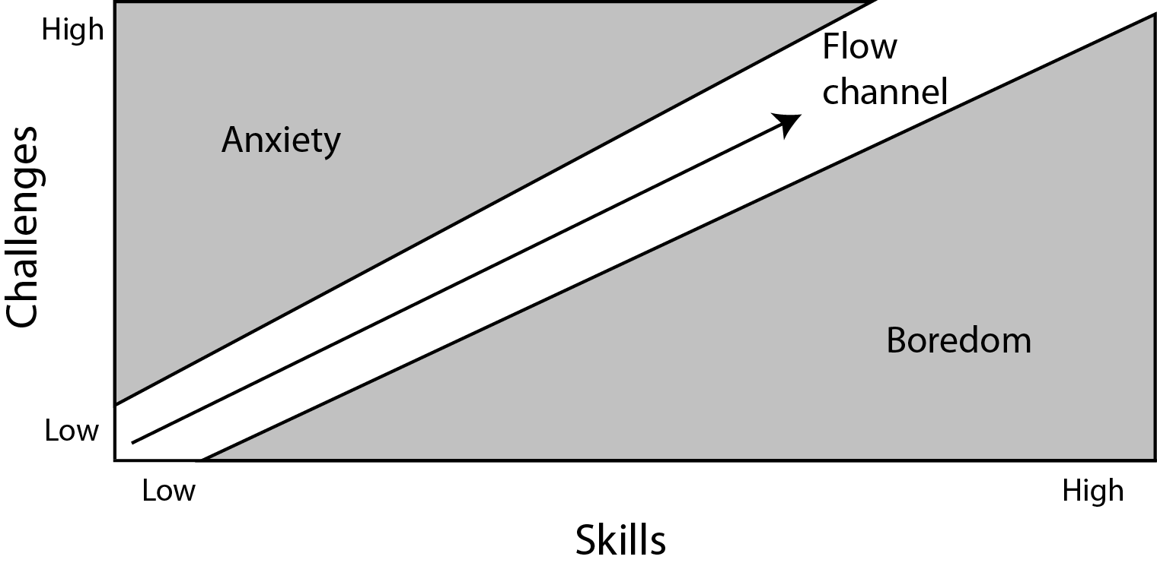
Csikszentmihalyi, Mihaley. 1988. Optimal Experience: Psychological
Studies of Flow in Consciousness. Cambridge: Cambridge University Press.

