Slide 1
The Information Revolution and its aftermath (Part 1)
Justin Murphy, PhD
University of Southampton
jmrphy.net
@jmrphy

Slide 2
Overview
What was the information revolution, exactly?
The difference between analog and digital
The significance of digitalism
Skill-biased cultural change
A macropolitical theory of the information revolution

Slide 3
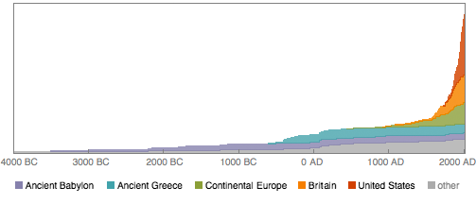
Cumulative Number of Information-Processing Innovations
Wolfram|Alpha, http://blog.stephenwolfram.com/2011/08/advance-of-the-data-civilization-a-timeline/

Slide 4
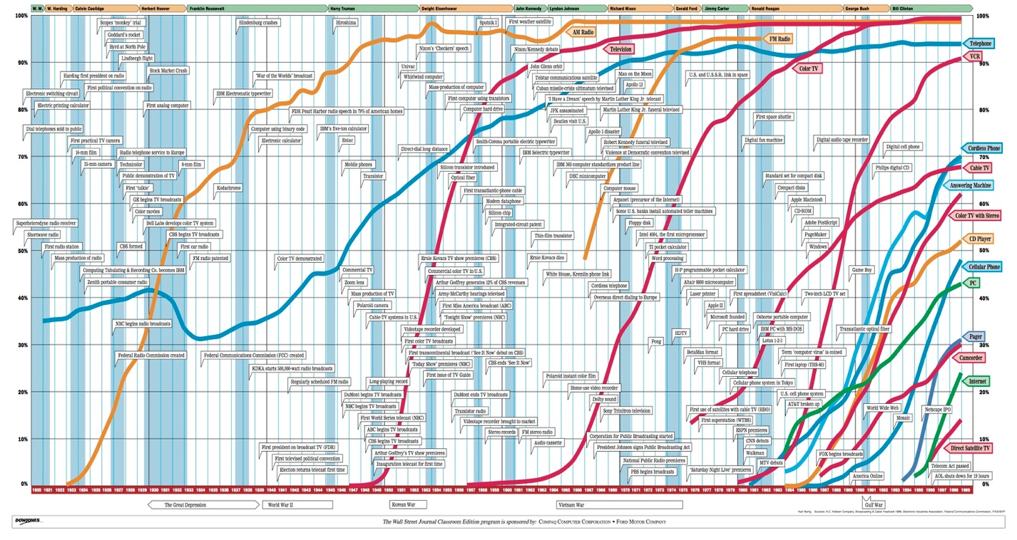
Wall Street Journal

Slide 5
The Information Revolution
Based on a set of intellectual and technological discoveries revolving around the War effort in the US.
Theory of information (1948), the transistor (1947), cellular networks (1947), transatlantic telephone cables (1956), and much more.
Digitalism.

Slide 6
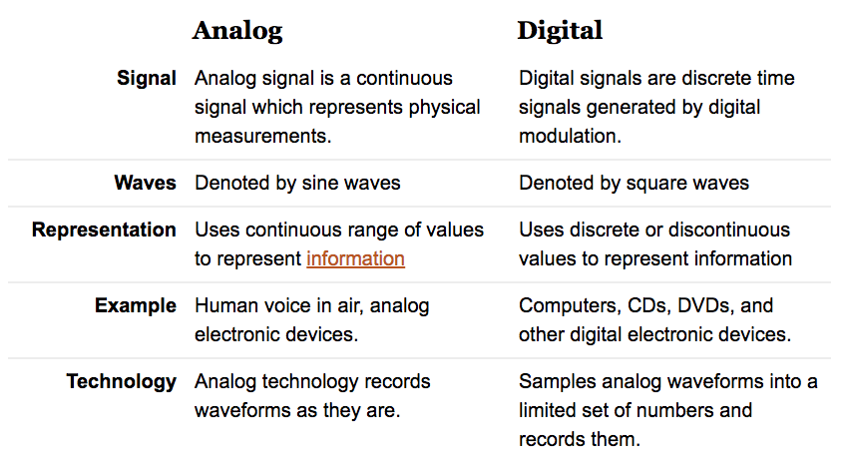
“Analog vs. Digital - Difference and Comparison.” Diffen. http://www.diffen.com/difference/Analog_vs_Digital (November 2, 2017).

Slide 7
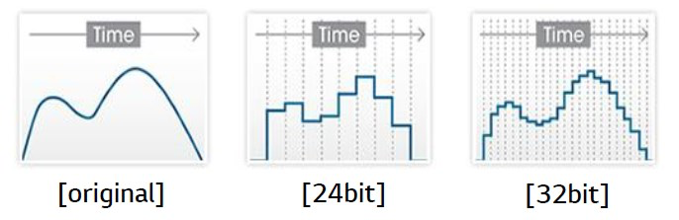
Analog vs. Digital
“What Is a DAC?” Ubergizmo. http://www.ubergizmo.com/what-is/dac/ (November 2, 2017).

Slide 8
The Significance of Digitalism
Decreases the costs for producing, storing, and sharing information
Noiseless copying and transmission of information
Compression/miniaturization
Technological convergence (cyberspace)
Integration of communication and computation
Reduction of continuous (infinite) variation to discrete (finite) variation

Slide 9
Skill-biased Technological change
Wage inequality begins to increase in the early 1980s, right after the advent of microcomputers (Katz 1999).
Skill and capital are complements (Griliches 1969).
High-skill high-education workers more likely to use computers on the job (Krueger 1993).
The relative price of capital equipment has been decreasing (Krussell, Ohanian, Rios-Rull and Violante 2001).

Slide 10
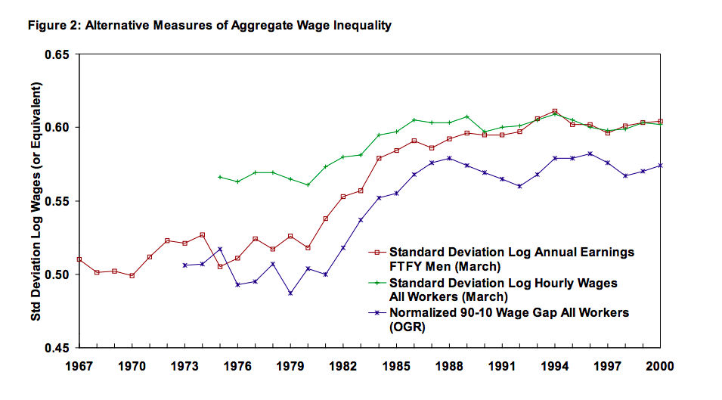
Card, David, and John E DiNardo. 2002. “Skill Biased Technological Change and Rising Wage Inequality: Some Problems and Puzzles.” http://www.nber.org/papers/w8769.pdf.

Slide 11
A Macropolitical Theory of the information Revolution
Information revolution increased the positive feedbacks (decreased the negative feedbacks) between intelligence, capital, and technological innovation.
Cultural and political implications:
Skill-biased ethical change in favor of instrumentalism
Unequally distributed social learning
Increasing efficiency of selection effects
Geographical compression & segregation

Slide 12
Cultural & political Changes
1950s and 1960s saw the rise of television (“Golden Age of broadcasting”).
1950s to early 1970s were periods of upheaval.
- extraordinary class, race, and gender conflict
- Decolonization & national liberation struggles
- Wage compression, democratic tendencies
Mid-to-late 1970s saw the emergence of right-wing reaction (‘neoliberalism’).
Reagan elected in 1980, Thatcher in 1979.
Steadily increasing social liberalism, increasingly conservative economic realities.
- A division of labor in collective deception

Slide 13
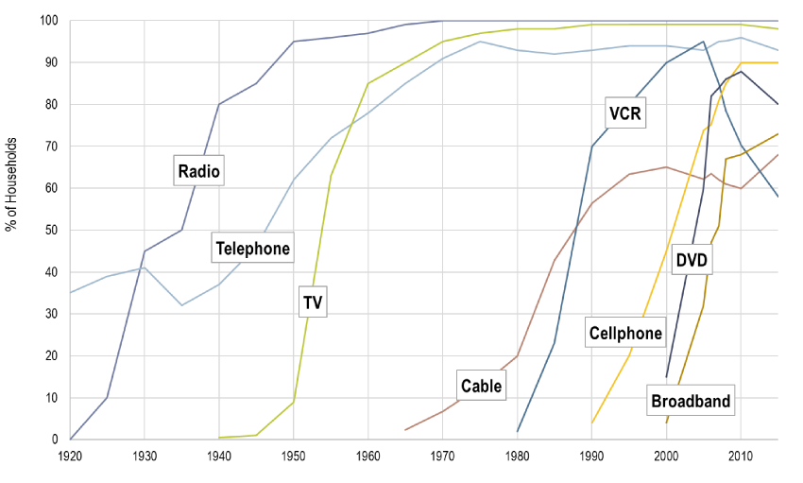
https://people.hofstra.edu/geotrans/eng/ch1en/conc1en/telecomdiffusionUS.html

Slide 14
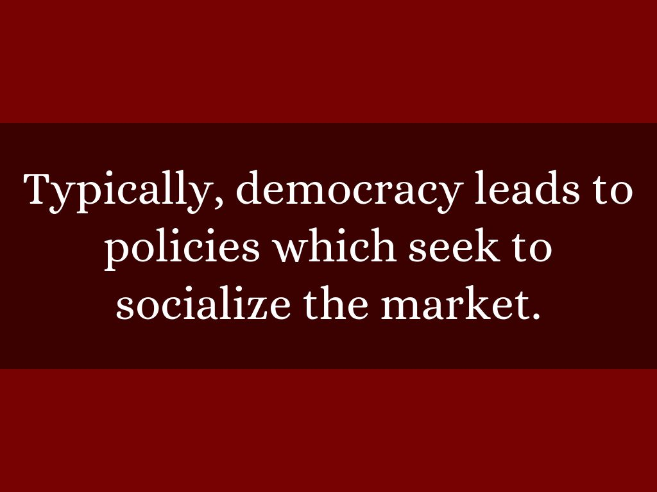

Slide 15
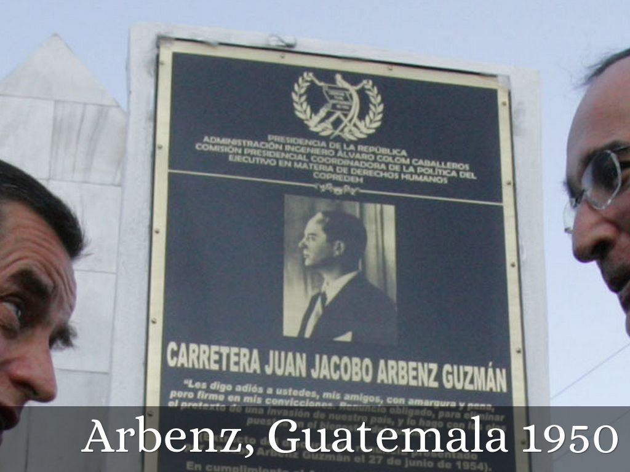
Photo by Gobierno de Álvaro Colom, Guatemala 2008-2012 - Creative Commons Attribution-NonCommercial-ShareAlike License https://www.flickr.com/photos/40856688@N04

Slide 16
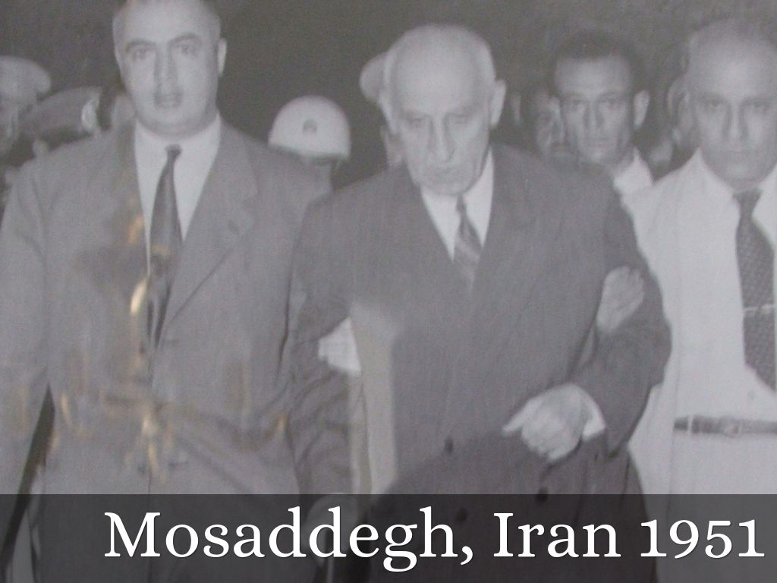
Photo by cfarivar - Creative Commons Attribution-NonCommercial-ShareAlike License https://www.flickr.com/photos/57082570@N00

Slide 17
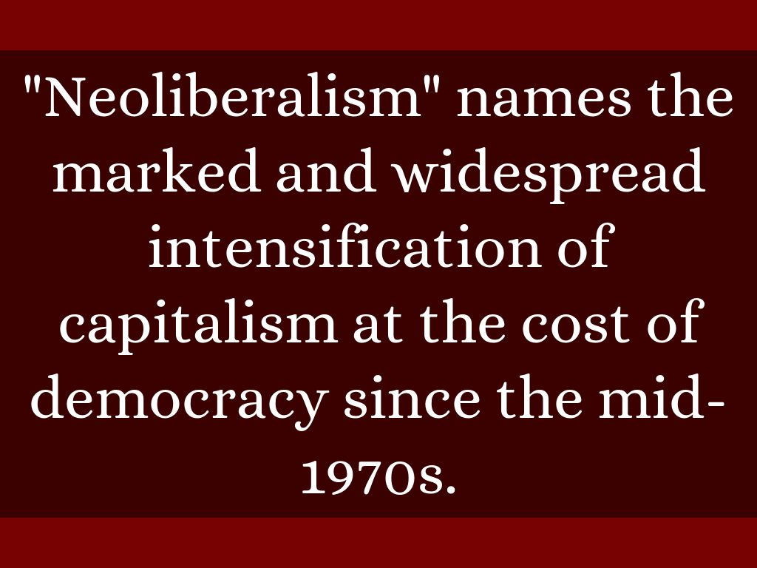

Slide 18
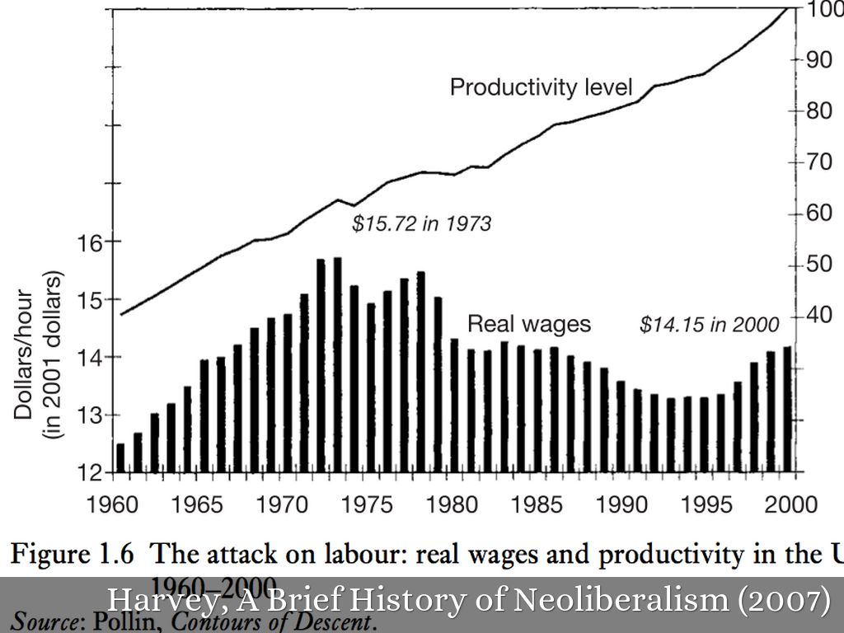

Slide 19
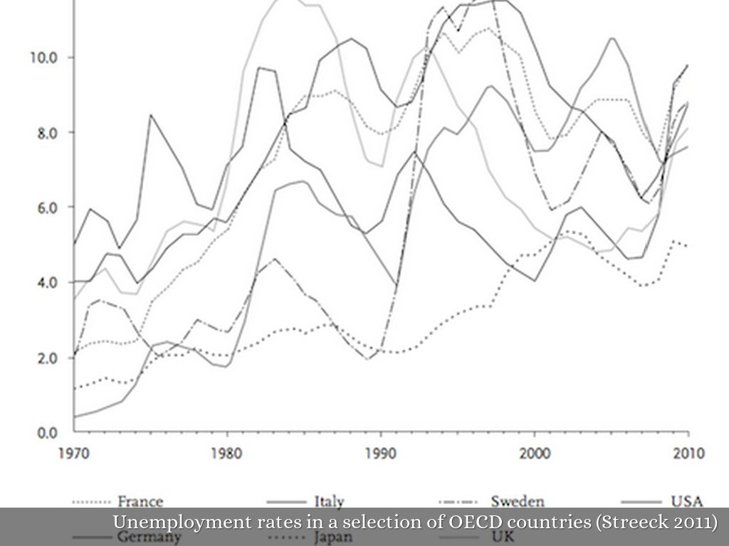

Slide 20
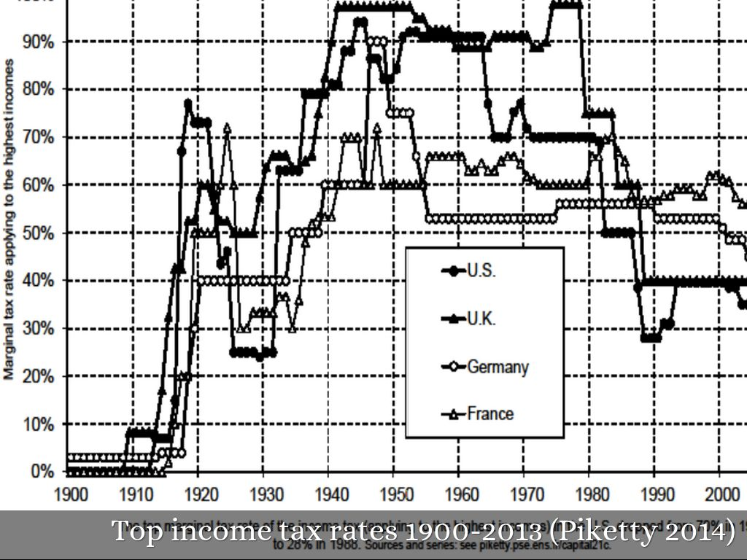

Slide 21
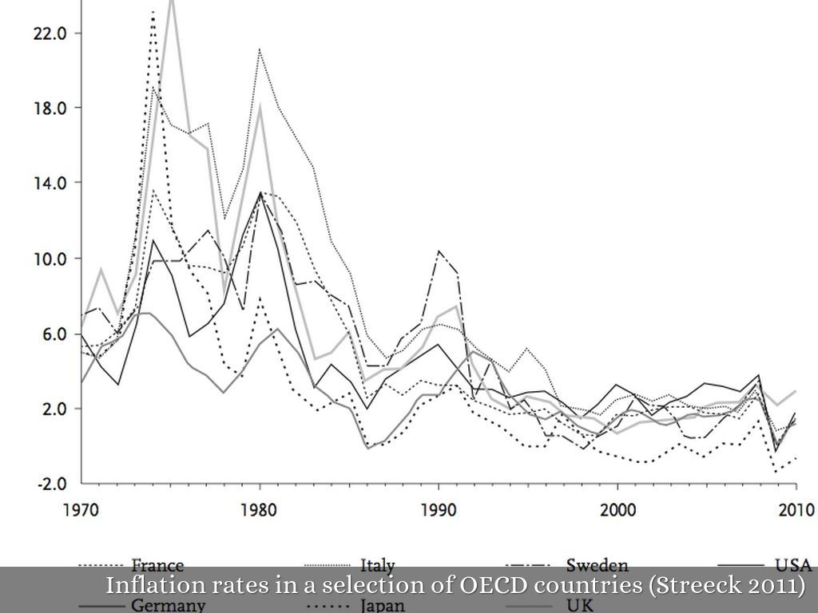

Slide 22
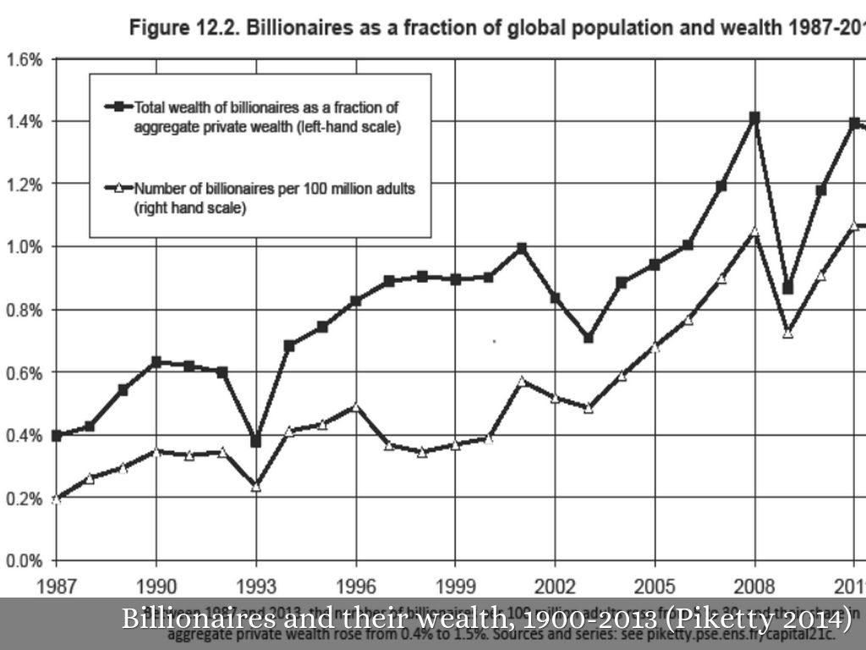

Slide 23
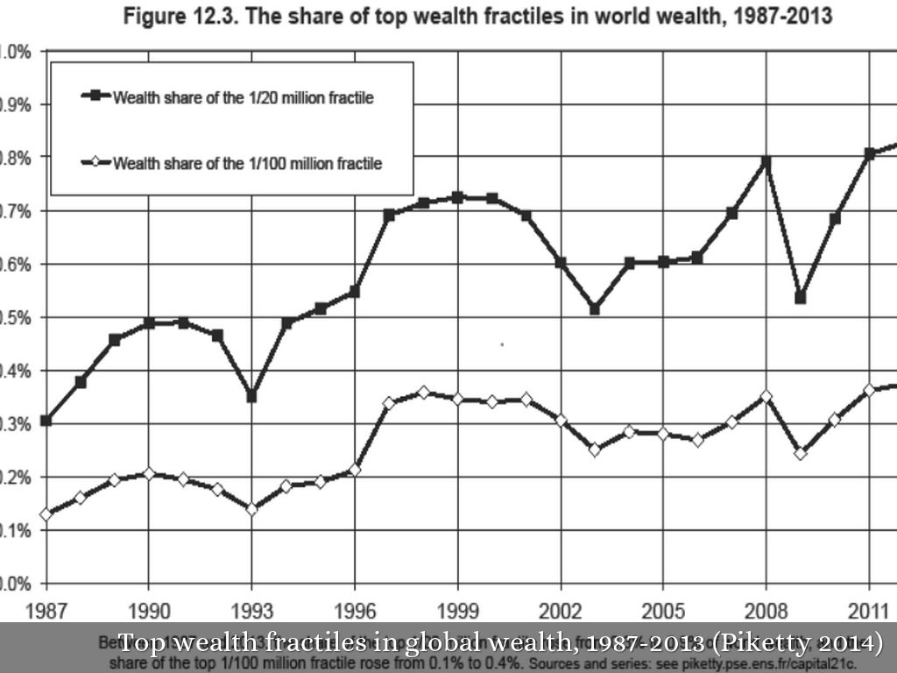

Slide 24


Slide 25
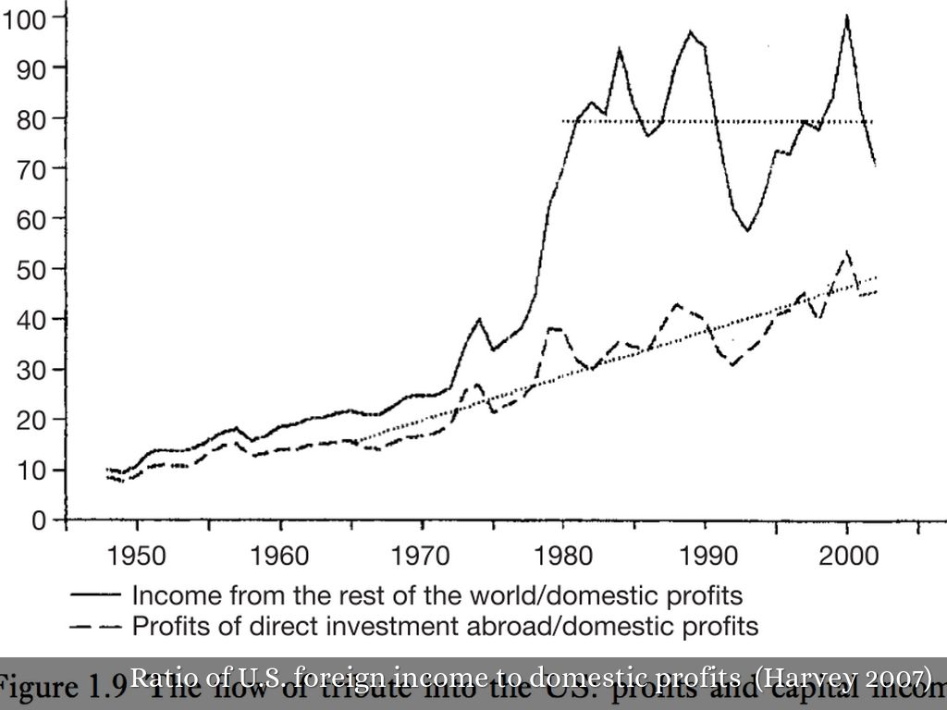

Slide 26

Photo by Gamma Man - Creative Commons Attribution License https://www.flickr.com/photos/51625243@N06
Created with Haiku Deck

Slide 27
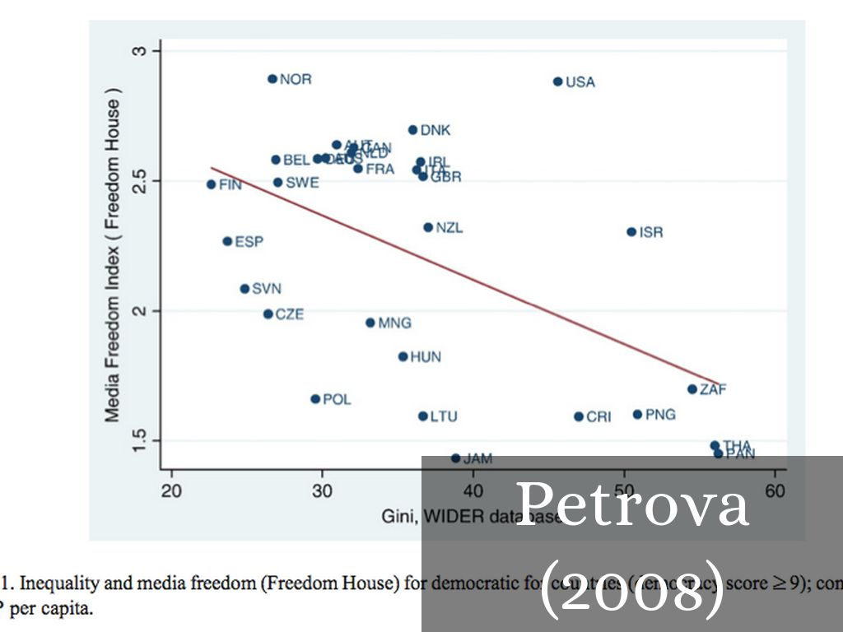

Slide 28
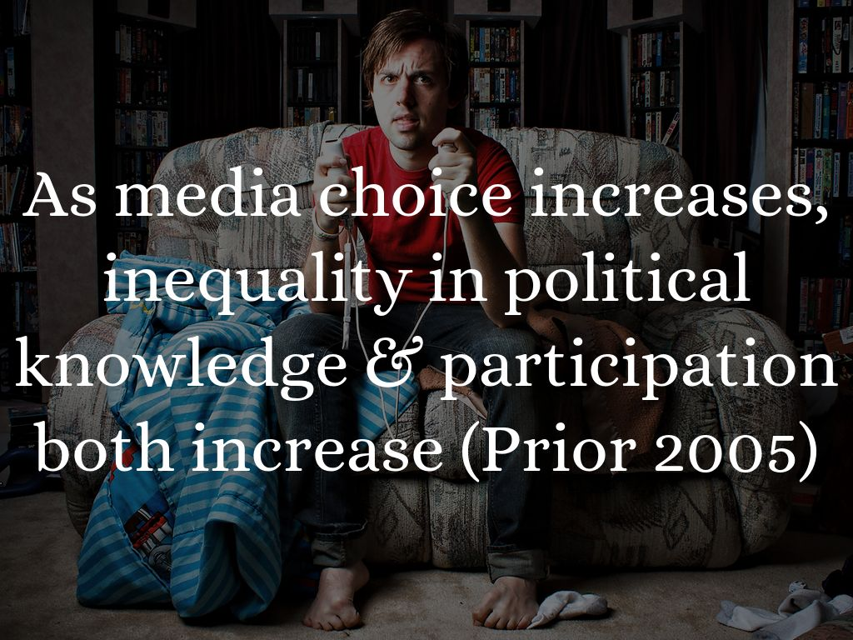
Photo by Steven Andrew Photography - Creative Commons Attribution-NonCommercial License https://www.flickr.com/photos/51555844@N07
Created with Haiku Deck

Slide 29
