Slide 1
The Early Social Science of Media
Justin Murphy

Slide 2
Overview
From major effects to ‘limited effects’
What we’ve learned from early political science research on the media
Why were systemic approaches replaced by linear approaches?
The larger implications

Slide 3
Conventional Wisdom, 1920s – 1950s
For a while, most influential media thinkers agreed mass media has hugely powerful effects.
Bernays (1891 − 1995)
Lippmann (1889 – 1974)
Wiener (1894 – 1964)
McLuhan (1911 – 1980)
Deutsch (1912–1992)
Others

Slide 4
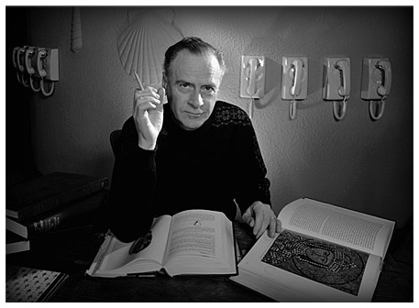
“The medium is the message.” - Marshall McLuhan
https://www.youtube.com/watch?v=viuIKgjLnDE

Slide 5
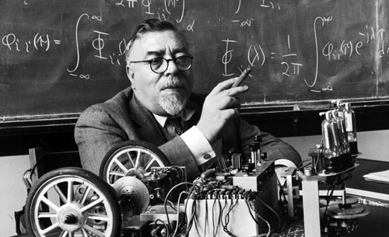
Norbert Weiner

Slide 6
"It is my thesis that the physical functioning of the living individual and the operation of some of the newer communication machines are precisely parallel in their analogous attempts to control entropy through feedback.”
NORBERT WIENER, THE HUMAN USE OF HUMAN BEINGS

Slide 7
The decline of massive systemic effects
Cybernetics would seem to unify the physical and social sciences
Wiener was pessimistic about social science because decoupling observer & observed is difficult (plus poor data)
Cybernetics disappeared from social science
Linear statistical modeling grew to prominence

Slide 8
New mainstream social science (1940s)
1. The Bureau of Applied Social Research at Colombia University (1944) pioneered the use of survey research and quantitative methods for the study of mass communications.
AKA the “Colombia School”
Led by Paul Lazarsfeld (1901-1976)
Built on corporate and government funding
2. Specifically interested in the question of whether individual decision-making can be influenced by short-term media campaigns.
Eerie County Study (The People’s Choice)
Decatur Study (Personal Influence)
Elmira Study (Voting)

Slide 9
Eerie County Study
A panel study of 2,400 voters in Erie County, Ohio
Paul Lazarsfeld, Bernard Berelson, and Hazel Gaudet had interviewers ask repeated questions about decision-making during the Presidential election campaign of 1940.
The People’s Choice (1944) introduced “the two-step flow of communications,” and kicked off the “limited effects school of thought.
Specifically, ideas flow from media to “opinion leaders” to the less politically-interested.

Slide 10
Decatur Study
A panel study of 800 women in Decatur, Illinois; similar model as the Eerie County study
Lazarsfeld, Robert Merton, C. Wright Mills, Thelma Ehrlich Anderson
Personal Influence (1955) presented in favor of the “two-step flow” or “limited effects” perspective

Slide 11
Elmira Study
Another panel study, conducted in Elmira, New York, during the 1948 Presidential campaign.
An exploratory study of the voting decision.
Voting (1954).
Again, they interpreted the evidence as consistent with the primacy of small groups over mass media effects.
In particular the effect of family on political partisanship.
Voting (1954) and People’s Choice (1944) came to be associated with the “Colombia School,” which emphasised sociological explanations of voting behavior.

Slide 12
Summary Of “Limited Effects”
Media rarely is a direct cause of opinion change.
When media does have an effect, it is highly conditional on the person’s “primary group.”
Though media does appear to have a robust effect in reinforcing previously held opinions.

Slide 13
So what happened?
Explicit cybernetics disappeared from academic political research
Instrumentally rational rent-seeking to protect substantively rational insulation from markets
Cybernetic intelligence advanced at the supra-human market level
1. Intensification of double-loop learning by firms & entrepreneurs
Global megabrands stop selling things in favor of meanings
Increasingly recursive operations research (e.g. Amazon)
Info-tech refines marketing sophistication, statistical learning
Commodities become marketing vehicles for other commodities

Slide 14
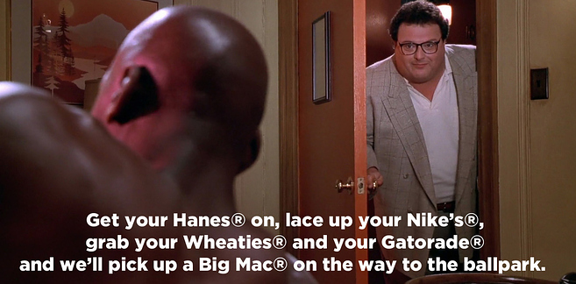
Have you ever seen Space Jam (1996)?

Slide 15
So what happened?
2. The radical 1960s & “neoliberalism” as sequential, personality-conditioned, systemic learning episodes.

Slide 16
Primer on Personality Traits

Slide 17
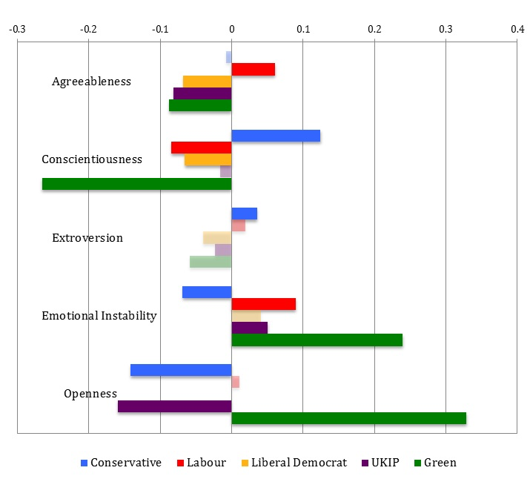
Dennison 2015,
http://blogs.lse.ac.uk/politicsandpolicy/populist-personalities-the-big-five-personality-traits-and-party-choice-in-the-2015-uk-general-election/

Slide 18
So what happened?
3. Cybernetic social looping (alternative worlds on the left & right & within sub-groups).
Limited effects school was right about primary groups.
4. Hyper-intelligent production vs. anti-intelligent rent-seeking (typically leveraging morality).

Slide 20
The end of secrets
Traditionally politics is organized around secrets (elite knowledge, state secrets, etc.)
Classified info, codes/cyphers
Secretive = false = unjust
Group structures control resources for insiders based on a code
Info-tech cracks secrets & empowers new ones
“The non-linear effects of leaks on unjust systems” (Assange)
Encryption tech

