Slide 1
Information, Communication, Intelligence, Rationality
Justin Murphy
jmrphy.net
@jmrphy

Slide 2
Motivation
It’s not obvious what information and communication are, exactly
How do you know what you are communicating to someone, if anything at all?
How do you know if you are learning?
Learning is receiving communication from the outside world.
Machines and systems can learn, too
What if something smarter than us, is playing us?

Slide 3
What is information?
“A difference that makes a difference.”
– Gregory Bateson
Decreases randomness (i.e., entropy, chaos)
Contrast with noise
Most elementary unit is the bit (0 vs 1)
In a closed system, information decreases with time (entropy increases)

Slide 4
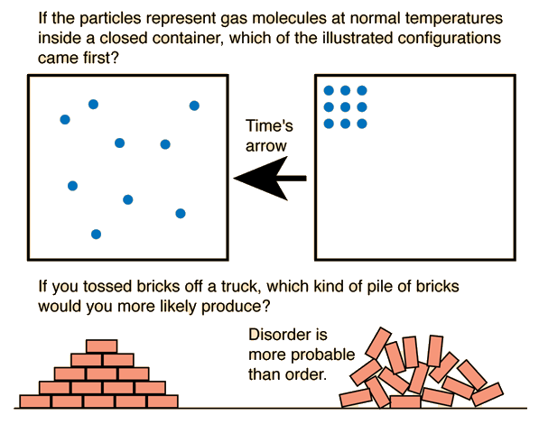

Slide 6
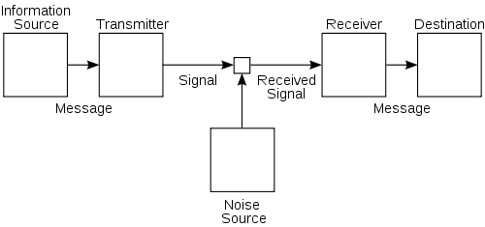
What is communication?
Shannon, Claude E. 1948. “A Mathematical Theory of Communication.” The Bell System Technical Journal 27(3): 379–423, 623–656. Page 7.

Slide 7
What is rationality?
Instrumental rationality
Substantive rationality

Slide 8
Two Types of Communication
Instrumental communication
Extrinsic motivation
Strategic manipulation or signaling
Delayed gratification
Cost-minimizing
Substantive communication
Intrinsic or auto-telic motivation
Disinterested revealing or alethea (ἀλήθεια)
Immanently enjoyable
Cost-maximizing

Slide 9
The Supreme Danger
Modern technology is not just dangerous but is the supreme danger (Heidegger). Why?
Technology is instrumental but it is also a way of revealing.
Not a bringing-forth like poetry, but a challenging-forth (control, extraction, storage).
Everything becomes “standing-reserve,” including ourselves.
The possibility of an absolute and irreversible alienation.
"But where danger is, grows the saving power also." Hölderlin
Notes:
“Energy concealed in nature is unlocked, what is unlocked is transformed, what is transformed is stored up, what is stored up is, in turn, distributed, and what is distributed is switched about ever anew,”
- he might just as well be describing encryption and encoding, electrical transformers, hard drives, networks, and packet-switching.
I believe the supreme danger is coming to pass.
What to do?
Something like “non-instrumental intelligence” or intelligence applied to the goal of truth.
Truth is the accurate picture.
Ironically, this has effects.

Slide 10
What is intelligence?
Basically, problem-solving.
Relative to a given goal
Example of the rubik’s cube
In humans: g
Time-travelling aliens
Notes:
So basically our powers to see, to think, and to shape the world get captured by technology.
So how do we exit this? We need to understand more about what we do when we think. What is intelligence even?

Slide 11
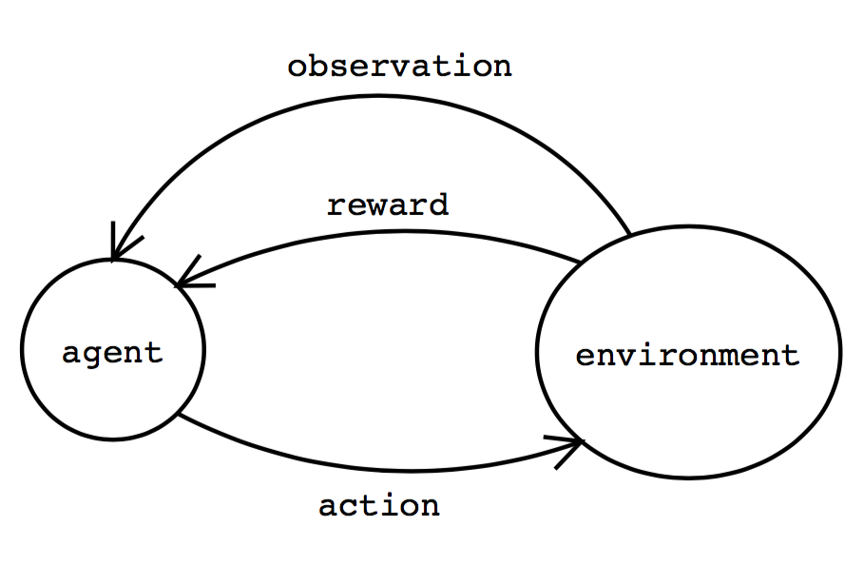
A simple model of intelligence
Notes:
Circular structure
Intelligence is feedback between an actor and an environment. Powerful, learning; but what if goal is bad? Runaway potential.

Slide 12
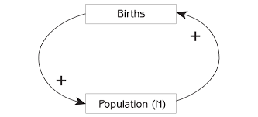
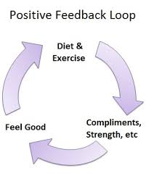
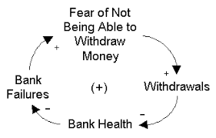
Positive Feedback
Notes:
Systems with circular structure are extremely powerful and appear throughout social phenomena.
Cybernetics: "the scientific study of control and communication in the animal and the machine.” – Weiner 1948

Slide 13
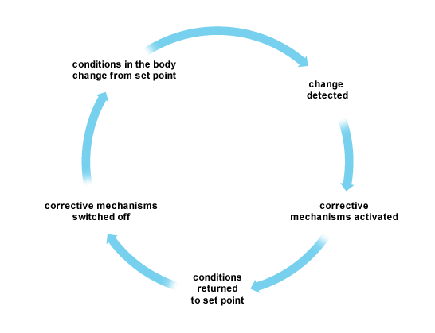
Negative Feedback
http://www.bbc.co.uk/bitesize/higher/biology/control_regulation/homeostatic_control/revision/1/

Slide 14
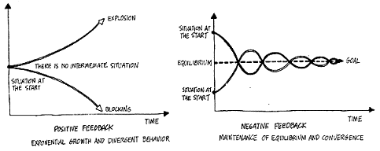
Effects of Positive vs. Negative Feedback
de Rosney, J. 1997. “Feedback.” Principia Cybernetica Web. http://pespmc1.vub.ac.be/FEEDBACK.html.

Slide 15
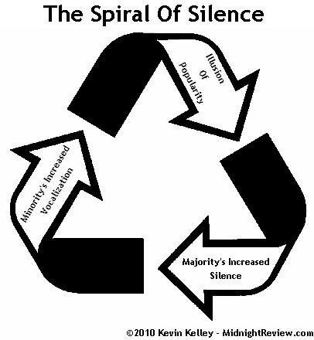
Notes:
Feedback loops have obvious implications for public communications.

Slide 16
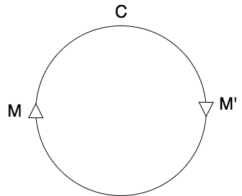
What is capitalism?
Diagram of Marx
Notes:
Capitalism is based on a fundamental form of positive feedback.
Intelligence of capitalism colonizes the intelligence of humans. And it’s takeoff.
But there’s no intelligent adjudication of final goals. What matters to us? Intelligence can’t say.

Slide 17
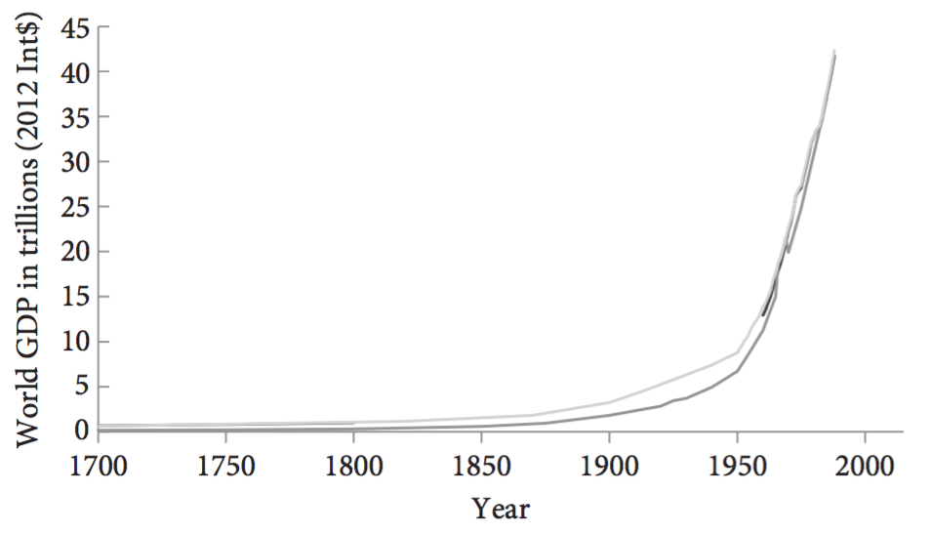
Bostrom, Nick. 2014. Superintelligence: Paths, Dangers, Strategies. Oxford: Oxford University Press.
Notes:
So we might ask, how do we get embroiled in these interminable collective confusions?
Capitalism is intelligence become autonomous. No goal but the increasing of intelligence.

Slide 18
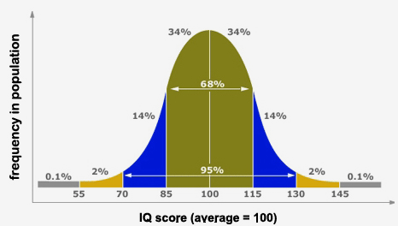
Notes:
Many political problems are knots of conflicting instrumental communication. Left tells a lie, right tells a lie: doom over time.
Consider IQ differences. They exist. Left denies their importance (all social conditioning), the Right overstates their importance (denies equal human dignity & obligation).
IQ as a case study of unbearable acceleration leading to universal confusion.
Capitalism selects for intelligence, but intelligence is unequally distributed.
So, inequality.
The greater the information processing power, the more efficient is sorting.
So the most capable have the incentives and capacities to escape obligations to the less powerful.
- geographical sorting, gated communities, tax reform, media influence
The least capable have real incentives to inflate their intelligence, deny reality, & manipulate etc.
- They will convince most people beneath them.

Slide 19
