Slide 1
Free Media and Government Accountability
Justin Murphy, PhD
University of Southampton
Jmrphy.net
@jmrphy

Slide 2
Background
Longstanding belief that free media prevents corruption and ensures good government.
“Only a free and unrestrained press can effectively expose deception in government.” - Hugo L. Black, 1971
“The last right we shall mention regards the freedom of the press. The importance of this consists, besides the advancement of truth, science, morality, and arts in general, in its diffusion of liberal sentiments on the administration of Government, its ready communication of thoughts between subjects, and its consequential promotion of union among them whereby oppressive officers are shamed or intimidated into more honourable and just modes of conducting affairs.”
- Letter written by the (U.S.) Continental Congress (1774)

Slide 3
The Evidence
Brunetti and Weder (2003)
Freedom House Freedom of the Press Data
145 countries since 1996
Corruption measure from International Country Risk Guide

Slide 4
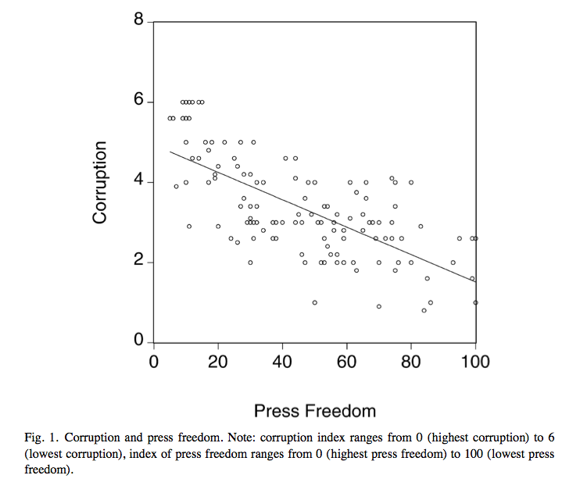
From Brunetti and Weder (2003)

Slide 5
The Evidence
Brunetti and Weder (2003)
Freedom House Freedom of the Press Data
145 countries since 1996
Corruption measure from International Country Risk Guide
They estimate that an increase of 46 points in the Freedom House score (moving an average country to full press freedom) would reduce corruption by roughly 1 point on average.
Large effect given that mean corruption is 3.4 on a scale in which 0 is the highest corruption to and 6 is the lowest

Slide 6
Issues/Questions?
Maybe corruption drives whether or not there is free media?
Is formal media freedom enough to ensure that the media will function as a watchdog?
Finally, even a free media might be little more than a function of its political and economic environment.
Was Watergate an example of watchdog journalism or were the journalists just pawns of divided government intrigue (Feldstein 2004)?

