Slide 1
The Propaganda Model
Justin Murphy, Phd
Jmrphy.net
@jmrphy

Slide 2
“Manufacturing Consent” (1988)
Noam Chomsky (1928-Present)
- Linguist by vocation
- Probably the most famous intellectual in the world
- Dozens of books and articles on politics
Edward Herman (1925-Present)
- Business scholar at University of Pennsylvania
Manufacturing Consent would have mixed effects on academic research but remains widely known and widely taught.

Slide 3
The Propaganda Model
Financial causes (size, ownership, profit-motive)
Relatively cheap to start a national paper in early 1800s
Increasingly expensive through second half of 1800s
The working-class and radical press declined
Advertising as primary income source
- Mass media need “audiences w/ buying power, not audiences per se” (p.16)
Reliance on the government and official sources
- Gov’ts and corporations produce the most information
“Flak” (negative feedback)
Anti-communism as nationalism/patriotism

Slide 4
Some Evidence From Herman and CHomsky
Comparative Case Study of Nicaragua (1984) and El Salvador (1982) Election Coverage
- Nicaragua elected socialist Sandanistas
- Nicaragua elections were more democratic
- Nicaragua elections reported on very critically
- El Salvador was a client of the CIA
- El Salvador election surrounded by terror
- Salvadoran elections reported on supportively

Slide 5
Kern and Hainmueller 2009
Western television entering into East Germany made East Germans more satisfied with their authoritarian government.
- How do they test this?

Slide 6
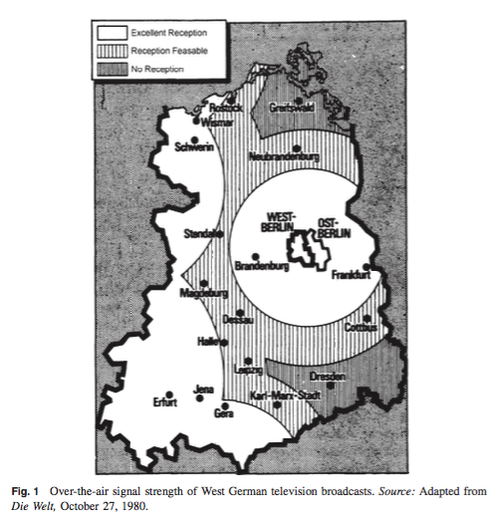

Slide 7
Kern and HAinMueller 2009
Natural experiment exploiting topography
- Shows that support was lower in low-reception Dresden area
- Also: exit visas and government documents revealing government awareness of the phenomena

