Slide 1


Slide 2
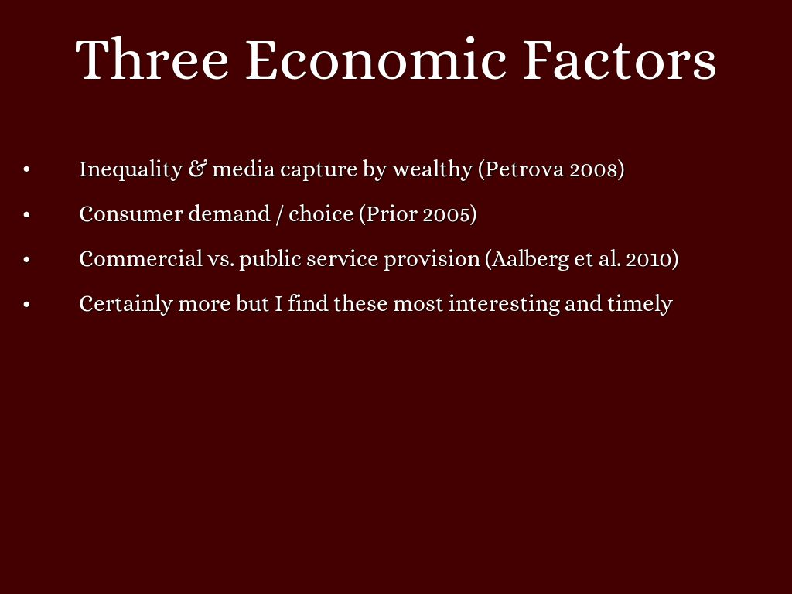

Slide 3
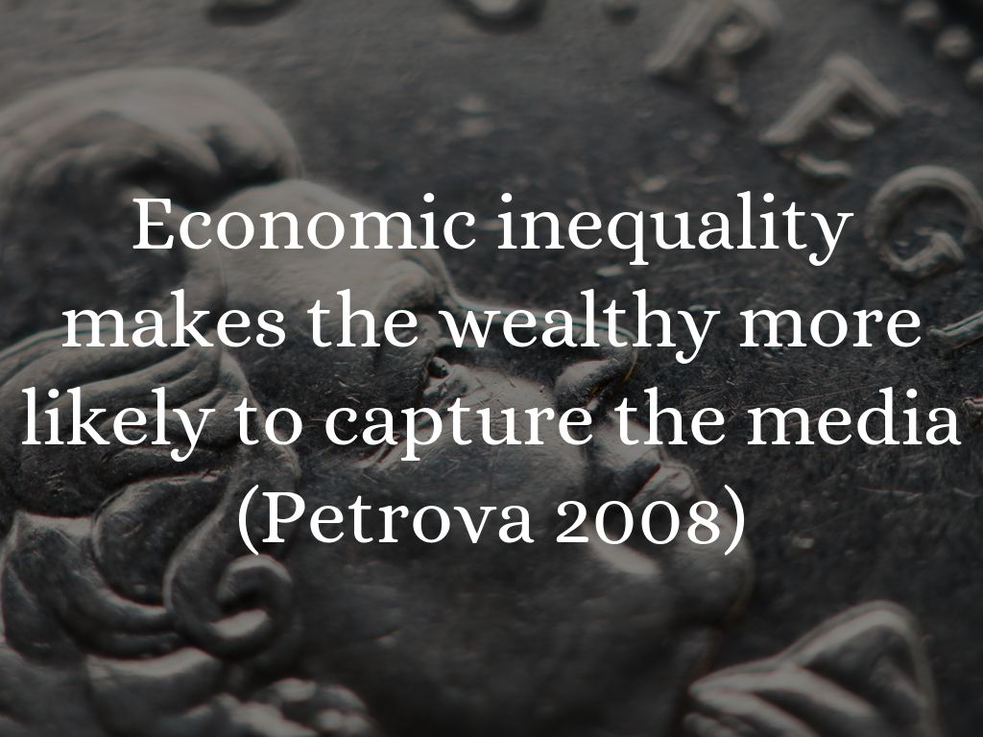
Photo by Gamma Man - Creative Commons Attribution License https://www.flickr.com/photos/51625243@N06

Slide 4
“…the greater inequality in the economy implies lower income of the median voter, which leads to a higher popular demand for redistribution. This, in turn, increases incentives for those with high-income to affect the preferences for taxation and public good provision of those with low-income.” (pp. 205)

Slide 5
Example: the Estate Tax in the US
A highly progressive tax with top rate of 55%, only paid by richest 1-2%
In the 1990s, wealthy Americans started a campaign to abolish this tax
Since 1998, 18 wealthy families spend $490.3 million on lobbying, mostly information campaigns in media
Anti-tax adverts popularized the phrase “death tax”
Frank Blethen, controlling owner of The Seattle Times, steered the paper against it
Robert Johnson of BET paid for anti-estate tax ads in Washington Post, USA Today, and others
In 2001, Congress voted to repeal the estate tax
O

Slide 6
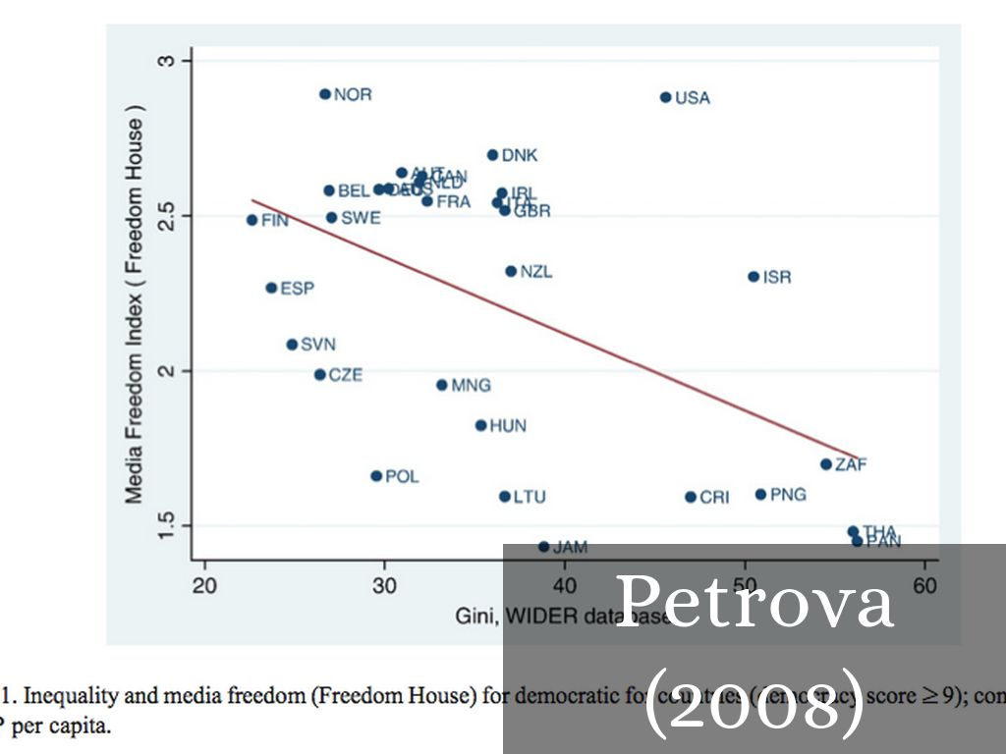

Slide 7
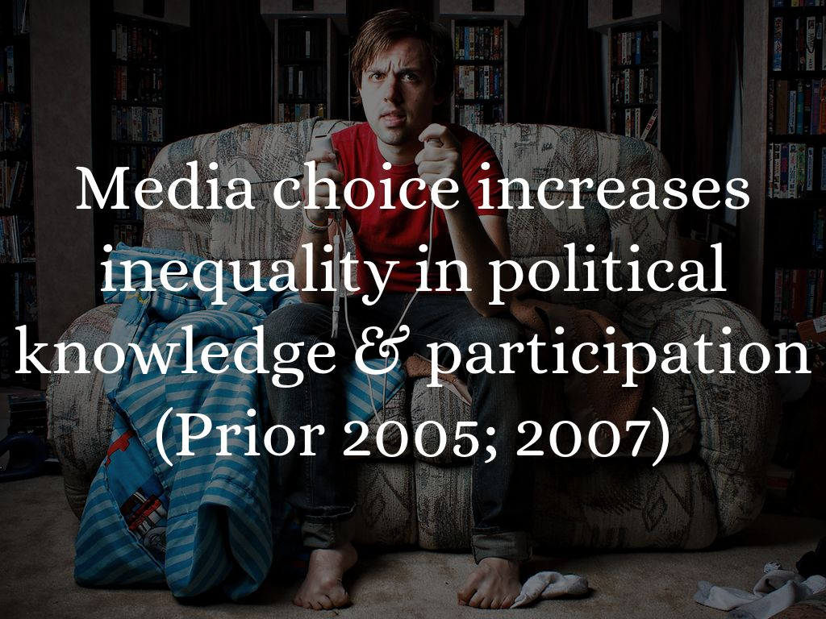
Photo by Steven Andrew Photography - Creative Commons Attribution-NonCommercial License https://www.flickr.com/photos/51555844@N07

Slide 8
“As media choice increases, the likelihood of
‘chance encounters’ (Sunstein) with any political content
declines significantly for many people, as this study will
demonstrate. Greater choice allows politically interested
people to access more information and increase their political knowledge. Yet those who prefer nonpolitical content can more easily escape the news…”

Slide 9
Prior conducts surveys tracking a large set of individuals over time.
Measures media choice (cable/internet access)
Measures their “relative entertainment preference:”
entertainment / entertainment + news
Measures knowledge of politics & turnout
Relative entertainment preference shapes the effect of increased media choice on knowledge and participation.

Slide 10
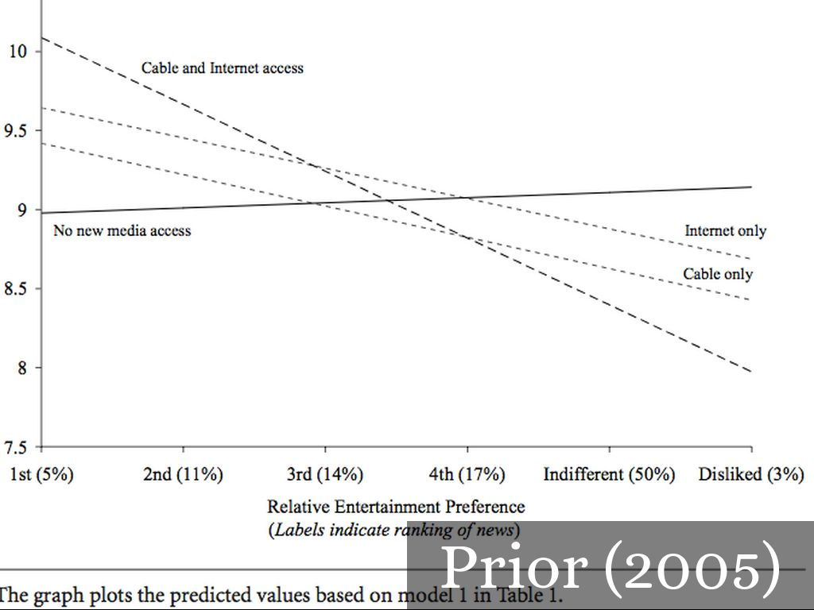

Slide 11
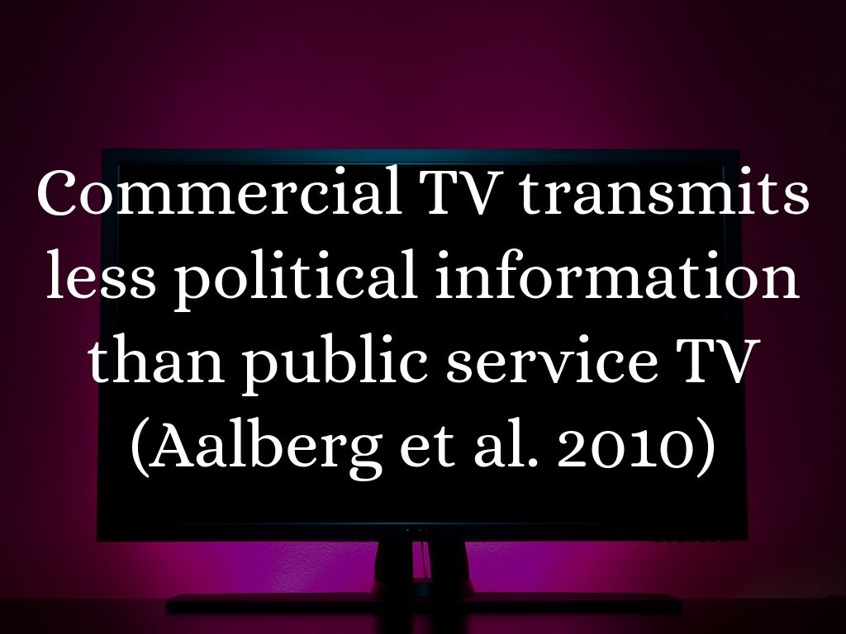
Photo by heanster - Creative Commons Attribution-NonCommercial-ShareAlike License https://www.flickr.com/photos/24582142@N00

Slide 12
