Slide 1
Political Institutions and the media
Justin Murphy, PhD
University of Southampton
Jmrphy.net
@jmrphy

Slide 2
Overview
Reporters index reportage to range of elite debate (Bennett 1990).
Political institutions which affect the flow of information affect political behavior (Baek 2009).
Party systems condition the effects of media on public opinion and, consequently, public policy (Baum 2012).

Slide 3
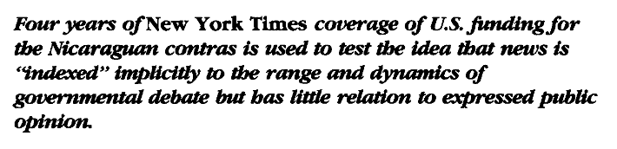
BennetT (1990)

Slide 4
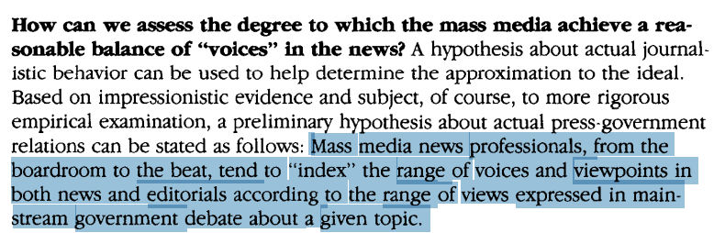
Bennett (1990)

Slide 5
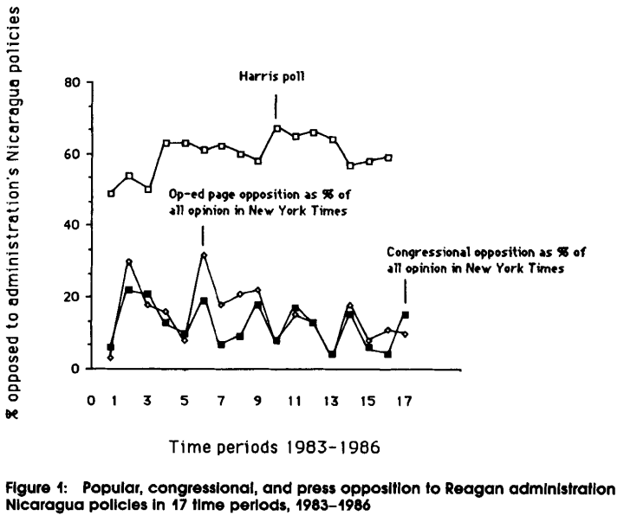

Slide 6
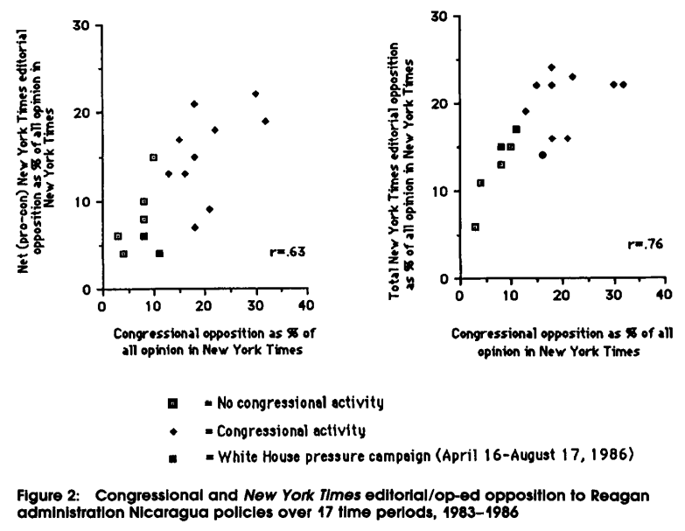

Slide 7
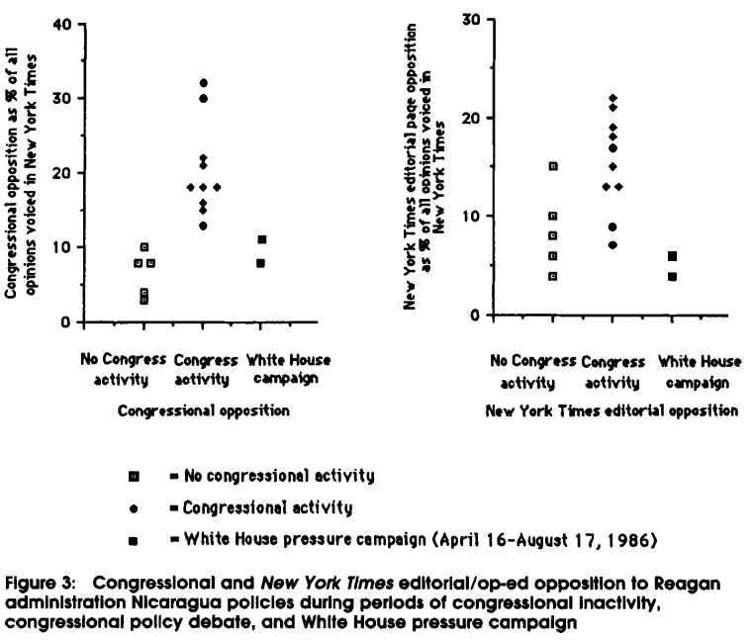

Slide 8
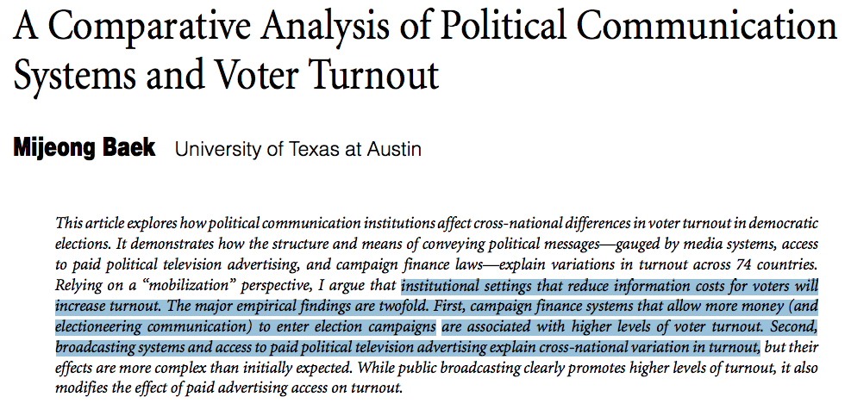
Baek (2009)

Slide 9
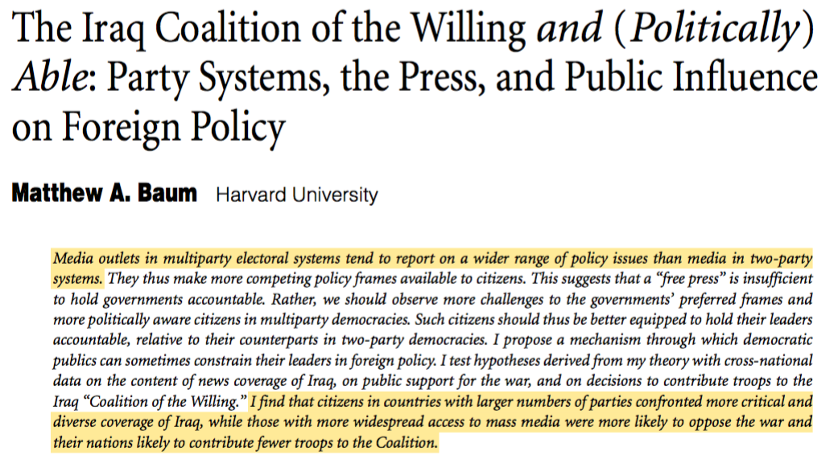
Baum (2012)

Slide 10
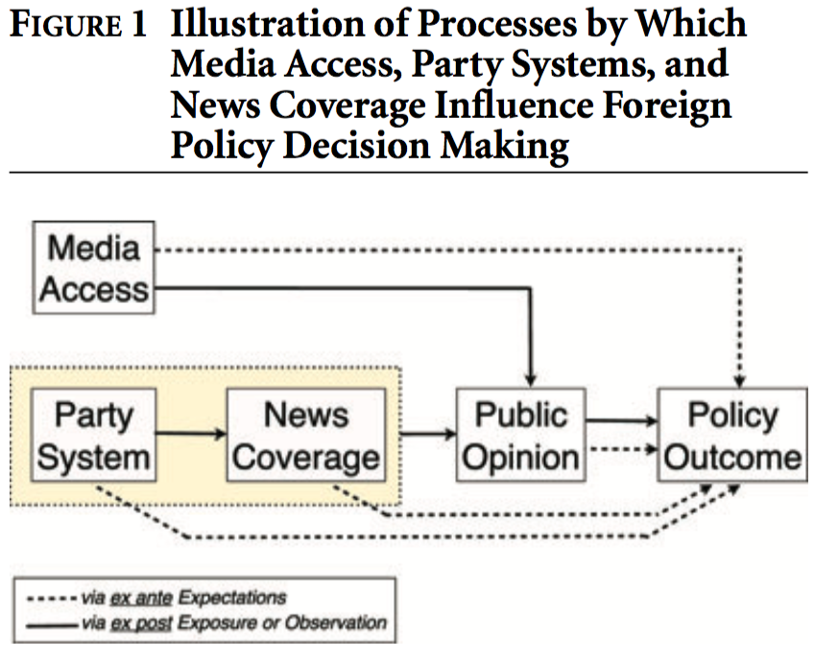

Slide 11
