Slide 1

Photo by @Doug88888 - Creative Commons Attribution-NonCommercial-ShareAlike License https://www.flickr.com/photos/29468339@N02
Created with Haiku Deck

Slide 2
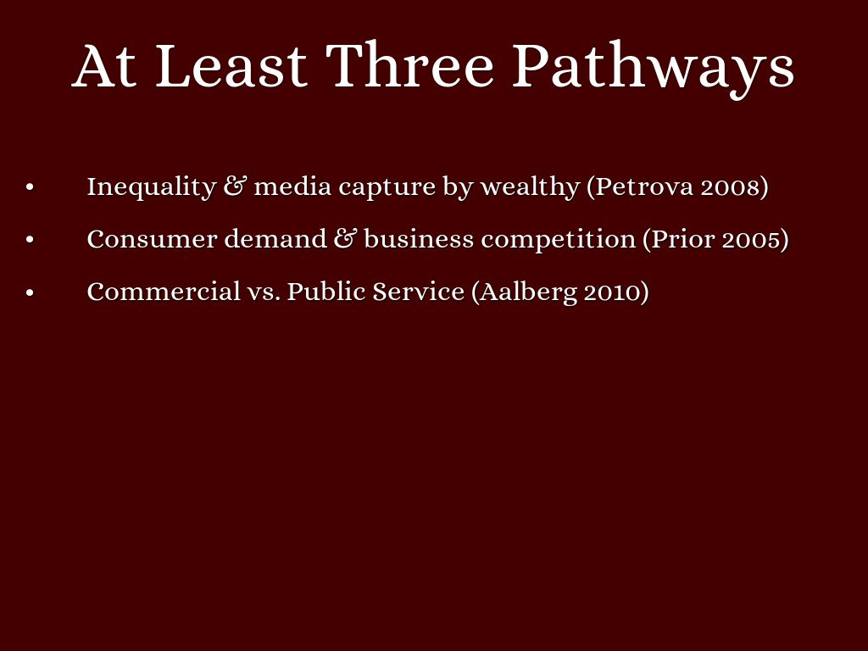
Photo by wstera2 - Creative Commons Attribution-NonCommercial-ShareAlike License https://www.flickr.com/photos/13836188@N04
Created with Haiku Deck

Slide 3

Photo by Gamma Man - Creative Commons Attribution License https://www.flickr.com/photos/51625243@N06
Created with Haiku Deck

Slide 4
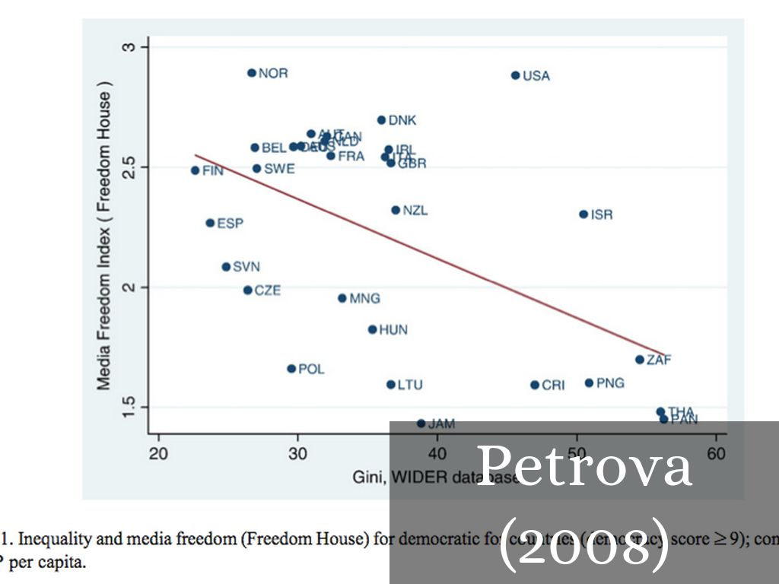

Slide 5

Photo by Steven Andrew Photography - Creative Commons Attribution-NonCommercial License https://www.flickr.com/photos/51555844@N07
Created with Haiku Deck

Slide 6
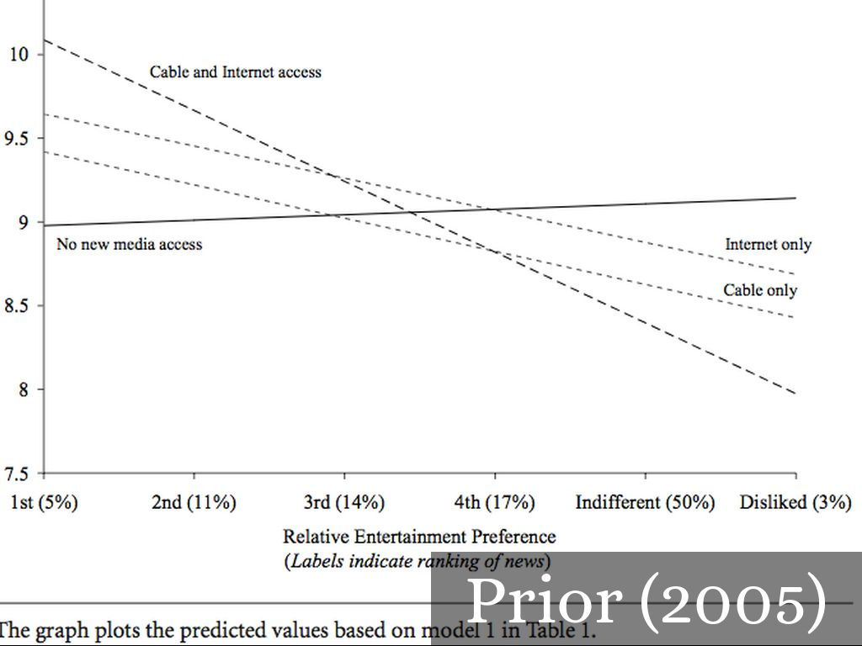

Slide 7
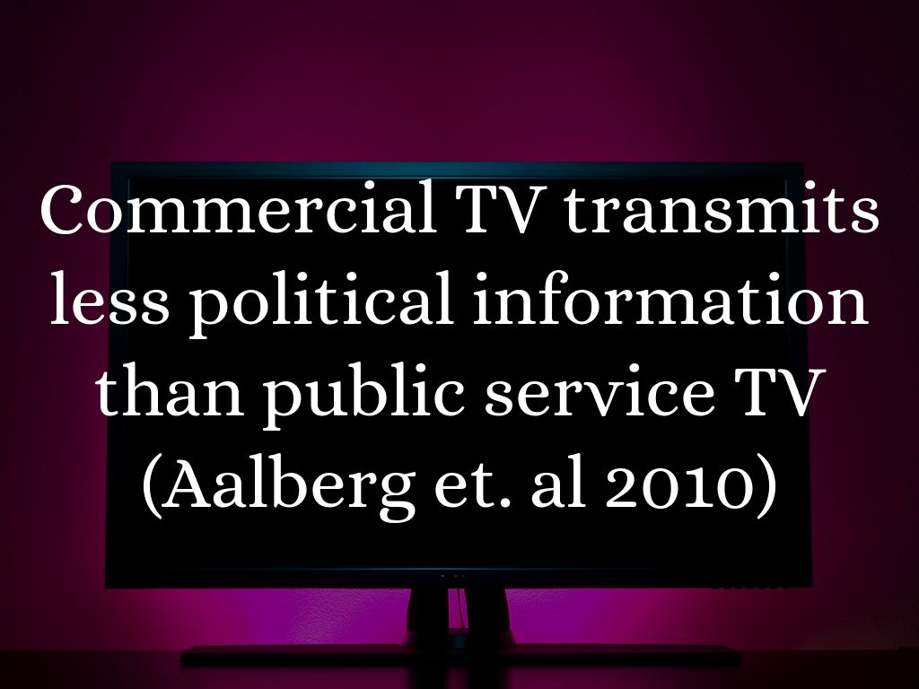
Photo by heanster - Creative Commons Attribution-NonCommercial-ShareAlike License https://www.flickr.com/photos/24582142@N00
Created with Haiku Deck

Slide 8
