Slide 1


Slide 2
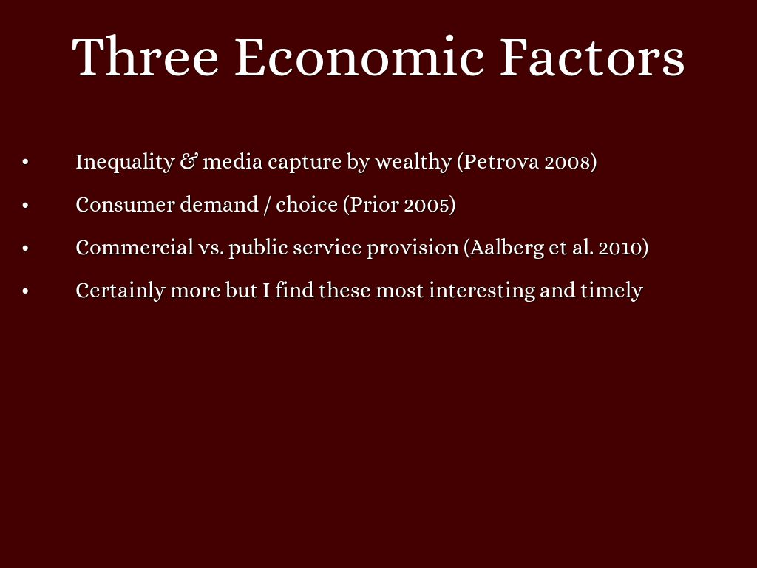

Slide 3
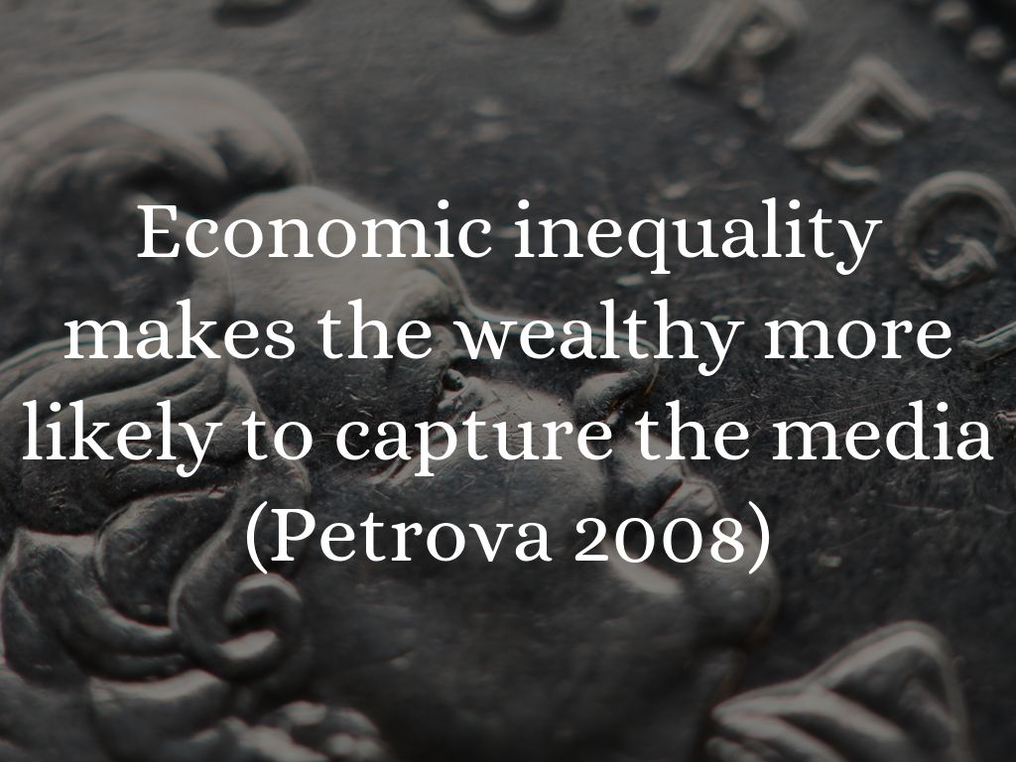
Photo by Gamma Man - Creative Commons Attribution License https://www.flickr.com/photos/51625243@N06

Slide 4
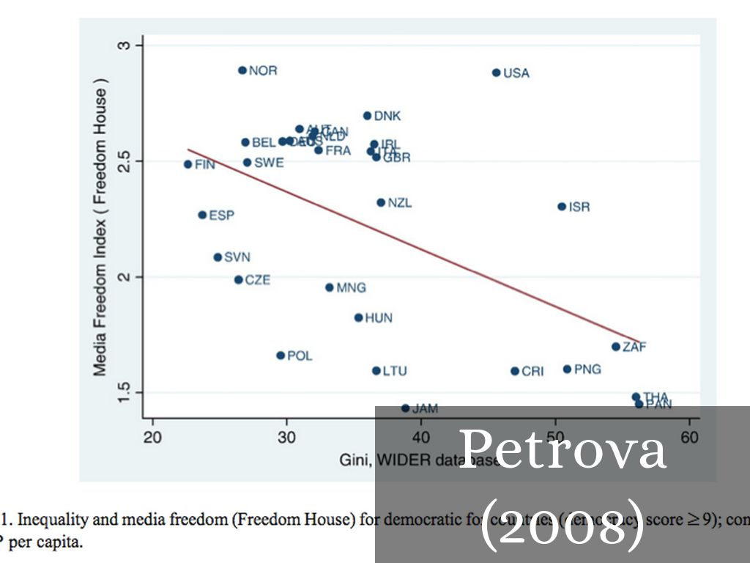

Slide 5

Photo by Steven Andrew Photography - Creative Commons Attribution-NonCommercial License https://www.flickr.com/photos/51555844@N07

Slide 6
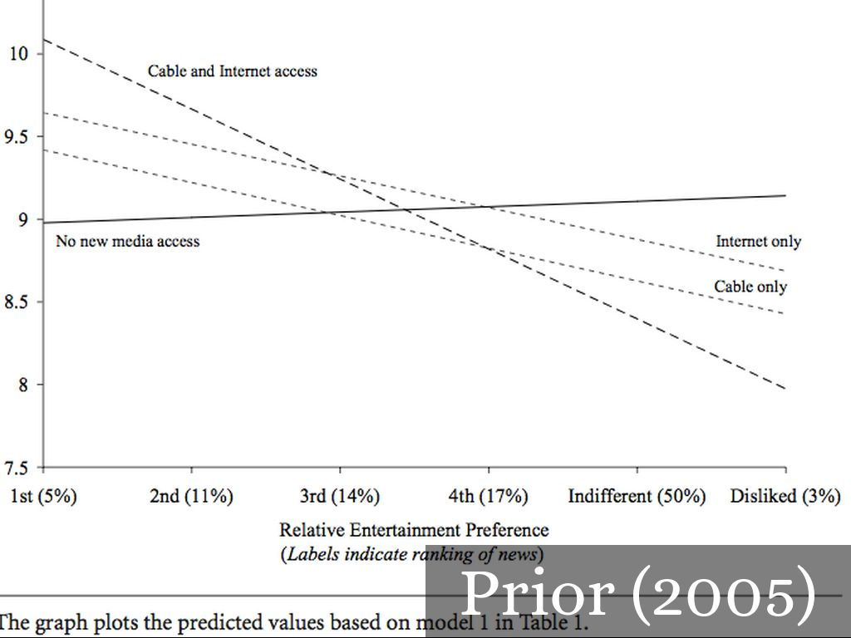

Slide 7
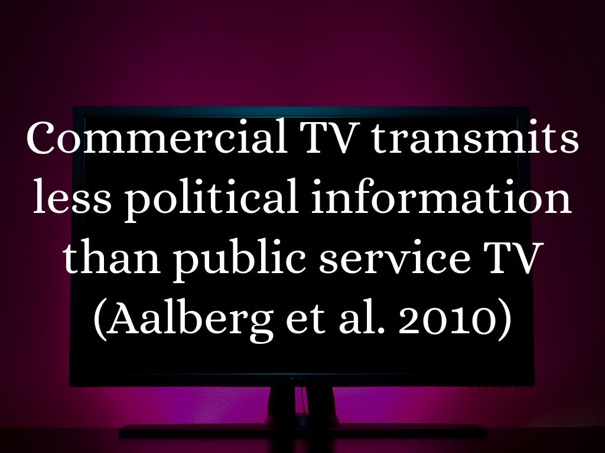
Photo by heanster - Creative Commons Attribution-NonCommercial-ShareAlike License https://www.flickr.com/photos/24582142@N00

Slide 8
