Slide 1
On Making-Up the Mind: A Political Theory of Plato’s Forms
Justin Murphy
Temple University

Slide 2
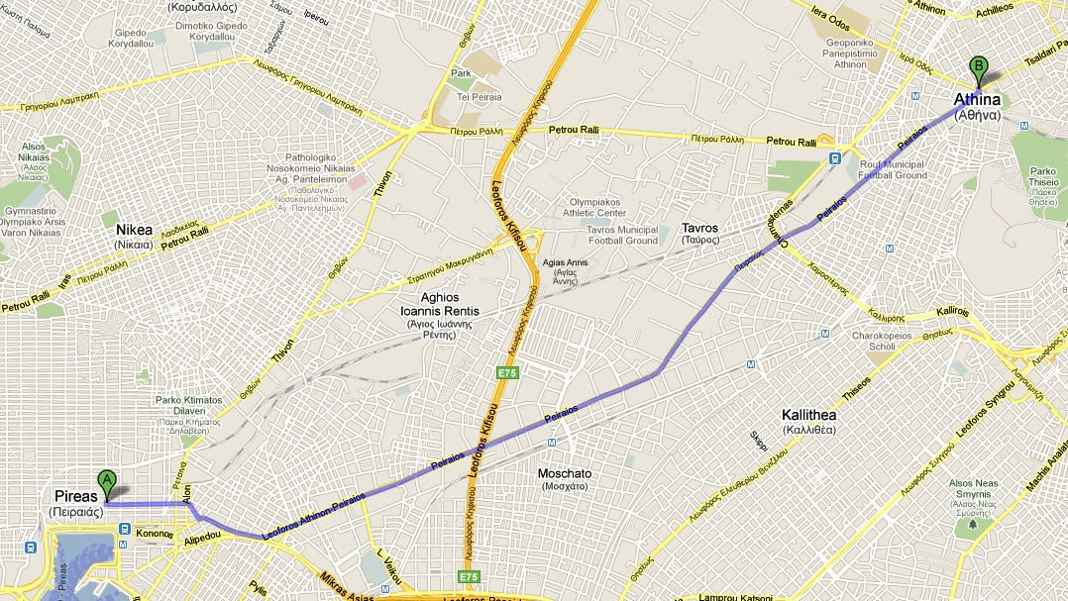
The Path of Socrates in the Republic

Slide 3
The Puzzle
Polemarchus: “But could you persuade us, if we won’t listen?”
Glaucon: “Certainly not.”
Polemarchus: “Well, we won’t listen; you’d better make up your mind to that.” (οὕτω διανοεῖσθε)
What does this mean?
Why this awkward and seemingly unnecessary prelude?
Notes:
1. What does this mean?

Slide 4
The Argument
This prelude dramatizes at least two features of Plato’s political thought:
Philosophical theoria and political power have a dialectical relationship.
The Theory of Forms is simply the theory of the form of this dialectic, strategically developed to enshrine political space for the new and dangerous practice of philosophical theoria.
Notes:
If every philosophical theory is invested by political power which corrupts its claim to free-standing truth, then real truth can only be sought by critiquing truth claims. This is the way of Socrates, radical Socratic negativity. Plato basically agrees with this, hence the foregrounding of Socrates. The problem is that for critique to be politically viable,

Slide 5
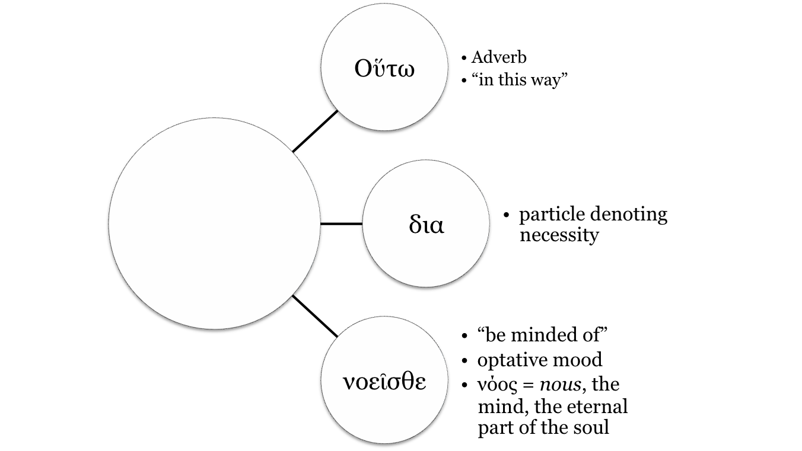
1A. “You’d better make up your mind to that.”
Oὕτω διανοεῖσθε

Slide 6
1B. History and Structure of Theoria
Traditional forms of theoria were trips undertaken to experience a sight and return back with a “return account” (Nightingale 2004).
Nightingale shows how Plato draws on theoric traditions to constitute philosophical theoria.
Religious (Oracles)
Diplomatic (Festivals, such as the one at Bendis)
Personal travel (Solon, Socrates)
Life in general (The Myth of Er)
Finally, Philosophy (The Cave)
In each case, knowledge is only a byproduct of the failure to really attain and maintain the vision.

Slide 7
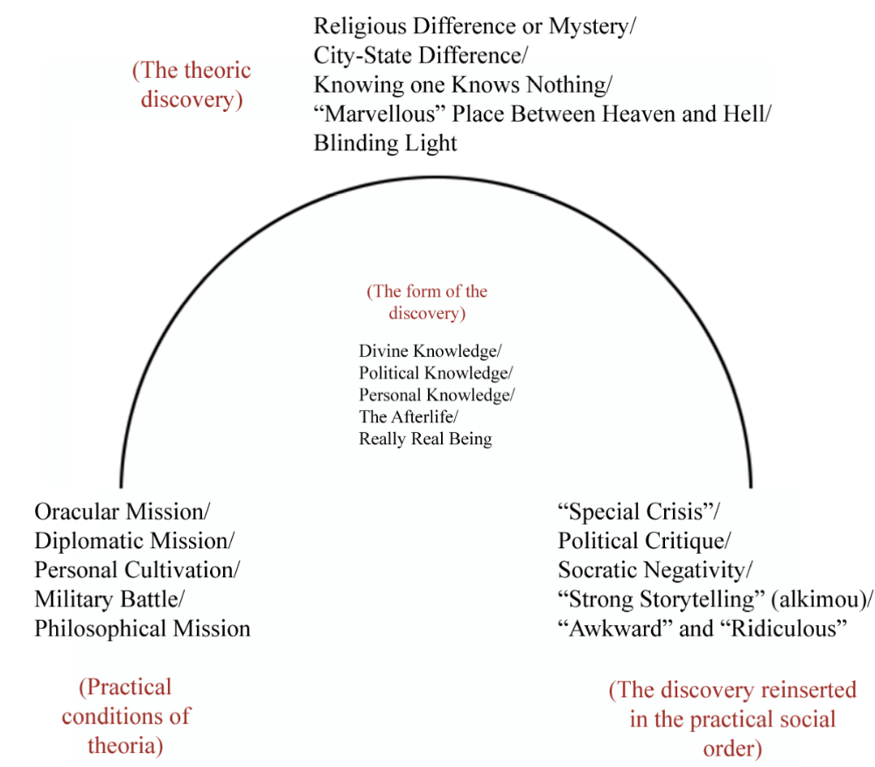
Notes:
What is condensed in the puzzling prelude is the fundamental problem of philosophical theoria: that philosophical thinking is so much a function of the established order that it cannot achieve an absolute truth beyond the contingent social arrangements from which it “takes off” and back to which it must return. Those who seek to achieve such an absolute truth are either killed, as in the case of Socrates, or laughed at, as in the case of our own society’s caricatures of the philosopher. The Theory of Forms responds to this paradox by simply enshrining it, by arguing that this very problematic is itself the only truth that theory can provide. Thus, the insight of political theory at its founding is that political theory is an eternal dialectic between politics and truth in which theory, the search for truth, is invested by politics and politics is invested by truth claims. This explains why the Republic is so fantastical, rhetorical, and diaological. It is a political-philosophical maneuver to name and sanctify philosophical theory as an ongoing political project. Notice that Socrates and Glaucon never make it back to Athens, suggesting that we ourselves are the heir to a philosophic venture still in the discovery phase. The Theory of Forms, that the absolute truth of things exists elsewhere, in an ideal plane, simply names the structure of philosophical theoria, which shows that knowledge is only knowledge of the form it takes. Thank you.

Slide 8
Thank you.

