Slide 1
Basic Vocabulary and Descriptive Inference
Justin Murphy
jmrphy.net
@jmrphy

Slide 2
Inference?
The challenge of inference is to use available information to make the best possible conclusions about what we don’t know but would like to know.
Descriptive inference seeks to describe the existence of something.
Example: The number of people who participate in a riot.
Causal inference seeks to understand the effect of some variable(s) on some other variable(s)
Example: The causal effect of unemployment on the probability a riot will occur.
Example: The causal effect of a riot on next year’s government spending.

Slide 3
Some Key Terms
A unit of analysis is simply the object of study.
E.g., the individual human being, the constituency, the country, etc.
A variable is a measurement of some concept that varies across a set of units.
E.g. unemployment rate across EU countries.
An observation is one realisation of a variable for one unit.
E.g., UK unemployment is equal to 6.0% in 2014.
Moving from micro-level to macro-level is aggregation (reverse is disaggregation).
E.g., from individual-level (“are you unemployed?)” to country-level (unemployment rate)
Our sample is the set of observations we gather to make inferences about the world outside the sample.
I.e. a quantitative dataset or the cases you select to investigate.
The population is what we call the world outside the sample we want to make generalisations about.

Slide 4
Some Key Terms (2)
Cross-sectional data capture observations at one point in time, across a set of units
E.g., one survey of individuals.
Time-series data capture observations over time for one unit.
E.g. unemployment rate every month for the UK.
Panel data capture observations for multiple units over time.
E.g., UK unemployment is equal to 6.0% in 2014.
Data can be quantitative (numerical).
Data can be qualitative (non-numerical).

Slide 5
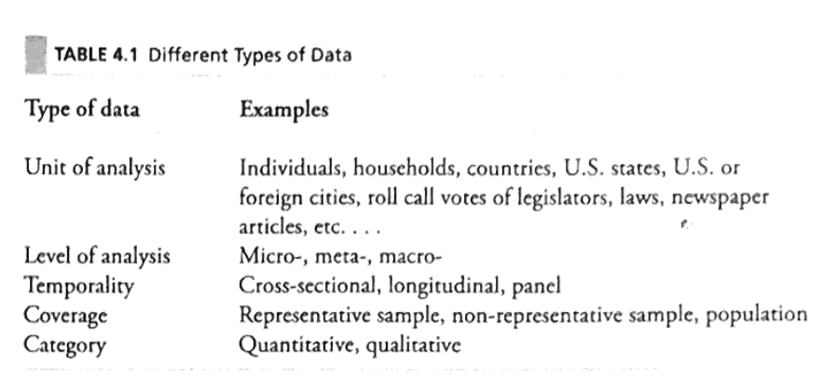
BSS, pp.89

Slide 6
Descriptive Inference
Let’s say we want to know how much of the British population supports the current government.
Take a random, representative sample of, say, 5,000 Brits.
Ask them if they support the government.
The sample mean can be used to infer the population mean.
Statistical theory provides rigorous rules for this inference, accounting for sample size, variance, and random error.

Slide 7
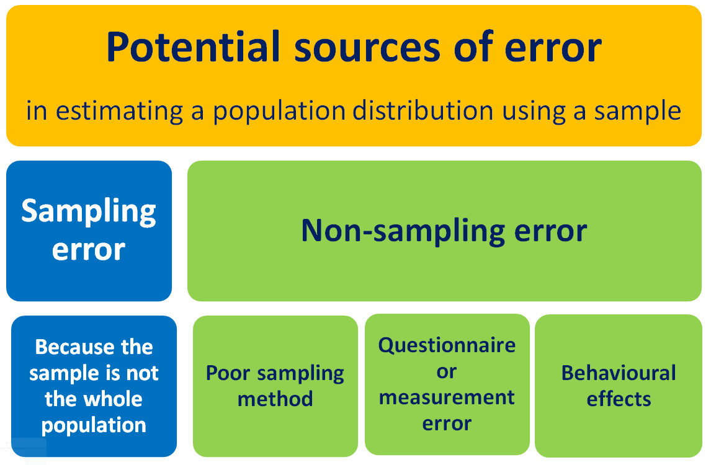
Source: https://learnandteachstatistics.wordpress.com/2014/09/04/sampling-and-non-sampling-error/

Slide 8
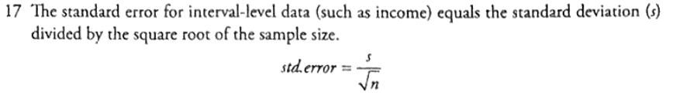
BSS, pp. 99

Slide 9
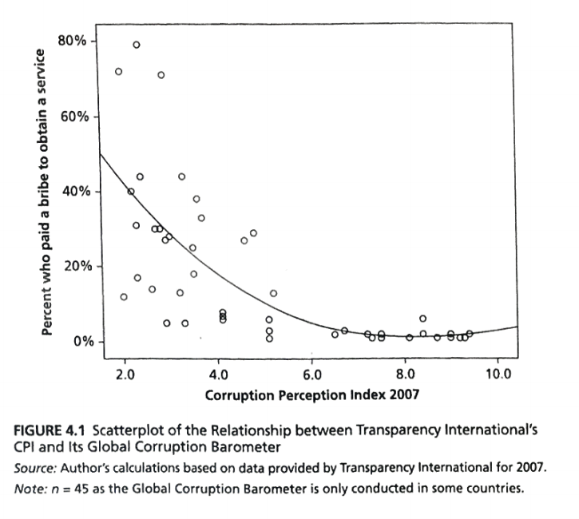

Slide 10
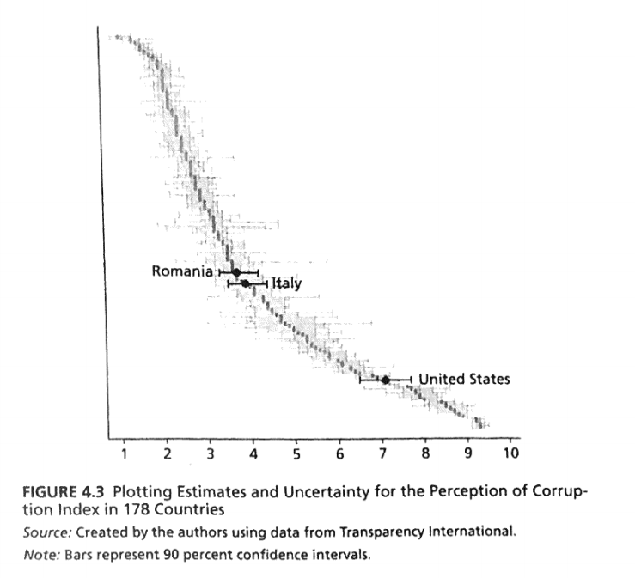

Slide 11
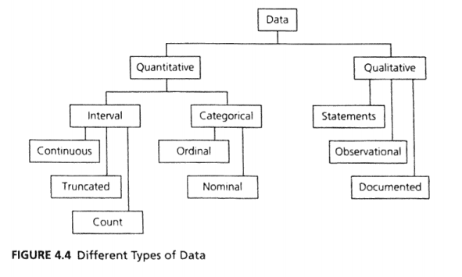

Slide 12
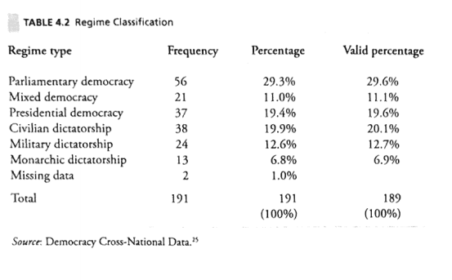
Nominal-Level Data

Slide 13
