Slide 1
Mass Media and
Civil War Onset
Article: j.mp/media_civil_war
Slides: j.mp/media_war_slides
Justin Murphy, PhD
Assistant Professor
Department of Politics and IR
University of Southampton
jmrphy.net
@jmrphy

Slide 2
Overview
The Puzzle
A Theory of Non-Linear Media Effects
Hypotheses
Data and Method
Findings
Implications and Conclusion

Slide 3
The Puzzle
It is widely argued that mass media play a role in the outbreak of civil wars (Brass 1997; Des Forges 1999; Gagnon Jr 1994; Kellow and Steeves 1998; Metzl 1997; Tambiah 1996).
But there is also evidence that mass media strengthen the state and pacify potential challengers (Anderson 1983; Deutsch 1953; Warren 2014).
How can we square these contradictory findings?

Slide 4
A Theory of Non-Linear Media Effects
A system of mass communications will strengthen a state because it generates a unique economy of scale (Warren 2014).
The key of my argument is that this should only take effect beyond some critical threshold of media density.
Before that threshold, each increase in media density encourages insurgency by increasing the payoffs of taking state power before mass communications are achieved.

Slide 5
Hypotheses
At the cross-national historical level (unit is the country-year):
1. There should exist some threshold of mass media density below which there is a positive correlation between mass media and civil war onset and above which there is a negative correlation.
At the international level (unit is global system in each year):
2. The mean level of media density should have a negative correlation with civil war prevalence but year-to-year changes in media density should be associated with an increase in civil war prevalence.

Slide 6
Data and Method
Cross-national time-series data on civil war onset (Sambanis 2004) and mass media density from Arthur Banks and World Bank (Warren 2014).
Unbalanced panel of 175 countries over a maximum of 55 years in the period from 1945 to1999.
Semi-parametric logistic regression (a general additive model) fits mass media density to civil war onset with a nonparametric smooth.
Traditional parametric logistic regressions for more convenient effect estimates.
For the international level hypothesis, negative binomial models for the count of total onsets in each year, using TV as the key independent variable.

Slide 7
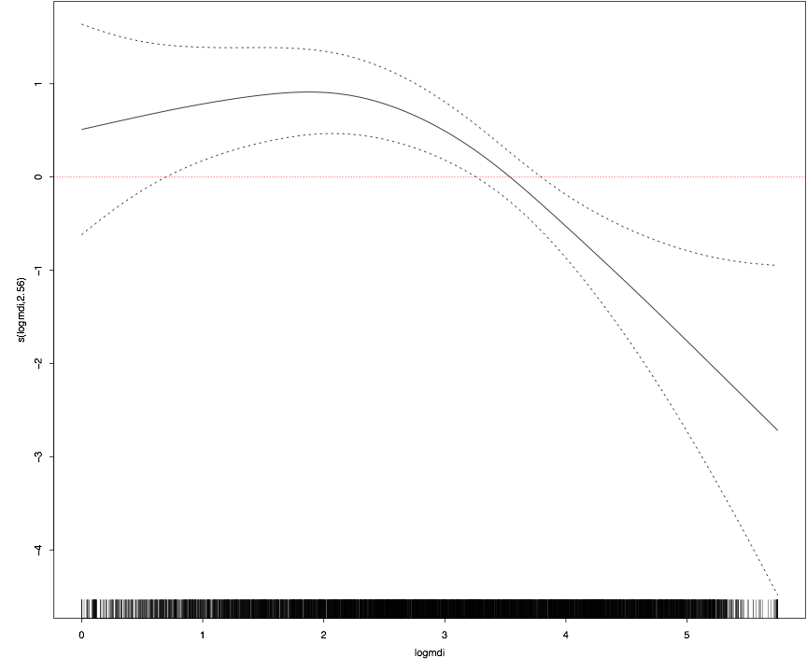
The Non-Linear Effect of Media Density on Civil War Onset

Slide 8
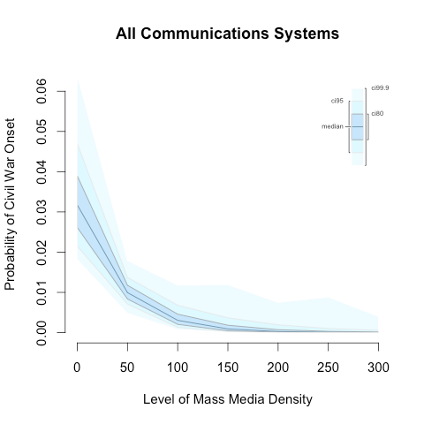
Effect of Mass Media Density on Civil War
Onset for All Countries

Slide 9
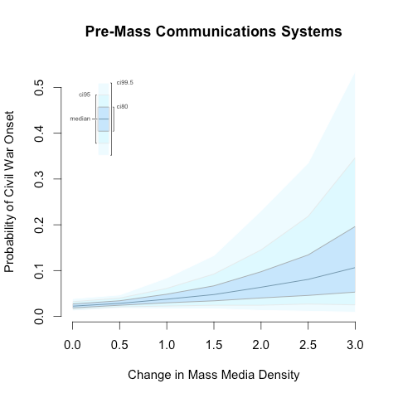
Effect of Mass Media Density on Civil War
Onset for Countries < 20th Percentile of Media Density

Slide 10
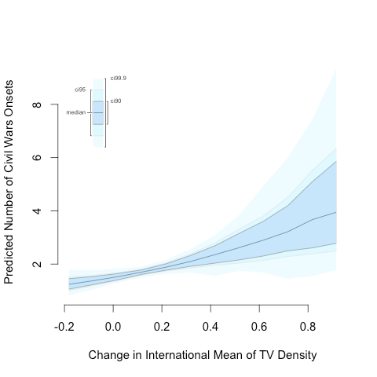
Effect of Change in the Global Mean of TV Density
on Number of Civil War Onsets

Slide 11
Conclusion
These findings suggest a crucial revision to our current understanding of the role played by media in civil war onset.
The introduction and early growth of mass media appears to significantly increase the probability of observing a civil war within a particular country.
The global growth of mass media technologies since the 1960s helps explain the dramatic rise of civil wars in this period.
Thank you and feel free to get in touch.
Website: http://jmrphy.net
Twitter: @jmrphy
Article: j.mp/media_civil_war
Slides: j.mp/media_war_slides

