Slide 1




PERFECT BROADBAND SOUND ABSORBER METAMATERIAL FOR NOISE REDUCTION IN A ROCKET LAUNCH
METAMATERIAL ABSORBENTE DE BANDA ANCHA PARA LA REDUCCIÓN DE RUIDO EN EL LANZAMIENTO DE COHETE
October, 2021.
José M. Requena-Plens¹, Rubén Picó¹, Víctor J. Sánchez-Morcillo¹, Noé Jiménez², Alejandro Cebrecos², Mara S. Escartí-Guillem^{3,4}
¹ Instituto de investigación para la Gestión Integrada de Zonas Costeras, Universitat Politècnica de València, Spain
² Instituto de Instrumentación para Imagen Molecular, Universitat Politècnica de València - CSIC, València, Spain
³ Instituto universitario de matemática pura y aplicada, Universitat Politècnica de València, València, Spain
⁴ Comet Ingeniería, Convento Carmelitas 2, 46010, València, Spain.

Slide 2
Introduction
Acknowledgements
The authors acknowledge the support of the European Space Agency under contract 4000126316/19/NL/LvH of project REDLAUCH: Launch Sound Level Reduction.
The authors also acknowledge support from the Spanish Ministry of Science and Innovation, and European Union FEDER through project PID2019- 109175GB-C22.

Slide 3
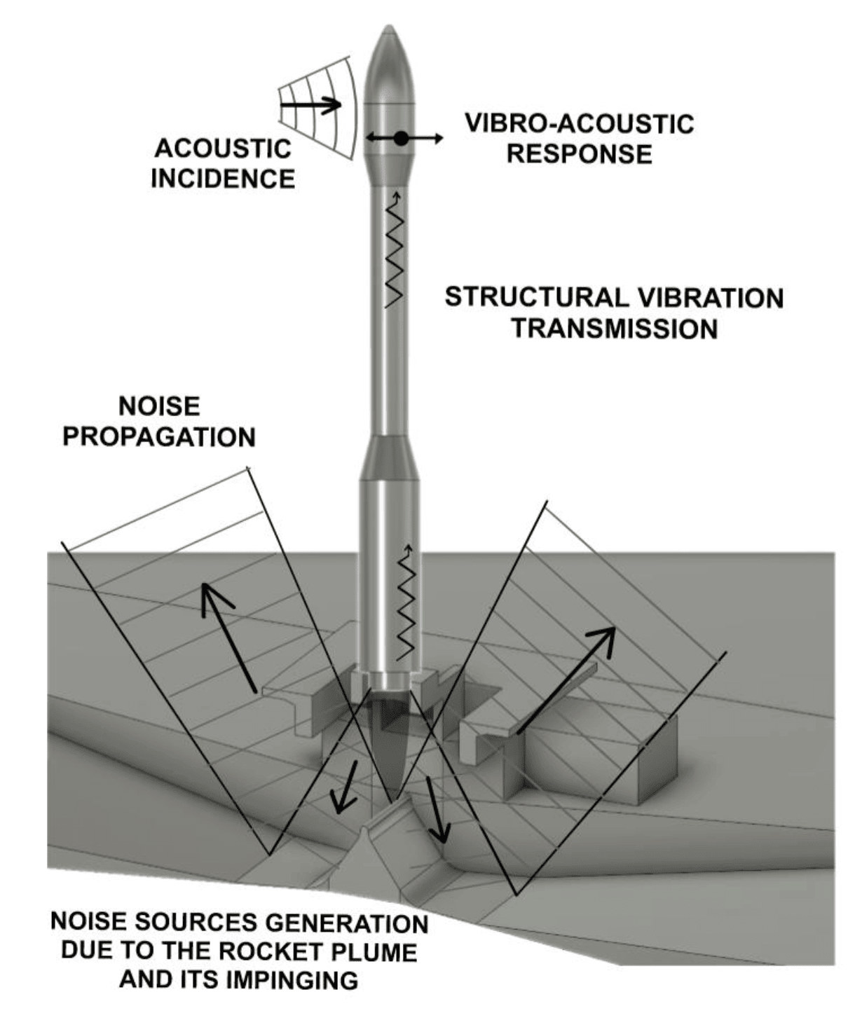
Introduction
Problem
In rocket launches, the noise reflected on the launch pad affects the rocket again, generating a vibroacoustic response that is detrimental to the load and the equipment.
Proposed solution:
Reduce reflected noise (this work).
Reduce the transmission of noise into the fairing. (overview on Escartí-Guillem, ECSSMET 2021).
Previous work:
Reduction specular noise with sonic crystals
[Garcia-Raffi, Aerosp Sci Technol 73 (2018)]
[Escartí-Guillem, ECSSMET (2021)]
3

Slide 4
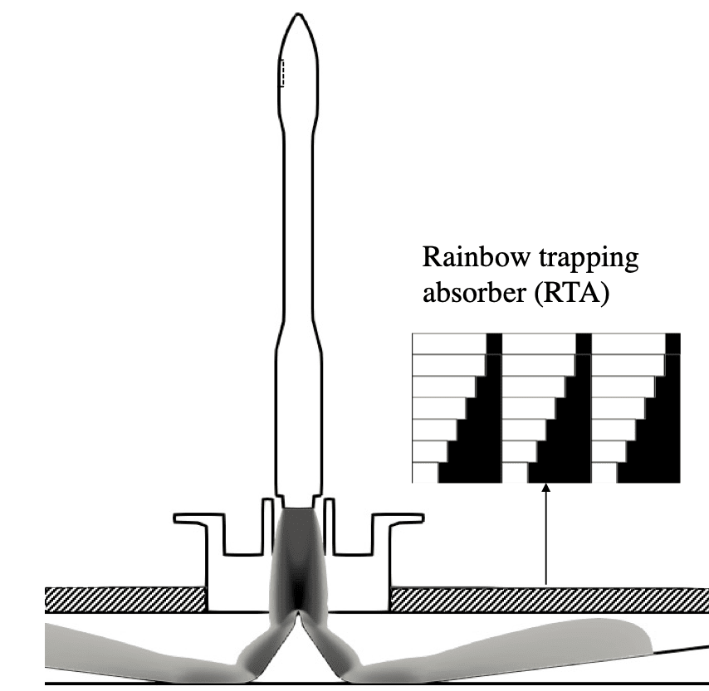
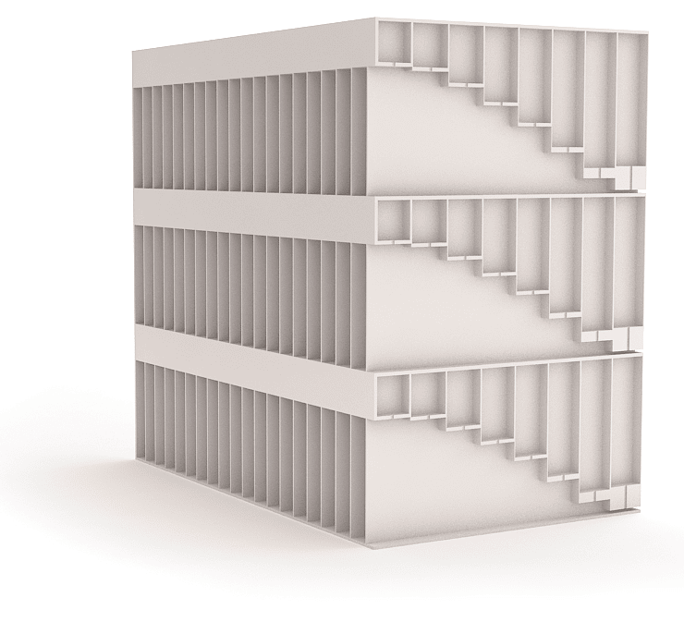
Introduction
Proposed solution
To reduce reflected noise, it has been proposed to cover the gas evacuation channels with Rainbow trapping absorbents.
[Jiménez, Sci. Rep. 7 (2017)]
4

Slide 5
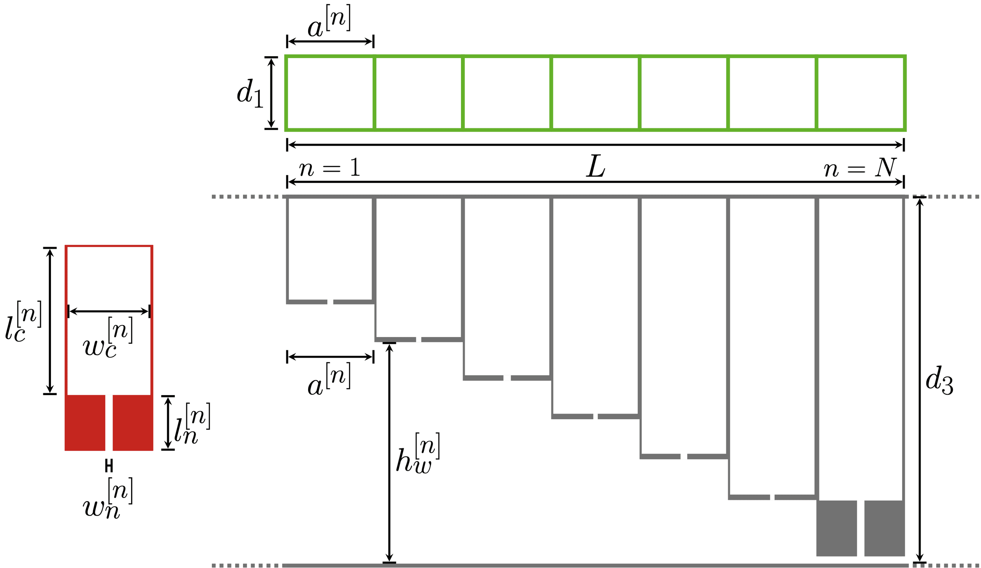
Unit cell design
Geometry of the metamaterial unit cell
A rainbow trapping absorber is made up of multiple Helmholtz resonators. Each of them have the dimension parameters that are observed in the figure.
TOP VIEW
SINGLE VIEW
SIDE VIEW
5

Slide 6
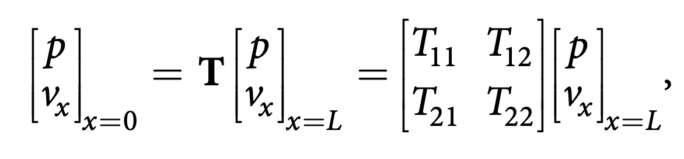
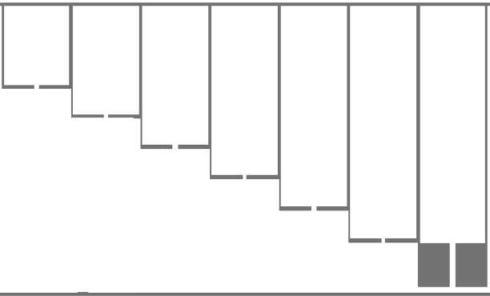
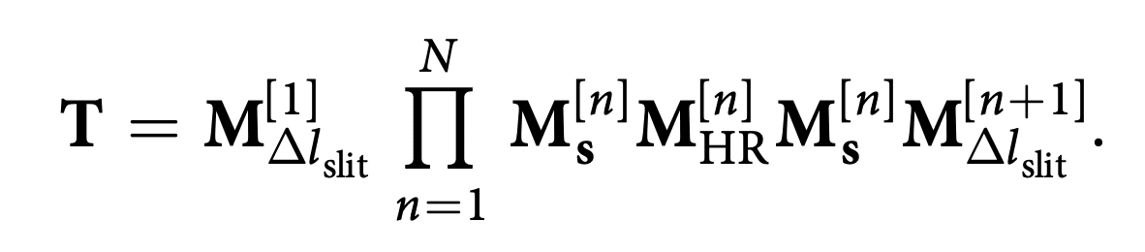
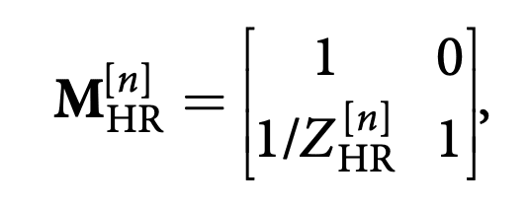
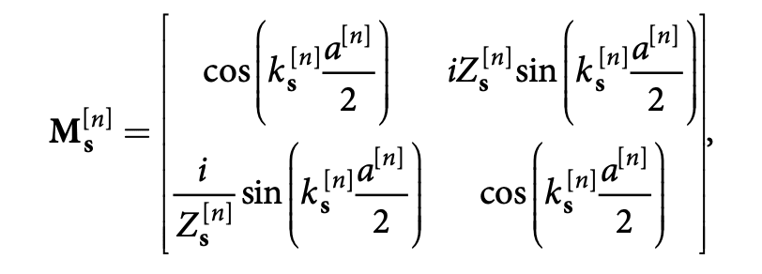
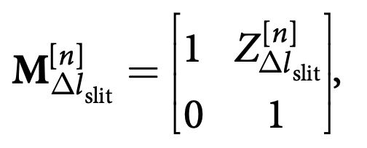
Unit cell design
Theoretical model (TMM)
[Jiménez, Sci. Rep. 7 (2017)]
Where T is given by the product of the transfer matrices of the N different cross-section waveguides loaded by HRs:
Resonators transfer matrix:
The transmission matrix for the n-th waveguide half-segment:
Radiation correction of the n-th waveguide segment due to cross-section changes
6

Slide 7
Unit cell design
Theoretical model (TMM)
[Jiménez, Sci. Rep. 7 (2017)]
Where T is given by the product of the transfer matrices of the N different cross-section waveguides loaded by HRs:
Resonators transfer matrix:
The transmission matrix for the n-th waveguide half-segment:
Radiation correction of the n-th waveguide segment due to cross-section changes
6

Slide 8
Unit cell design
Theoretical model (TMM)
[Jiménez, Sci. Rep. 7 (2017)]
Where T is given by the product of the transfer matrices of the N different cross-section waveguides loaded by HRs:
Resonators transfer matrix:
The transmission matrix for the n-th waveguide half-segment:
Radiation correction of the n-th waveguide segment due to cross-section changes
6

Slide 9
Unit cell design
Theoretical model (TMM)
[Jiménez, Sci. Rep. 7 (2017)]
Where T is given by the product of the transfer matrices of the N different cross-section waveguides loaded by HRs:
Resonators transfer matrix:
The transmission matrix for the n-th waveguide half-segment:
Radiation correction of the n-th waveguide segment due to cross-section changes
6

Slide 10
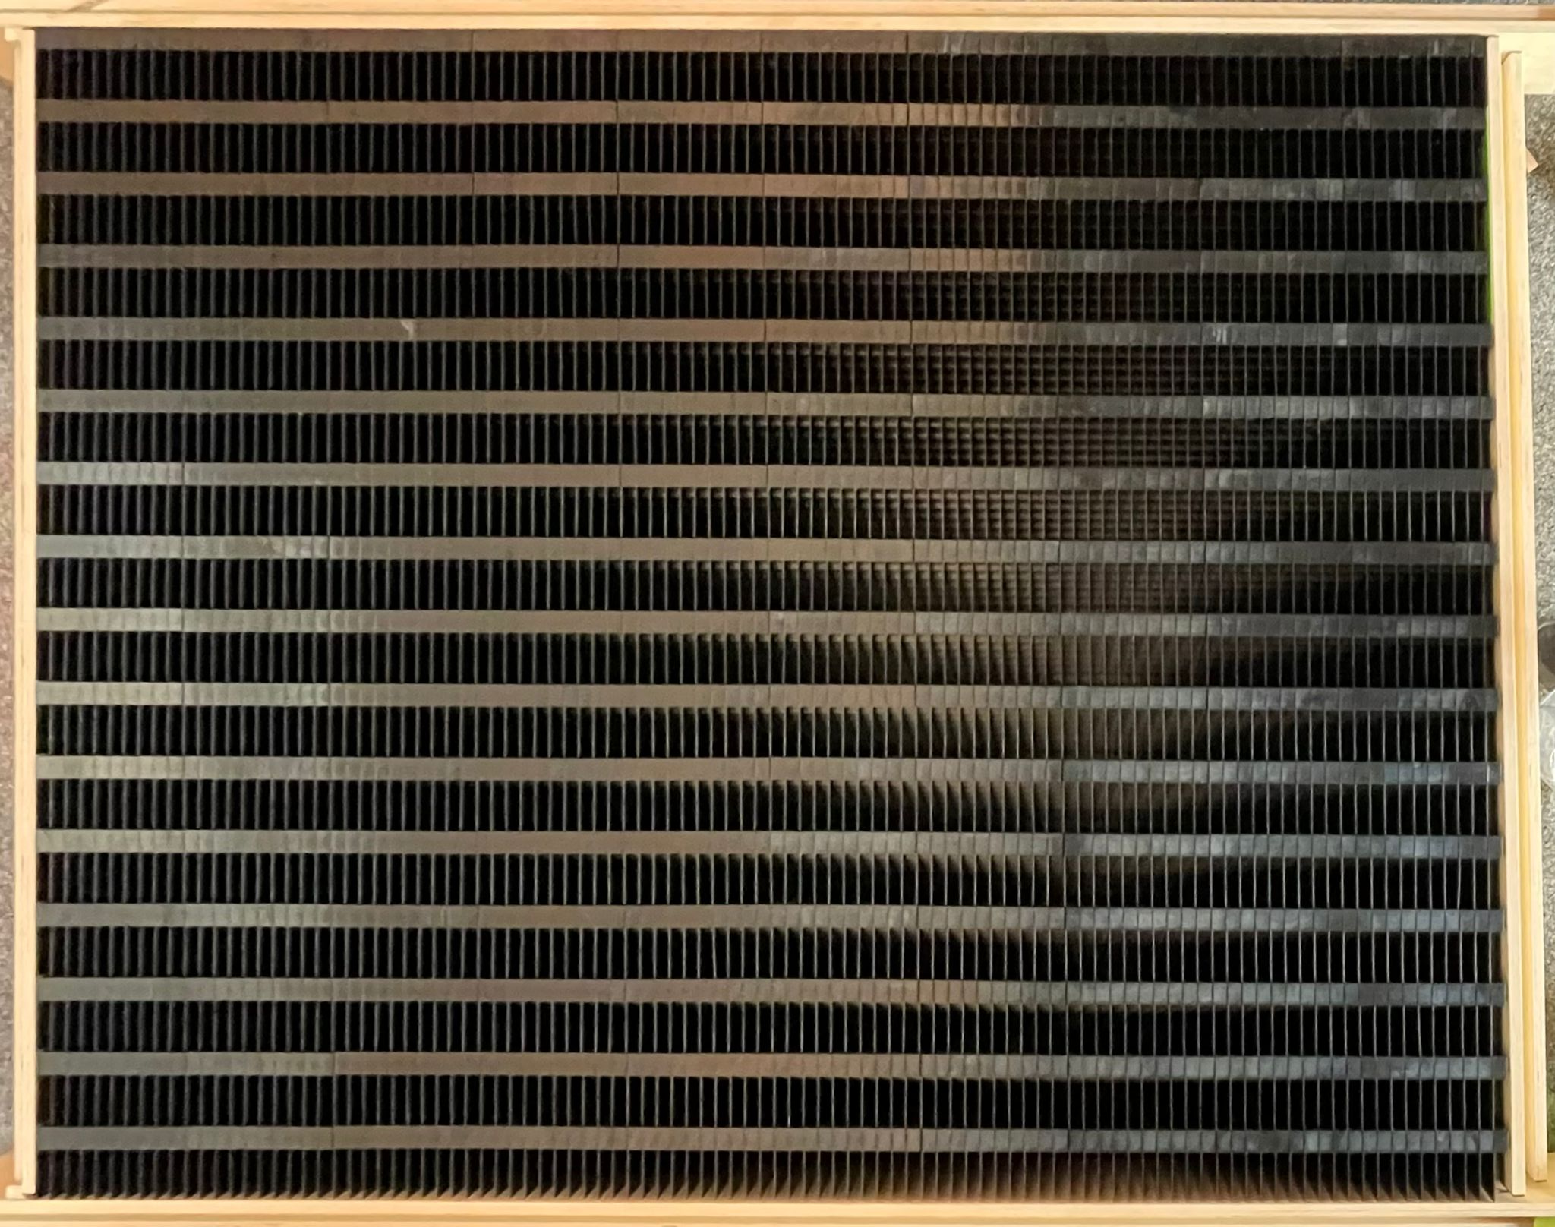
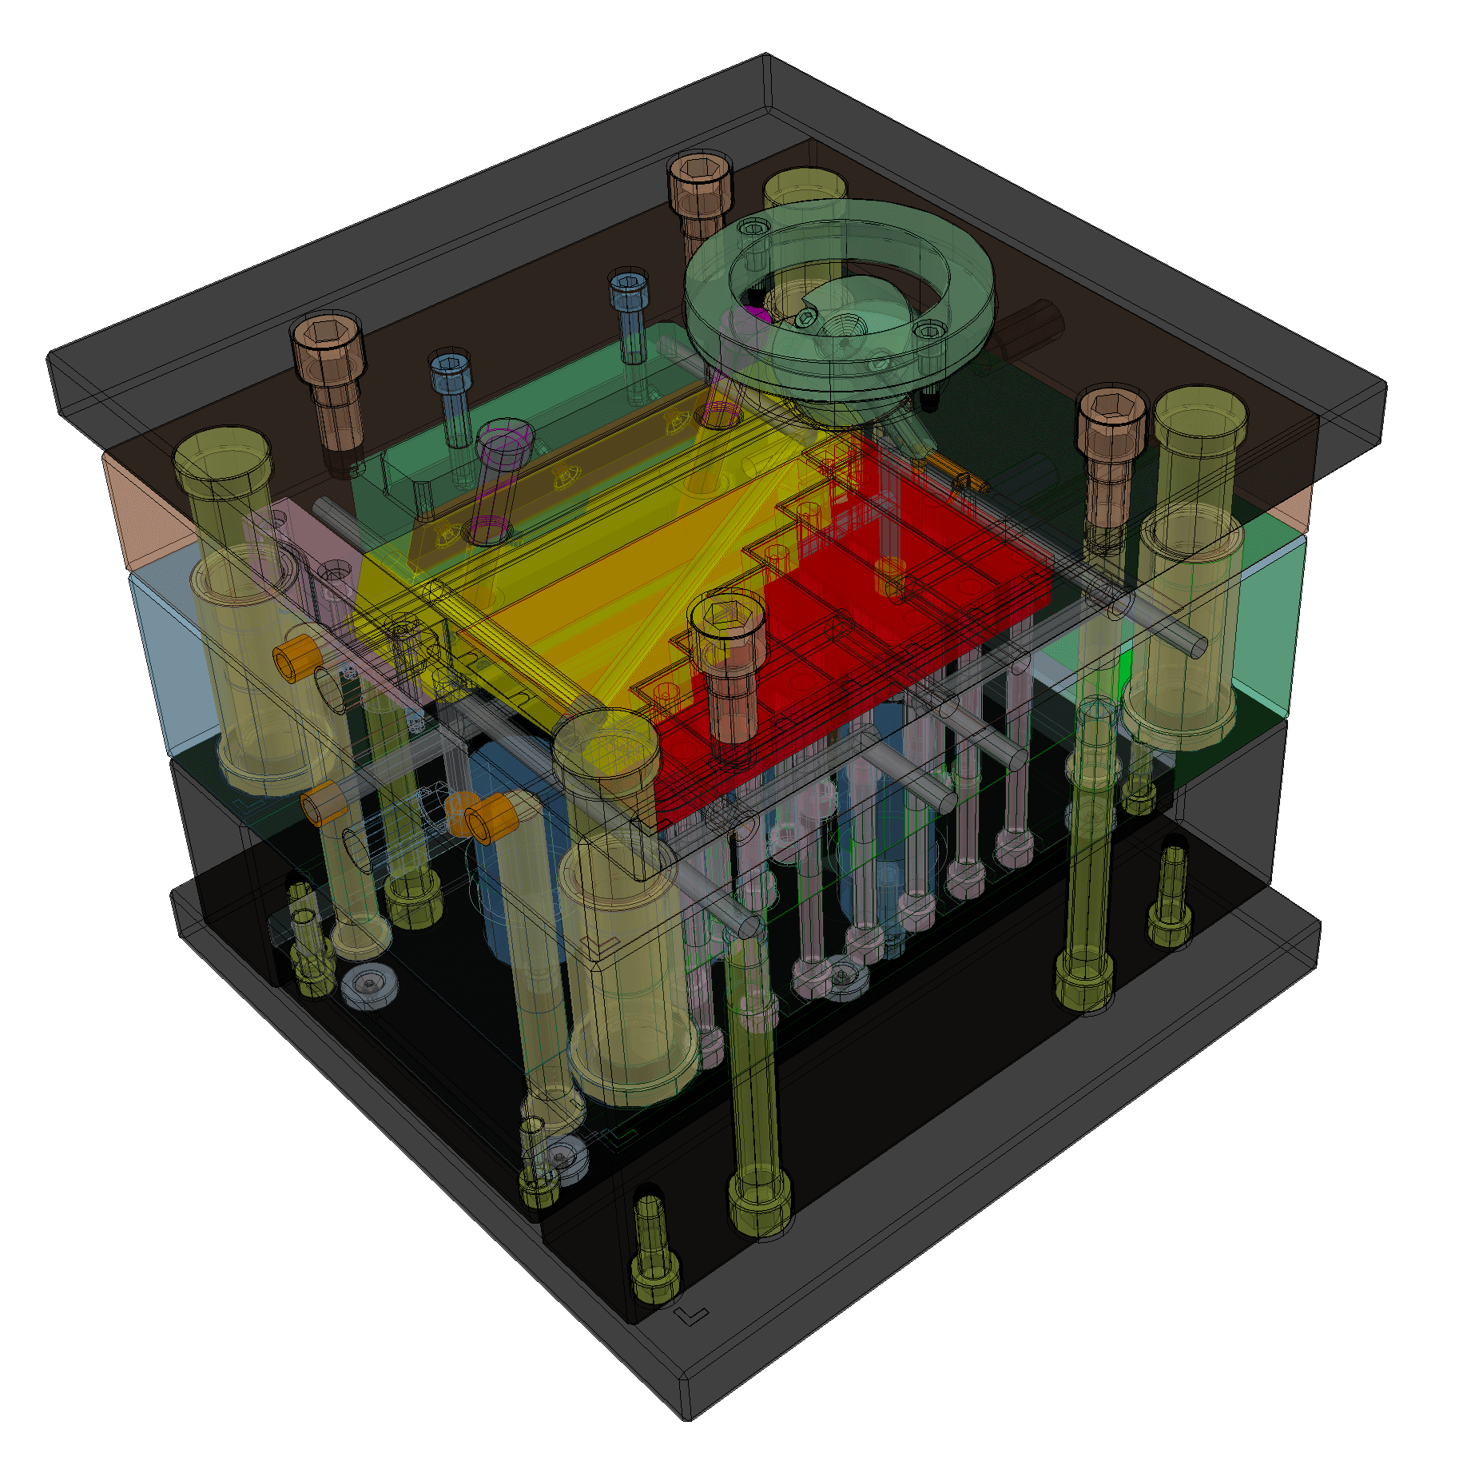
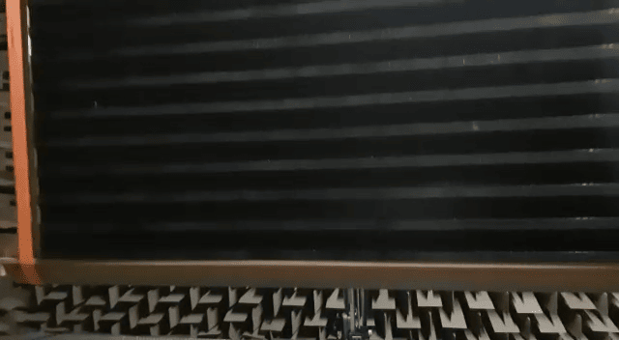
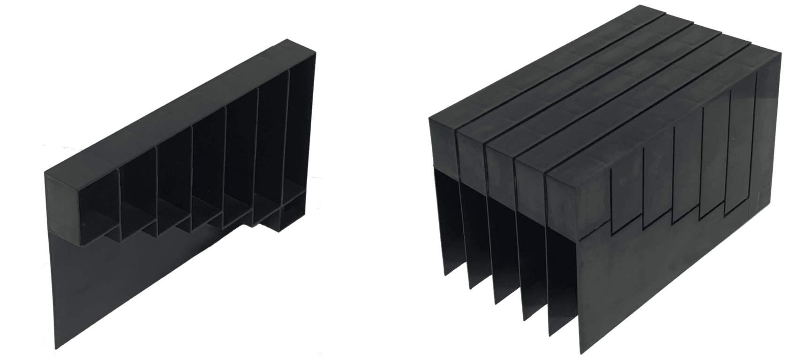
Manufacture of prototypes
Experimental prototype
Made with ABS with plastic injection mold
Experimental samples (this work)
Experiment in progress. Panel with 1600 unit cells (1.6 x 2 m). Results expected at mid November.
7

Slide 11
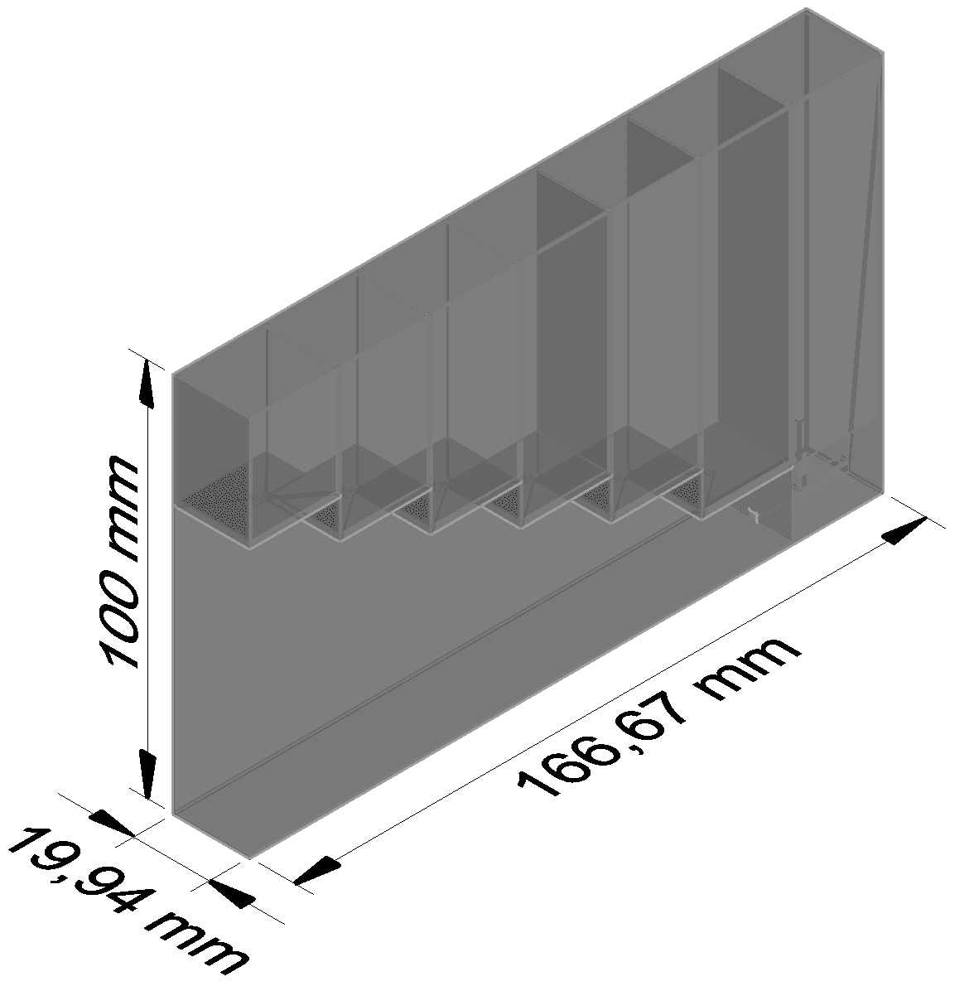
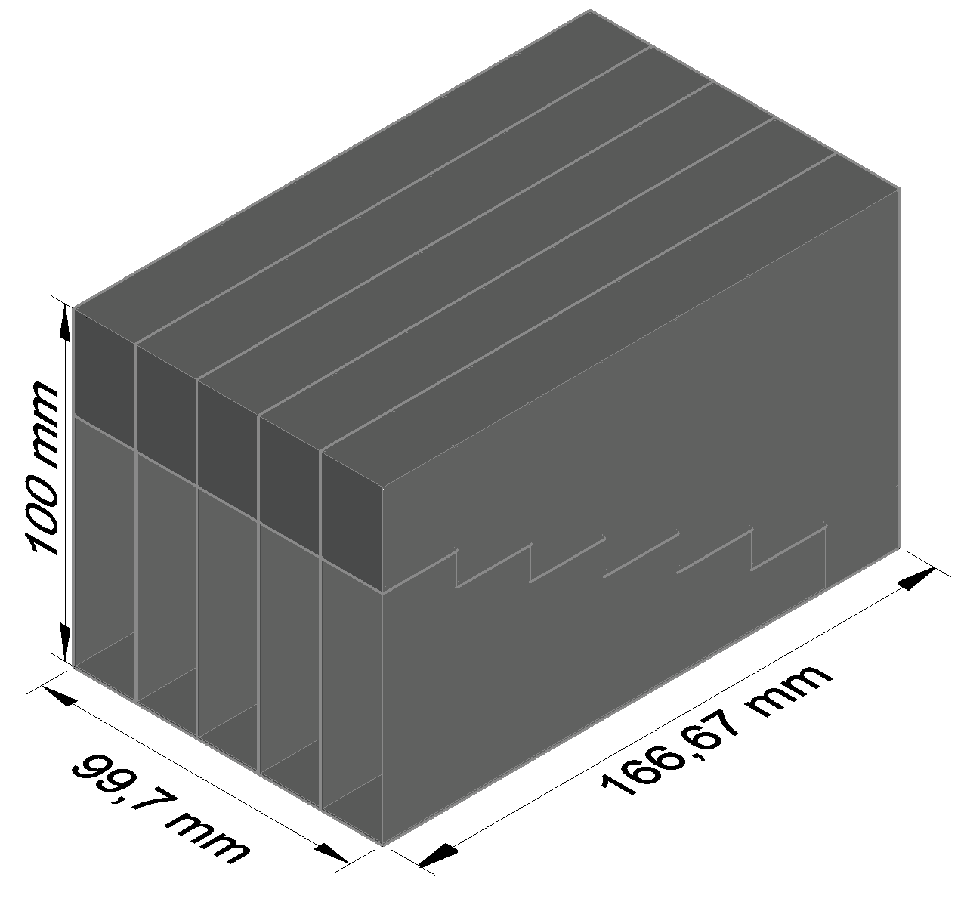
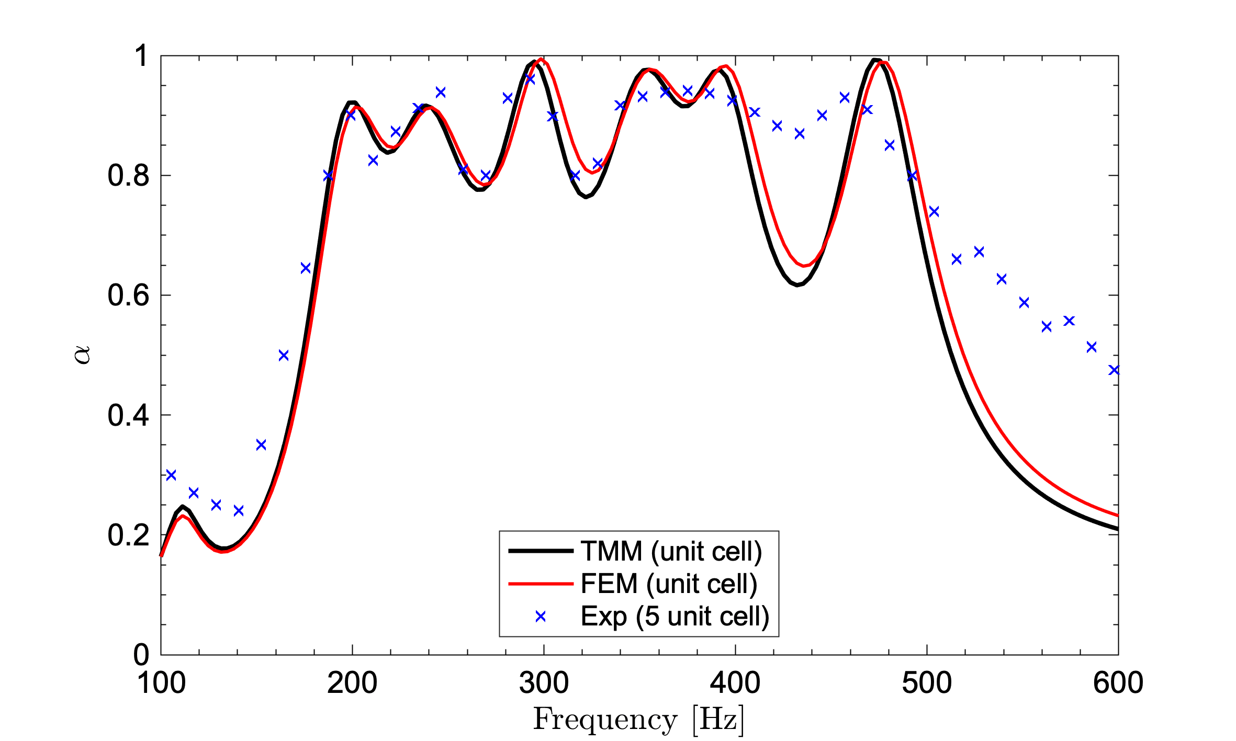
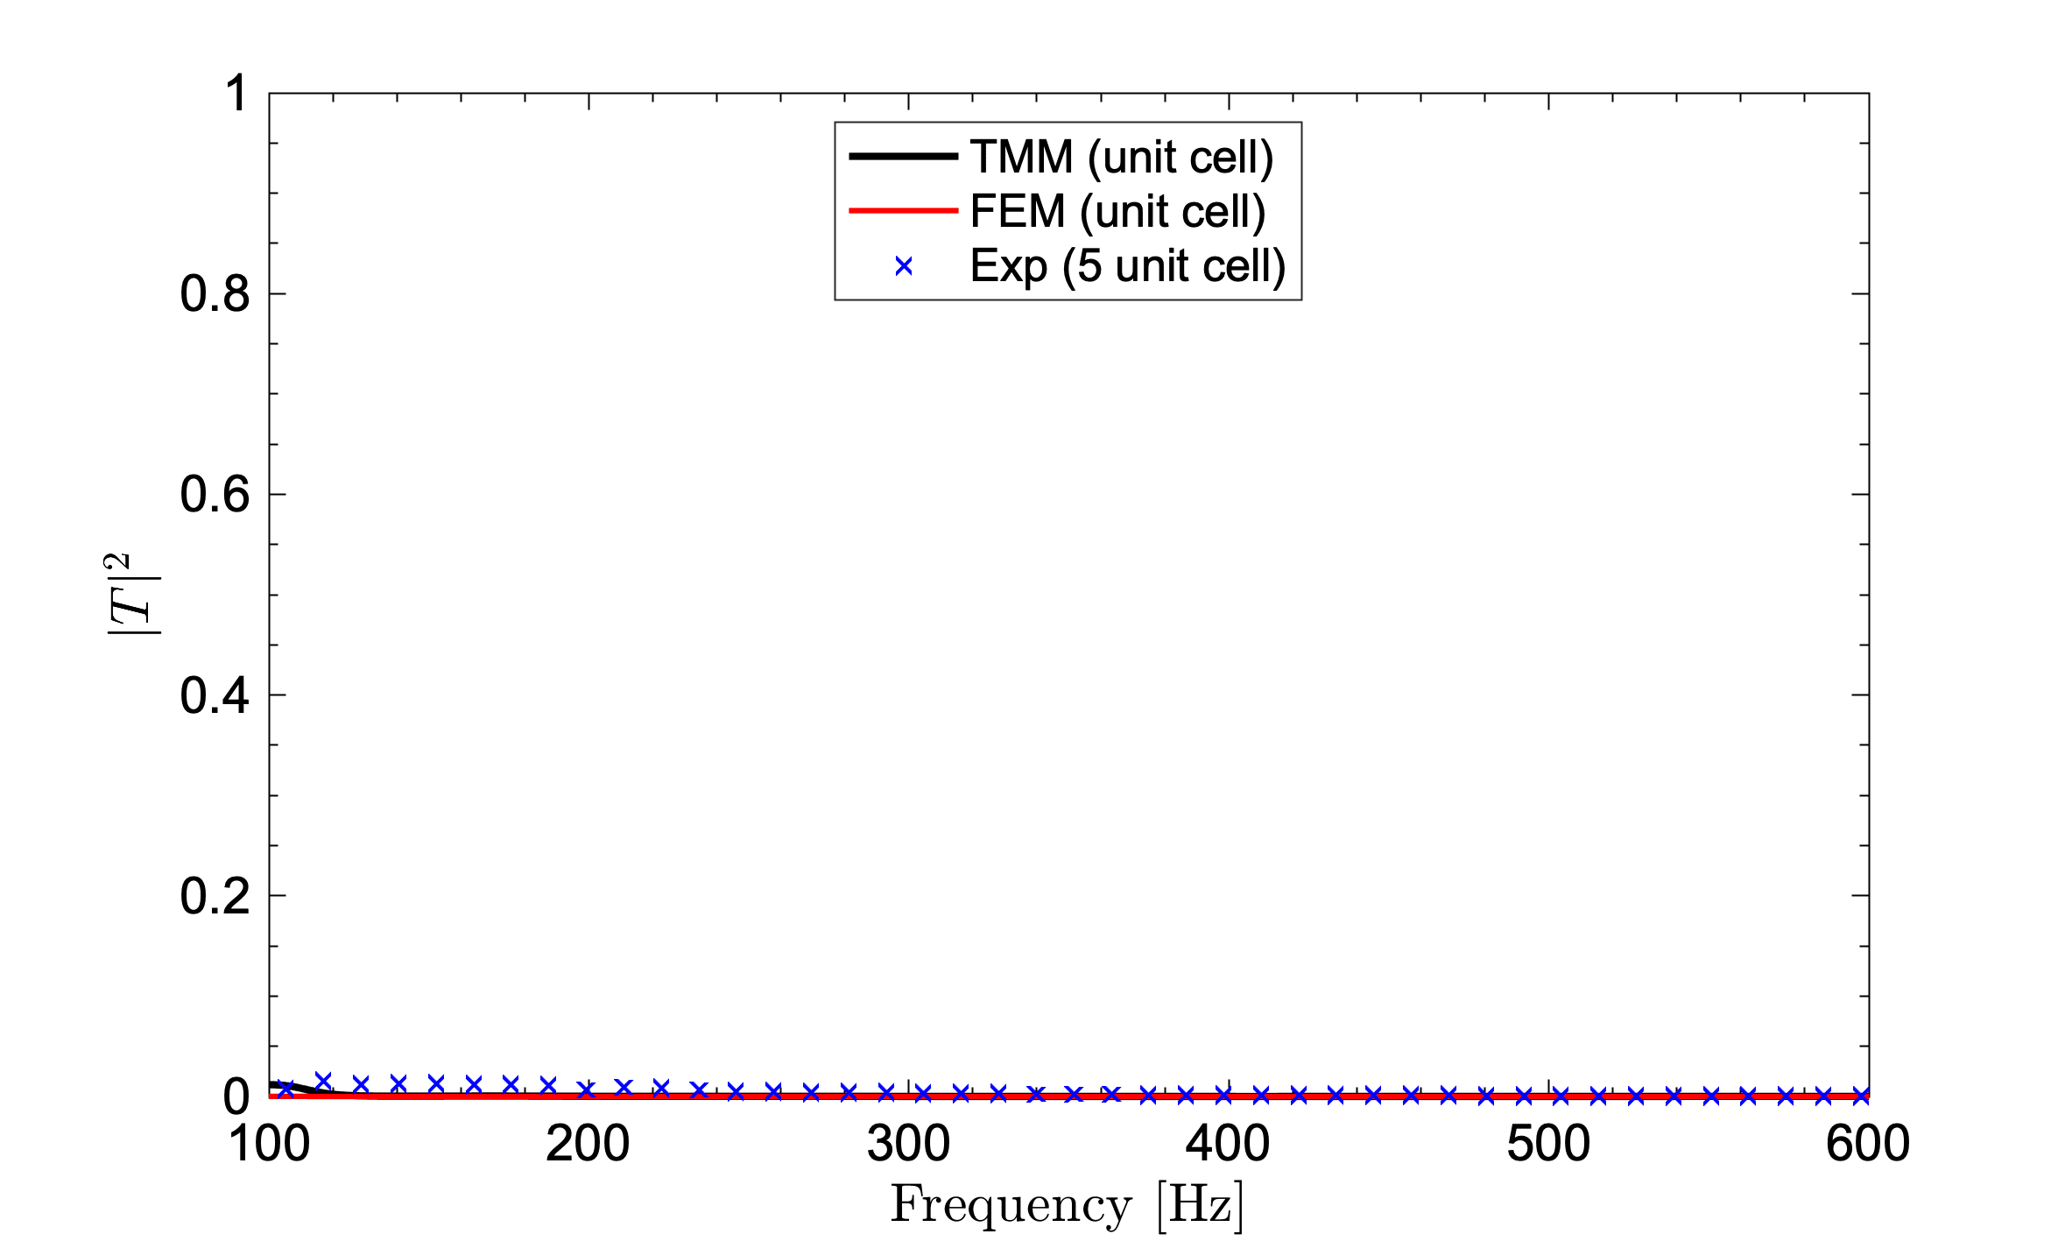
Results
Experimental 5-unit cell (transmission tube)
Analytical and numerical results of one unit cell. Experimental result of a 5-unit cell system.
8

Slide 12
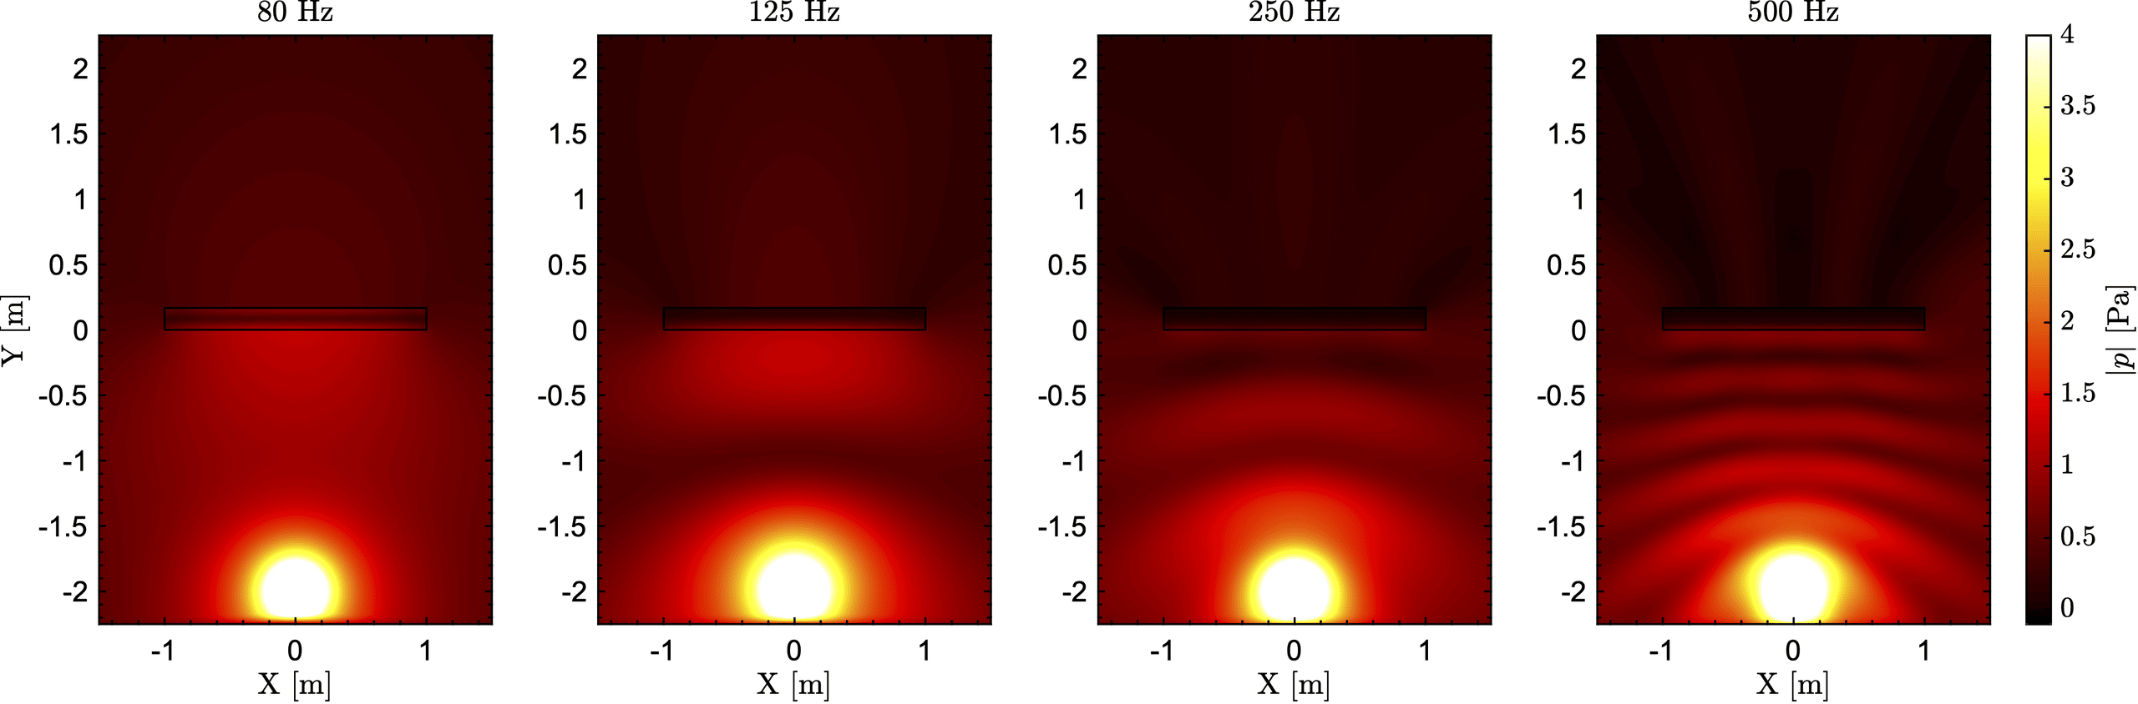
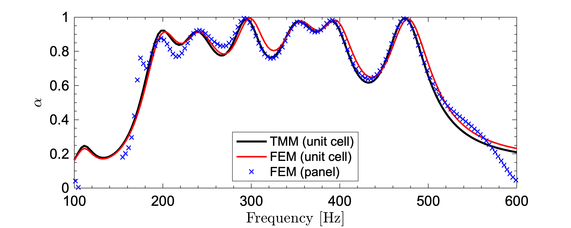
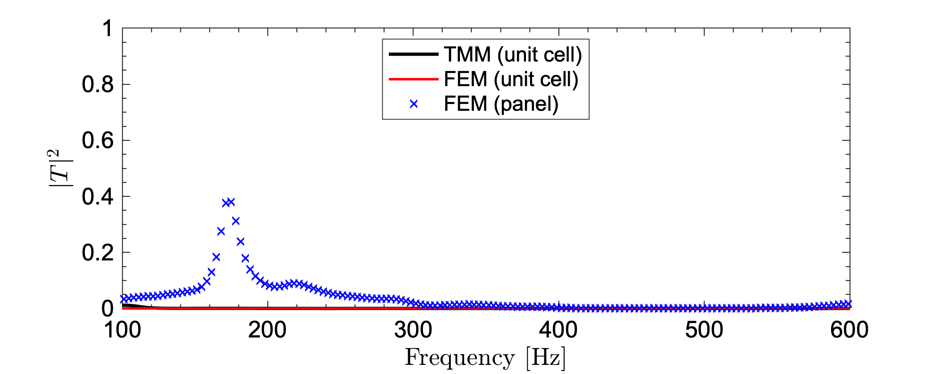
Results
Numerical results of the panel
9

Slide 13
Conclusions
We have proposed, designed and fabricated the use of a metamaterial panel for noise mitigation in rocket launch.
Using optimization and transfer matrix methods, a metamaterial presenting broadband quasi-perfect absorption is designed.
Samples have been fabricated and experimentally tested in an transmission tube. A good match has been obtained with the numerical calculations performed.
The acoustic behaviour of a panel formed by nearly 1600 unit cells, with total dimensions of 1.6x2m, has been simulated by using effective acoustical parameters. Although it has a finite size, the results expected in the numerical models have been obtained.
Future work will consist of carrying out the experiments with the panel (1600 units) in an anechoic chamber. Significant noise reductions are expected when this solution will be installed in the rocket launch pad.
10

Slide 14
PERFECT BROADBAND SOUND ABSORBER METAMATERIAL FOR NOISE REDUCTION IN A ROCKET LAUNCH
METAMATERIAL ABSORBENTE DE BANDA ANCHA PARA LA REDUCCIÓN DE RUIDO EN EL LANZAMIENTO DE COHETE
October, 2021.
José M. Requena-Plens¹, Rubén Picó¹, Víctor J. Sánchez-Morcillo¹, Noé Jiménez², Alejandro Cebrecos², Mara S. Escartí-Guillem^{3,4}
¹ Instituto de investigación para la Gestión Integrada de Zonas Costeras, Universitat Politècnica de València, Spain
² Instituto de Instrumentación para Imagen Molecular, Universitat Politècnica de València - CSIC, València, Spain
³ Instituto universitario de matemática pura y aplicada, Universitat Politècnica de València, València, Spain
⁴ Comet Ingeniería, Convento Carmelitas 2, 46010, València, Spain.

