Slide 1
Category review: Chips
June 2020
Retail Analytics
Brand note: If client logo is not required, use alternate title page layout right click slide thumbnail > Layout > Title

Slide 2
Notes:
To view Privacy video explaining how important data privacy is to Quantium, please click here: https://www.youtube.com/watch?v=Zq1QDAkoRzU
or here Q:\Company Reference\Brand & Design\Brand videos\Q Privacy.mp4
At Quantium, we believe that data is the behavioural footprint of humanity and that it has to be treated with the utmost care and responsibility.
Histories, attitudes, indeed lives are stored within it in ways that aren’t always apparent – and that’s what makes its potential so powerful.
To work with it responsibly, sensitively, we set ourselves the highest data privacy protection and governance standards.
We have spent 17 years perfecting privacy-by-design and secure-by-design principles. Central to this is not holding any personally identifiable information about people –
we neither receive it, and put the necessary protections in place to be unable to decipher it.
Every aspect of handling data is safeguarded: from its de-identification, to its encryption – data security is paramount and of the highest grade.
We pride ourselves on gaining the trust of iconic organisations around the world through years of securely working with their data,
and in turn the trust that builds with their stakeholders.

Slide 3
Executive summary
01
Task 1
Chips are considered a basic food item, mainly appreciated by cost-conscious families and everyday consumers without the obligations of providing for a family.
02
Task 2
The trial layout boosted chip sales by attracting more customers from February to April 2019.

Slide 4
01
Category

Slide 5
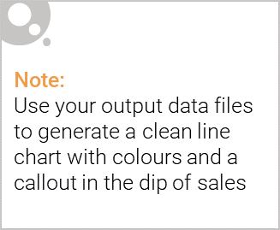
Overview: For some families, chips represent a cost-effective option, while others have the means to spend more.

Slide 6

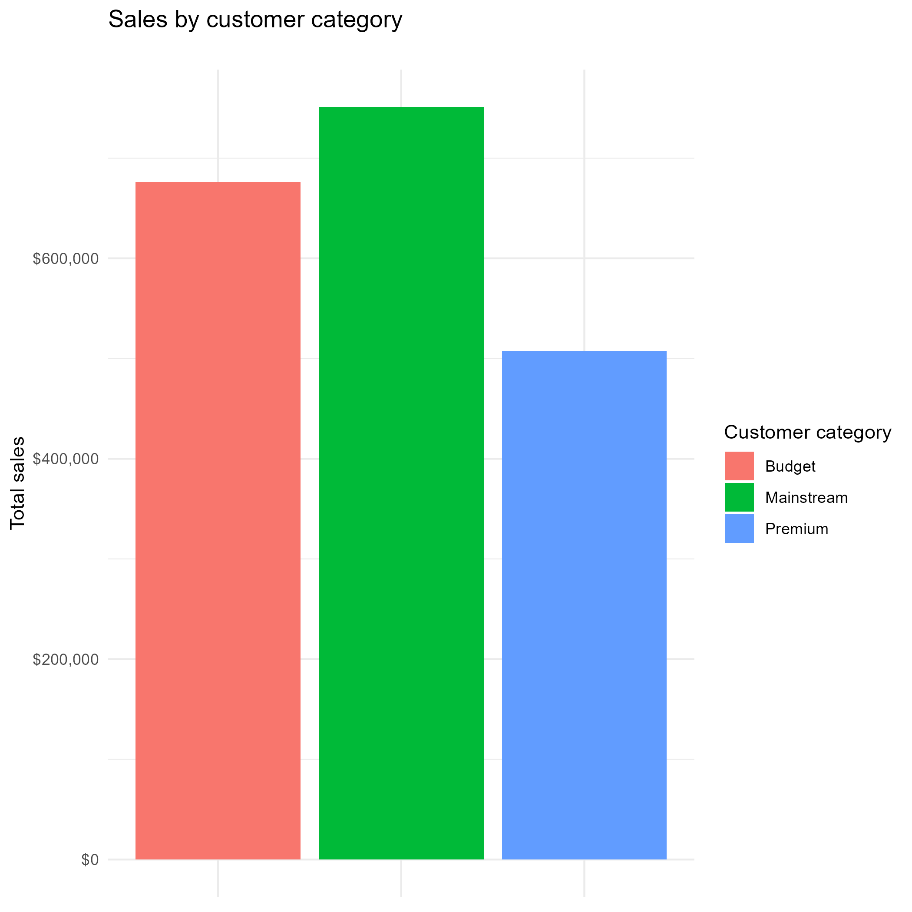
Chip sales are not predominantly influenced by premium consumers.
In fact, budget-conscious and mainstream shoppers each account for a larger share of sales compared to premium buyers, suggesting that chips are not considered a luxury product.
Since affluent customers do not largely contribute to chip sales, any marketing efforts should focus on appealing to the more price-sensitive demographic.

Slide 7
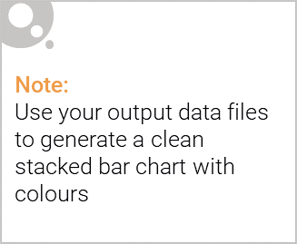
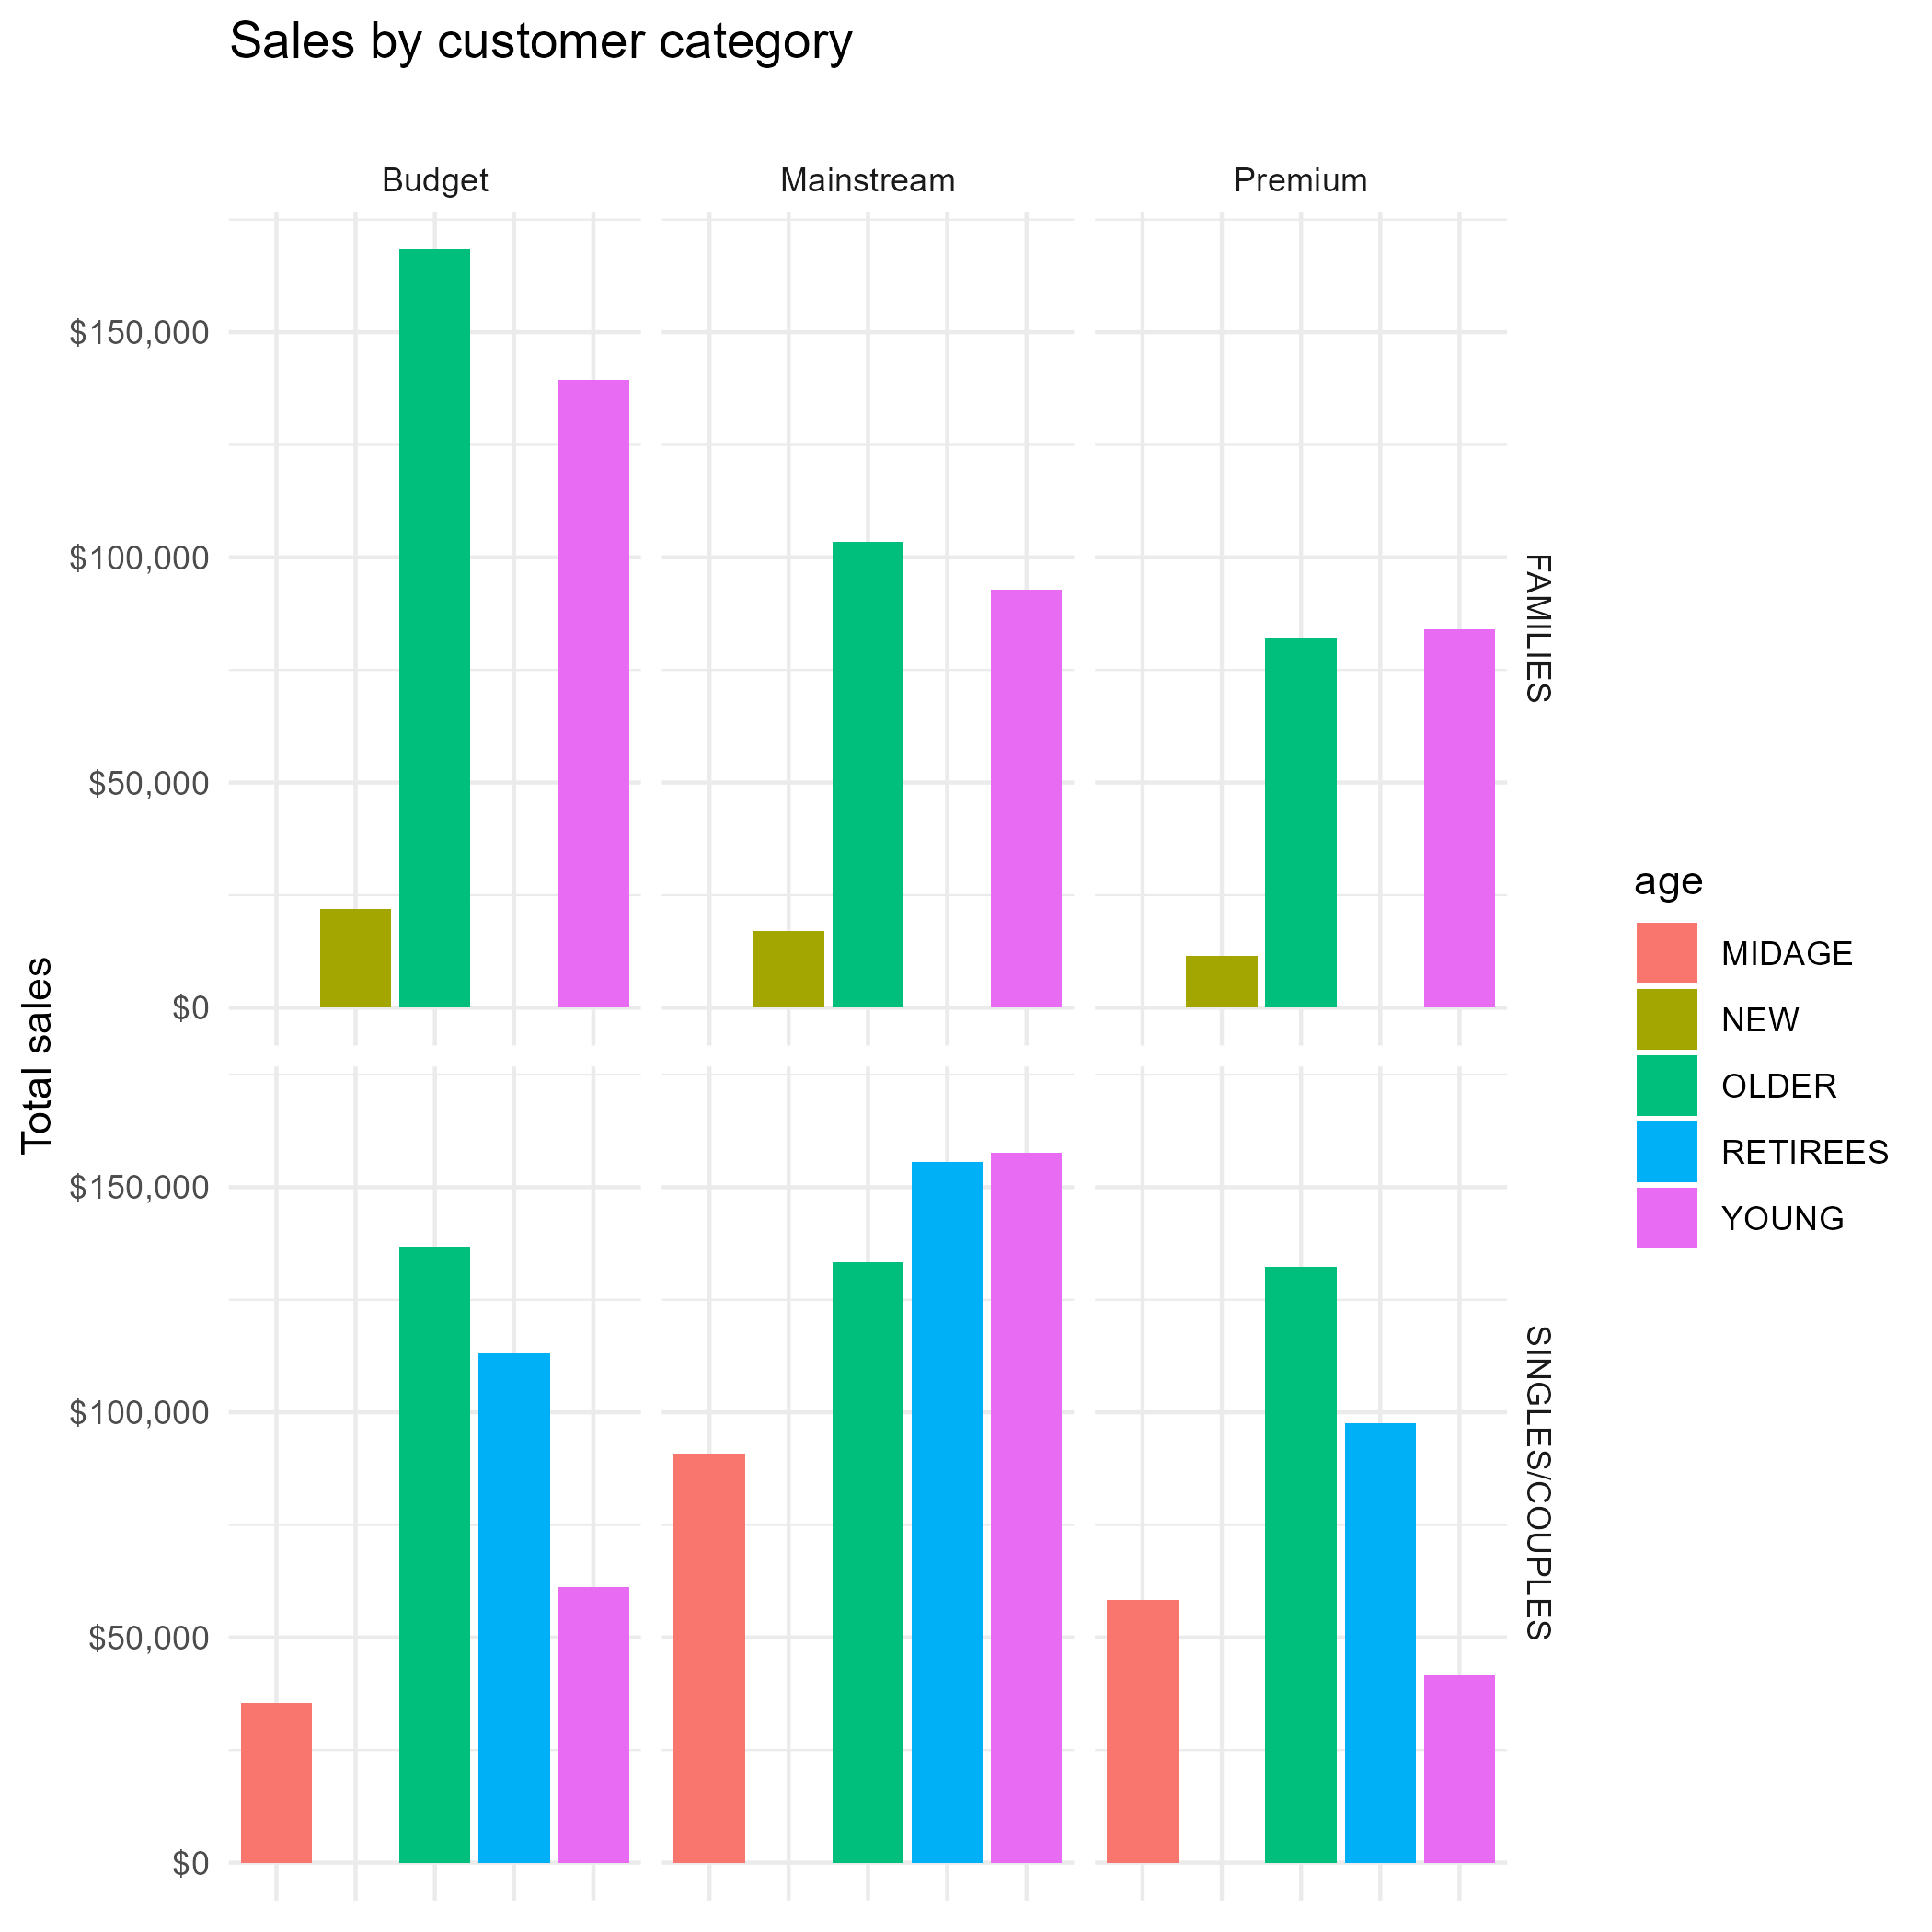
Editable (delete this)
The majority of chips bought by families across all life stages fall into the budget customer segment.
In contrast, the singles and couples who primarily purchase chips are from the mainstream category.
Families with premium status tend to buy fewer chips compared to those in the budget category.

Slide 8
02
Trial store performance

Slide 9
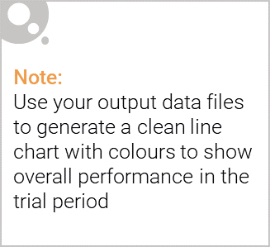
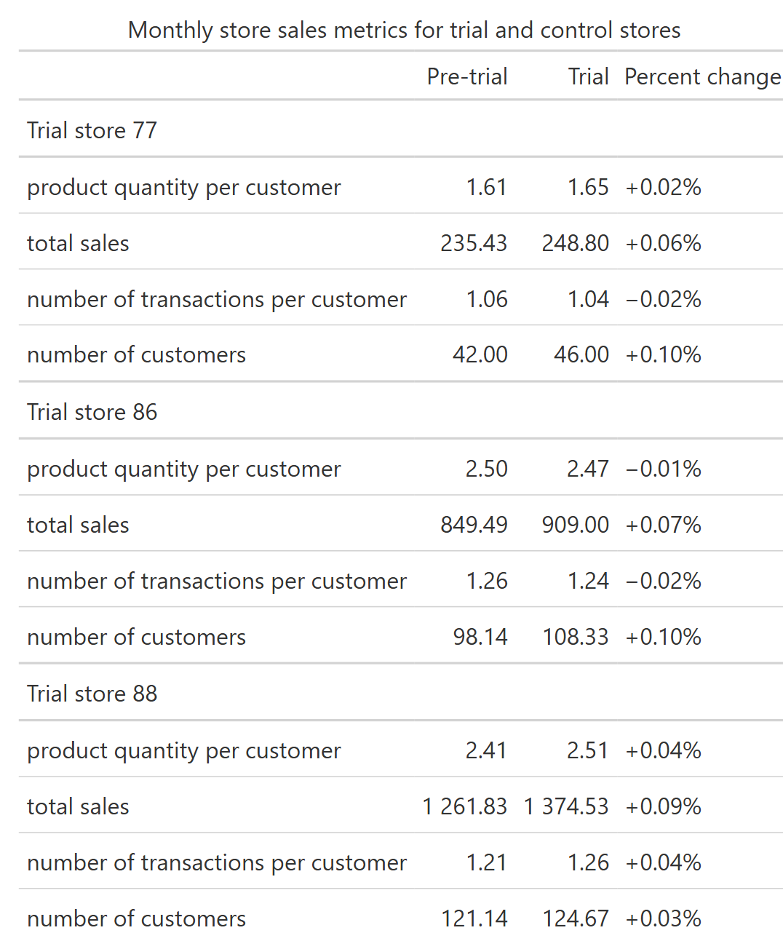
During the trial period, while many other stores reported stagnant or decreasing sales, the trial stores enjoyed a rise in sales driven by a boost in customer traffic. Although other stores faced a decline in customer numbers, the new layouts in the trial stores facilitated a higher volume of chip purchases, resulting in increased sales, even though the overall quantity and frequency of purchases remained relatively stable.

Slide 10
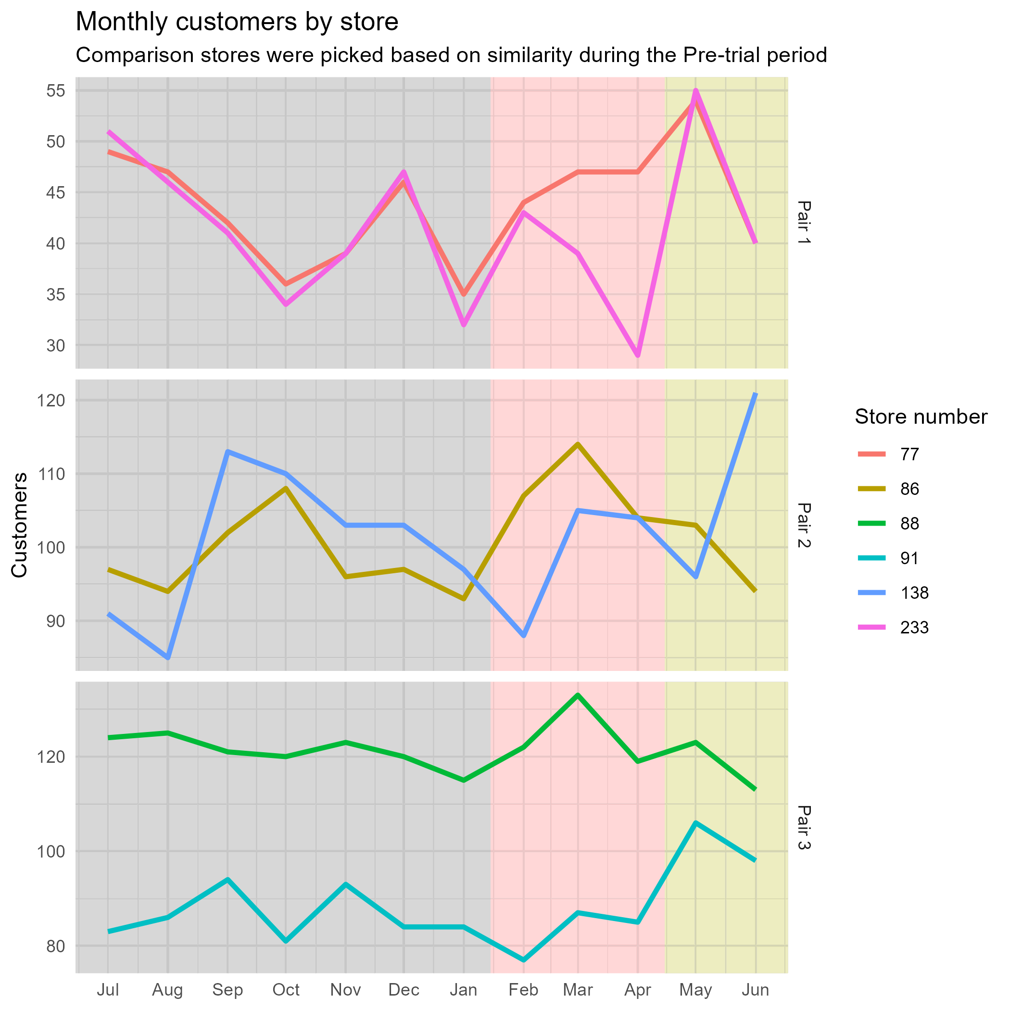
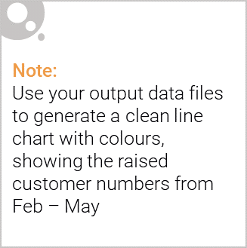
The trial layout proved effective, leading to a rise in customer traffic at the trial stores compared to those without any layout modifications. This significant increase is most evident in the initial pairing, although a positive impact is observed across all three pairings.
Pre-trial Trial Post-trial

