Slide 1
2018-2019 Ebola virus outbreak North Kivu, DRC
Jamie Caldwell, Tina Cheng, Deena Giffen, John Huber, and Sarah Bowden

Slide 2
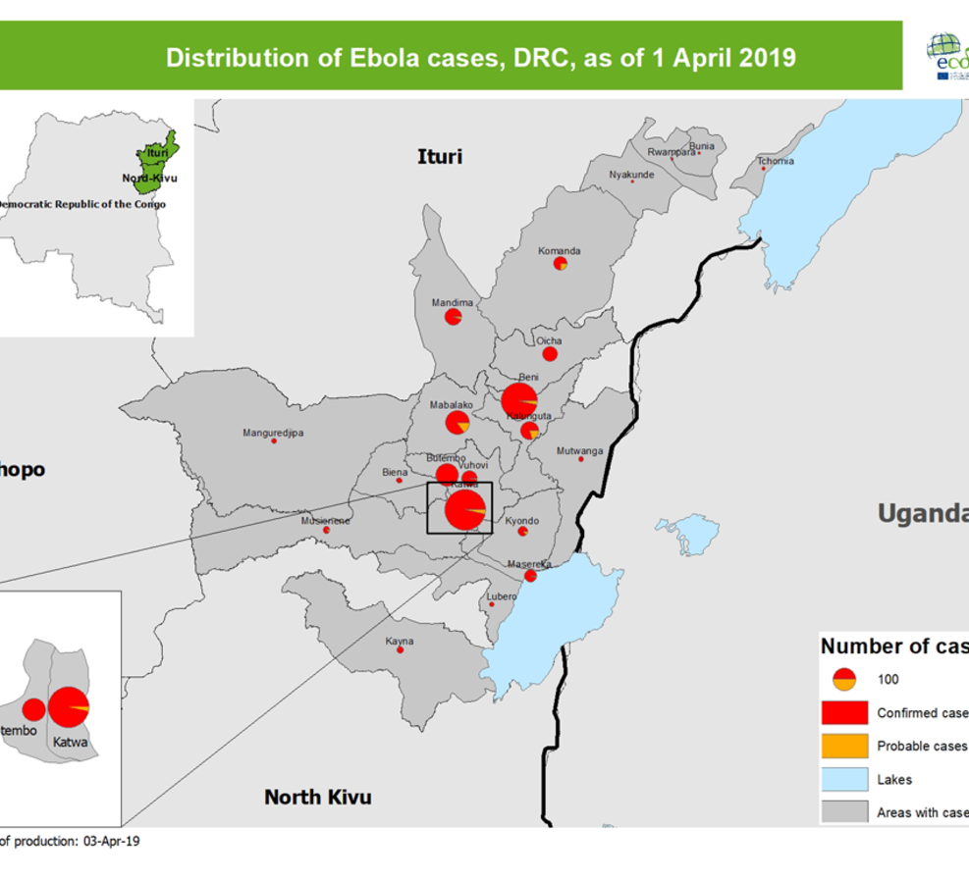
Outbreak area: DRC
Cases spreading south from Beni towards Goma(large population center)
Recent spillover into Uganda
<90 km from border with South Sudan as of last week
9 countries within a 500 km radius of outbreak epicenter

Slide 3
Complications of current outbreak
Public distrust of health system
Political unrest
Human mobility

Slide 4
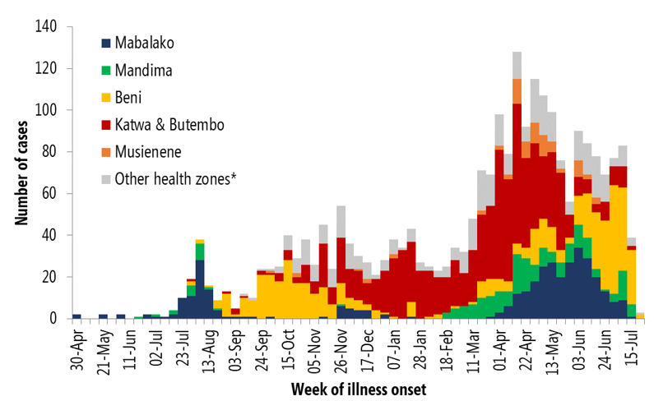
Ebola case data
Top 6 health zones with most cases to date:
Beni
Butembo
Mabalako
Kalunguta
Katwa
Mandima
Aggregated cases by week
Omitted past 12 weeks for forecasting

Slide 5
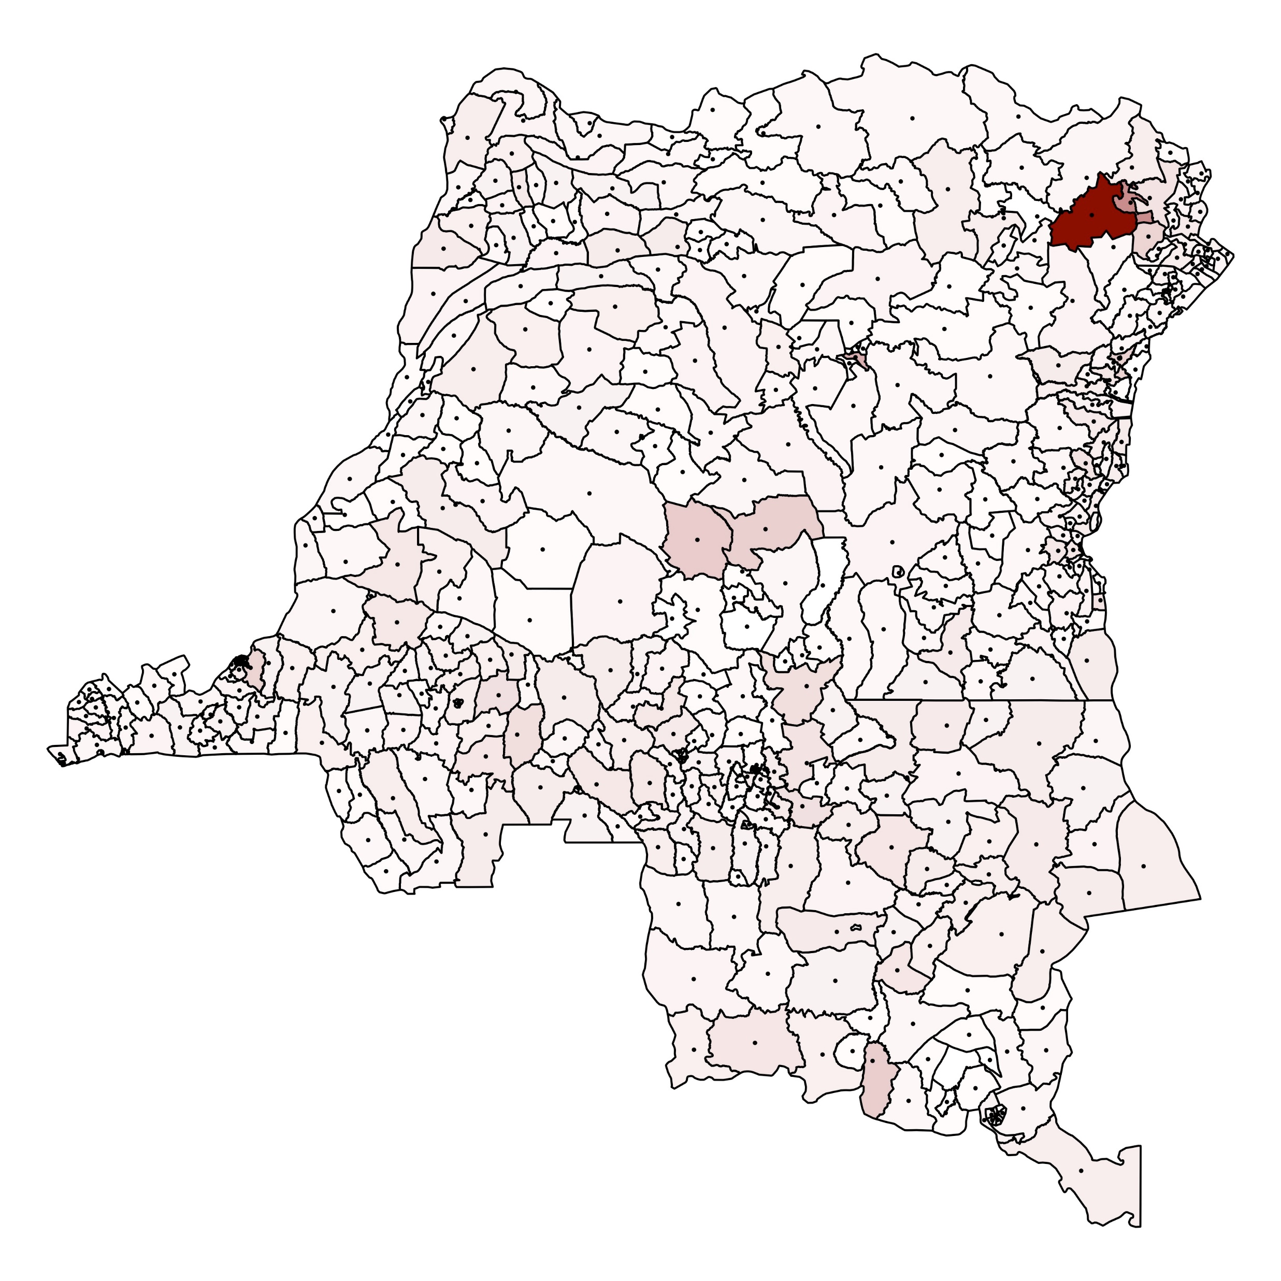
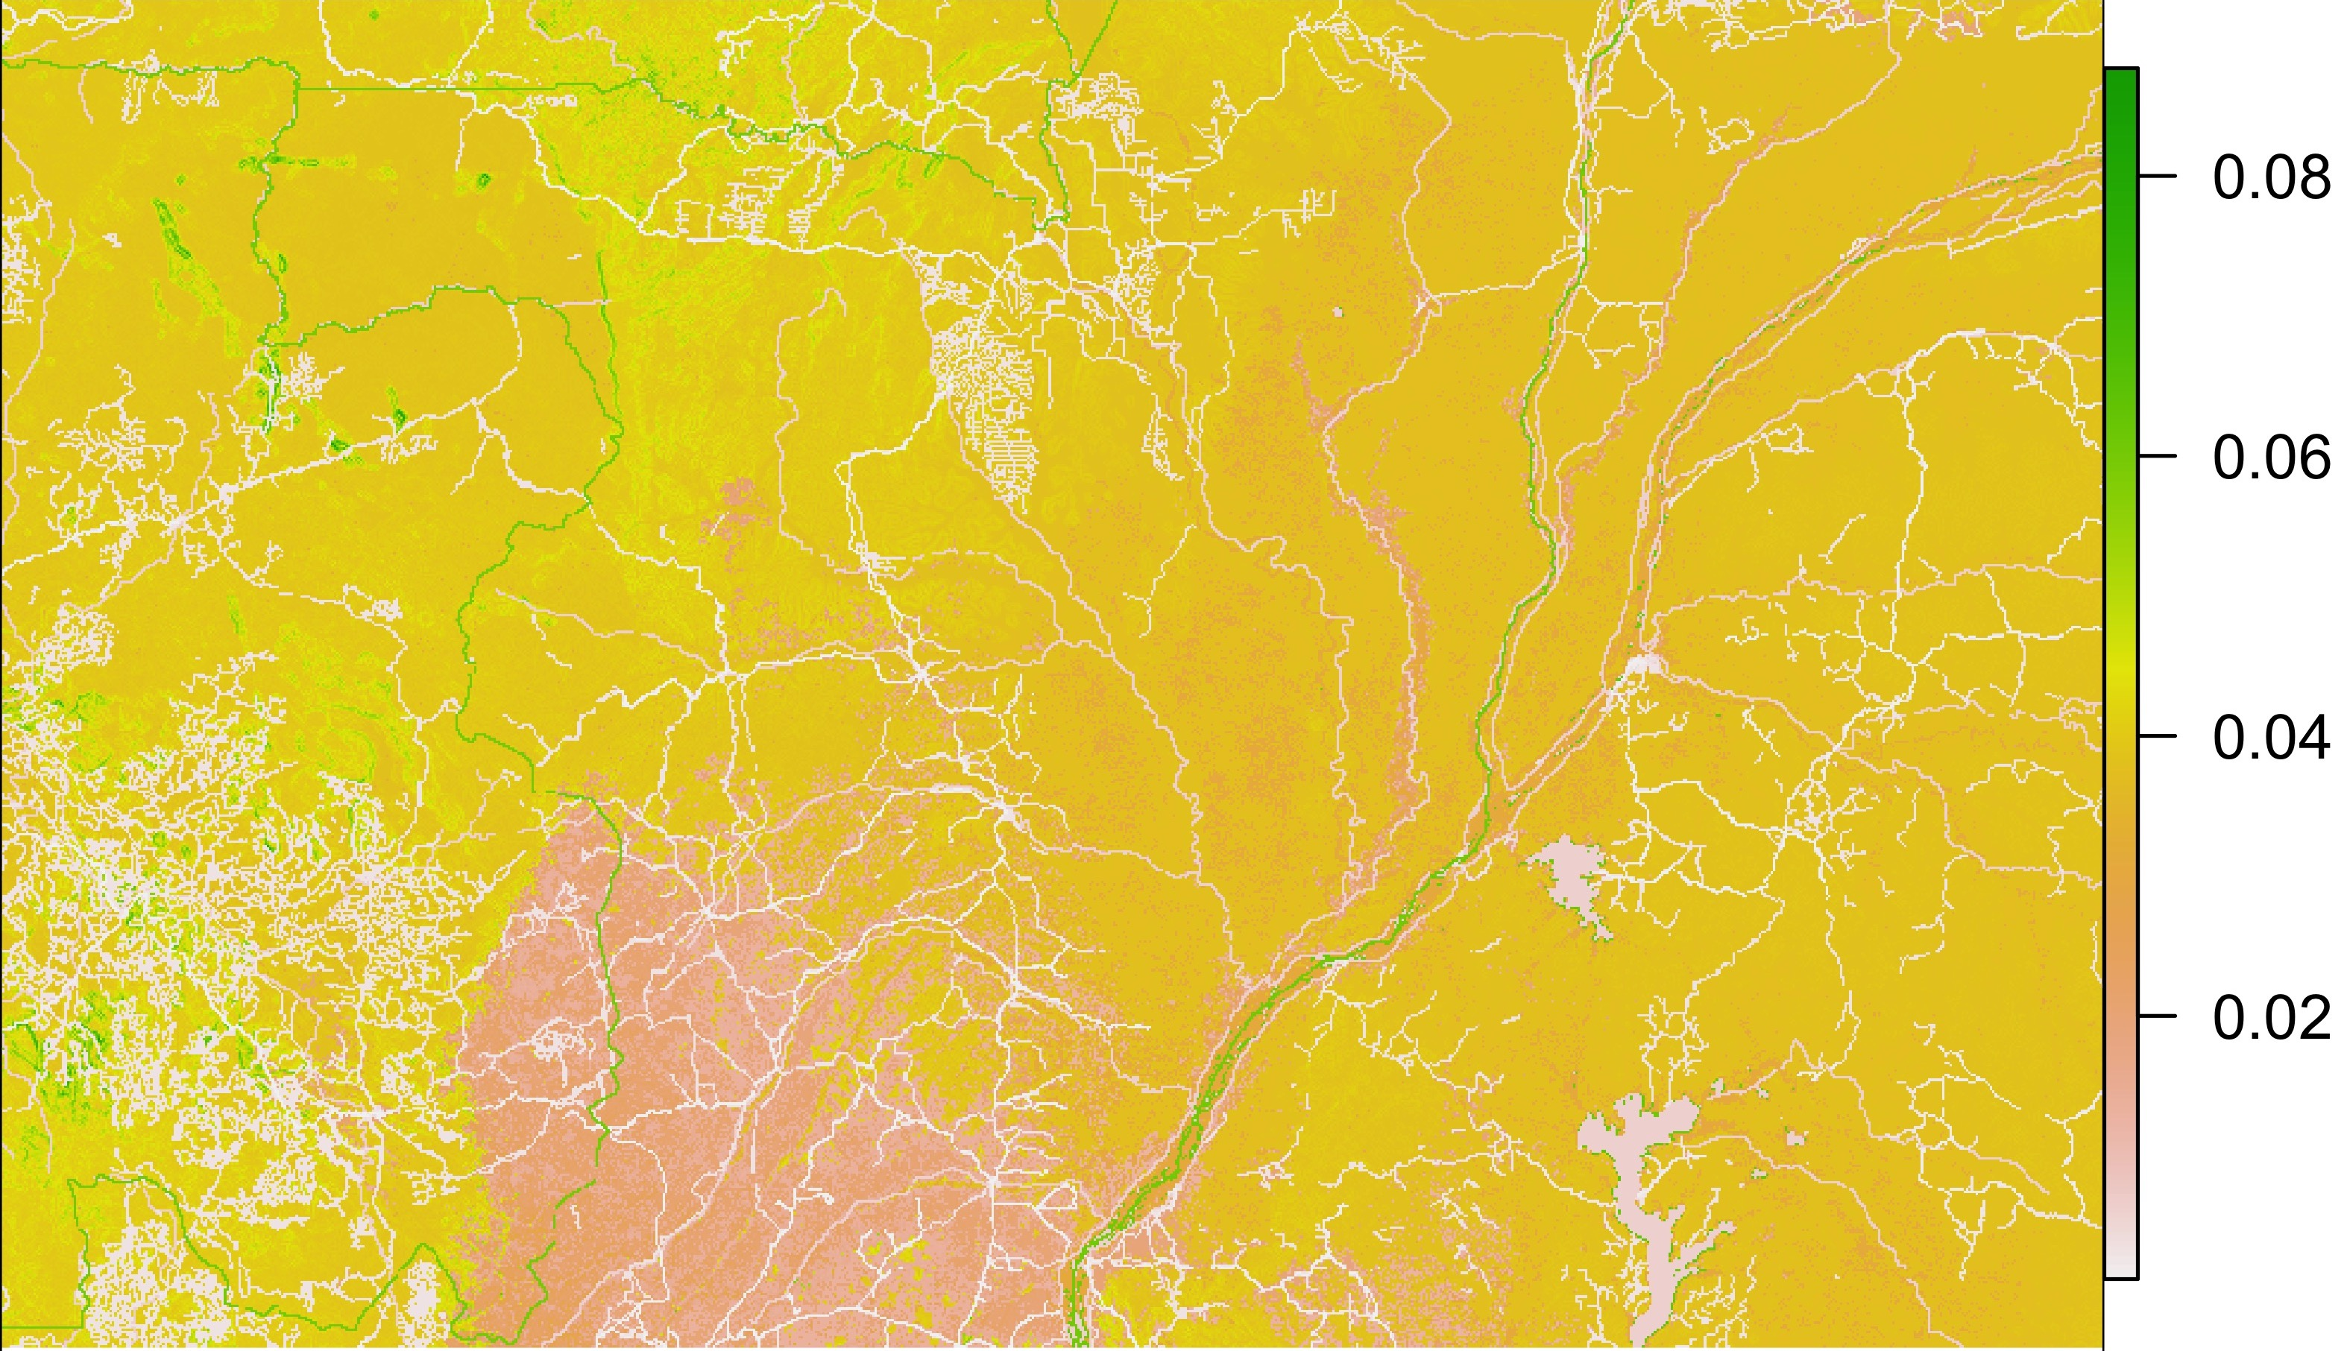
Spatial data
Population-weighted centroids
Friction surface

Slide 6
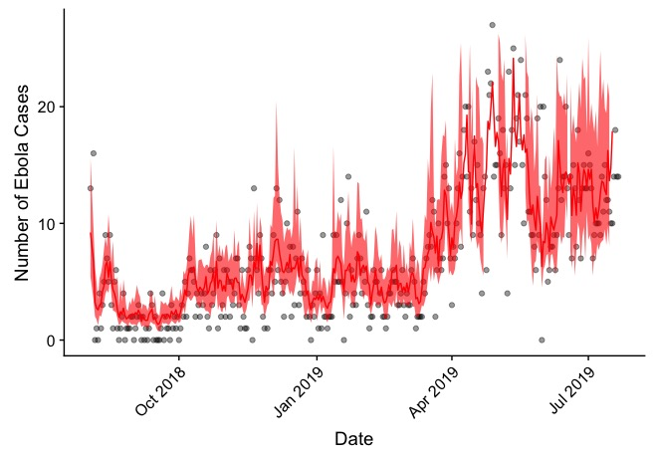
Model 1: random walk

Slide 7
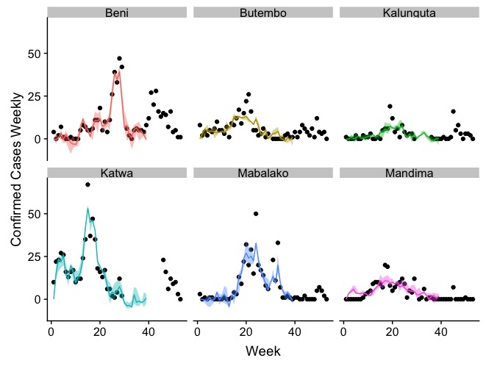
Model 2: Euclidean distance

Slide 8
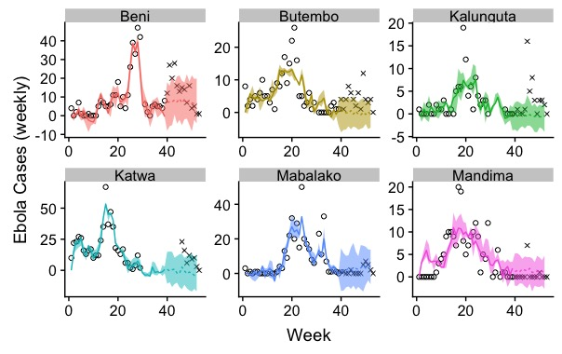
Model 2: Forecast

Slide 9
Model 3: surface friction weighted distance
…maybe next time.

