Slide 1
Identifying and Measuring Curvature of Caulobacter Cells
Jenna Schabdach
Department of Biomedical Informatics
University of Pittsburgh

Slide 2
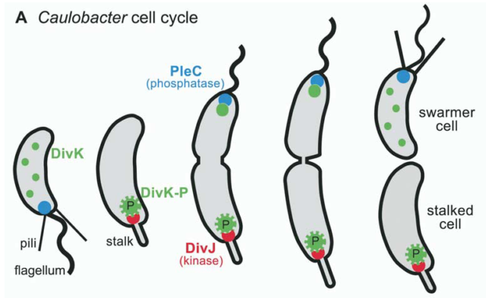
Caulobacter Bacteria 101
Highly studied by biological researchers
Cells divide into 2 cell types
Stationary, stalked cell
Motile swarmer cell
Similar functionalities to stem cells
Image source: Z. Gitai, “The New Bacterial Cell Biology: Moving Parts and Subcellular Architecture,” Cell, vol. 120, pp. 577–586, 2005.

Slide 3
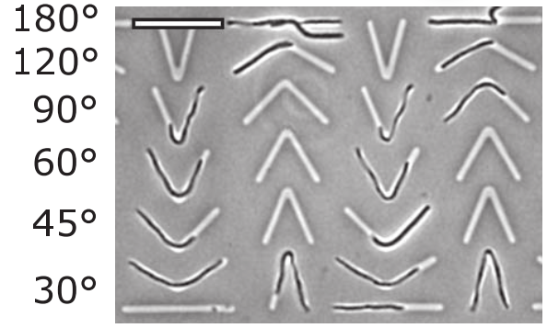
Caulobacter Bacteria 101
Current research: division process
Proteins localize to different points in the cell
How do they know where to go?
Theory: curvature plays a role
Force cells to grow to a curvature using a scaffold
Image cells using light microscope
Measure the curvature of the cells
Image credit: L. D. Renner, P. Eswaramoorthy, K. S. Ramamurthi, and D. B. Weibel, “Studying Biomolecule Localization by Engineering Bacterial Cell Wall Curvature,” PLoS One, vol. 8, no. 12, 2013.

Slide 4
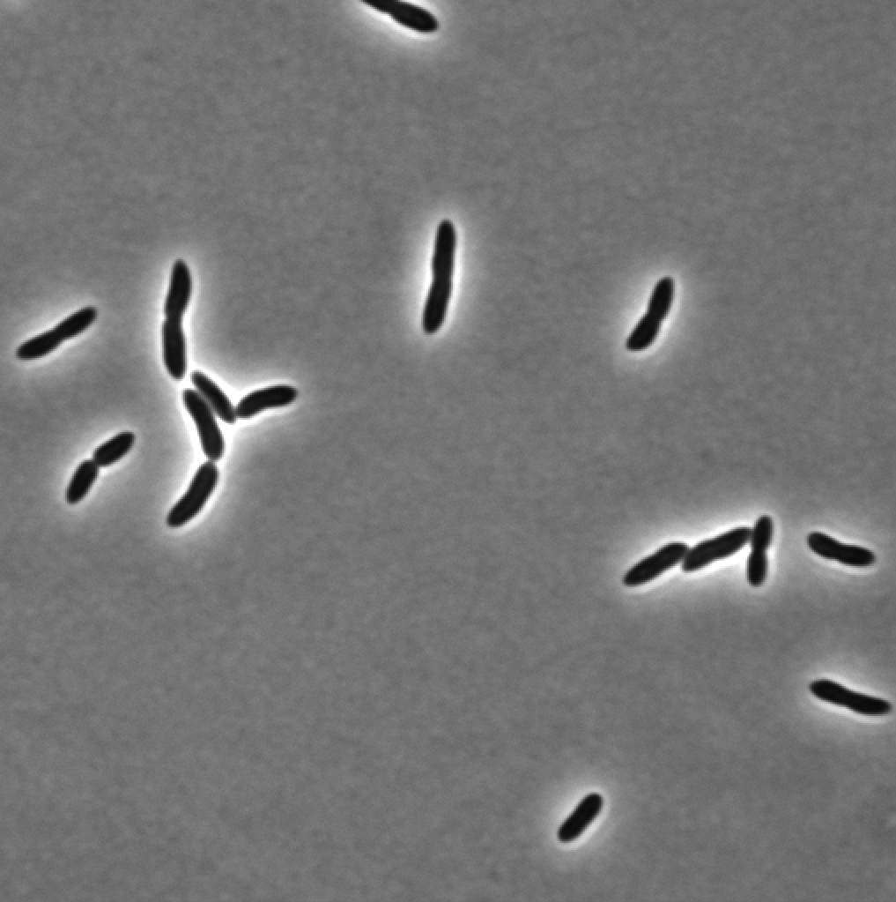
Analyzing Caulobacter Images
Segment the image: identify bacteria cells vs. background
Measure the curvature of the cells

Slide 5
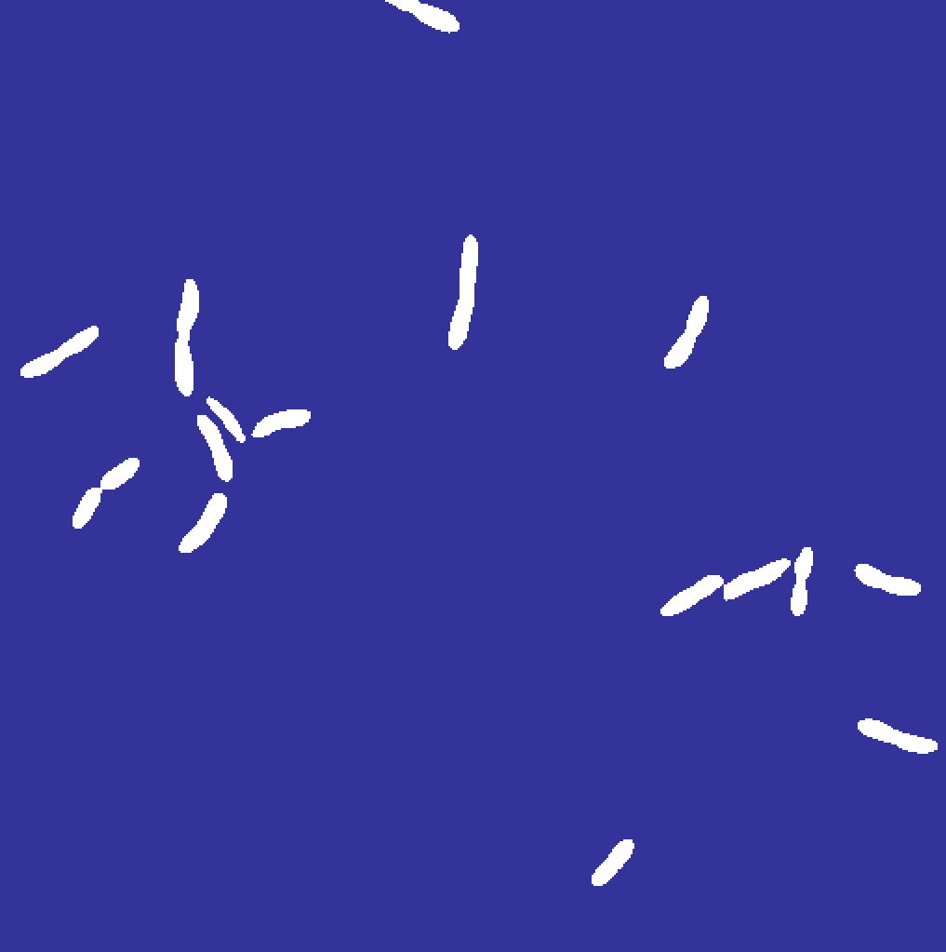

Segmenting Cells vs. Background
Original
Thresholded Image
Label Map

Slide 6
Measuring Curvature
Iterate through label map
Fit a polynomial to the cells
Calculate the curvature of the polynomial
Label Map

Slide 7
Preliminary Results: Counting Cells
How many cells in original?
Researcher: 16
Label map: 16
Original
Label Map

Slide 8
Challenges, Limitations, and Future Work
Challenges
File formats
Finding best segmentation pipeline
Researcher needs unclear
Limitations | Future Work
Thresholds specific to test image | Tweak parameters using more images
Specific to type of microscopy image | Coordinate with researchers
 | Incorporate fluorescent images
Notes:
Phase images, but there are other types
Coordinate with the researchers to make sure that I’m writing this program to work with the type of image they will use, supporting one or multiple image types

Slide 9
Acknowledgements
Sara Whitlock
Childers Lab

