Slide 1


DLWeek
2025
March 2025
Systematic Approaches to AI-Powered Trading
(Finance Track)
Team Lean Large Men

Slide 2

Considerations
Market-Beating AI is Nearly Impossible
Top quant firms invest billions in infrastructure, data, and TOP academic talent.
Educational Value in Exploration
While true alpha is elusive, studying AI trading strategies builds valuable skills and sparks optimism for the future as AI capabilities grow exponentially.
Amount
Number of years

Slide 3


Market Complexity
Dynamic & Adaptive Nature
Strategies that work today may fail tomorrow.
Market participants react to and anticipate each other's moves.
Key Challenges in Prediction
Signal vs. Noise: Finding real insights amid randomness.
Self-Fulfilling Prophecies: Predictions can shape market behavior.
Market Mood Swings: Strategies may collapse in downturns.

Slide 4
Key Market Factors for Adaptive Trading
Technical Indicators
Interest Rates
Market Sentiment
Dictate trend-following
vs.
mean-reversion strategies
Federal Interest rates greatly impact market sectors
Impacts valuations, capital flows, and sector performance.
Liquidity Conditions
Cross-Asset
Relationships
Global liquidity indicators like M1, M2 money supply can influence prices
Different assets grow at different rates and economic cycles.

Slide 5
Our Approach
LSTM Model (Naive Price Prediction)
Deep Q Learning Network (Reinforcement Learning)
Potential Hybrid Ensemble Models
Sentiment Analysis
We chose to trade the S&P 500 for its liquidity, efficient price discovery, broad market exposure, and suitability for AI-driven trading strategies.

Slide 6
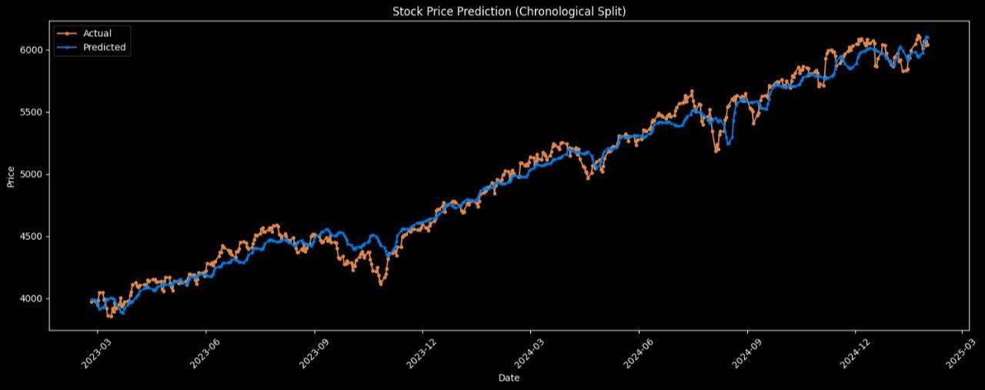
Chosen for its ability to capture sequential patterns and long-term dependencies in time-series data
LSTMs mitigate problematic effects of ML like gradient-vanishing issues
LSTM Model

Slide 7
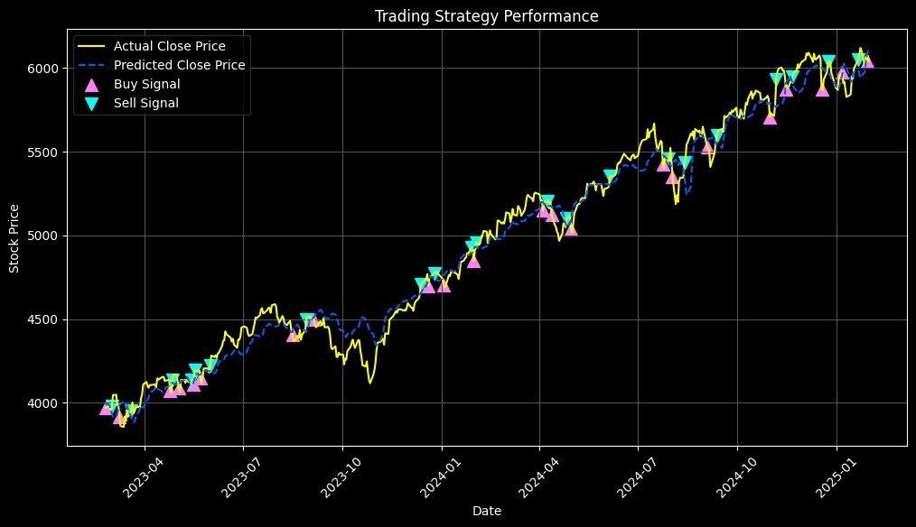
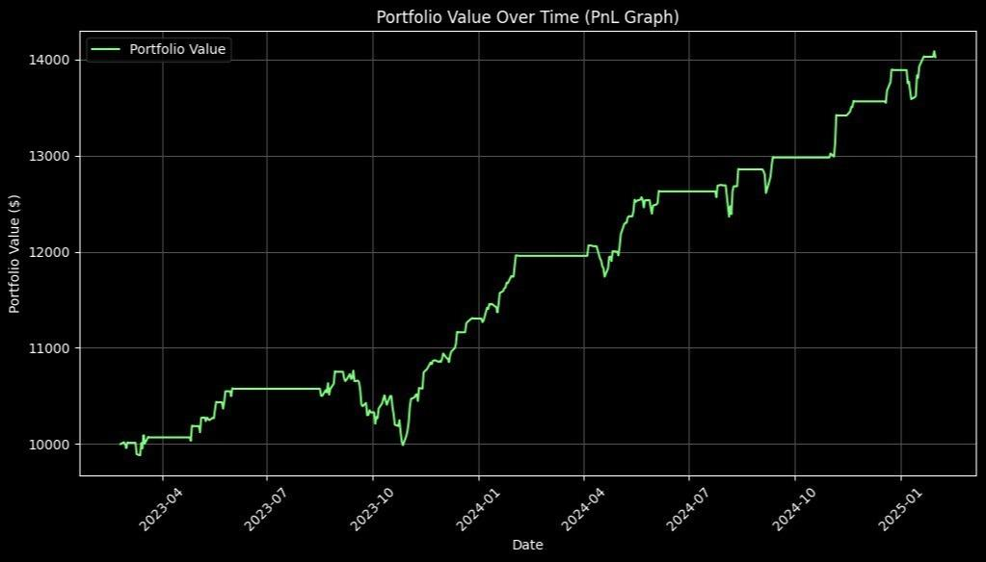
Evaluation of LSTM Model
Initial Capital: $10000
Final Portfolio Value: $14023.52
Profit/Loss: $4023.52
Sharpe Ratio: -0.6437
Max Drawdown: 120.84%
Sub-optimal performance compared to just buying and holding
Nevertheless, a step forward in the right direction

Slide 8
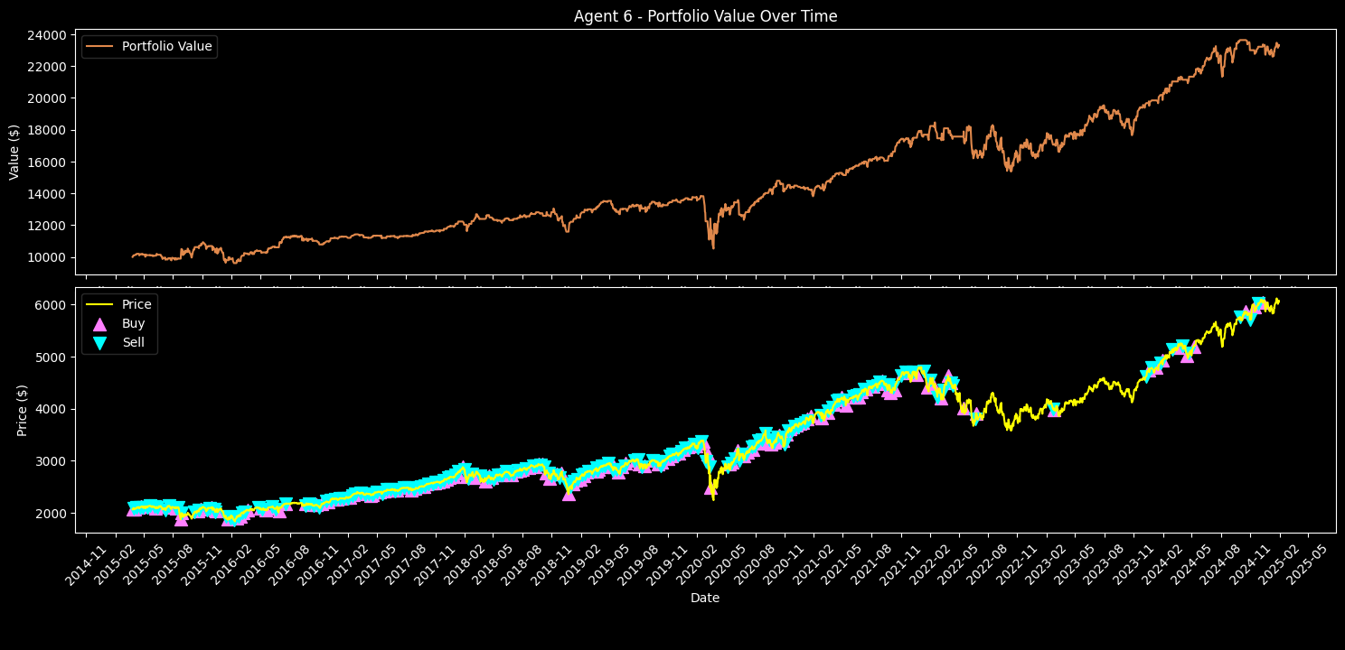
Deep Q-Network (DQN) Model
Selected for its reinforcement learning approach, enabling the agent to learn optimal strategies through interaction with the market environment
DQN allows the agent to adapt its decision-making model based on rewards and punishments, aligning with the goal of developing an adaptive trading strategy

Slide 9
Evaluation of DQN Model
The DQN agent achieved a total return of 161.14%, outperforming traditional buy-and-hold strategies.
With a Sharpe Ratio of 0.7025, the model demonstrated a favorable risk-adjusted return profile.
While promising, further validation across diverse market conditions is necessary to confirm the model's robustness and adaptability.
Total Return (%) | 133.12
Sharpe Ratio | 0.71
Max Drawdown (%) | 59.31
Final Portfolio Value (USD) | 23312.60

Slide 10
Comparison of Models
The DQN model outperformed the LSTM both arithmetically and across key financial metrics, including Sharpe Ratio and Max Drawdown.
With a significantly higher Sharpe Ratio, the DQN model demonstrated stronger risk-adjusted returns compared to the LSTM approach.
Improved risk management was evident, as the DQN model’s max drawdown was limited to 59.31%, far lower than the LSTM’s steep 120.84% decline.
Overall, the DQN model proved more effective by minimizing risk and making more strategic, data-driven trading decisions, ultimately maximizing profitability.

Slide 11
Potential future approaches
Given more time, we would have gone on to explore:
Explore even more hybridised deep learning models combining LSTM, Transformer, and reinforcement learning
Incorporate financial sentiment analysis using NLP (BERT) to augment input features (currently limited to using AlphaVantage’s market sentiment API)
Expand our financial dataset to include more diverse financial instruments and markets
Conduct more extensive backtesting and forward testing to validate adaptability and robustness

Slide 12
DLWeek
2025
March 2025
Thank you to all the judges, organisers, and sponsors!
Team Lean Large Men

