Slide 1
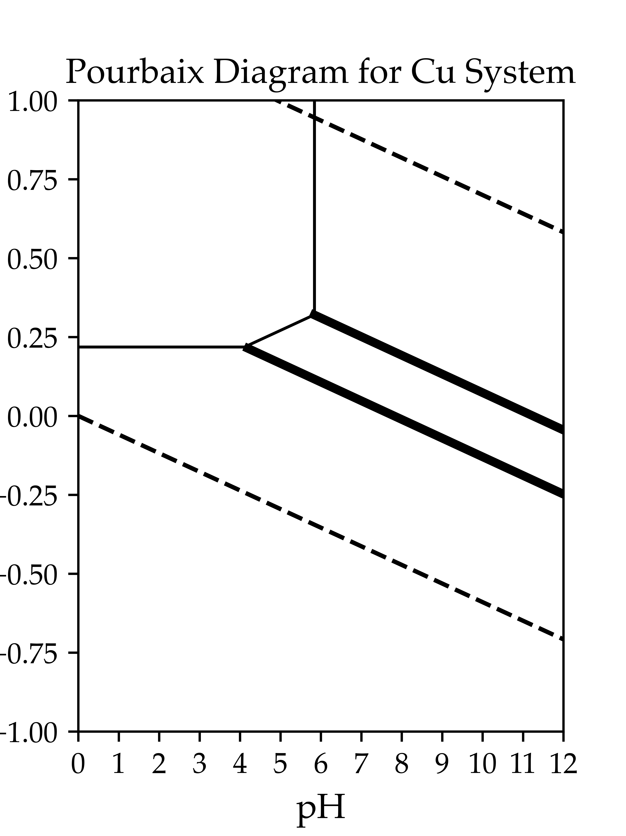
H_{2(g)}
(4)
(1)
Cu²⁺_{(aq)}
CuO_{(s)}
(7)
(3)
(6)
Cu₂O_{(s)}
H₂O_{(l)}
(5)
Cu_{(s)}
(2)
O_{2(g)}

Slide 2
Cathode
Anode
+
-
20e⁻
20e⁻
20Fe³⁺+20e⁻ → 20Fe²⁺
20Fe²⁺→20Fe³⁺+20e⁻
7Fe²⁺
Migration
13Fe²⁺
7Fe³⁺
20Fe²⁺
Diffusion
7Fe²⁺
20Fe³⁺

