Slide 1


WhereSIOUS - San Diego
Where Should I Open Up Shop?
Jeffrey Silverman, Insight DS Fellow
with Maksim Pecherskiy, San Diego CDO
for the City of San Diego, CA

Slide 2
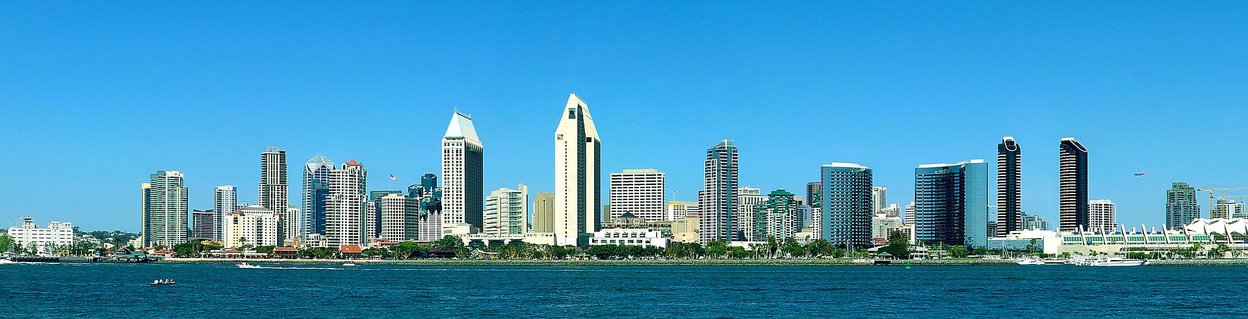
Where Should I Open Up Shop?
Notes:
The City of San Diego wants to use DATA to improve things.
They want to help businesses open in locations where they will be most successful.
Lots of factors related to the location of a business influence how successful it will be...but we have lots of data!

Slide 3
Where Should I Open Up Shop?
We want to predict how successful a business will be in a given location
Notes:
The City of San Diego wants to use DATA to improve things.
They want to help businesses open in locations where they will be most successful.
Lots of factors related to the location of a business influence how successful it will be...but we have lots of data!

Slide 4
Where Should I Open Up Shop?
We want to predict how successful a business will be in a given location
We want to predict the best place for a business to open
Notes:
The City of San Diego wants to use DATA to improve things.
They want to help businesses open in locations where they will be most successful.
Lots of factors related to the location of a business influence how successful it will be...but we have lots of data!

Slide 5
Things that could affect the success of a business at a given location (i.e., features)
Notes:
Is the location zoned for the given business?
How many people walk or bike by the location?
How much parking is near the location?
How many residents (i.e., potential customers) live nearby?
What are the demographics of the neighborhood?
Are there already similar businesses nearby (i.e., competition)?

Slide 6
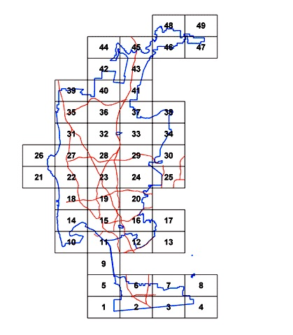
Things that could affect the success of a business at a given location (i.e., features)
Notes:
Is the location zoned for the given business?
How many people walk or bike by the location?
How much parking is near the location?
How many residents (i.e., potential customers) live nearby?
What are the demographics of the neighborhood?
Are there already similar businesses nearby (i.e., competition)?

Slide 7


Things that could affect the success of a business at a given location (i.e., features)
Notes:
Is the location zoned for the given business?
How many people walk or bike by the location?
How much parking is near the location?
How many residents (i.e., potential customers) live nearby?
What are the demographics of the neighborhood?
Are there already similar businesses nearby (i.e., competition)?

Slide 8

Things that could affect the success of a business at a given location (i.e., features)
Notes:
Is the location zoned for the given business?
How many people walk or bike by the location?
How much parking is near the location?
How many residents (i.e., potential customers) live nearby?
What are the demographics of the neighborhood?
Are there already similar businesses nearby (i.e., competition)?

Slide 9

Things that could affect the success of a business at a given location (i.e., features)
Notes:
Is the location zoned for the given business?
How many people walk or bike by the location?
How much parking is near the location?
How many residents (i.e., potential customers) live nearby?
What are the demographics of the neighborhood?
Are there already similar businesses nearby (i.e., competition)?

Slide 10

Things that could affect the success of a business at a given location (i.e., features)
Notes:
Is the location zoned for the given business?
How many people walk or bike by the location?
How much parking is near the location?
How many residents (i.e., potential customers) live nearby?
What are the demographics of the neighborhood?
Are there already similar businesses nearby (i.e., competition)?

Slide 11
Measures of success of a business at a given location (i.e., labels)
Profits (per employee?)
Change in profits over time
Change in # of employees over time
Yelp reviews
Other?
Notes:
I want to try to label my dataset like this so that I can use a subset of the already existing businesses as my validation set.

Slide 12
Measures of success of a business at a given location (i.e., labels)
Profits (per employee?)
Change in profits over time
Change in # of employees over time
Yelp reviews
Other?
How well have similar businesses in a similar location performed?
Notes:
I want to try to label my dataset like this so that I can use a subset of the already existing businesses as my validation set.

Slide 13
Data Sets
City treasurer’s business listings
Census data (population, median income, etc.)
Parking meter locations & transactions
Bike lanes
Walk score
Waze
City zoning & land use
Notes:
I have some public data already and will get private data too.
Most of the data is CSV files and shapefiles (GIS) for mapping.
(Maybe also Yelp to use as a measure of business success?)

Slide 14
Deliverables – Basic
A model that predicts a “success score/probability” for a given business location in San Diego

Slide 15
Deliverables – Basic
A model that predicts a “success score/probability” for a given business location in San Diego
A blog post with the City of San Diego describing the process and results

Slide 16
Deliverables – Basic
A model that predicts a “success score/probability” for a given business location in San Diego
A blog post with the City of San Diego describing the process and results
A simple web interface where you enter an address and it returns a “success score/probability”, e.g., here

Slide 17
Deliverables – Advanced (i.e., Stretch Goals)
Multiple success scores/probabilities for different categories (e.g., foot traffic, distance from competition, etc.)

Slide 18
Deliverables – Advanced (i.e., Stretch Goals)
Multiple success scores/probabilities for different categories (e.g., foot traffic, distance from competition, etc.)
Users can weight the importance of different categories

Slide 19
Deliverables – Advanced (i.e., Stretch Goals)
Multiple success scores/probabilities for different categories (e.g., foot traffic, distance from competition, etc.)
Users can weight the importance of different categories
Different types of businesses can give different scores

Slide 20
Deliverables – Advanced (i.e., Stretch Goals)
Multiple success scores/probabilities for different categories (e.g., foot traffic, distance from competition, etc.)
Users can weight the importance of different categories
Different types of businesses can give different scores
Given a type of business, calculate the best (or top 10?) locations

Slide 21
Deliverables – Advanced (i.e., Stretch Goals)
Multiple success scores/probabilities for different categories (e.g., foot traffic, distance from competition, etc.)
Users can weight the importance of different categories
Different types of businesses can give different scores
Given a type of business, calculate the best (or top 10?) locations
The web app allows all of the above possible variations

Slide 22
Possible Algorithms for the Model
Linear Regression
Something more complicated!?

Slide 23
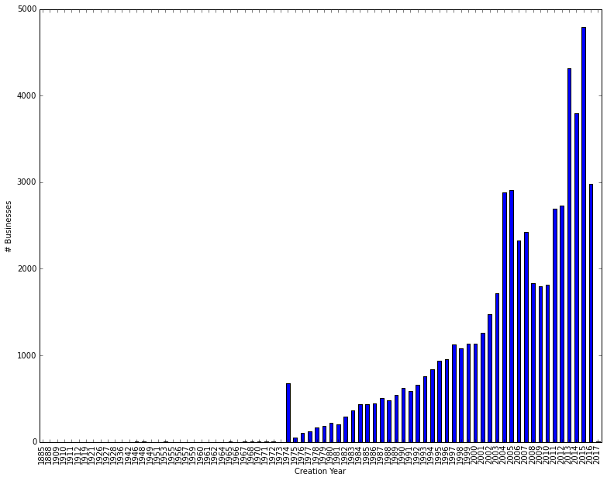
Business Info – Creation Date
Notes:
How long a business has been around *could* be an indicator of success, but I don’t want to penalize young business that are doing well.

Slide 24
Business Info – Creation Date
First Spiritualist Church of San Diego (1885)
Notes:
How long a business has been around *could* be an indicator of success, but I don’t want to penalize young business that are doing well.

Slide 25
Business Info – Creation Date
First Spiritualist Church of San Diego (1885)
SD City Treasurer
Starts Tracking Businesses
Notes:
How long a business has been around *could* be an indicator of success, but I don’t want to penalize young business that are doing well.

Slide 26
Business Info – NAICS (North American Industry Classification System)
Notes:
NAICS has a bunch of numeric codes to describe various industries, so hopefully I can use this to identify different business types and how they perform in different locations.
Each business has a single code, but they’re not super unique and very similar businesses have different codes!
<click>For example, Starbucks has 87 locations in SD with 18 different NAICS codes!
Their numbering system has the first two-digits as the most general category and then more digits refine the classification (i.e., 722, 7224, 722213).
I could just use the codes as-is, but it seems silly that we have 18 different “types” of Starbucks.
So one thing I tried was to just take the first two digits, which are the top-most level in the classification hierarchy.
This method turns this list into 4 different codes for all Starbucks, with 79% of them sharing the same code (72), 13% with a second code (44)

Slide 27
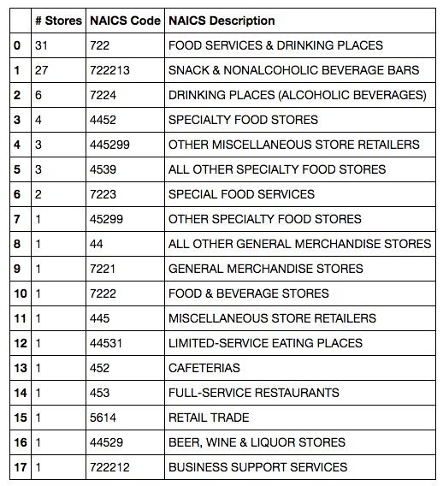

Business Info – NAICS (North American Industry Classification System)
Notes:
NAICS has a bunch of numeric codes to describe various industries, so hopefully I can use this to identify different business types and how they perform in different locations.
Each business has a single code, but they’re not super unique and very similar businesses have different codes!
<click>For example, Starbucks has 87 locations in SD with 18 different NAICS codes!
Their numbering system has the first two-digits as the most general category and then more digits refine the classification (i.e., 722, 7224, 722213).
I could just use the codes as-is, but it seems silly that we have 18 different “types” of Starbucks.
So one thing I tried was to just take the first two digits, which are the top-most level in the classification hierarchy.
This method turns this list into 4 different codes for all Starbucks, with 79% of them sharing the same code (72), 13% with a second code (44)

Slide 28
Business Info – NAICS (North American Industry Classification System)
4 “simple” codes
79% are Code 72
13% are Code 44
Notes:
NAICS has a bunch of numeric codes to describe various industries, so hopefully I can use this to identify different business types and how they perform in different locations.
Each business has a single code, but they’re not super unique and very similar businesses have different codes!
<click>For example, Starbucks has 87 locations in SD with 18 different NAICS codes!
Their numbering system has the first two-digits as the most general category and then more digits refine the classification (i.e., 722, 7224, 722213).
I could just use the codes as-is, but it seems silly that we have 18 different “types” of Starbucks.
So one thing I tried was to just take the first two digits, which are the top-most level in the classification hierarchy.
This method turns this list into 4 different codes for all Starbucks, with 79% of them sharing the same code (72), 13% with a second code (44)

Slide 29
The End... …for now

