Slide 1
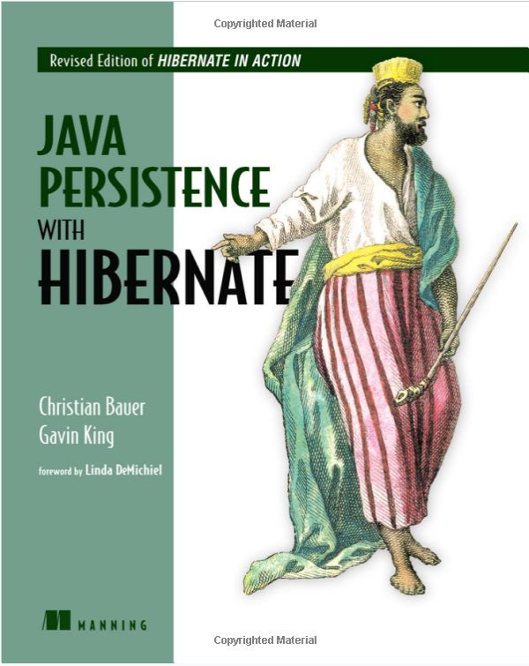

JPA and Hibernate
J. Slick
Computer Science Corp., General Dynamics Electric Boat
Jmslick@gmail.Com

Slide 2

JPA and Hibernate
Mid 90’s:
“Object/Relational Impedance Mismatch”

Slide 3
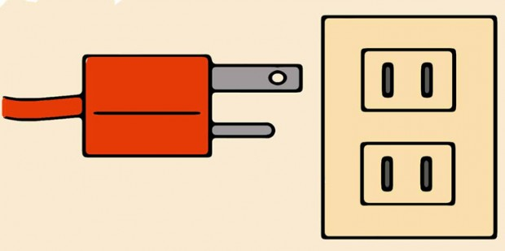
JPA and Hibernate
Impedance:
Restriction of flow between two systems

Slide 4

Relational model and Object model do not play well together

Slide 5
Object / Relational Impedance Mismatch
RELATIONAL | OBJECT
Data | Business Logic
Tables, Rows | Objects, Collections
Identity / Sameness: PK | Identity: a==b, a.equals(b)
Associate by FK | Associate by Reference
Navigate by join | Navigate object graph
No Inheritance | Inheritance, Polymorphism
JDBC Data Types | Java Types

Slide 6
Solution: Object / Relational Mapping
  Map business objects and associations to relational tables

Slide 7

ORM Benefits?
Productivity, fewer LOC
Reduce time and tedious JDBC code
Maintainability
Focus on OO business logic
Hide database architecture from user
Transparently persist objects to tables
Encourage OO queries
Support native SQL queries
Buffer changes between relational and object models
  Alterations
  Providers
  Data store

Slide 8
ORM
  Map business objects and associations to relational tables
    XML Metadata
    <class name=”com.jpahib.Customer” table=”Customer”>
    <property name=”username” type=string”/>
    . . .
    </class>
    Annotated POJOs
    @Entity
    @Table(name=“CUSTOMER”)
    public class Customer {
    @Column(name=”USERNAME”)
    private String username;
    . . .
    }

Slide 9
What is Java Persistence API?
Java spec for accessing, persisting Java objects to RDBMS
Prompted by EJB 1 & 2
Concepts from Hibernate, Oracle TopLink, JDO, EJB
Finalized in EJB 3.0 spec, J2EE 5, 2006
Just a specification, cannot perform persistence
J2EE app servers should implement
Can be used in Java EE and SE apps
Many JPA implementations:
Hibernate, EclipseLink, OpenJPA, BEA Koda…

Slide 10
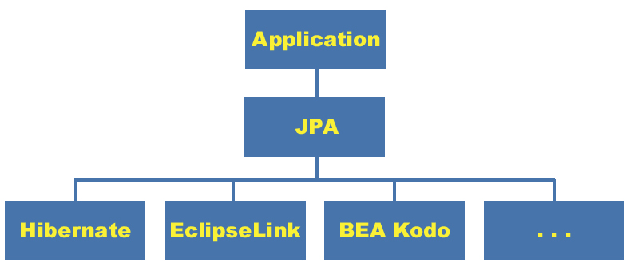
JPA Position
RDBMS

Slide 11
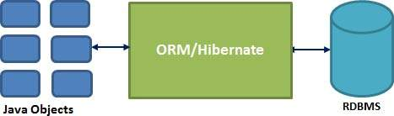
What is Hibernate?
Object/Relational Mapping tool to resolve Impedance Mismatch
Persistence provider implementing JPA specification

Slide 12

Hibernate Tools
Ant command line
Eclipse plug-in
Wizards
  Config files
  Map files
  Reverse Engineering
  Code generation
Editors: configs, queries
HQL Console
Query Editor
SQL Analyze
Visual Map Diagrams
Code Hints, Completion

Slide 13
Hibernate Integration
Top Down: generate POJO’s from map file or DB
*.hbm.xml (Metadata)
<class name=”com.jpahib.Customer” table=”Customer”>
<property name=”username” type=string”/>
. . .
</class>
RDBMS
hbm2java
@POJO
@POJO

Slide 14
Hibernate Integration
Bottom up: generate schema from map file or POJOs
RDBMS
hbm2ddl
*.hbm.xml (Metadata)
<class name=”com.jpahib.Customer” table=”Customer”>
<property name=”username” type=string”/>
. . .
</class>
@POJO
@POJO

Slide 15
JPA Integration: Persistence Unit
Specifies entity classes, queries, provider, connection
Identified by name
Injected by EE container or managed by SE application
<persistence>
<persistence-unit name=“pu1">
<provider>org.hibernate.ejb.HibernatePersistenceProvider</provider>
<mapping-file>META-INF/queries.xml</mapping-file>
<jar-file>packedEntity.jar</jar-file>
<class>com.jpahib.Customer</class>
<class>com.jpahib.Address</class>
<properties>
<property name=“javax.persistence.jdbc.driver” value=“oracle.jdbc.driver.OracleDriver”/>
<property name="javax.persistence.jdbc.user" value="admin"/>
<property name="javax.persistence.jdbc.password" value="admin"/>
<property name=“hibernate.dialect" value=“Oracle10gDialect"/>
</properties>
</persistence-unit>
</persistence>

Slide 16
JPA Integration: Entity Manager
Container Managed (EE)
Persistence context propagated to application components
@PersistenceContext
EntityManager em;
em.find(), em.persist(T), em.remove(T), etc…
Application Managed (SE)
Persistence context from javax.persistence.Persistence
EntityManagerFactory emf = Persistence.createEntityManagerFactory(“pu1”);
EntityManager em = emf.createEntityManager();
em.find(), em.persist(T), em.remove(T), etc…

Slide 17
CRUD

Slide 18
Insert
SQL / JDBC
String sql = "INSERT INTO CUSTOMER (USER_ID, USERNAME, ADDRESS) "
+ "VALUES(1, 'Joe Sixpack', '123 North St.')";
statement = dbConnection.createStatement();
statement.execute (sql);
JPA
Customer c = new Customer(1, “Joe Sixpack”, “123 North St.”);
entityManager.persist(c);

Slide 19
Read
SQL / JDBC
PreparedStatement ps = con.prepareStatement("select customer_id, name, address, from customer");
ResultSet result = ps.executeQuery();
while(result.next()) {
Customer cust = new Customer();
cust.setCustomerID(result.getLong("customer_id"));
cust.setName(result.getString("name"));
cust.setAddress(result.getString("address"));
list.add(cust);
}
return list;
JPA
TypedQuery<Customer> q =
entityManager.createTypedQuery(“select * from customer”, Customer.class);
return q.getResultList();

Slide 20
Update
SQL / JDBC
String sql = "UPDATE CUSTOMER “
+ “SET USERNAME = ‘Ginger Vitys’, ADDRESS = ‘321 South St.’ “
+ “WHERE USER_ID = 1”;
statement = dbConnection.createStatement();
statement.execute (sql);
JPA / Hibernate
Customer c = entityManager.find(Customer.class, 1);
c.setName(“Ginger Vitys”);
c.setAddress(“123 North South St.”);
entityManager.merge(c);

Slide 21
Delete
SQL / JDBC
String sql = "DELETE FROM CUSTOMER WHERE USER_ID = 1”;
statement = dbConnection.createStatement();
statement.execute (sql);
JPA / Hibernate
Customer c = entityManager.find(Customer.class, 1);
entityManager.remove(c);

Slide 22
Short Case Study

Slide 23
Case Study
Port legacy FoxPro data to Oracle, optimize, export to JavaDB
Write new Java web app
Eight seasoned remote dev’s no JPA/Hibernate experience
Single code base
  217 Classes
  153 Entities
  107 Pages
  96 Named queries
Run application on shore (Oracle) and at sea (JavaDB)
  Oracle and JavaDB dialect differences
Reduced functionality at sea, read-only DB, fewer pages
Change persistence unit with single word: “shore” or “boat”

Slide 24
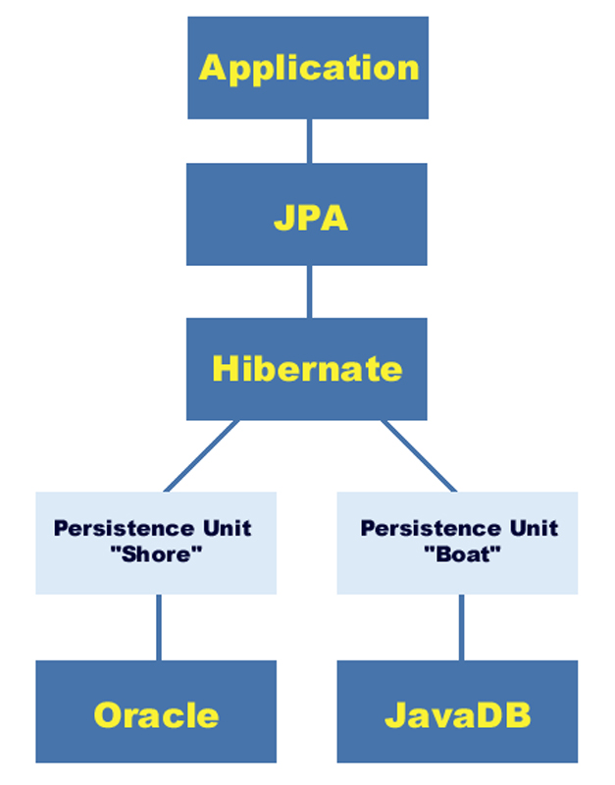
Case Study

Slide 25


