Slide 1
AI-Powered Health Monitoring System
Developed by James Mukoma Mburu
—2025

Slide 2
Project Objective
To provide a visual, real-time AI-based health monitoring system for tracking Heart Rate, SpO2, and Temperature.

Slide 3
Methodology
Data sourced from synthetic records.
Streamlit was used to build an interactive dashboard.
Visualization tools (e.g., line charts) were used to detect anomalies.

Slide 4
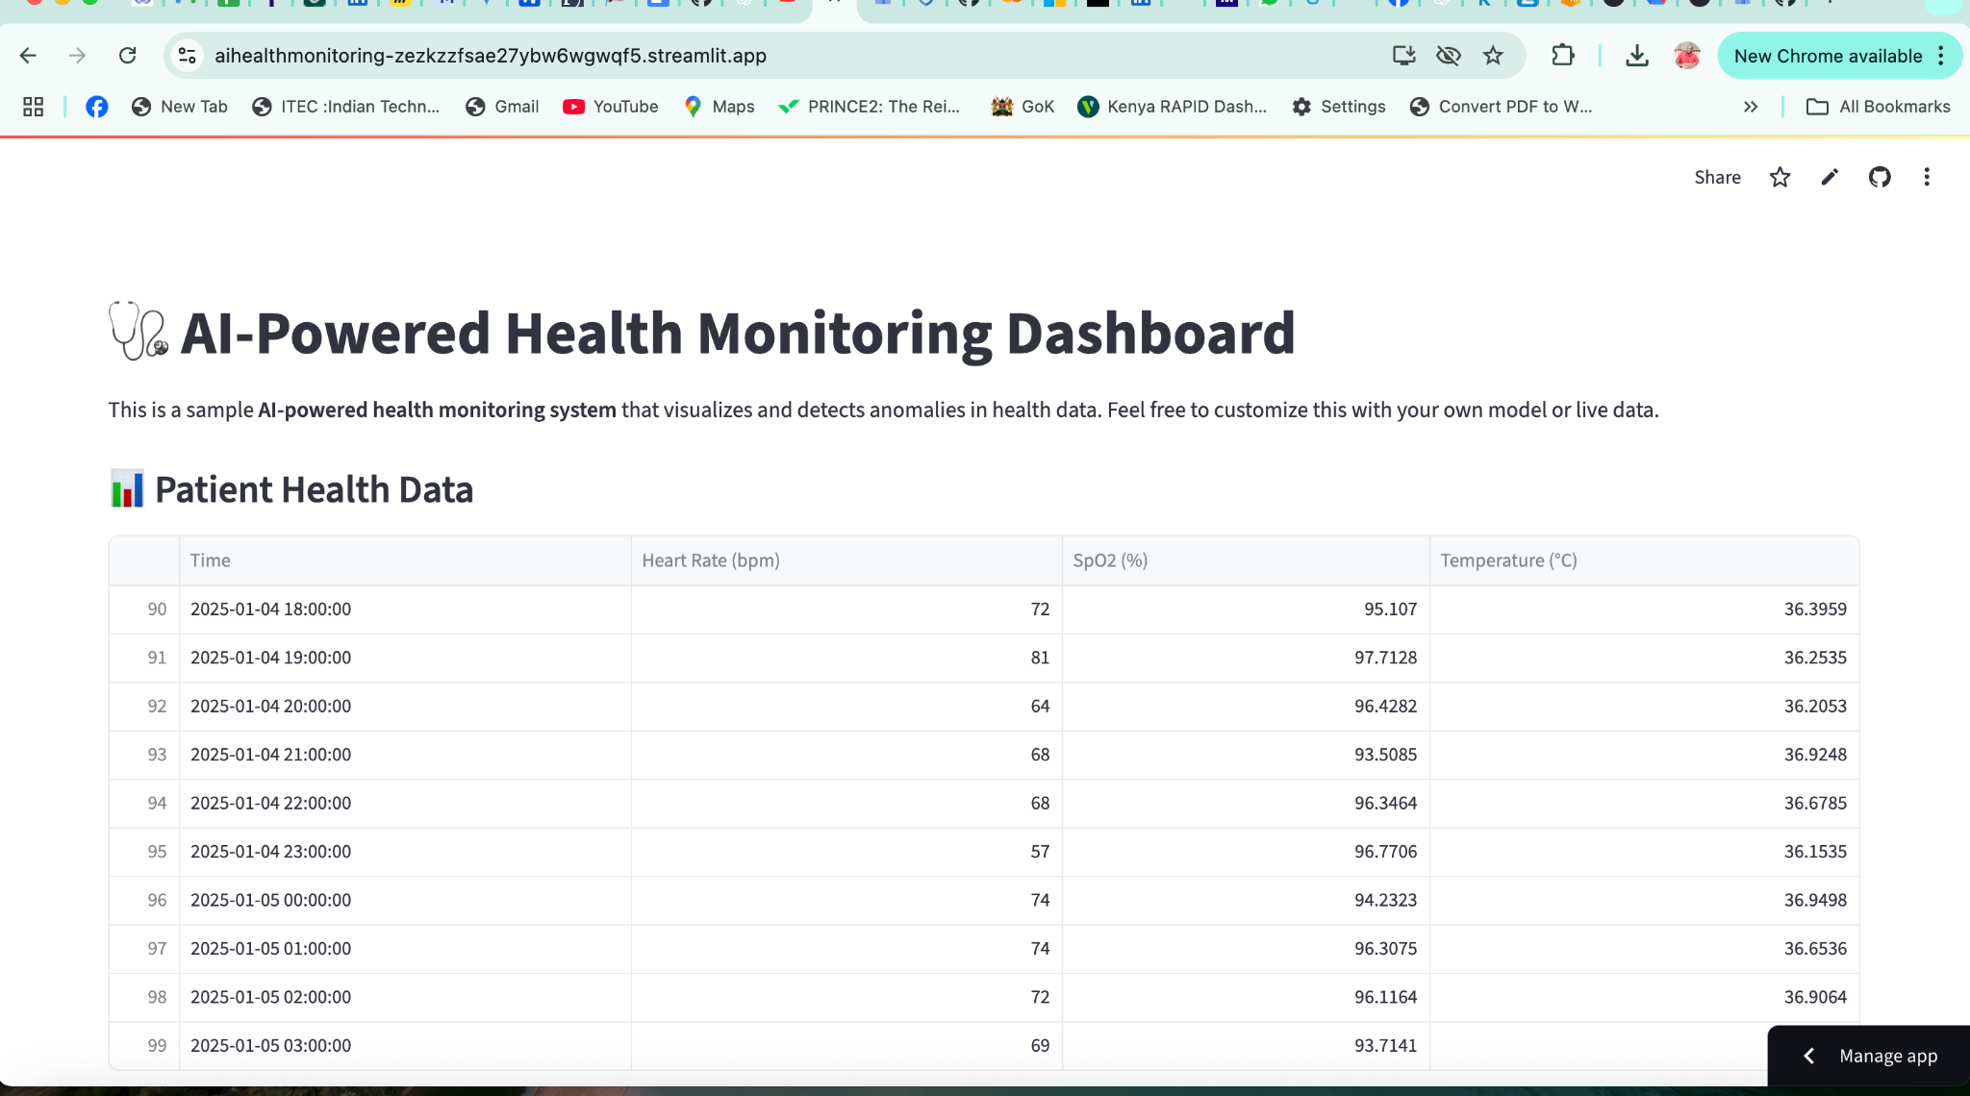
System Screenshot 1
Below is a snapshot of the health dashboard interface.

Slide 5
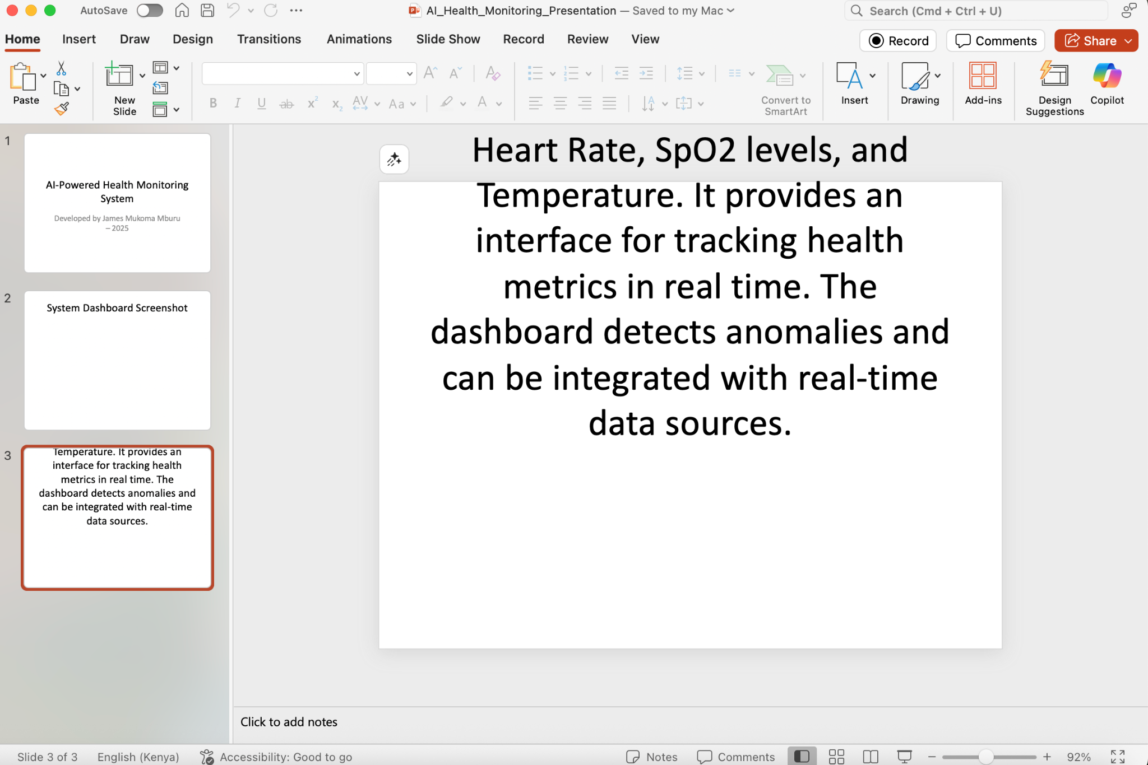
System Screenshot 2
System running on Streamlit Cloud.

Slide 6
Technologies Used
- Python 3.13
- Streamlit
- Pandas
- GitHub
- Streamlit Cloud
- VS Code

Slide 7
Conclusion
An easy-to-deploy, real-time AI system with strong visualizations and public accessibility — suitable for telehealth integration.

