Slide 1
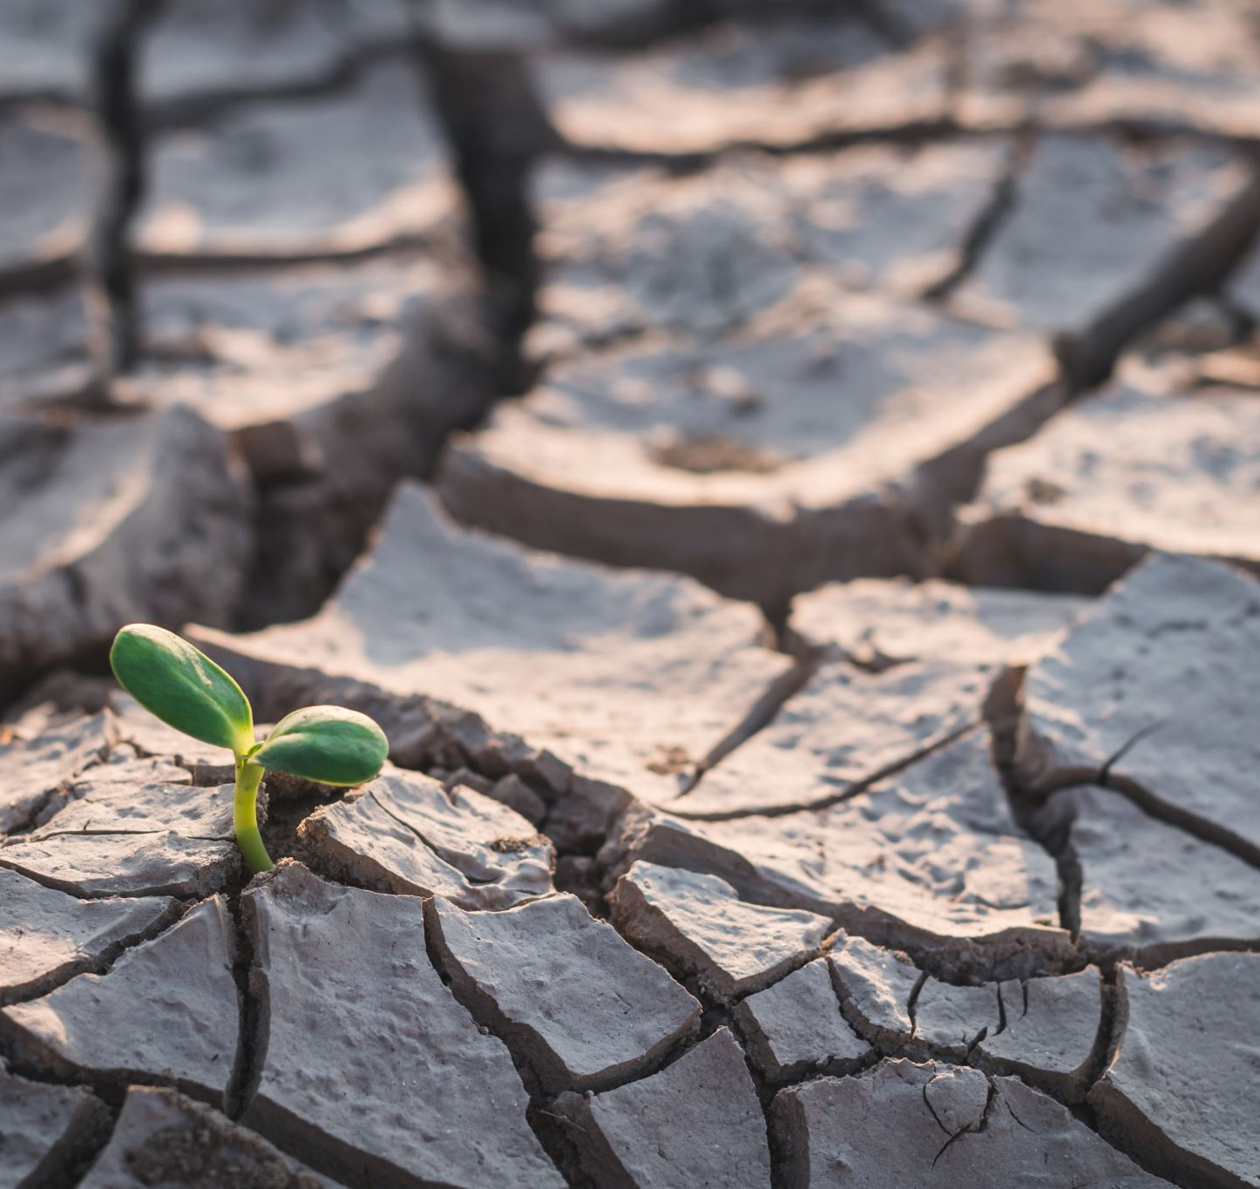
Soil Nutrient Gap Prediction for SDG 2 – Zero Hunger
Using AI to predict N, P, K fertilizer needs across Africa

Slide 2
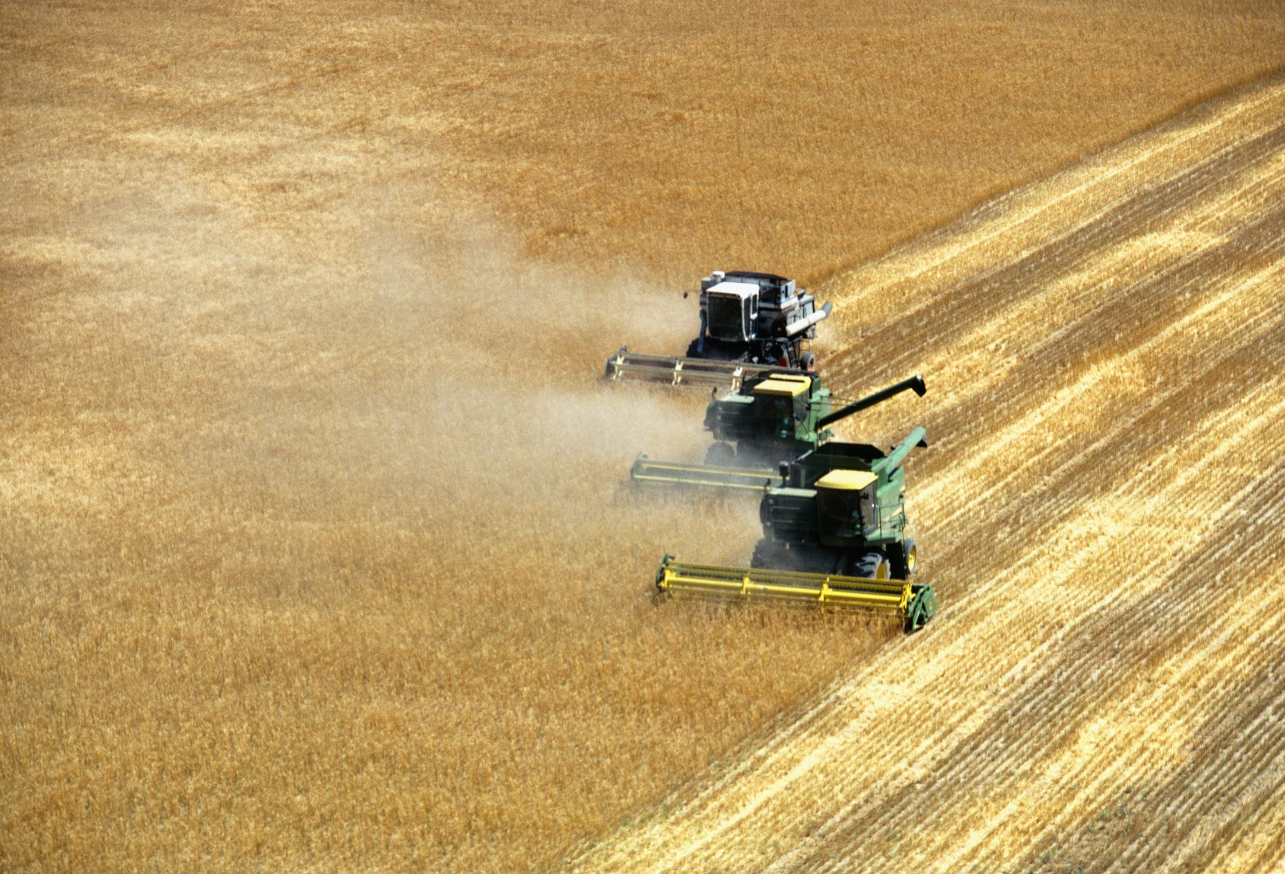
🚨 The Problem
- Overuse or underuse of fertilizer
- Reduced crop yields
- Lack of data-driven farming in Africa
- Smallholder farmers face high input costs

Slide 3
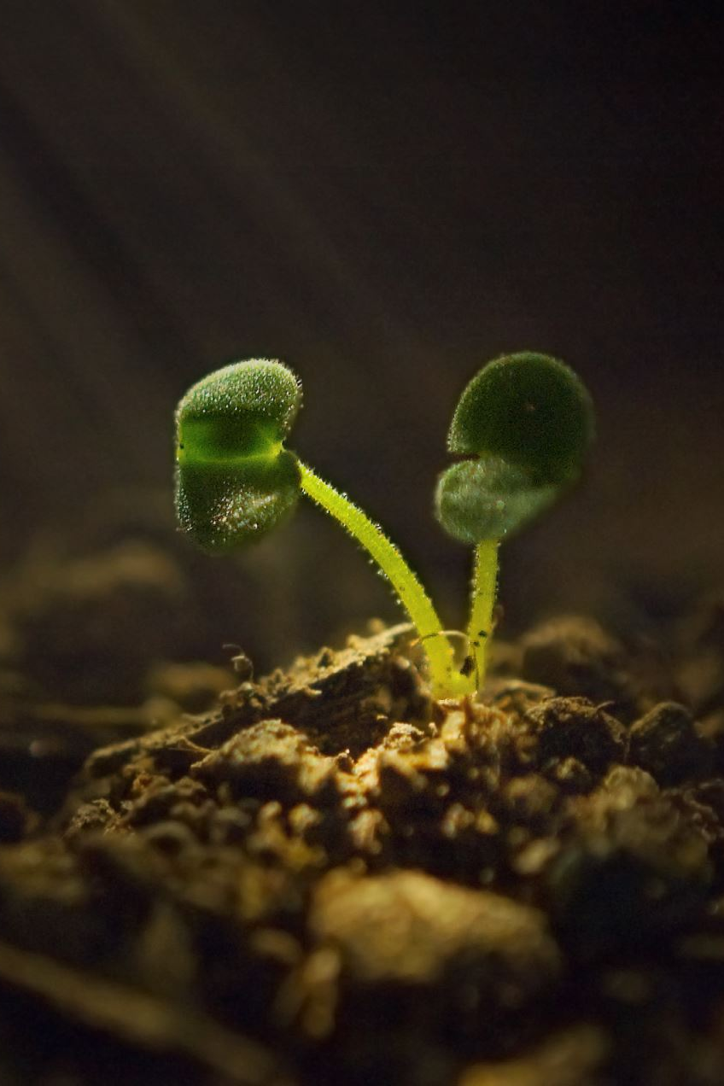
🤖 The AI Solution
Using a supervised machine learning model (Random Forest Regressor),
we predict the amount of Nitrogen (N), Phosphorus (P), and Potassium (K)
needed to close the yield gap on farms.
Trained on soil, crop, and environmental data.

Slide 4
📊 Results & Accuracy
Model achieved a Mean Absolute Error (MAE) of 47.80.
Visuals show strong correlation between predicted and actual nutrient needs.
Helps farmers apply just the right amount of fertilizer.

Slide 5
🌍 Future Steps
- Deploy as mobile/USSD tool
1
- Collaborate with agricultural extension workers
2
- Scale to all of Sub-Saharan Africa
3
- Reduce hunger and environmental harm
4

