Slide 1
Conclusion:
Quasi-perpendicular
As plasma crosses shock
Inertial slope flattens
Ion slope unchanged
e⁻ slope steepens
Ion & e slopes steeper than -5/3
Ion & e slopes equivalent in STR
Correlation length? I don’t think it’s very clear what’s happening with these specific events
Kurtosis? Again fairly unclear
High kurtosis constrained to smaller scales in SW
Spreads out in STR, max lower but distribution broader
Quasi-parallel
As plasma crosses shock
Inertial slope increases (more +ve)
Ion slope steepens
e⁻ slope steepens
Inertial slope -5/3 in SW, gets shallower
Ion slope -5/3 in SW, gets steeper
E slope -2 in SW, covers -2 -> -5 in STR
Correlation length? Unclear. Maybe decreases approaching foreshock and then does other stuff?
Kurtosis? Again fairly unclear
Max kurtosis higher in SW
Distribution broader w/ lower max in STR

Slide 2
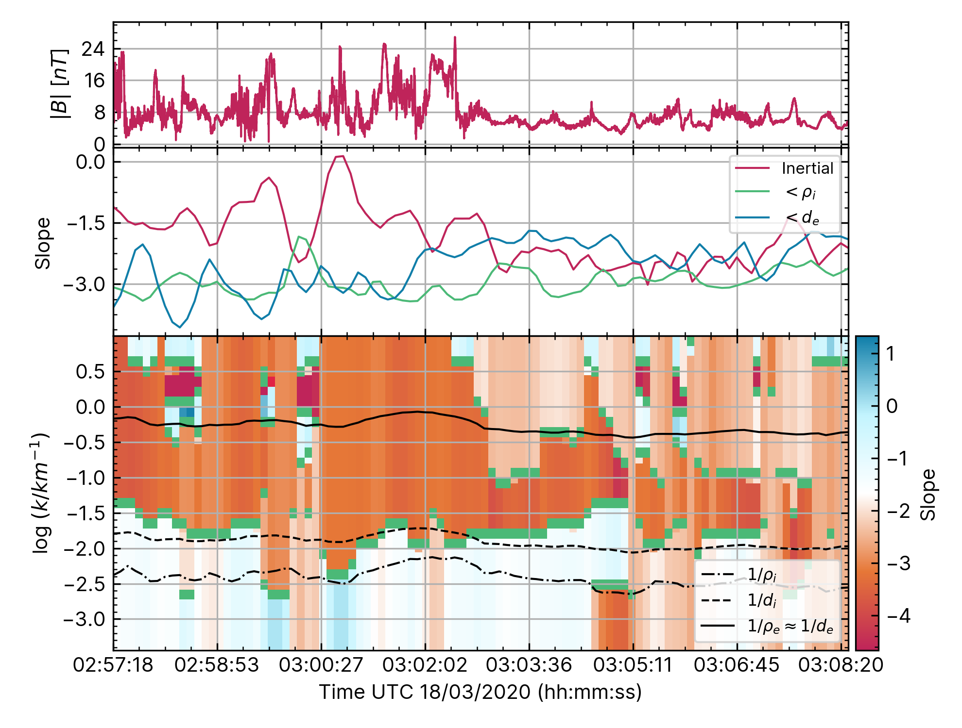
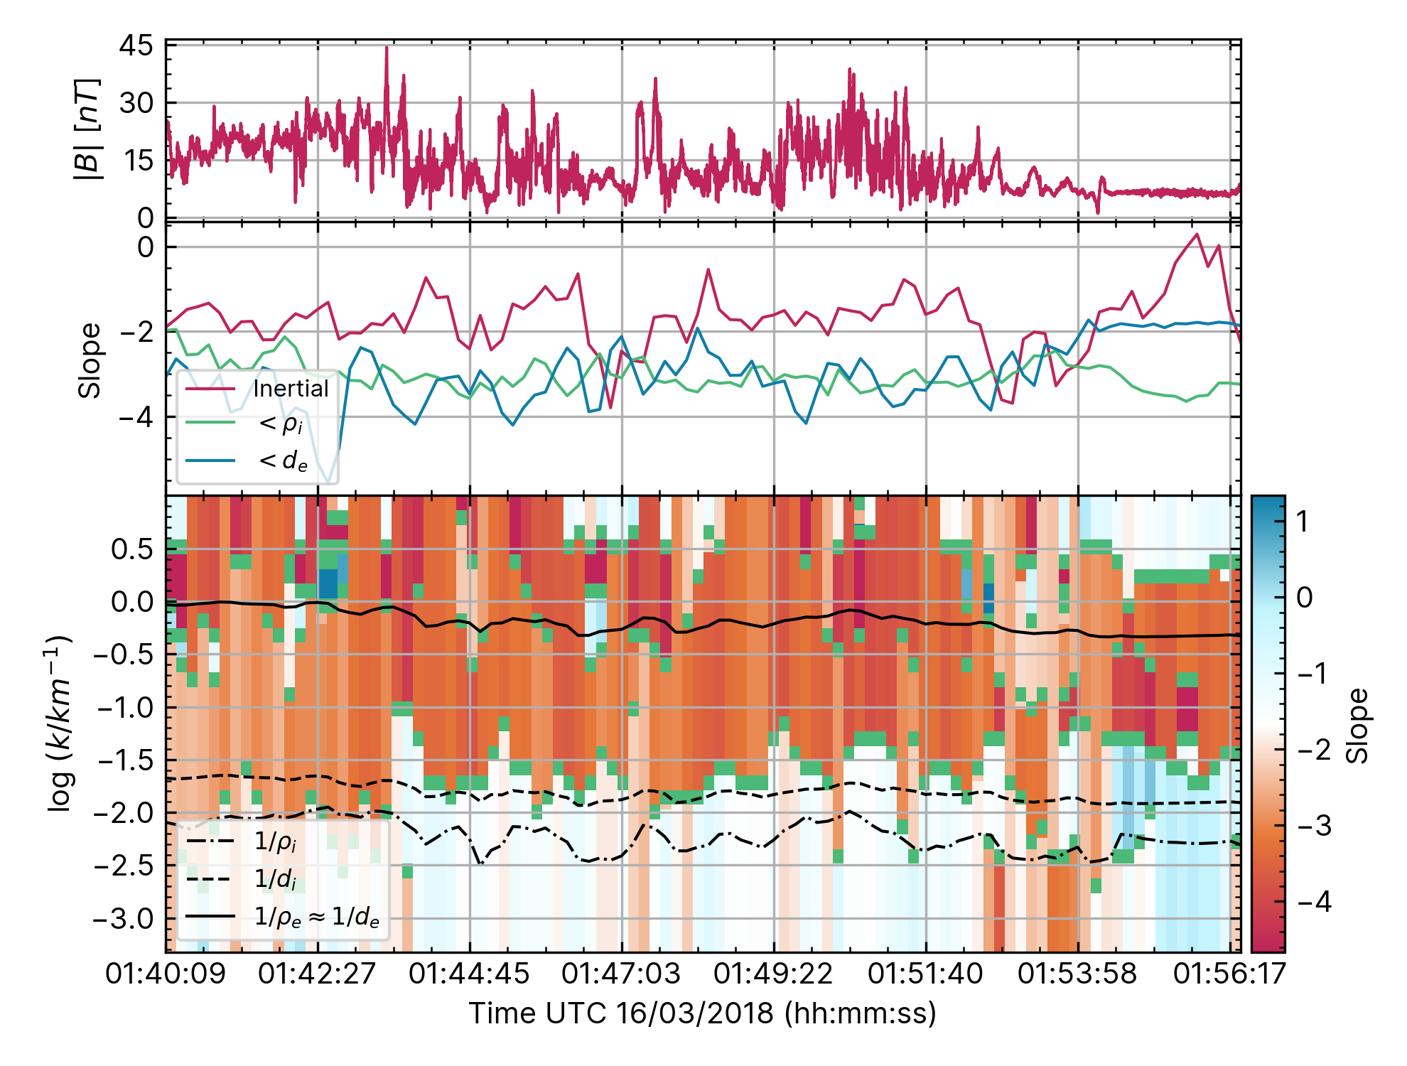
Both quasi-perp
Similar features:
Inert. Slope consistently shallowest slope
e slope steepens across shock to overlap (ish) with ion
Inert->ion spectral break occurring @ scale < d_i & rho_i
Different features:
Dip in inert. Slope In foreshock. All slopes same
e and ion slopes different more often. Might still average out to same though?
Inert. Slope not -5/3 as much

Slide 3
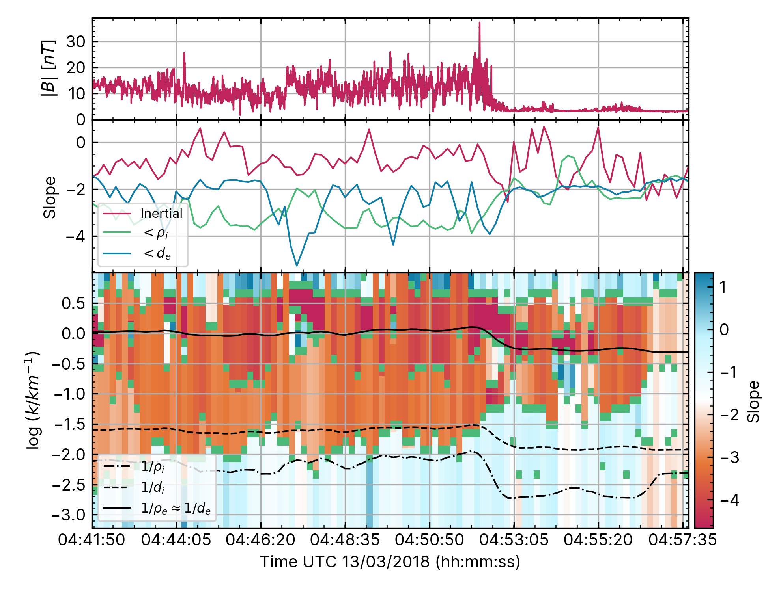
Quasi-perp vs. quasi-para
Similar features:
e scale waves present in both?
Ion & electron slopes look to be similar on average. Inert. Slope shallower in quas-para
Different features:
Significant change in inertial length & gyroradius for ions and electrons
Inert->ion spectral break occurring between d_i & rho_i in STR
Both ion & electron slopes steeper across shock.
Increase in inert. Slope to > -5/3

Slide 4
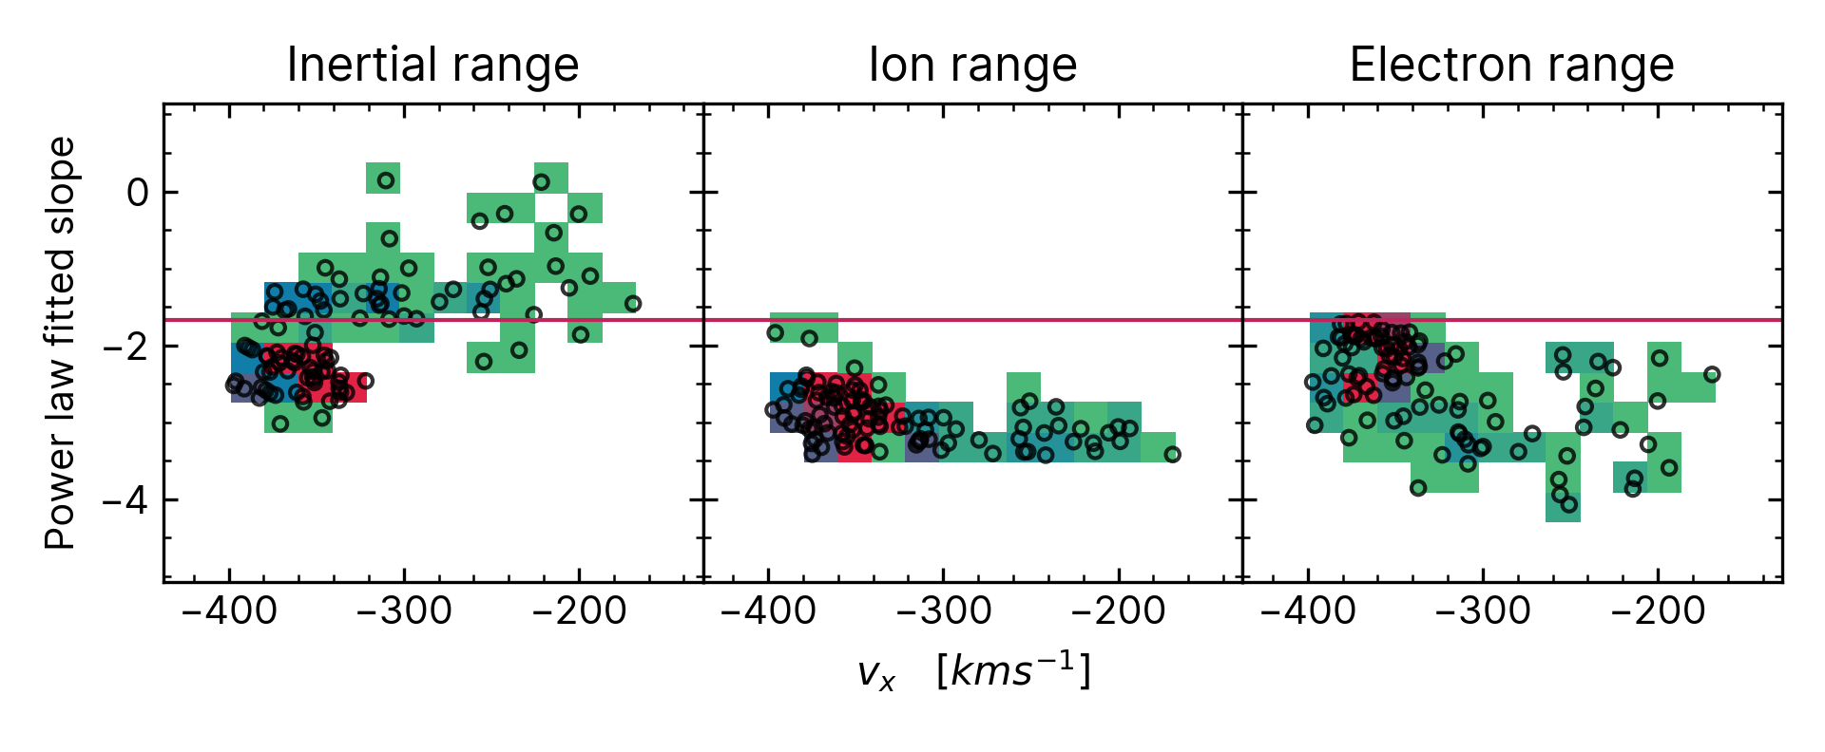
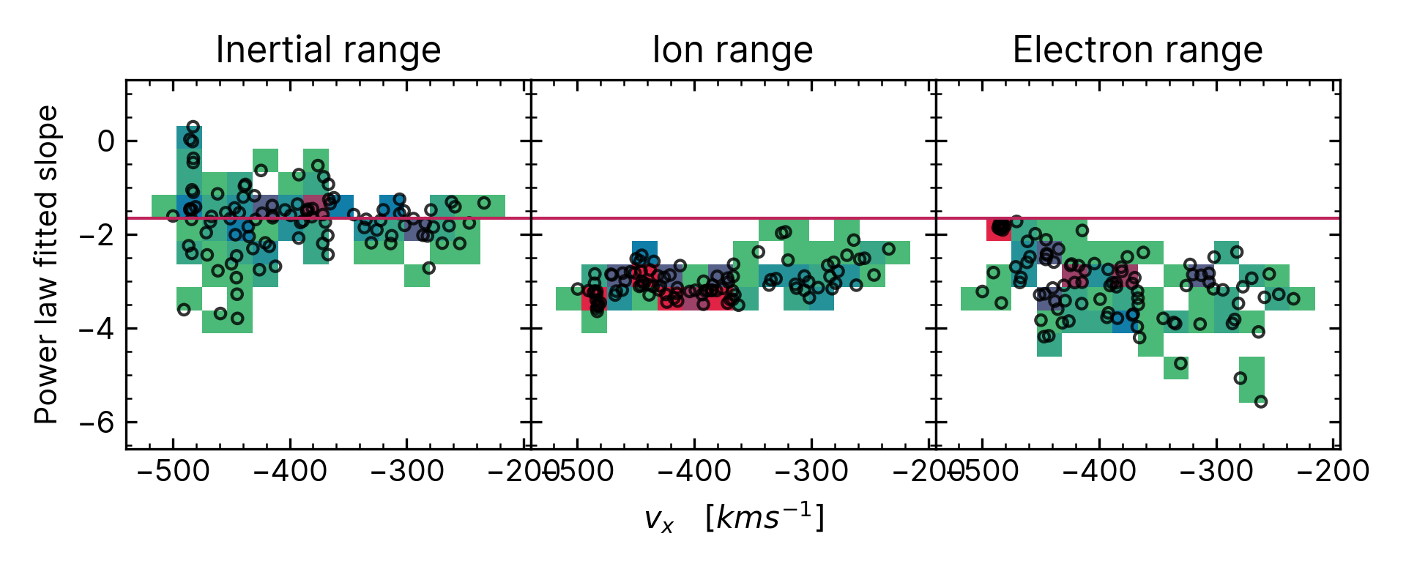
Both quasi-para

Slide 5
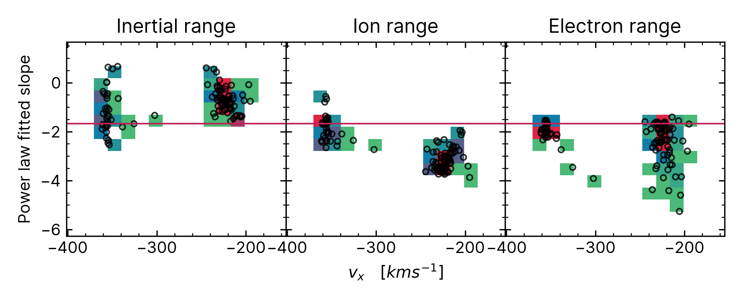
Quasi-para
Quasi-Perp

Slide 6
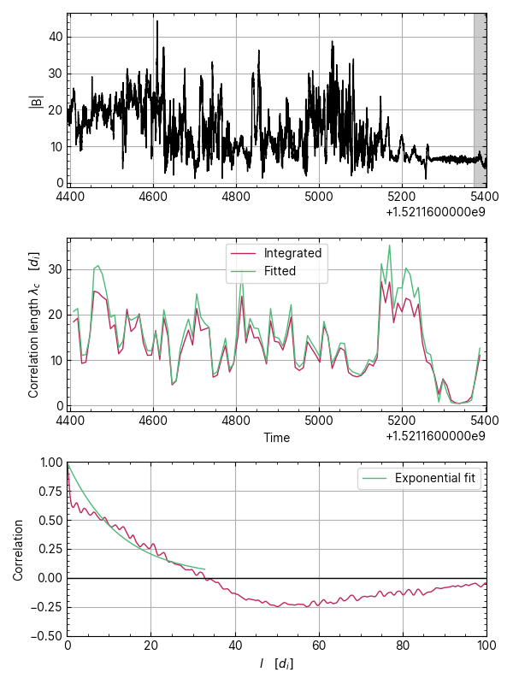
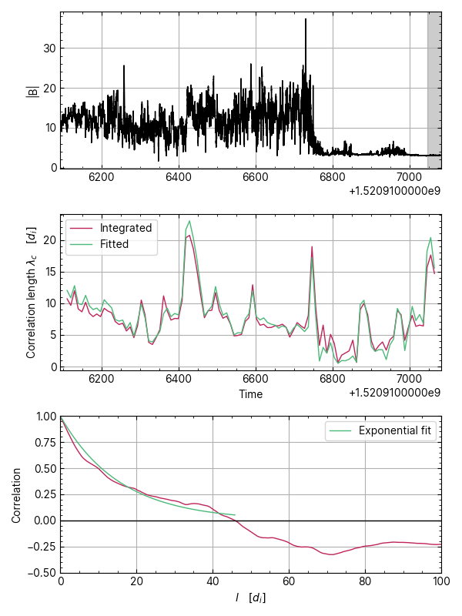

Slide 7
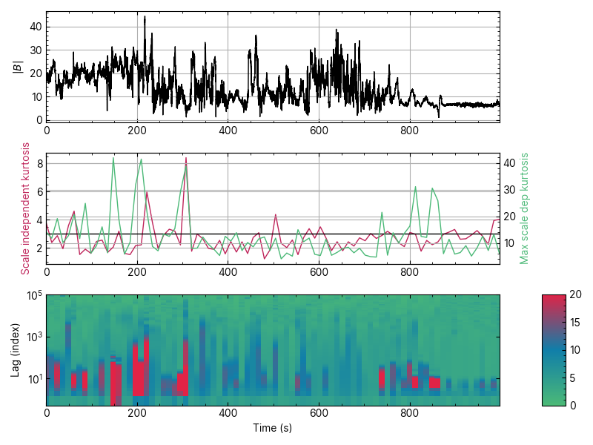
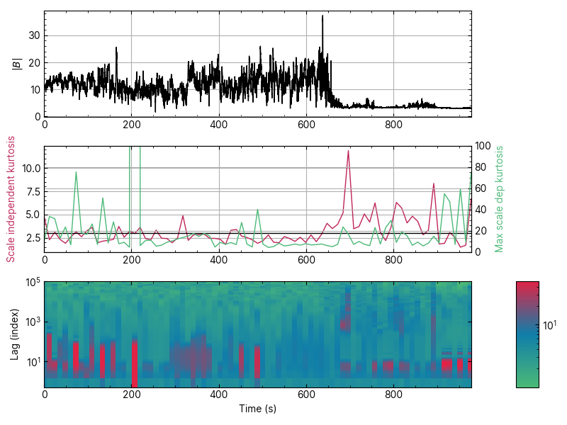
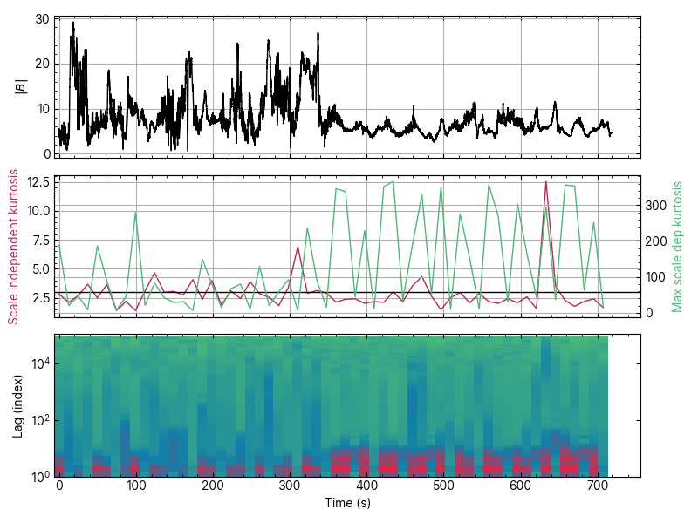

Slide 8
