Slide 1
Input accuracy
text1
text2
Average score
Basic information
Paper test test time for each
image3
image4
Average score
image5
image6
Visualization Model
text1
text2
Average score
Control data collected from GUI
Ipad test time for each
image3
image4
Average score
image5
image6
Facial data
Motion data
Solar data
Total time
Average by minute
Average by minute

Slide 2
Trends update
Text test and preference
More subjects preferred paper.
According to the newly collected data, the text test performance
becomes closer when the weather is cloudy.

Slide 3
Trends update
Image test
Image test may be differed by individual abilities. And the difference between paper and ipad is more obvious.

Slide 4
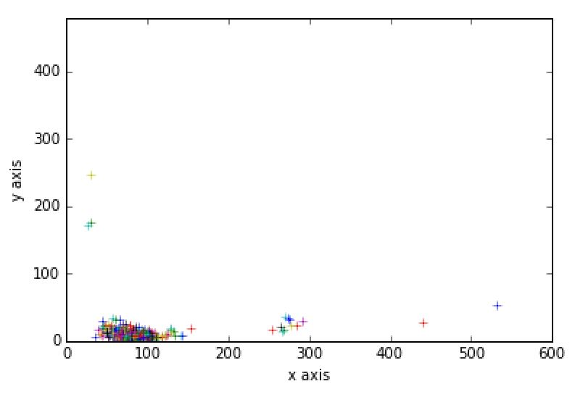
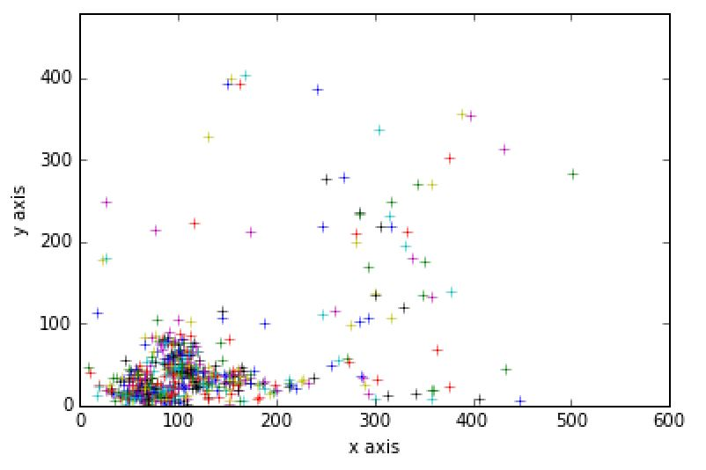
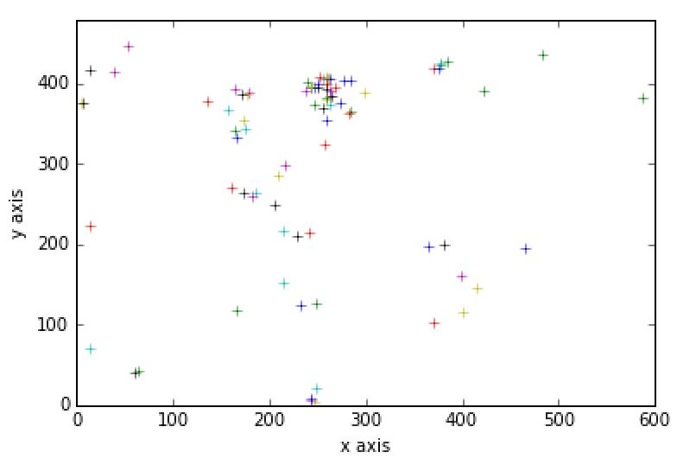
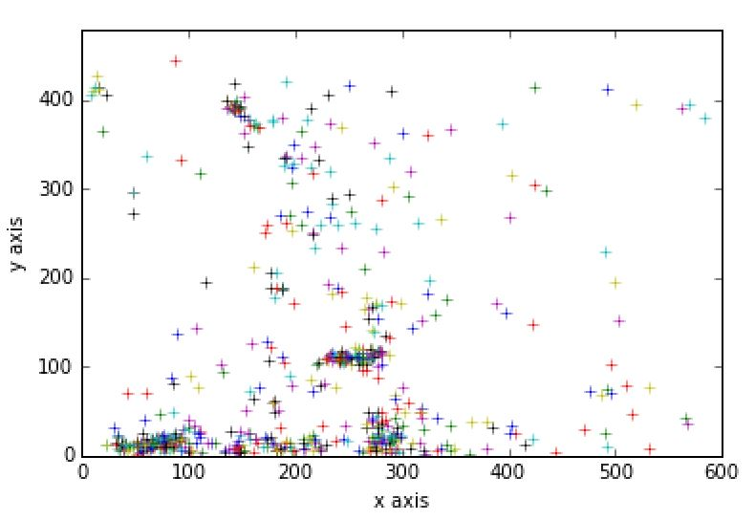
Trends update
Face position: case 8 analysis
case8 _0517 gender/m glass/n
Ipad text
Ipad image
Paper text
Paper image
Solar Rad, W/m^2
(0517 data missing, waiting for Jay’s reply)

Slide 5
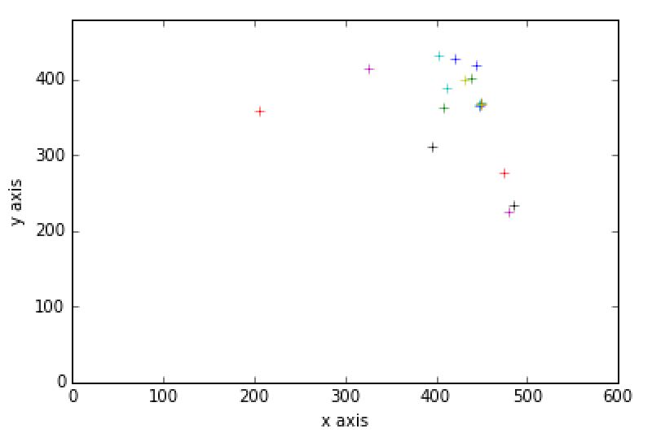
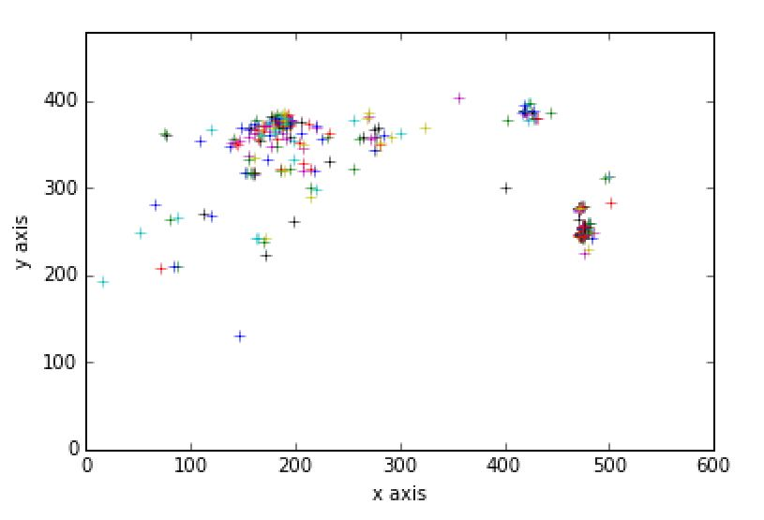
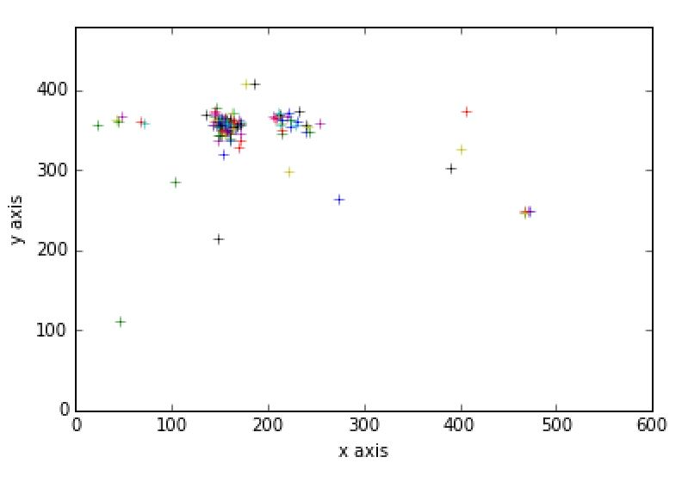
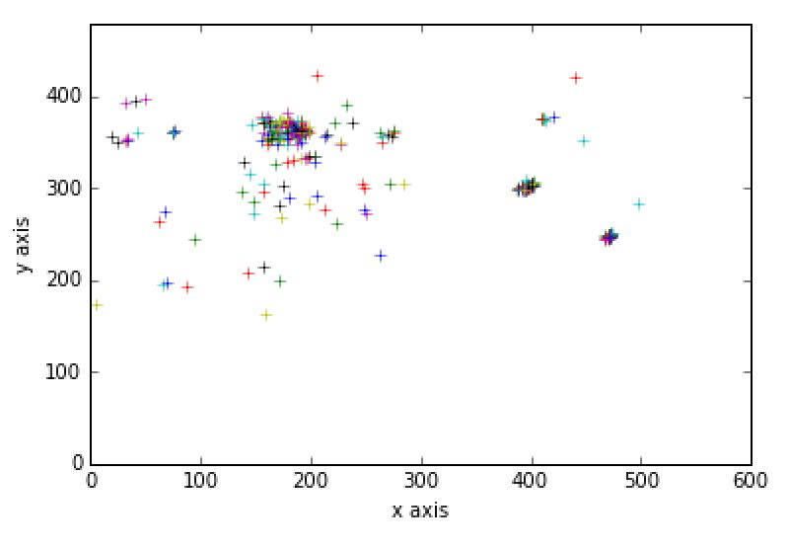
Trends update
Face position: case 9 analysis
case9 _0525 gender/f glass/y
Ipad text
Ipad image
Paper text
Paper image
Solar Rad, W/m^2

Slide 6
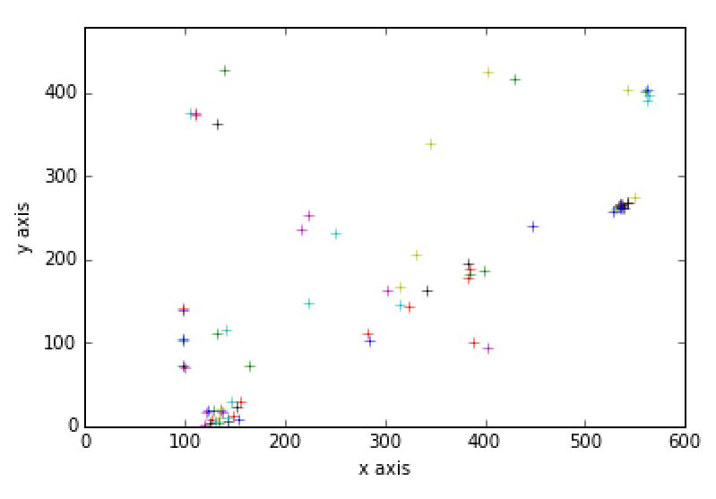
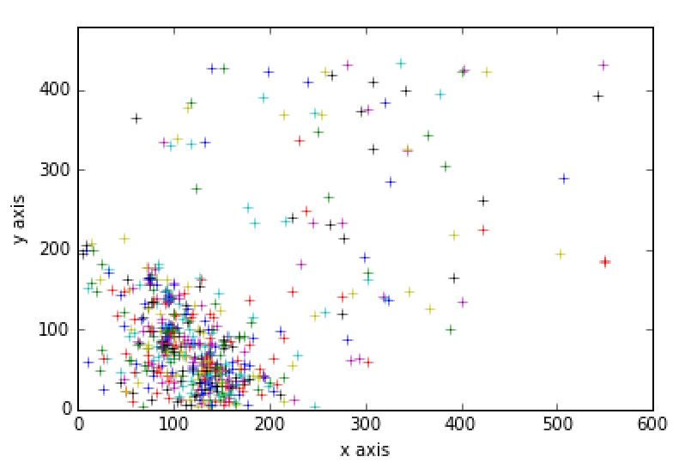
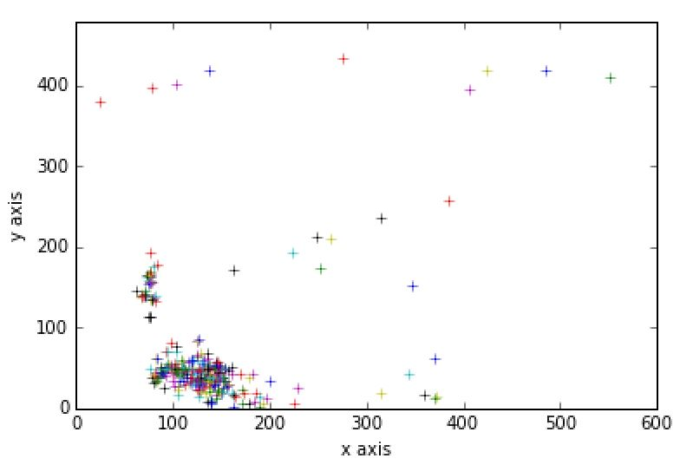
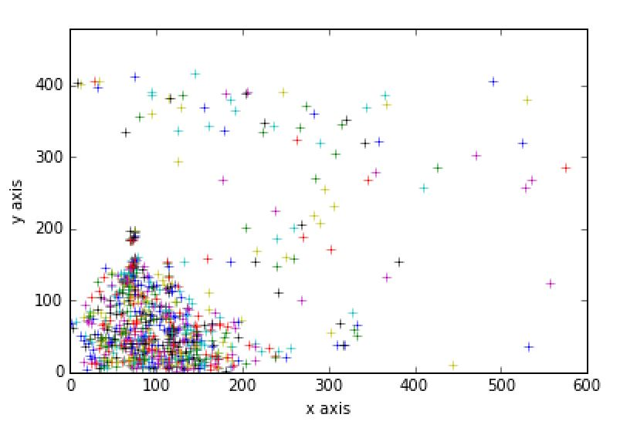
Trends update
Face position: case 11 analysis
case11 _0526 gender/m glass/y
Ipad text
Ipad image
Paper text
Paper image
Solar Rad, W/m^2

Slide 7
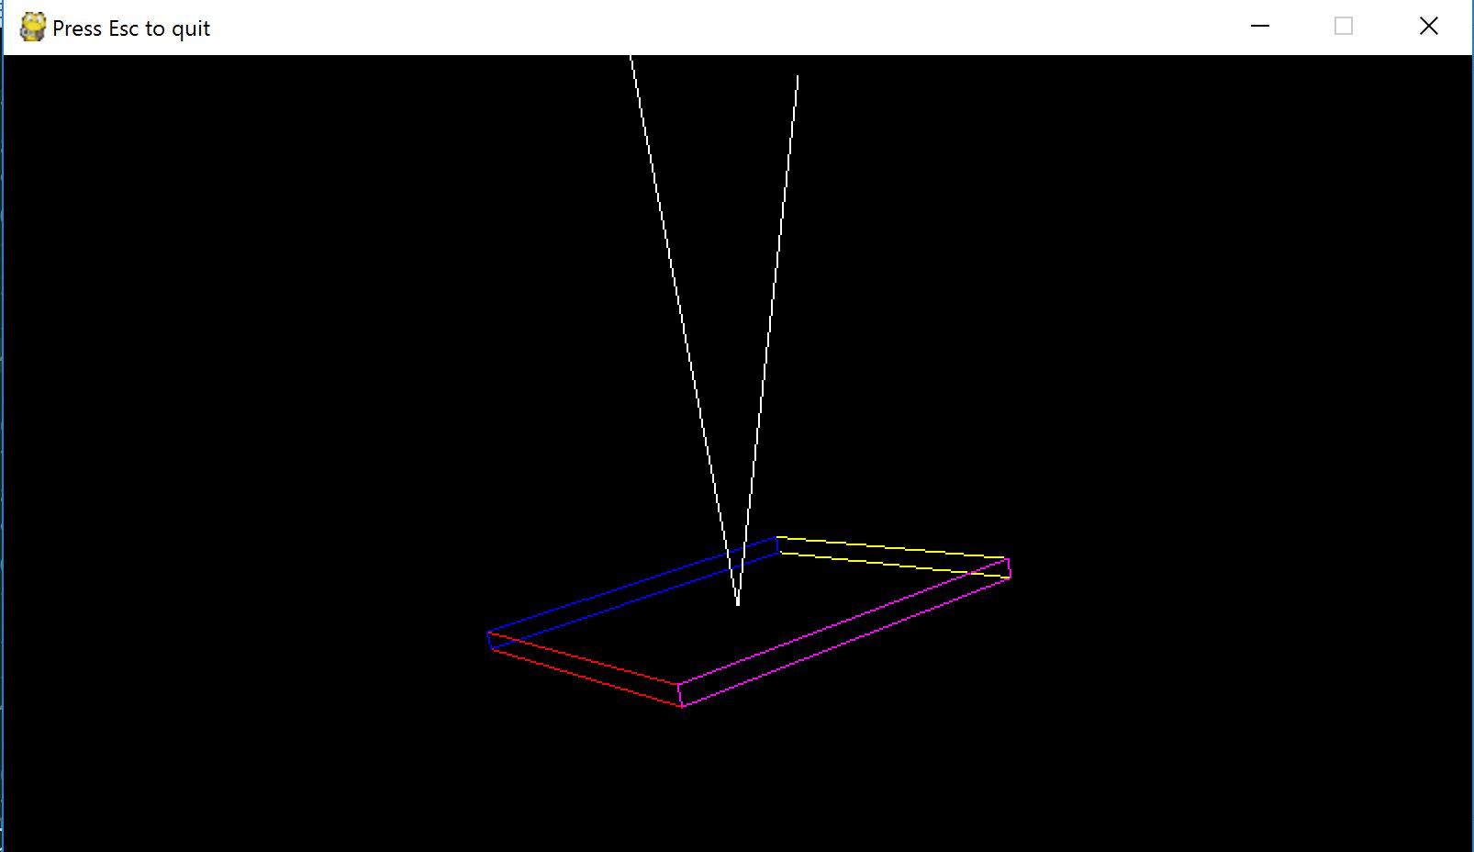
Trends update
1. How to project the face position
to the visualization model?

