Slide 1
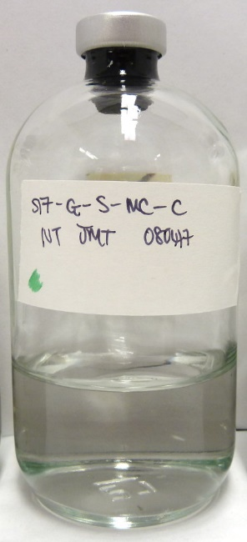
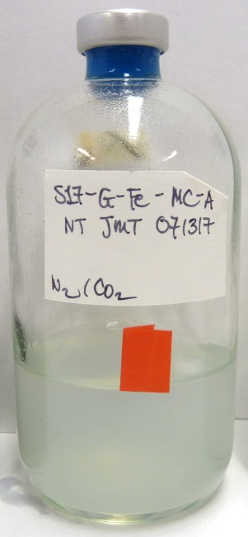
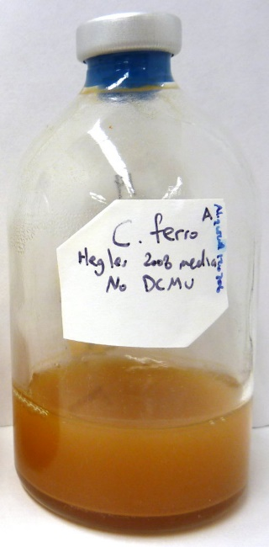
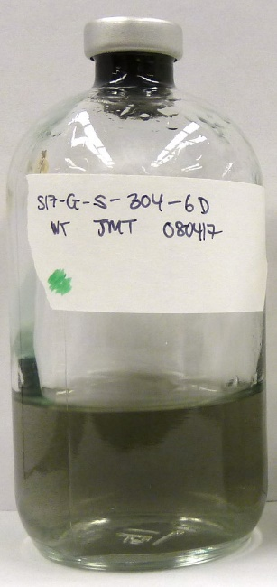
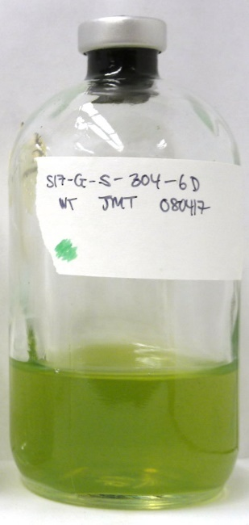
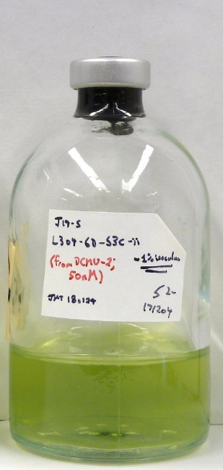
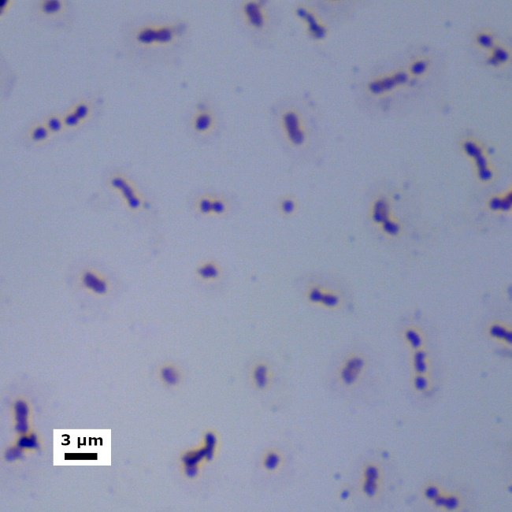
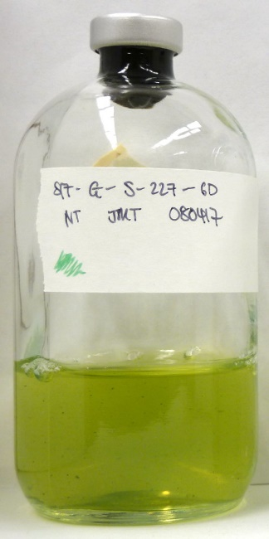
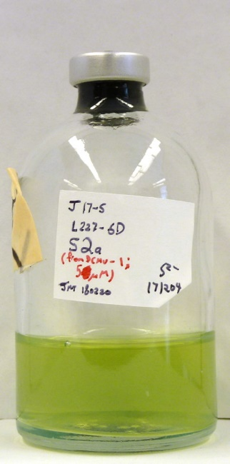
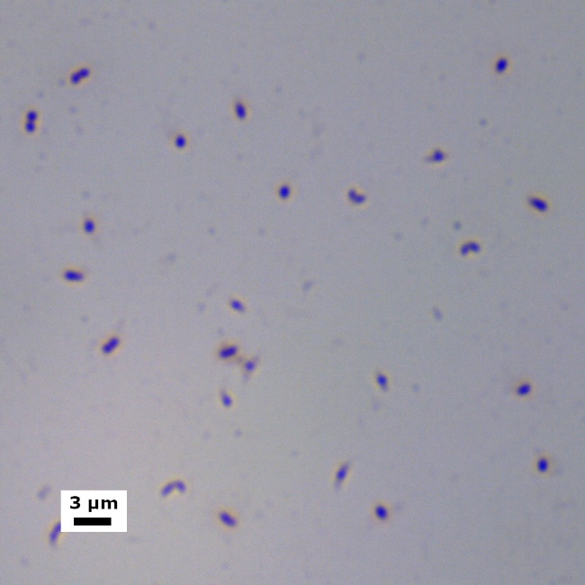
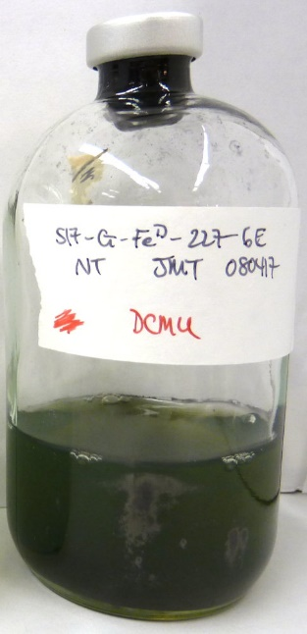
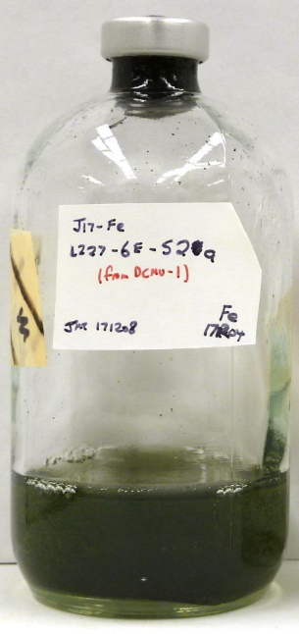
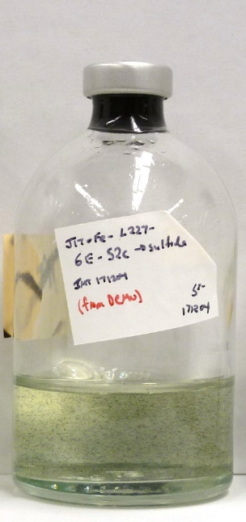
Photograph log of key enrichment cultures
Media controls:
Left: Pfennig’s medium (S2-)
Right: Freshwater medium from Hegler and colleagues, 2008 (Fe²⁺)
Reference culture of Chl. ferrooxidans KoFox grown on Hegler medium
L304 enrichment S-6D
Inoculated Aug. 8th, 2017
Subcultured Nov. 23rd, 2017 (~3.5 months later)
Typical growth time of ~3 weeks
Cells ~0.8-1 x 1.2-1.5 µm in size
Named “Ca. Chl. canadense L304-6D”
Aug. 24th, 2017
Nov. 23rd, 2017
Healthy subculture
Simple stain (dry mount); bright field microscopy
L227 enrichment S-6D
Dates of initial inoculation and subculture same as above
Typical growth time of ~4-8 weeks (slower growing)
Cells ~0.7-0.9 x 1-1.5 µm in size
Strain was lost in May 2018
Nov. 23rd, 2017
Healthy subculture
Simple stain (dry mount); bright field microscopy
L227 enrichment Fe-6E
Inoculated into Hegler medium (Fe²⁺) on Aug. 8th, 2017
Developed greenish-black colouration
Eventually transitioned to sulfide-containing medium (Pfennig’s), although growth was poor; dsrA sequence confirmed identical to L227-S-6D above
Oct. 19th, 2017
Subculture, Hegler
Subculture, Pfennig

