Slide 1
Thank you for participating our study

Slide 2
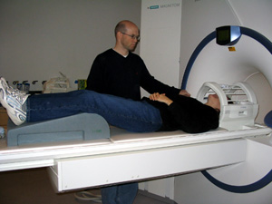
Timeline
Consent & Instruction
fMRI
Practice session (without scanning)
Localizer scan (~1 min)
Interference task1 (~7 min)
Interference task2 (~7 min)
Interference task3 (~7 min)
Anatomical scans (~10 min)
Practice session (without scanning)
Button response task1 (~6 min)
Button response task2 (~6 min)
Some questionnaires.

Slide 3
Payment
Today, we will pay $40 per hour (not $50).
But, you will have a chance to earn a cash bonus (up to $63) in a Button Response task.

Slide 4
Interference Task
You will see sets of three numbers (1, 2, 3 or 0) in the center of screen every 2 seconds.
One number will be always different from the other two (020, 331, 211, etc).

Slide 5
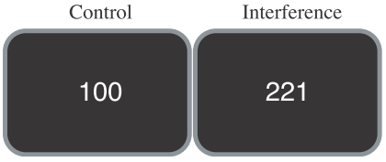
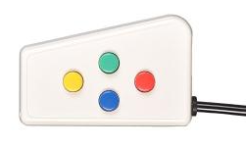

Interference Task
Your task is to report the identity of the number that is different from the other two numbers.
Control trials: the target number always matches its position on the button press (e.g., 100, 020, 003)
Interference trials: the target never matches its position on the button press, and the distracters are themselves potential targets (e.g., 233, correct answer is “2”; 221, correct answer is 1).
2
1
2
3
1
3

Slide 6
Interference Task
Please try to answer as quickly as possible, but since getting the correct answer is important, do not sacrifice accuracy for speed.
Each session lasts ~7 min.
Fixation (30 s)
24 Control trials
24 Interference trials
Fixation (30 s)
+
…
001
…
232
……
+

Slide 7
Button Response Task
Feedback(0.8 s)
Cue
(0.5 s)
Delay (2-3 s)
Target
(160 – 300 ms)
You won $2.00
…
……
Next trial starts after 1.5 s
$2.00
+
■
Miss!
$0.00
$0.20
or
$2.00
Your task is to press the yellow button as soon as the “white square” appears.
If you successfully pressed the button while a white square is on the screen, you will get the money specified in the Cue period (either, $0.00, $0.20, $2.00).

Slide 8
Button Response Task
In each session (~6 min), you will perform 45 such trials.
You will perform two sessions (potential to make up to $63).

Slide 9
Important!!
Try not to move during scanning (especially your head)

Slide 10
020
2
1
2
3
1
3

Slide 11
003
2
1
2
3
1
3

Slide 12
332
2
1
2
3
1
3

Slide 13
131
2
1
2
3
1
3

Slide 14
221
2
1
2
3
1
3

Slide 15
311
2
1
2
3
1
3

