Slide 1
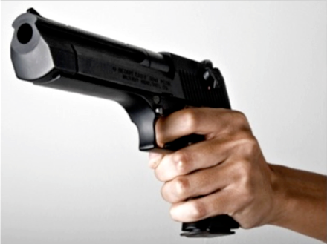
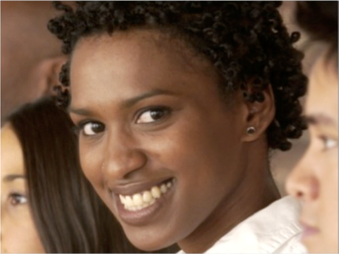
Photo Captions Test
You will see photos of people. Before each photo, you will see a caption. Once you see the photo, answer the question:
Does the caption fit the photo?
A caption that “fits” is one that makes sense given what you see in the photo. For the examples below, most agree that the caption for Example 1 fits while the caption for Example 2 does not fit.
Example 1
Example 2
He is holding a gun
She is sad
To respond, use BUTTON 1 for “Yes, the caption fits” and BUTTON 2 for “No, the caption does not fit”. You will have a limited amount of time to read each caption and respond to each photo.

Slide 2
Example 1
Is he holding a gun?
Example 2
Is she sad?

Slide 3
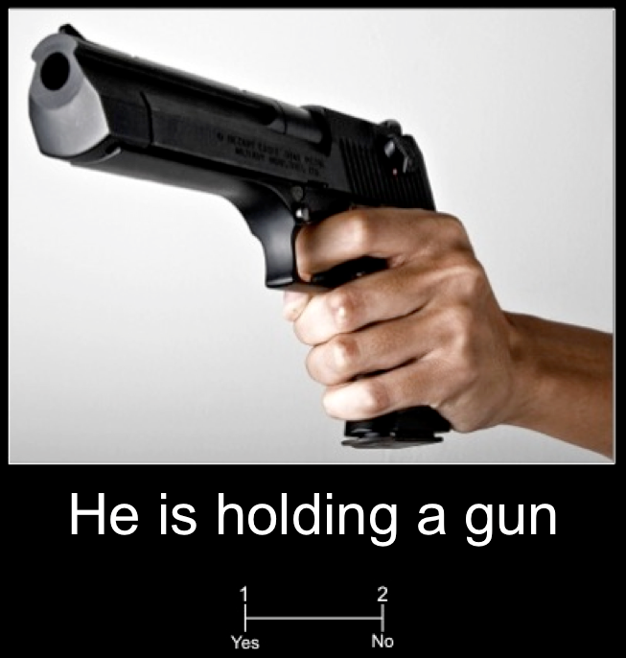
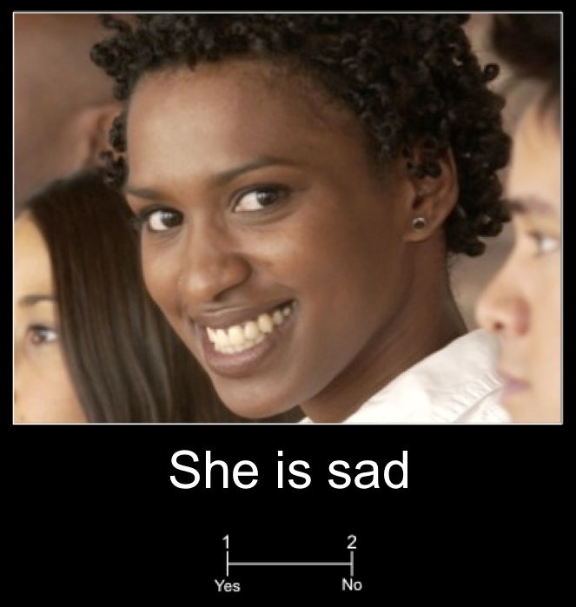
Photograph Judgment Test
You will see photos with captions. For each, answer the question:
Does the caption fit the photo?
A caption that “fits” is one that makes sense given what you see happening in the photo. For the examples, most agree that the caption for Example 1 fits while the caption for Example 2 does not fit.
Example 1
Example 2
Use BUTTON 1 for “Yes” and BUTTON 2 for “No”. You will have a limited amount of time to respond to each photo. If you do not respond in time, you will automatically advance to the next photo.

Slide 4
Photograph Judgment Test
Every trial shows a photo paired with a caption.
Answer the question:
Example 1
Example 2
Does the caption fit
the photograph?
A caption that “fits” is one that makes sense given what you see happening in the photograph. For example, most would agree that the caption for Example 1 fits while the caption for Example 2 does not fit. Use BUTTON 1 for “Yes” and BUTTON 2 for “No”. You will have a limited amount of time to respond to each trial. If you do not respond in time, you will automatically advance to the next trial.

