Slide 1
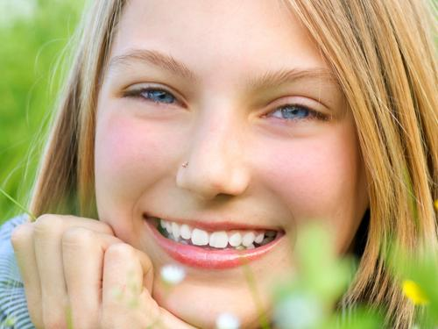
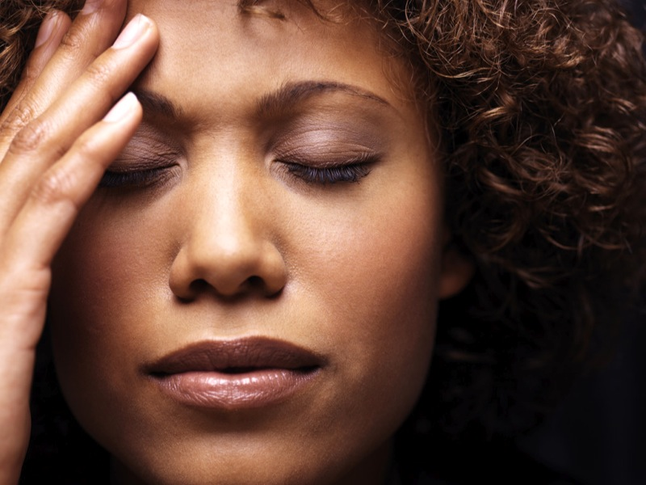
Photo Judgment Test
For this test, you will answer questions about photos of people. The photos will be presented in sets of 7, and for each set you will answer the same question for the photos in the set. The following shows the first two photos of an example set:
Every new set will be preceded by a crosshair like this one.
Sets will always begin with the question.
Use BUTTON 1 to answer “Yes” and BUTTON 2 to answer “No”
A reminder will appear between the photos in each set.
Respond as soon as you have your answer.
+
Is the person
happy?
happy?
Make sure to use BUTTON 1 for “Yes” and BUTTON 2 for “No”. If you are not sure about any answer, just make your best guess. You will have a limited amount of time to respond to each photo.

Slide 2
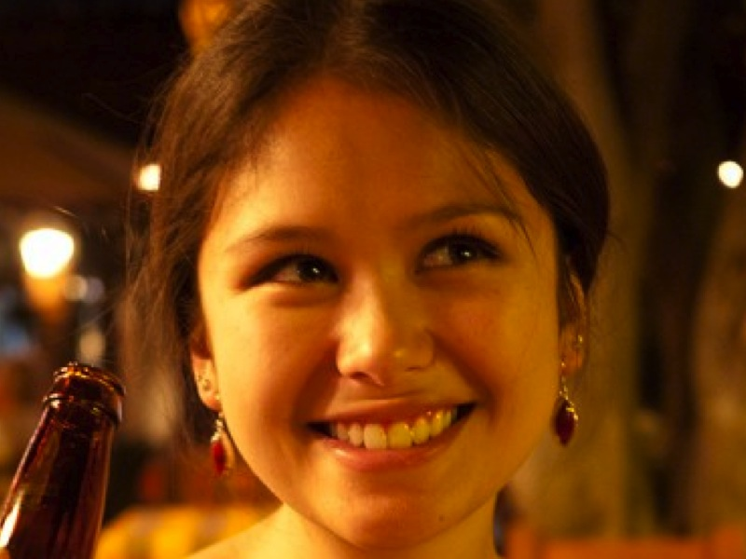
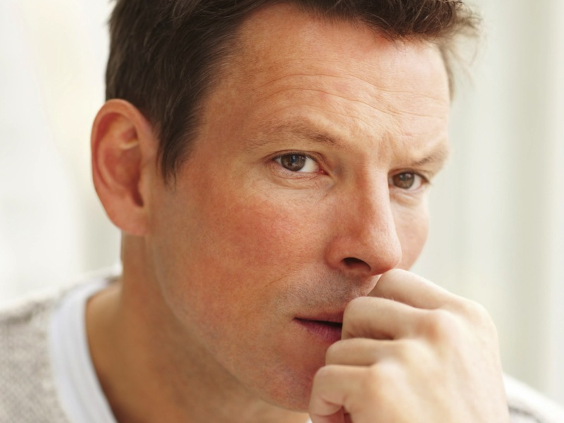
Photo Judgment Test
In this test you will view several sets of photos of people. Before each photo set, you will see a YES/NO question that you will answer for each photo in the set. For example, the question for the following set of photos regards whether the person in the photo looks like they are (or are not) happy:
Example Set
Is the person
happy?
Use BUTTON 1 to answer YES and BUTTON 2 to answer NO, and make your answer as soon as you know it. If you are unsure of the answer for a photo, just make your best guess. Note that you will have a limited amount of time to respond to each photo.

Slide 3
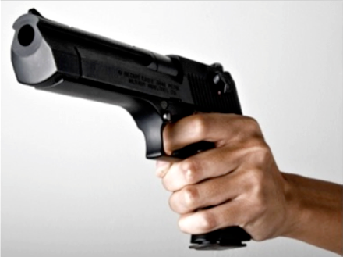
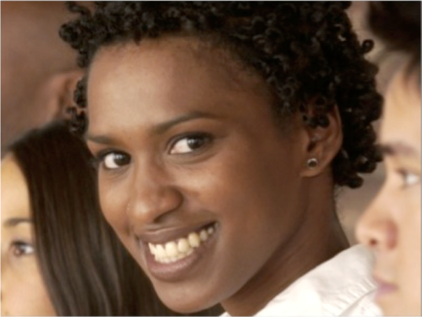
Photo Judgment Test
You will answer YES/NO questions for several
photos of people. Before each photo, you will see a caption. Once you see the photo, answer the question:
Does the caption fit the photo?
A caption that “fits” is one that makes sense given what you see in the photo. For the examples below, most agree that the caption for Example 1 fits while the caption for Example 2 does not fit.
Example 1
Example 2
He is holding a gun
She is sad
To respond, use BUTTON 1 for “Yes, the caption fits” and BUTTON 2 for “No, the caption does not fit”. You will have a limited amount of time to read each caption and respond to each photo.

Slide 4
Example 1
Is he holding a gun?
Example 2
Is she sad?

Slide 5
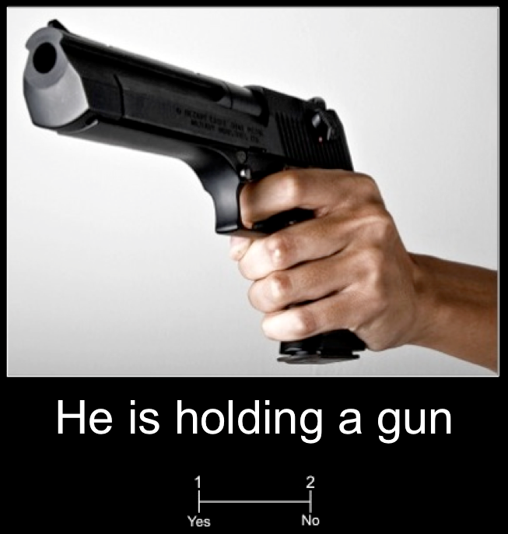
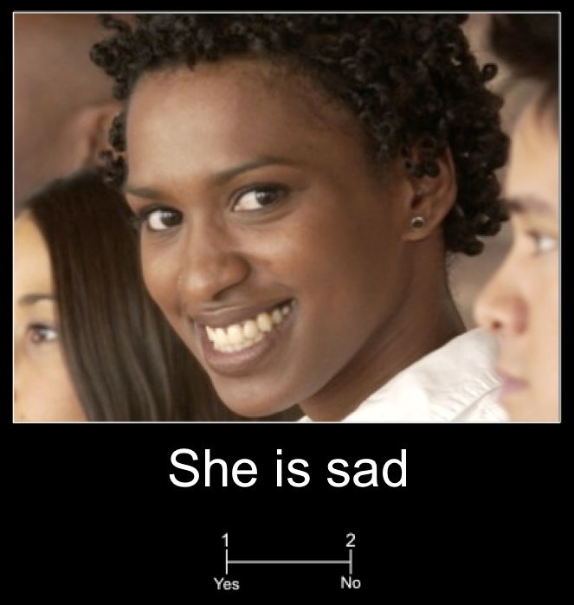
Photograph Judgment Test
You will see photos with captions. For each, answer the question:
Does the caption fit the photo?
A caption that “fits” is one that makes sense given what you see happening in the photo. For the examples, most agree that the caption for Example 1 fits while the caption for Example 2 does not fit.
Example 1
Example 2
Use BUTTON 1 for “Yes” and BUTTON 2 for “No”. You will have a limited amount of time to respond to each photo. If you do not respond in time, you will automatically advance to the next photo.

Slide 6
Photograph Judgment Test
Every trial shows a photo paired with a caption.
Answer the question:
Example 1
Example 2
Does the caption fit
the photograph?
A caption that “fits” is one that makes sense given what you see happening in the photograph. For example, most would agree that the caption for Example 1 fits while the caption for Example 2 does not fit. Use BUTTON 1 for “Yes” and BUTTON 2 for “No”. You will have a limited amount of time to respond to each trial. If you do not respond in time, you will automatically advance to the next trial.

