Slide 1
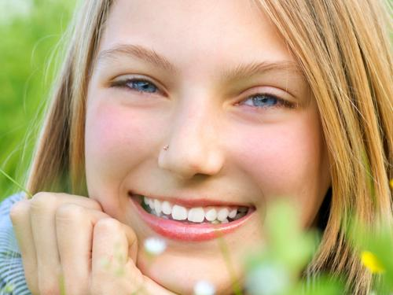
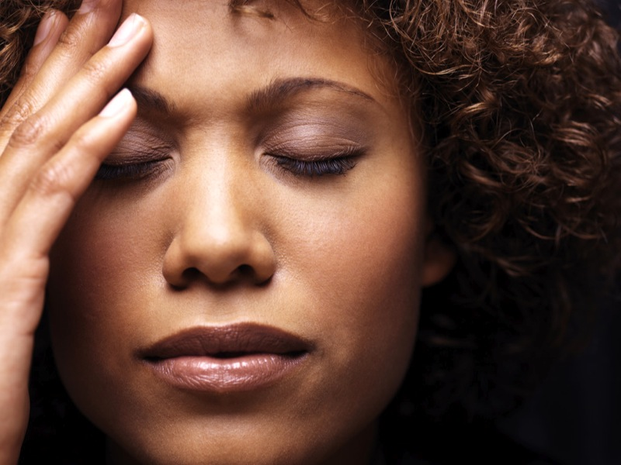
Photo Judgment Test
For this test, you will answer questions about photos of people. The photos will be presented in sets of 9, and for each set you will answer the same question for the photos in the set. The following shows the first two photos of an example set:
Every new set will be preceded by a crosshair like this one.
Sets will always begin with the question.
Use BUTTON 1 to answer “Yes” and BUTTON 2 to answer “No”
A reminder will appear between the photos in each set.
Respond as soon as you have your answer.
+
Is the person
happy?
happy?
Make sure to use BUTTON 1 for “Yes” and BUTTON 2 for “No”. If you are not sure about any answer, just make your best guess. You will have a limited amount of time to respond to each photo.

