Slide 1

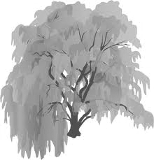


A
B
0
1
10
100
1000
Distance (m)

Slide 2
1
A
0
Portion
aquatic
0
1
B
0
0
Distance from water’s edge

Slide 3
1
A
0
0
1
B
Portion
aquatic
0
0
1
C
0
0
Distance from water’s edge

