Slide 1
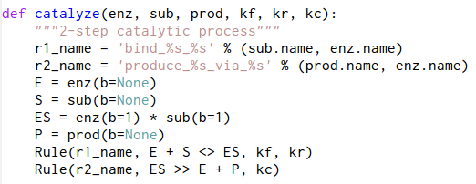
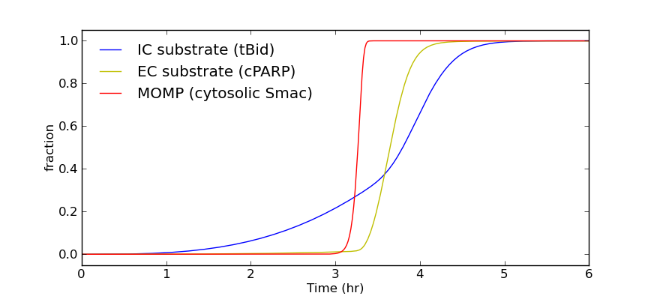
Pysb: A Rule-Based Modeling System Embedded in Python
Jeremy Muhlich
Sorger Lab
January 19, 2010

Slide 2
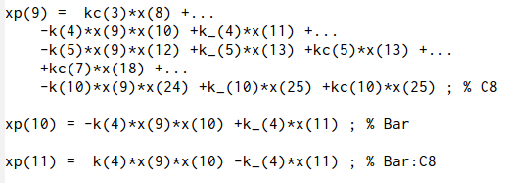



This talk will explain the benefits of rule-based modeling and why it must be closely tied to a programming language
The math of mass-action kinetics
Manual curation of the math
Rules to decrease the knowledge gap
Python to provide power and practicality
begin reaction rules
L(b) + pR(b) <-> L(b!1).pR(b!1) kf1, kr1
L(b!1).pR(b!1) -> DISC(b) kc1
flip(b) + DISC(b) <-> flip(b!1).DISC(b!1) kf2, kr2
pC8(b) + DISC(b) <-> DISC(b!1).pC8(b!1) kf3, kr3
DISC(b!1).pC8(b!1) -> C8(b) + DISC(b) kc3
C8(b) + BAR(b) <-> BAR(b!1).C8(b!1) kf4, kr4

Slide 3
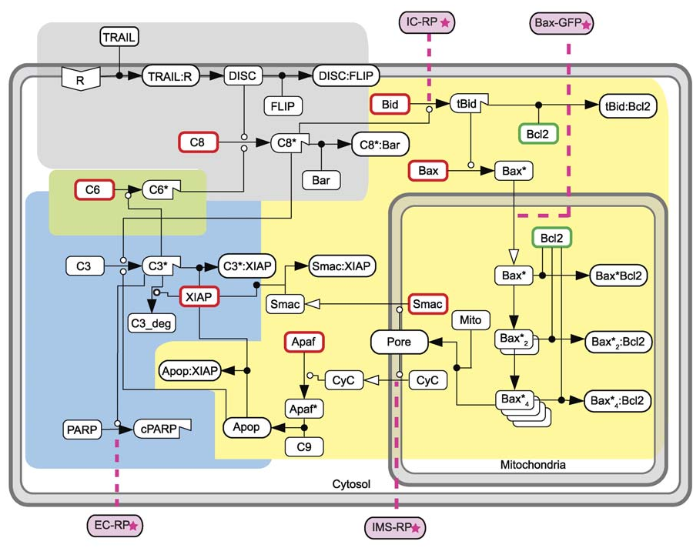
The EARM v1.0 model is a reasonable test case
Notes:
58 species
70 reactions

Slide 4
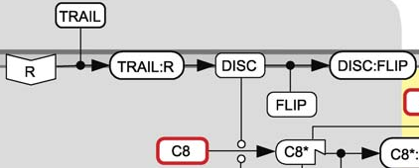
Mass-action kinetics expressed directly in math is unmanageable
% L + pR <--> L:pR --> DISC
k(1)=4E-7; k_(1)=1E-3; kc(1)=1E-5;
% flip + DISC <--> flip:DISC
k(2)=1E-6; k_(2)=1E-3;
% pC8 + DISC <--> DISC:pC8 --> C8 + DISC
k(3)=1E-6; k_(3)=1E-3; kc(3)=1;
% C8 + BAR <--> BAR:C8
k(4)=1E-6; k_(4)=1E-3;
% pC3 + C8 <--> pC3:C8 --> C3 + C8
k(5)=1E-7; k_(5)=1E-3; kc(5)=1;
% pC6 + C3 <--> pC6:C3 --> C6 + C3
k(6)=1E-6; k_(6)=1E-3; kc(6)=1;
% pC8 + C6 <--> pC8:C6 --> C8 + C6
k(7)=3E-8; k_(7)=1E-3; kc(7)=1;
% XIAP + C3 <--> XIAP:C3 --> XIAP + C3_U
k(8)=2E-6; k_(8)=1E-3; kc(8)=.1;
% PARP + C3 <--> PARP:C3 --> CPARP + C3
k(9)=1E-6; k_(9)=1E-2; kc(9)=1;
% Bid + C8 <--> Bid:C8 --> tBid + C8
k(10)=1E-7; k_(10)=1E-3; kc(10)=1;
% tBid + Bcl2c <--> tBid:Bcl2c
k(11)=1E-6; k_(11)=1E-3;
% Bax + tBid <--> Bax:tBid --> aBax + tBid
k(12)=1E-7; k_(12)=1E-3; kc(12)=1;
xp(1) = -k(1)*x(1)*x(2) +k_(1)*x(3) ; % Ligand
xp(2) = -k(1)*x(1)*x(2) +k_(1)*x(3) ; % R
xp(3) = k(1)*x(1)*x(2) -k_(1)*x(3) -kc(1)*x(3) ; % L:R
xp(4) = kc(1)*x(3) +...
-k(2)*x(4)*x(5) +k_(2)*x(6) +...
-k(3)*x(4)*x(7) +k_(3)*x(8) +kc(3)*x(8); % R*
xp(5)= -k(2)*x(4)*x(5) +k_(2)*x(6) ; % flip
xp(6)= k(2)*x(4)*x(5) -k_(2)*x(6) ; % flip:R*
xp(7) = -k(3)*x(4)*x(7) +k_(3)*x(8) +...
-k(7)*x(7)*x(17) +k_(7)*x(18) ; % pC8
xp(8) = k(3)*x(4)*x(7) -k_(3)*x(8) -kc(3)*x(8) ; % R*:pC8
xp(9) = kc(3)*x(8) +...
-k(4)*x(9)*x(10) +k_(4)*x(11) +...
-k(5)*x(9)*x(12) +k_(5)*x(13) +kc(5)*x(13) +...
+kc(7)*x(18) +...
-k(10)*x(9)*x(24) +k_(10)*x(25) +kc(10)*x(25) ; % C8
Notes:
Equations are all correct, but comments get out of sync.

Slide 5
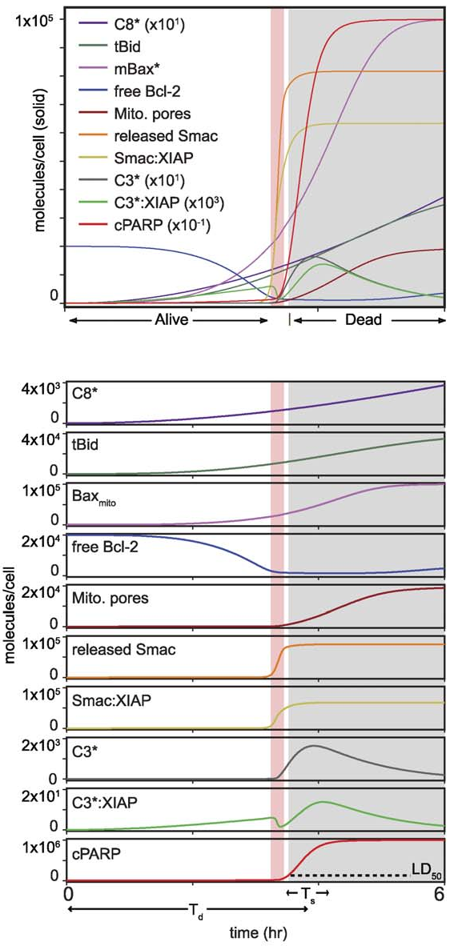
Mapping the equations to useful biology requires careful attention
[[ 2986.54001165, 186.54001165, 99.99999194],
[ 2974.79307612, 174.79307612, 99.99993867],
[ 2964.53492011, 164.53492011, 99.99980296],
[ 2955.57198113, 155.57198113, 99.99955506],
[ 2947.73689036, 147.73689036, 99.99917157],
[ 2940.88469026, 140.88469026, 99.99863445],
[ 2934.88965242, 134.88965242, 99.99793019],
[ 2929.64258825, 129.64258825, 99.99704908],
[ 2925.04856885, 125.04856885, 99.99598462],
...,
[ 2921.02497895, 121.02497895, 99.99473295],
[ 2917.4998605 , 117.4998605 , 99.99329241],
[ 2914.41048954, 114.41048954, 99.99166317],
[ 2911.70215491, 111.70215491, 99.9898469 ],
[ 2909.32710701, 109.32710701, 99.98784644],
[ 2907.24365091, 107.24365091, 99.98566563],
[ 2905.41536238, 105.41536238, 99.98330905],
[ 2903.8104076 , 103.8104076 , 99.98078186],
[ 2902.40095756, 102.40095756, 99.97808967],
[ 2901.16267671, 101.16267671, 99.97523841]]
y(:,1)=x(:,9)+x(:,11)+x(:,13)+x(:,25); % CC8
y(:,2)=x(:,26)+x(:,28)+x(:,30); % tBid
y(:,3)=x(:,32)+x(:,34)+2.*x(:,35)+2.*x(:,36)+...
+4.*x(:,37)+4.*x(:,38)+4.*x(:,40)+4.*x(:,41);%smBax
y(:,4)=x(:,33); %sBcl2
y(:,5)=x(:,41)+x(:,43)+x(:,46); % sMito
y(:,6)=x(:,55)+x(:,57); % sSmac
y(:,7)=x(:,57); % sSmacXIAP
y(:,8)=x(:,14)+x(:,16)+x(:,22); % sC3
y(:,9)=x(:,20); % sC3XIAP
y(:,10)=x(:,23); % sCP
Notes:
Large data set from simulation, need to plot. Biologically relevant entities are often not represented by a single column in the data matrix. Need complex logic/math.
Fragile – what if model changes?

Slide 6
Rules can better represent your biological knowledge, as well as do the math for you
begin molecule types
L(b)
pR(b)
DISC(b)
flip(b)
pC8(b)
C8(b)
BAR(b)
pC3(b)
C3(b)
pC6(b)
C6(b)
XIAP(b)
C3_U(b)
PARP(b)
CPARP(b)
Bid(b)
tBid(b)
...
begin reaction rules
L(b) + pR(b) <-> L(b!1).pR(b!1) kf1, kr1
L(b!1).pR(b!1) -> DISC(b) kc1
flip(b) + DISC(b) <-> flip(b!1).DISC(b!1) kf2, kr2
pC8(b) + DISC(b) <-> DISC(b!1).pC8(b!1) kf3, kr3
DISC(b!1).pC8(b!1) -> C8(b) + DISC(b) kc3
C8(b) + BAR(b) <-> BAR(b!1).C8(b!1) kf4, kr4
pC3(b) + C8(b) <-> pC3(b!1).C8(b!1) kf5, kr5
pC3(b!1).C8(b!1) -> C3(b) + C8(b) kc5
pC6(b) + C3(b) <-> pC6(b!1).C3(b!1) kf6, kr6
pC6(b!1).C3(b!1) -> C6(b) + C3(b) kc6
pC8(b) + C6(b) <-> pC8(b!1).C6(b!1) kf7, kr7
pC8(b!1).C6(b!1) -> C8(b) + C6(b) kc7
XIAP(b) + C3(b) <-> XIAP(b!1).C3(b!1) kf8, kr8
XIAP(b!1).C3(b!1) -> XIAP(b) + C3_U(b) kc8
PARP(b) + C3(b) <-> PARP(b!1).C3(b!1) kf9, kr9
PARP(b!1).C3(b!1) -> CPARP(b) + C3(b) kc9
Bid(b) + C8(b) <-> Bid(b!1).C8(b!1) kf10, kr10
...
begin observables
tBid tBid()
CPARP CPARP()
cSmac cSmac()
...
begin actions
generate_network({overwrite=>1});
simulate_ode({t_end=>21600,n_steps=>360});
...
Notes:
36 monomers (molecule types)
42 rules
(compared to 58 species, 70 reactions)

Slide 7
Rules can better represent your biological knowledge, as well as do the math for you
begin species
...
19 L(b!1).pR(b!1) 0
20 DISC(b) 0
21 DISC(b!1).flip(b!1) 0
22 DISC(b!1).pC8(b!1) 0
23 C8(b) 0
24 BAR(b!1).C8(b!1) 0
25 C8(b!1).pC3(b!1) 0
26 Bid(b!1).C8(b!1) 0
27 C3(b) 0
28 tBid(b) 0
29 C3(b!1).pC6(b!1) 0
30 C3(b!1).XIAP(b!1) 0
31 C3(b!1).PARP(b!1) 0
32 Bcl2c(b!1).tBid(b!1) 0
33 Bax(b!1).tBid(b!1) 0
34 C6(b) 0
35 C3_U(b) 0
36 CPARP(b) 0
37 aBax(b) 0
38 C6(b!1).pC8(b!1) 0
...
begin reactions
1 1,2 19 kf1 #bind_L_pR
2 19 1,2 kr1 #bind_L_pR(reverse)
3 19 20 kc1 #produce_DISC
4 3,20 21 kf2 #bind_flip_DISC
5 4,20 22 kf3 #bind_pC8_DISC
6 21 3,20 kr2 #bind_flip_DISC(reverse)
7 22 4,20 kr3 #bind_pC8_DISC(reverse)
8 22 20,23 kc3 #cat_C8_DISC
9 5,23 24 kf4 #bind_C8_BAR
10 6,23 25 kf5 #bind_pC3_C8
11 10,23 26 kf10 #bind_Bid_C8
12 24 5,23 kr4 #bind_C8_BAR(reverse)
13 25 6,23 kr5 #bind_pC3_C8(reverse)
14 25 23,27 kc5 #cat_C3_C8
15 26 10,23 kr10 #bind_Bid_C8(reverse)
16 26 23,28 kc10 #cat_tBid_C8
17 7,27 29 kf6 #bind_pC6_C3
18 8,27 30 kf8 #bind_XIAP_C3
...
begin groups
1 tBid 28,32,33
2 CPARP 36
3 cSmac 52,54
...
Notes:
Species enumerated (complexes here, but also state sites in general)
Reactions generated (with proper stoichiometry)
Groups calculated

Slide 8
All existing rules software packages are standalone tools, leading to dead-ends
begin actions
generate_network({overwrite=>1});
# Equilibration
setConcentration("EGF(r)",0);
simulate_ode({t_end=>100000,n_steps=>10,sparse=>1,steady_state=>1});
setConcentration("EGF(r)","EGF_tot");
saveConcentrations(); # Saves concentrations for future reset
# Kinetics
writeSBML({});
simulate_ode({t_end=>120,n_steps=>120});
resetConcentrations(); # reverts to saved Concentrations
simulate_ssa({suffix=>ssa,t_end=>120,n_steps=>40});
end actions
Notes:
Limited to “actions” that bng provides.
Only other option is CSV export.

Slide 9
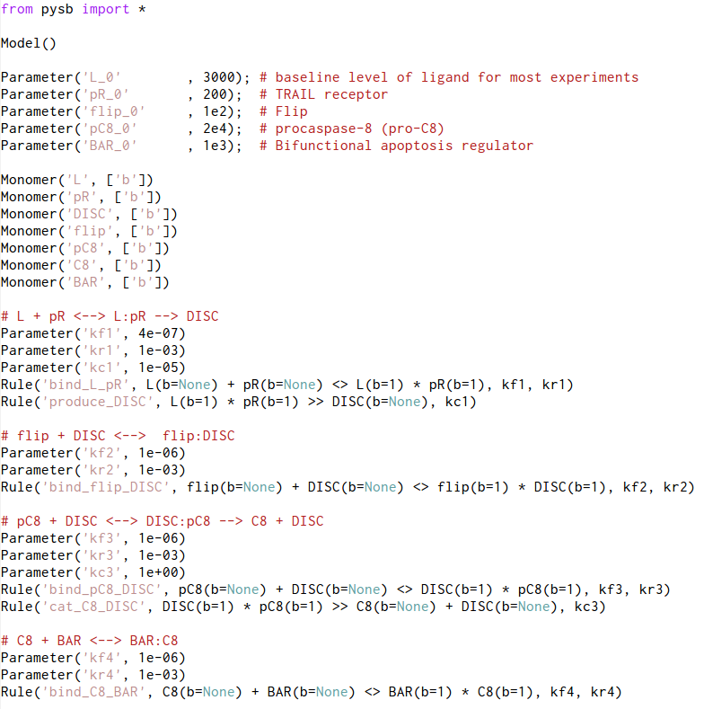
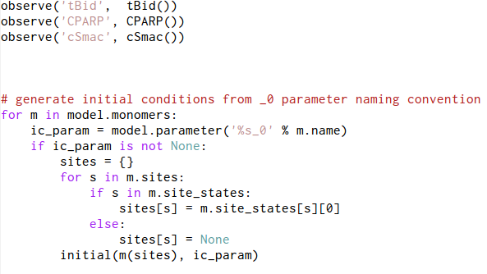
Pysb is a framework or library, embedding a rules system into the Python language
Notes:
All pure python syntax
Initial conditions an example of adding your own missing feature

Slide 10
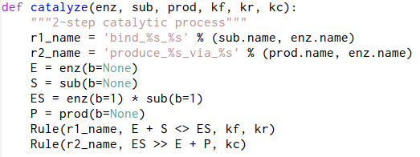
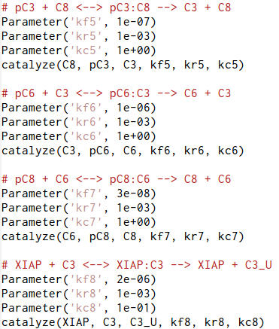
Pysb is a framework or library, embedding a rules system into the Python language
Notes:
Higher level programming – write a metarule that generates rules according to a pattern
Hierarchical organization assists in modularity, and comprehensibility for newcomers

Slide 11
Pylab environment is very similar to Matlab
if Fig_4A, % Dose response
tf=20*3600; % seconds
samp_freq=tf/60; % accurate to min
dt=(tf-0)/samp_freq;
tt=0:dt:tf;
options=odeset('AbsTol',1E-10,'RelTol',1E-8,'maxstep',dt);
Ls_exp=[1,1/4,1/20,1/100,1/500].*Lsat;
Td_exp=[144.2,178.7,236,362.5,656.5];
Td_std=[32.5,32.2,36.4,78.6,171.6];
Ts_exp=[21.6,23.8,27.2,22.0,19.0];
Ts_std=[9.5,9.5,12.9,7.7,10.5];
CVenv=0.2;
Ls=floor(logspace(1,5,40));
tn=1:1:length(tt)-1;
for i=1:length(Ls),
x0=IC;
x0(1)=Ls(i);
[t x]=ode15s(@rhs,tt,x0,options,k,k_,kc,v);
fs(i)=(x(1,21)-x(end,21))./x(1,21);
dP=60.*( x(tn(:),21) -x(tn(:)+1,21) )./(dt*x(1,21)); % min
[dPmax,ttn]=max(dP);
Ts(i)=1/dPmax; % min
Td(i)=tt(ttn)./60; % min
end,
plot(Ls./Lfactor,Td,'g-',...
Ls./Lfactor,(1-CVenv)*Td,...
'b-',Ls./Lfactor,(1+CVenv)*Td),
plot(Ls_exp./Lfactor,Td_exp,'go'),
for i=1:length(Td_std),
line([Ls_exp(i),Ls_exp(i)]./Lfactor,...
[Td_exp(i)-Td_std(i),Td_exp(i)+Td_std(i)],...
'color','g'),
end,
ylabel('Td (min)'),
xlabel('TRAIL (ng/ml)'),
set(gca,'XScale','log'),
axis([min(Ls)./Lfactor,max(Ls)./Lfactor,0,1000]),
def fig_4a():
t = linspace(0, 20*3600, 20*60+1) # 20 hours, in seconds, 1 min sampling
dt = t[1] - t[0]
Ls_exp = Lsat / array([1, 4, 20, 100, 500])
Td_exp = [144.2, 178.7, 236, 362.5, 656.5]
Td_std = [32.5, 32.2, 36.4, 78.6, 171.6]
Ts_exp = [21.6, 23.8, 27.2, 22.0, 19.0]
Ts_std = [9.5, 9.5, 12.9, 7.7, 10.5]
CVenv = 0.2
Ls = floor(logspace(1,5,40))
fs = empty_like(Ls)
Ts = empty_like(Ls)
Td = empty_like(Ls)
for i in range(len(Ls)):
model.reset_parameters()
model.set_parameter('L_0', Ls[i])
x = odesolve(model, t)
fs[i] = (x['PARP'][0] - x['PARP'][-1]) / x['PARP'][0]
dP = 60 * (x['PARP'][:-1] - x['PARP'][1:]) / (dt * x['PARP'][0]) # mins
ttn = argmax(dP)
dPmax = dP[ttn]
Ts[i] = 1 / dPmax # minutes
Td[i] = t[ttn] / 60 # minutes
figure()
plot(Ls/Lfactor, Td, 'g-', Ls/Lfactor, (1-CVenv)*Td, 'g--', Ls/Lfactor,\
(1+CVenv)*Td, 'g--')
errorbar(Ls_exp/Lfactor, Td_exp, Td_std, None, 'go', capsize=0),
ylabel('Td (min)'),
xlabel('TRAIL (ng/ml)'),
a = gca()
a.set_xscale('log')
a.set_xlim((min(Ls) / Lfactor, max(Ls) / Lfactor))
a.set_ylim((0, 1000))
Notes:
Translated matlab to python using pylab and pysb.

Slide 12
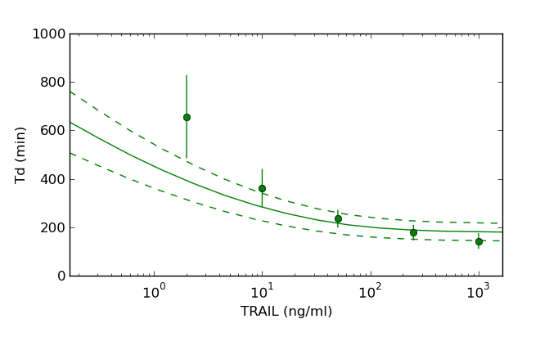
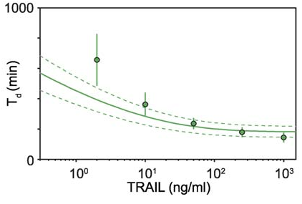
Pylab environment is very similar to Matlab
if Fig_4A, % Dose response
tf=20*3600; % seconds
samp_freq=tf/60; % accurate to min
dt=(tf-0)/samp_freq;
tt=0:dt:tf;
options=odeset('AbsTol',1E-10,'RelTol',1E-8,'maxstep',dt);
Ls_exp=[1,1/4,1/20,1/100,1/500].*Lsat;
Td_exp=[144.2,178.7,236,362.5,656.5];
Td_std=[32.5,32.2,36.4,78.6,171.6];
Ts_exp=[21.6,23.8,27.2,22.0,19.0];
Ts_std=[9.5,9.5,12.9,7.7,10.5];
CVenv=0.2;
Ls=floor(logspace(1,5,40));
tn=1:1:length(tt)-1;
for i=1:length(Ls),
x0=IC;
x0(1)=Ls(i);
[t x]=ode15s(@rhs,tt,x0,options,k,k_,kc,v);
fs(i)=(x(1,21)-x(end,21))./x(1,21);
dP=60.*( x(tn(:),21) -x(tn(:)+1,21) )./(dt*x(1,21)); % min
[dPmax,ttn]=max(dP);
Ts(i)=1/dPmax; % min
Td(i)=tt(ttn)./60; % min
end,
plot(Ls./Lfactor,Td,'g-',...
Ls./Lfactor,(1-CVenv)*Td,...
'b-',Ls./Lfactor,(1+CVenv)*Td),
plot(Ls_exp./Lfactor,Td_exp,'go'),
for i=1:length(Td_std),
line([Ls_exp(i),Ls_exp(i)]./Lfactor,...
[Td_exp(i)-Td_std(i),Td_exp(i)+Td_std(i)],...
'color','g'),
end,
ylabel('Td (min)'),
xlabel('TRAIL (ng/ml)'),
set(gca,'XScale','log'),
axis([min(Ls)./Lfactor,max(Ls)./Lfactor,0,1000]),
def fig_4a():
t = linspace(0, 20*3600, 20*60+1) # 20 hours, in seconds, 1 min sampling
dt = t[1] - t[0]
Ls_exp = Lsat / array([1, 4, 20, 100, 500])
Td_exp = [144.2, 178.7, 236, 362.5, 656.5]
Td_std = [32.5, 32.2, 36.4, 78.6, 171.6]
Ts_exp = [21.6, 23.8, 27.2, 22.0, 19.0]
Ts_std = [9.5, 9.5, 12.9, 7.7, 10.5]
CVenv = 0.2
Ls = floor(logspace(1,5,40))
fs = empty_like(Ls)
Ts = empty_like(Ls)
Td = empty_like(Ls)
for i in range(len(Ls)):
model.reset_parameters()
model.set_parameter('L_0', Ls[i])
x = odesolve(model, t)
fs[i] = (x['PARP'][0] - x['PARP'][-1]) / x['PARP'][0]
dP = 60 * (x['PARP'][:-1] - x['PARP'][1:]) / (dt * x['PARP'][0]) # mins
ttn = argmax(dP)
dPmax = dP[ttn]
Ts[i] = 1 / dPmax # minutes
Td[i] = t[ttn] / 60 # minutes
figure()
plot(Ls/Lfactor, Td, 'g-', Ls/Lfactor, (1-CVenv)*Td, 'g--', Ls/Lfactor,\
(1+CVenv)*Td, 'g--')
errorbar(Ls_exp/Lfactor, Td_exp, Td_std, None, 'go', capsize=0),
ylabel('Td (min)'),
xlabel('TRAIL (ng/ml)'),
a = gca()
a.set_xscale('log')
a.set_xlim((min(Ls) / Lfactor, max(Ls) / Lfactor))
a.set_ylim((0, 1000))

Slide 13
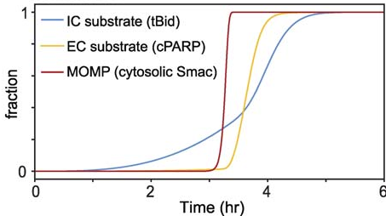
Pylab environment is very similar to Matlab

Slide 14

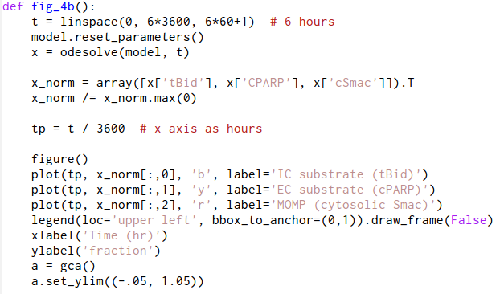
Pysb offers a smart interface to BNG's rules system
Notes:
This solves one of the biggest problems in using models to do real biology

Slide 15
Success in the future of modeling will require both rules for more faithful representation of the biology, and access to a first-class programming language for flexibility and extensibility. Pysb provides both.
Thanks to:
Carlos Lopez
Julio Saez-Rodriguez
Thomas Maiwald
Peter Sorger

