Slide 1
Efficiency and design optimization for fMRI
Online Brain Intensive 2017
Jeanette Mumford
University of Wisconsin - Madison

Slide 2
Motivation
What should we do before we collect our fMRI data to help boost our power?
  Even if we don’t have pilot data!!!

Slide 3

The best way to increase power?

Slide 4
Your N is fixed what do you do?
Give up?
Let’s look at the variance!
  Lowering the variance will increase our power!

Slide 5
Quick thoughts about variance
Typically analyze data in stages
  Why??
Stage 1
  Within-subject
Stage 2
  Between-subject

Slide 6
Quick thoughts about variance
Typically analyze data in stages
  Why??
Stage 1
  Within-subject ➔ Within-subject variability
Stage 2
  Between-subject ➔ Between-subject variability

Slide 7
Efficient designs will increase power
Lowering variance increases power

Slide 8
Efficient designs will increase power
Lowering variance increases power

Slide 9
Efficient designs will increase power
Lowering variance increases power
Between-subject variance
(probably unknown)

Slide 10
Efficient designs will increase power
Lowering variance increases power
Within-subject variance
(probably unknown)

Slide 11
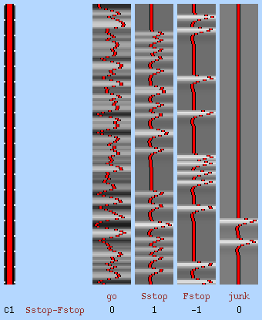
Efficient designs will increase power
Lowering variance increases power
Design matrix and contrasts
(We have total control over this!!)

Slide 12
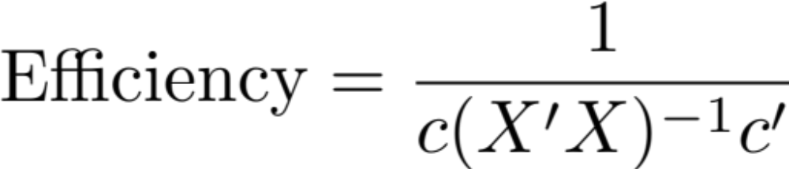
Efficiency

Slide 13
Interpreting efficiency
Relative measure
  Rank designs and pick the one with highest efficiency (lowest variance)

Slide 14
Motivating illustration
Two stimuli (positive and negative images)
Stimulus duration = 1s
ISI = 2s (fixed)
Contrast of interest: positive – negative
How much can I increase efficiency by searching over random trial orders?

Slide 15
Motivating illustration
Within- and between-subject variance estimates from real data
  within-subject variance = 3036
  between-subject variance = 810
N=30
alpha = 0.05
  What is the power as a function of effect size?

Slide 16
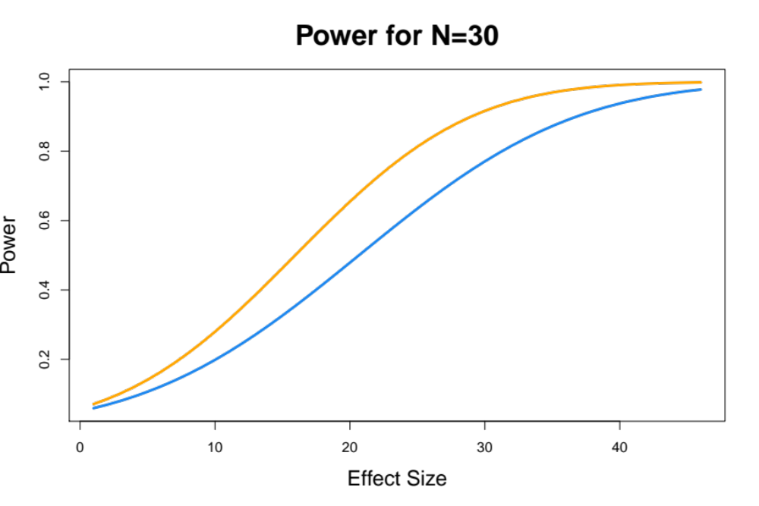
Motivating illustration
Least efficient
Most efficient

Slide 17
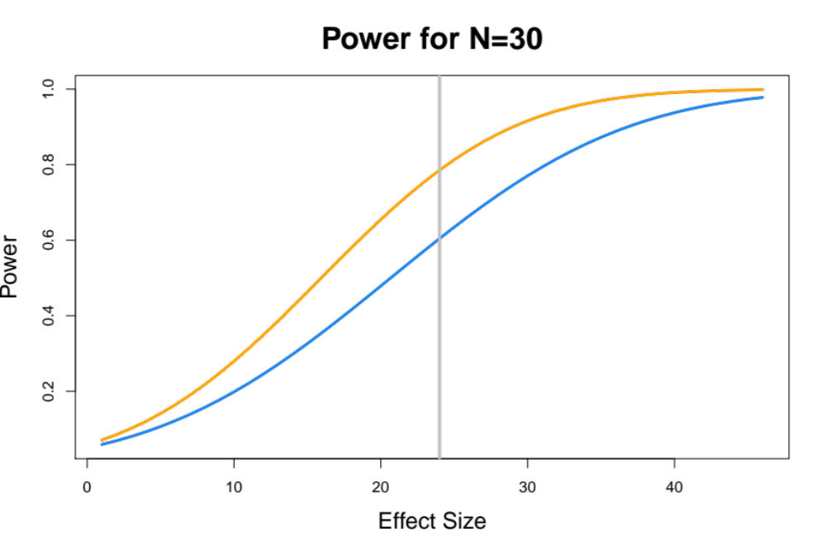
Motivating illustration
Least efficient
Most efficient
81% v 63% power

Slide 18
Things that might increase efficiency
Random trial order
Jittering your ITI
Increasing your ITI
Lengthen stimuli
Increase number of stimuli

Slide 19
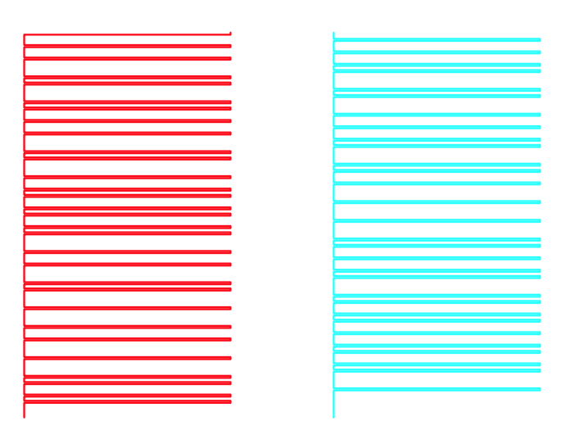
What exactly are c and X?
Time

Slide 20
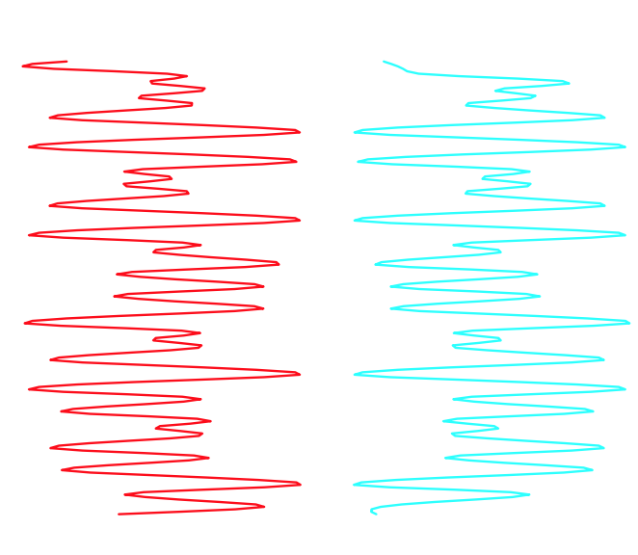
What exactly are c and X?
Time

Slide 21
What exactly are c and X?
X

Slide 22
What exactly are c and X?
X
HA: Faces > Houses ( 1 -1 )

Slide 23
What exactly are c and X?
X
c
HA: Faces > Houses ( 1 -1 )

Slide 24
Last but not least
Check the Variance Inflation Factor!
  Most efficient doesn’t guarantee it is great
  VIF is a measure the indicates when you have collinearity
    Want VIF<5

Slide 25
Summary
Before you run your behavioral pilot, run an efficiency study!
Check that the VIF is in check too

Slide 26
Thanks!
FYI, if you have questions you can post them to the mumfordbrainstats FB group!
www.facebook.com/groups/mumfordbrainstats/

