Slide 1
Digital Workplace
Automation Priority Model
A data-driven framework for prioritizing IT process automation across Micron's Digital Workplace organization
Portfolio Project | Business Analyst Candidate
August 2026

Slide 2





Which process should Digital Workplace
automate first?
Five teams generate constant requests, but no consistent framework exists to compare where automation pays off first.
Service Desk
Enterprise Systems
Management
Field Services
Digital Employee
Experience (DEX)
End User
Computing
The gap: prioritization by instinct, not evidence.

Slide 3
Methodology
Five workflows scored on a 3-axis model, anchored to real industry benchmarks, not synthetic guesses.
Priority Score =
Sourced from
(Feasibility × Impact) ÷ Risk
• Gartner
• Forrester
5 workflows: onboarding, shift-handoff, equipment requests, password reset, meeting booking
• SHRM 2025 Benchmarking Report
Each scored 1-5 on Feasibility, Impact, and Risk
• Verizon DBIR 2024
• Industry case studies (Eviview, Teamazing, Velocity Smart)
Time and cost savings anchored to published 2025-26 benchmarks (Gartner, Forrester, SHRM, industry case studies)
Top-scoring workflow mapped current-state to future-state

Slide 4
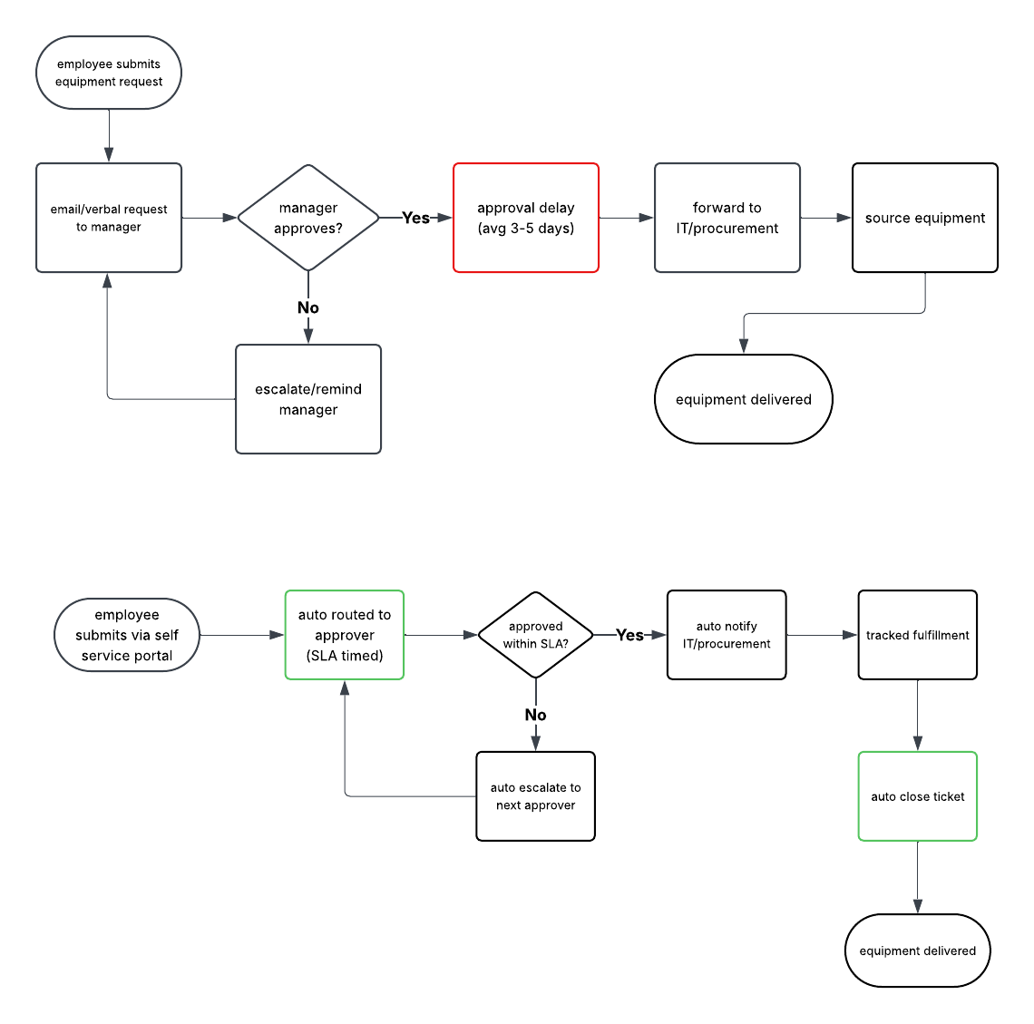
Case Study: Equipment / Tool Request Approval
Current-state (top) vs. future-state (bottom) workflow

Slide 5
Prioritization Results
Workflow | Annual Savings | Payback
Onboarding/Provisioning | $78,624 | 4.6 mo
Shift-Handoff | $123,930 | 2.8 mo
Equipment/Tool Request | $37,800 | 9.5 mo
Password/Access Reset | $113,400 | 5.1 mo
Meeting/Resource Booking | $36,000 | 2.1 mo
Equipment/Tool Request scores highest on feasibility and low risk. Shift-Handoff and Password Reset carry the largest dollar savings.

Slide 6
Stress-Testing the Model
A 20% conservative haircut on savings, to account for adoption lag and estimation error, was applied to every workflow. One recommendation didn't survive it.
BASELINE
RISK-ADJUSTED (-20%)
5.1 mo
166.7 mo
payback period for Password / Access Reset automation
payback period. Margin between savings and licensing cost nearly vanishes
Real SSPR licensing ($1.50/user/mo) vs. real Forrester/Gartner savings benchmarks
3-year net turns negative: -$7,840
Takeaway: prioritization frameworks need to survive scrutiny, not just look good on paper.

Slide 7



Recommendation & Next Steps
Pilot first
Equipment/Tool Request + Onboarding: both reuse Micron's existing ServiceNow instance, fastest low-risk payback.
Sequence next
Meeting/Resource Booking: cheap to license, positive under every scenario tested.
Revisit before committing
Password/Access Reset: thin margin under conservative assumptions; renegotiate licensing or confirm real reset volume before funding.
Gives a Digital Workplace team a repeatable way to rank automation candidates by evidence instead of instinct, and a build-ready process map for the top-scoring workflow.

