Slide 1
Week Five: Artificial Neural Network and Support Vector Machine
Paul Andrus (pandrus@regis.edu) – pmandrus@gmail.com
College of Computer and Information Sciences, Regis University

Slide 2
Overview
Artificial neural network (ANN) is inspired by biological neurons. ANN utilizes a network of units or nodes for learning to solve problems. In summary, an ANN model consists of large numbers of units called nodes. Nodes are connected by links. Each link is associated with a weight. These weights are continuously adjusted by learning. The most well-known learning algorithm is back-propagation. ANNs have shown a great success in numerous applications from various fields. However, there are some critical issues such as slow training, prone to local minima, and no unique solutions.
Support vector machine (SVM) is also known as maximum margin classifier, with the reason, that all examples should have large margins to be further away from the decision boundary. As a result, we can be certain about our classification decisions. The simple case of SVM is called linear SVM using linear classifier. However, the separation can be extended to non-linear boundaries, where the kernel trick is applied.

Slide 3
Outcomes
Explain the process of building a decision tree, and how to select split attributes.
Interpret the results from the decision tree.
Perform decision tree using R and conclude the results.
Explain how random forest works including its advantages.
Perform random forest using R and conclude the results.

Slide 4
Reading
Chiu, Y. (2015). Machine Learning with R cookbook. Packt Publishing (Chapter 6). ONLINE Book available via http://lumen.regis.edu/record=b1659405~S3.
Dyer, C. R. CS 540 (2015): Neural Networks. University of Wisconsin, Madison. Retrieved from http://pages.cs.wisc.edu/~dyer/cs540/notes/09_neuralNets.pdf.
James, G., Witten, D., Hastie, T., and Tibshirabi, R. (2011). An Introduction to Statistical Learning with Applications in R (pages 337-368). ONLINE Book available via http://lumen.regis.edu/record=b1565362~S3.
Lantz, B. (2013). Machine Learning with R. Packt Publishing. (Chapter 7 Practice ANNs using R with an example). ONLINE Book available via http://lumen.regis.edu/record=b1633448~S3.
Moore, A. (2001). Regression and Classification with Neural Networks. CMU lecture slides. Retrieved from http://www.autonlab.org/tutorials/neural13.pdf. Swingler, K. and Graham, B. Introduction to Neural Networks. •
Lecture 1: Introduction to Neural Networks. Retrieved from http://www.cs.stir.ac.uk/courses/ITNP4B/lectures/kms/1-Intro.pdf. •
Lecture 2: Single Layer Perceptrons. Retrieved from http://www.cs.stir.ac.uk/courses/ITNP4B/lectures/kms/2-Perceptrons.pdf. •
Lecture 3: Delta Rule. Retrieved from http://www.cs.stir.ac.uk/courses/ITNP4B/lectures/kms/3-DeltaRule.pdf. •
Lecture 4: Multi-Layer Perceptrons. Retrieved from http://www.cs.stir.ac.uk/courses/ITNP4B/lectures/kms/4-MLP.pdf.

Slide 5
ANN
Crudely like biological processes
Massively parallel
Degrades gracefully
Fault tolerant
Handles missing or incomplete data well
Slow training
Black box
Prone to local minima

Slide 6
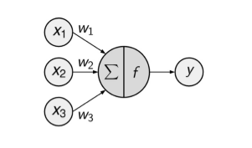

Theory

Slide 7
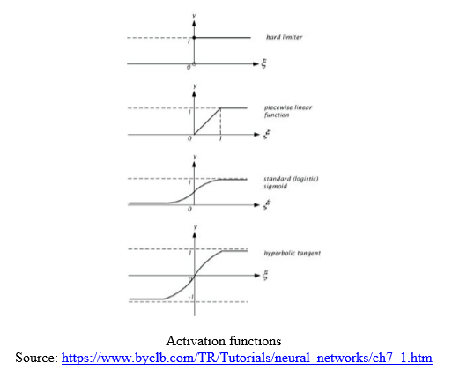
Activation function

Slide 8

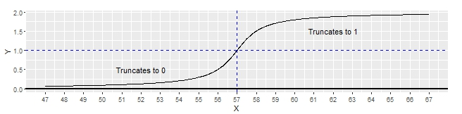
Home-grown activation function
Satellite orbital element set (ELSET) epoch data is in a unique format
ELSET epoch time uses two digits for the year, starting at 57.
1957 is the year the first artificial satellite – Sputnik I – was launched.
A user must add 1900 for years between 57 and 99, and add 2000 for all others.
The ELSET epoch time origin predates UNIX epoch time’s by thirteen years.

Slide 9
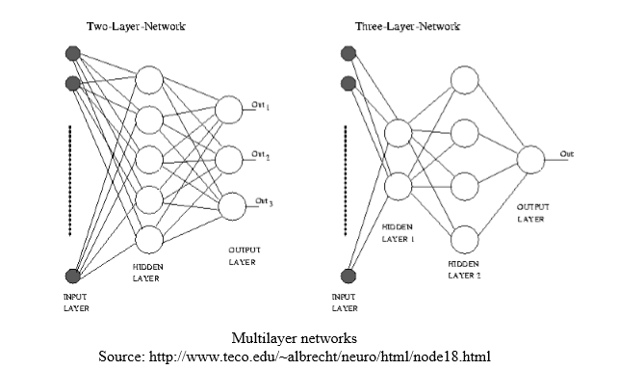
Network topology

Slide 10
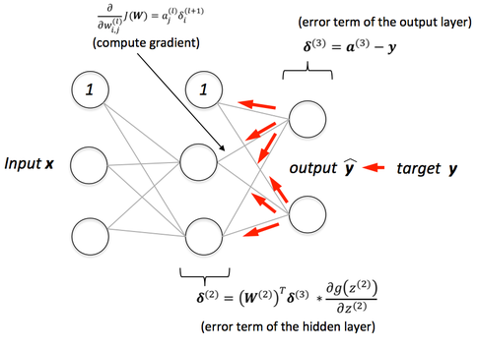
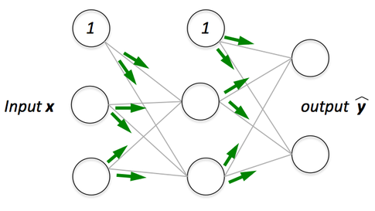
Loss functions and Backpropagation
https://sebastianraschka.com/faq/docs/visual-backpropagation.html
We need a way to find the best weights in the network
Make a prediction, calculate error, and move the weights in the direction that minimizes error
Notes:
Importance of Bias: The main function of Bias is to provide every node with a trainable constant value (in addition to the normal inputs that the node receives). See this link to learn more about the role of bias in a neuron. The bias nodes have a value of 1. https://ujjwalkarn.me/2016/08/09/quick-intro-neural-networks/
http://stackoverflow.com/questions/7175099/why-the-bias-is-necessary-in-ann-should-we-have-separate-bias-for-each-layer

Slide 11
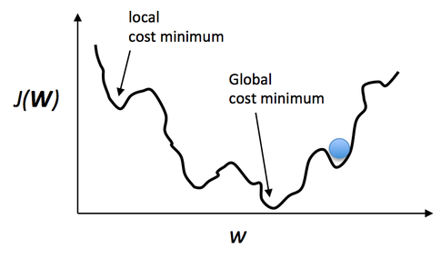
Loss functions and Backpropagation
https://sebastianraschka.com/faq/docs/visual-backpropagation.html
Keep doing this until our weights stop moving much
Called gradient descent, because we are descending down the slope of the loss function
Notes:
Link with the math:http://alexminnaar.com/deep-learning-basics-neural-networks-backpropagation-and-stochastic-gradient-descent.html

Slide 12
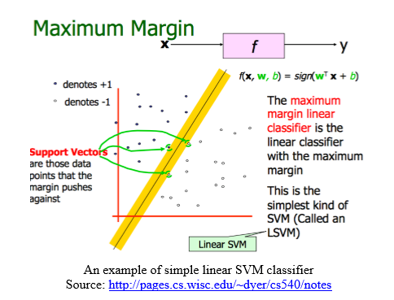
Support Vector Machine

Slide 13
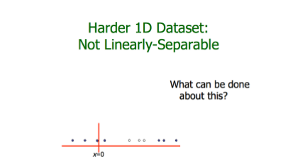

Slide 14
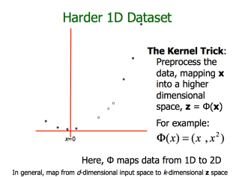

Slide 15
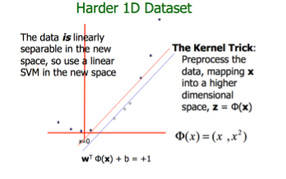

Slide 16
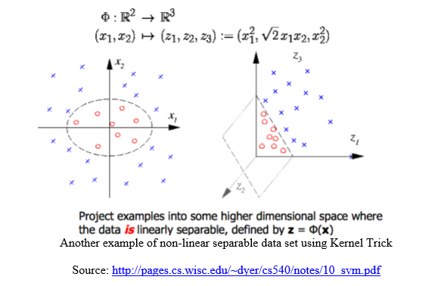

Slide 17
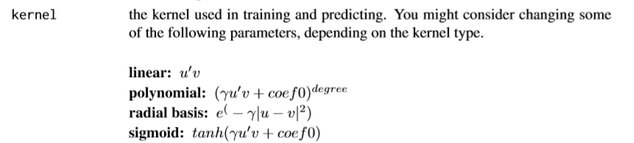
SVM Kernel
Radial bias kernel is another name for Gaussian kernel

Slide 18
Exercise
Texture classification: http://sci2s.ugr.es/keel/dataset.php?cod=72#sub2
Objective: to classify texture objects based on many attributes.
Various textures such as grass lawn, handmade paper, pressed calf leathered, canvas, etc. from 11 different categories (with 40 attributes) are measured.
From the given data set, build a classifier using neural network. Experiments with different parameters (e.g. learning rate), and network architecture (number of hidden nodes, number of layers, activation function, etc.). Report the best performance of your network, and its architecture.
From the given data set, build a classifier using SVM. Experiment with linear SVM, Gaussian kernel (AKA radial bias) SVM, and polynomial kernel SVM. Report the accuracy results.
Which one is the best? Why?
Compare the performance of neural networks with SVM.

Slide 19
Questions?

