Slide 1
Week Four: Decision Tree and Random Forest
Paul Andrus (pandrus@regis.edu) – pmandrus@gmail.com
College of Computer and Information Sciences, Regis University

Slide 2
Overview
Decision tree is a divide and conquer strategy where features are split into smaller subsets repeatedly. It can be used for classification and regression. Advantages of decision trees include simple, intuitive (close to the way we make decisions), and easy to interpret, etc.
Random forest is an ensemble method. The main concept is to grow many trees and aggregate the prediction results to improve the performance of the individual classifier. It is robust against overfitting, and has only few parameters to tune.

Slide 3
Outcomes
Explain the process of building a decision tree, and how to select split attributes.
Interpret the results from the decision tree.
Perform decision tree using R and conclude the results.
Explain how random forest works including its advantages.
Perform random forest using R and conclude the results.

Slide 4
Reading
Chiu, Y. (2015). Machine Learning with R cookbook. Packt Publishing (Chapters 5 & 8). ONLINE Book available via http://lumen.regis.edu/record=b1659405~S3.
Dyer, C. (2015). Slides on Decision Trees (Lecture: Introduction to Artificial Intelligence). Retrieved from http://pages.cs.wisc.edu/~dyer/cs540/notes/11_learning-decision-trees.pdf.
James, G., Witten, D., Hastie, T., and Tibshirabi, R. (2011). An Introduction to Statistical Learning with Applications in R (pages 303-332). ONLINE Book available via http://lumen.regis.edu/record=b1565362~S3.
Lantz, B. (2013). Machine Learning with R. Packt Publishing. (Chapter 5 Practice Decision Trees using R with an example). ONLINE Book available via http://lumen.regis.edu/record=b1633448~S3.
Montillo, A. A. (2009). Slides on Random Forest. Statistical foundations of data analysis. Temple University. Retrieved from http://www.dabi.temple.edu/~hbling/8590.002/Montillo_RandomForests_4-2-2009.pdf.
Page, D. (2015) Ensemble of Classifiers. Retrieved from http://pages.cs.wisc.edu/~dpage/cs760/ensembles.pdf.
Ross, A. (2015). Decision Trees (Lecture: Pattern Recognition and Analysis). Michigan State University. Retrieved from http://www.cse.msu.edu/~cse802/DecisionTrees.pdf.
Stephens, T. (2014). Titanic Getting Start with R. (Kaggle Competition). Retrieved from http://trevorstephens.com/post/72916401642/titanic-getting-started-with-r.

Slide 5
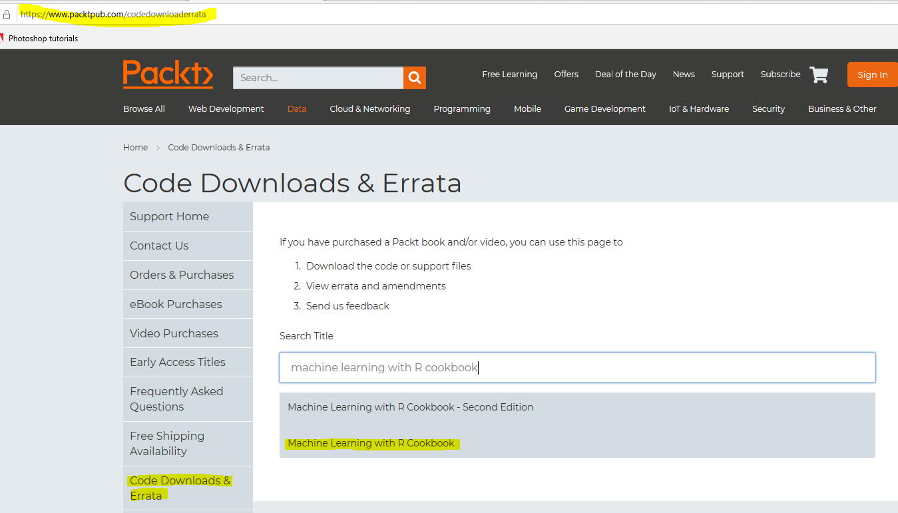
https://www.packtpub.com/codedownloaderrata

Slide 6


Slide 7
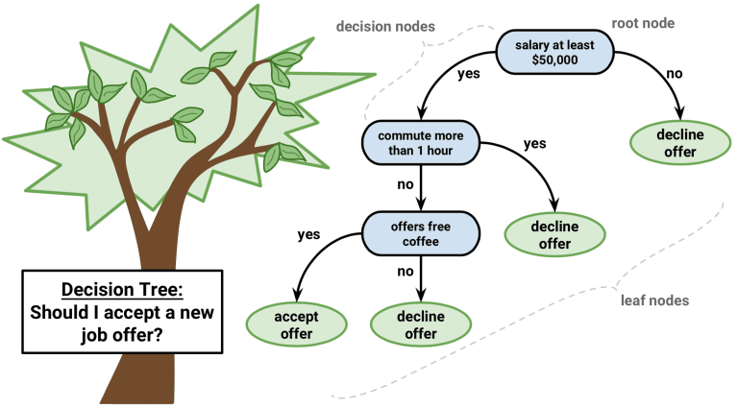
Decision trees
Notes:
Also see http://dataaspirant.com/2017/01/30/how-decision-tree-algorithm-works/

Slide 8
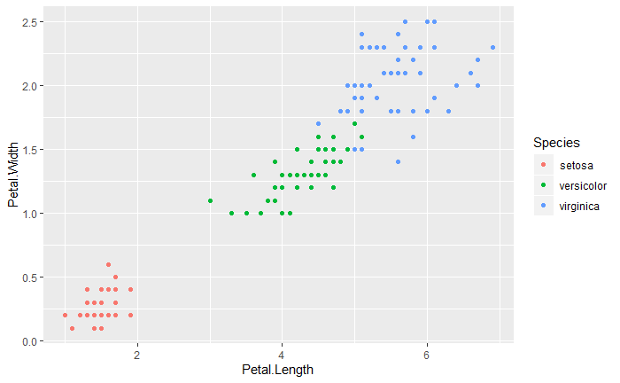

Slide 9
2.45
3.0
1.9

Slide 10
4 mis-classified points

Slide 11
4 mis-classified points

Slide 12
MyIris <- subset(iris, select = c("Petal.Length", "Petal.Width", "Species"))
set.seed(2)
ind <- sample(2, nrow(MyIris), replace = TRUE, prob = c(0.7, 0.3))
trainset <- MyIris[ind == 1, ]
testset <- MyIris[ind == 2, ]
nrow(trainset) + nrow(testset)
[1] 150

Slide 13
rpart()
Recursive Partitioning and Regression Trees
Recursive partitioning for classification, regression and survival trees. An implementation of most of the functionality of the 1984 book by Breiman, Friedman, Olshen and Stone.
Notes:
Survival analysis is a branch of statistical methods for investigating event occurrence— whether events occur and when events occur. https://www.ncbi.nlm.nih.gov/pmc/articles/PMC4409541/
Recursive partitioning is a statistical method for multivariable analysis.^{[1]} Recursive partitioning creates a decision tree that strives to correctly classify members of the population by splitting it into sub-populations based on several dichotomous independent variables. The process is termed recursive because each sub-population may in turn be split an indefinite number of times until the splitting process terminates after a particular stopping criterion is reached. https://en.wikipedia.org/wiki/Recursive_partitioning

Slide 14
Examples
fit <- rpart(Kyphosis ~ Age + Number + Start, data = kyphosis)
fit2 <- rpart(Kyphosis ~ Age + Number + Start, data = kyphosis, parms = list(prior = c(.65,.35), split = "information"))
fit3 <- rpart(Kyphosis ~ Age + Number + Start, data = kyphosis, control = rpart.control(cp = 0.05))
par(mfrow = c(1,2), xpd = NA) # otherwise on some devices the text is clipped
plot(fit)
text(fit, use.n = TRUE)
plot(fit2)
text(fit2, use.n = TRUE)

Slide 15
MyIris.rp <- rpart(Species ~ ., data = trainset)
n= 104
node), split, n, loss, yval, (yprob)
* denotes terminal node
1) root 104 68 versicolor (0.31730769 0.34615385 0.33653846)
2) Petal.Length< 2.45 33 0 setosa (1.00000000 0.00000000 0.00000000) *
3) Petal.Length>=2.45 71 35 versicolor (0.00000000 0.50704225 0.49295775)
6) Petal.Width< 1.7 38 3 versicolor (0.00000000 0.92105263 0.07894737) *
7) Petal.Width>=1.7 33 1 virginica (0.00000000 0.03030303 0.96969697) *

Slide 16
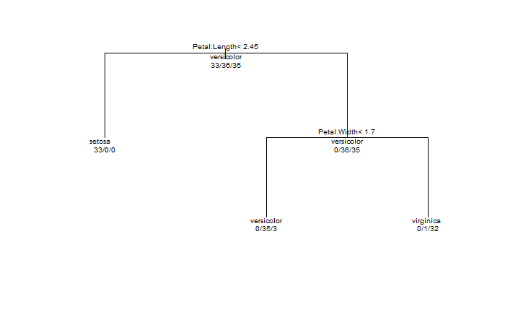
plot(MyIris.rp, margin = 0.1); text(MyIris.rp, all = TRUE, use.n = TRUE, cex = .6) # Added character expansion factor for readability
> levels(MyIris$Species)
[1] "setosa" "versicolor" "virginica"

Slide 17
Cost complexity parameter
Poorly documented
The benefit of another split divided by its cost in terms of model complexity
Bang for the buck

Slide 18
printcp(MyIris.rp)
Classification tree:
rpart(formula = Species ~ ., data = trainset)
Variables actually used in tree construction:
[1] Petal.Length Petal.Width
Root node error: 68/104 = 0.65385
n= 104
CP nsplit rel error xerror xstd
1 0.48529 0 1.000000 1.14706 0.064939
2 0.45588 1 0.514706 0.75000 0.074972
3 0.01000 2 0.058824 0.14706 0.044212

Slide 19
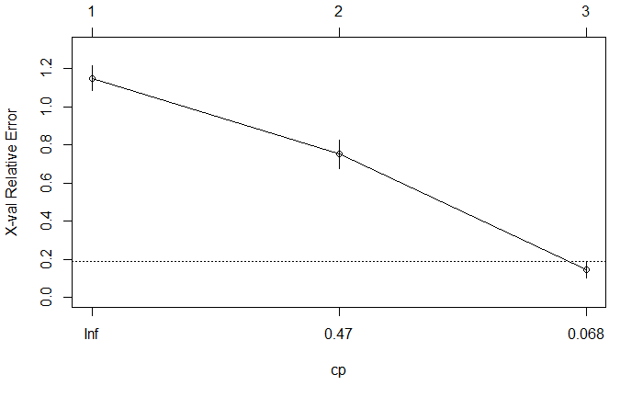
plotcp(MyIris.rp)
Notes:
The horizontal line is 1 standard error above the minimum. The standard error equals the standard deviation of the sample divided by the square root of the sample size.

Slide 20

x-validation relative error
RE = relative error
MAD = Mean Absolute Distance
Instance-Based Regression by Partitioning Feature Projections
ILHAN UYSAL AND H. ALTAY GÜVENIR
Department of Computer Engineering, Bilkent University, 06800 Ankara, Turkey
Notes:
The accuracy performance of the regression methods is based on the prediction error of the algorithms. Since the target values are continuous, the absolute difference between the prediction and the true target value in the test example is used. One common measure is mean absolute distan
However in order to get similar performance values for all datasets a modiﬁed version of MAD, namely relativeerror(RE),isusedintheexperiments.Relative error is the true mean absolute distance normalized by the mean absolute distance from the median.ce(MAD)[8,9].I t is the mean of absolute error found for all test examples.

Slide 21
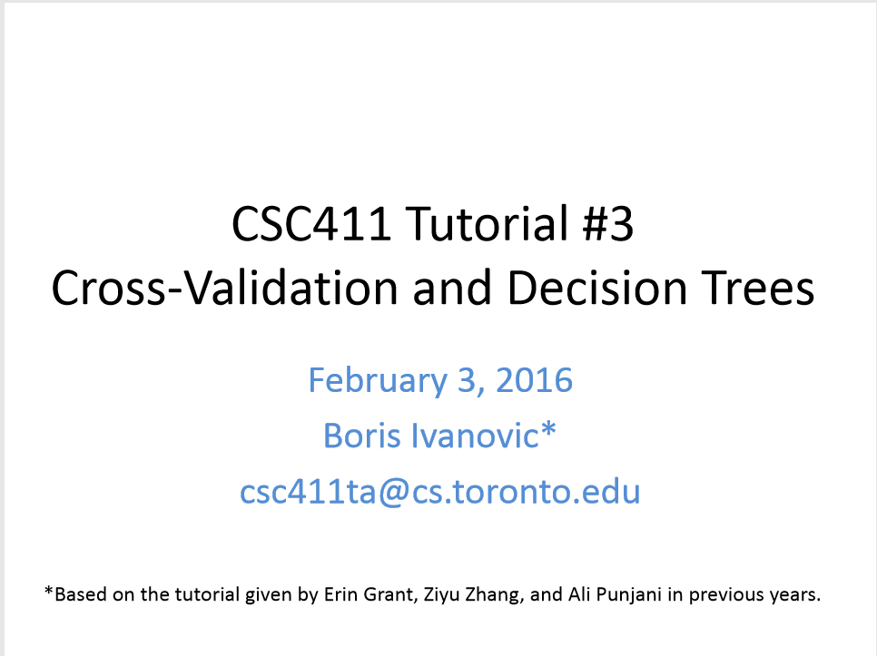

Slide 22
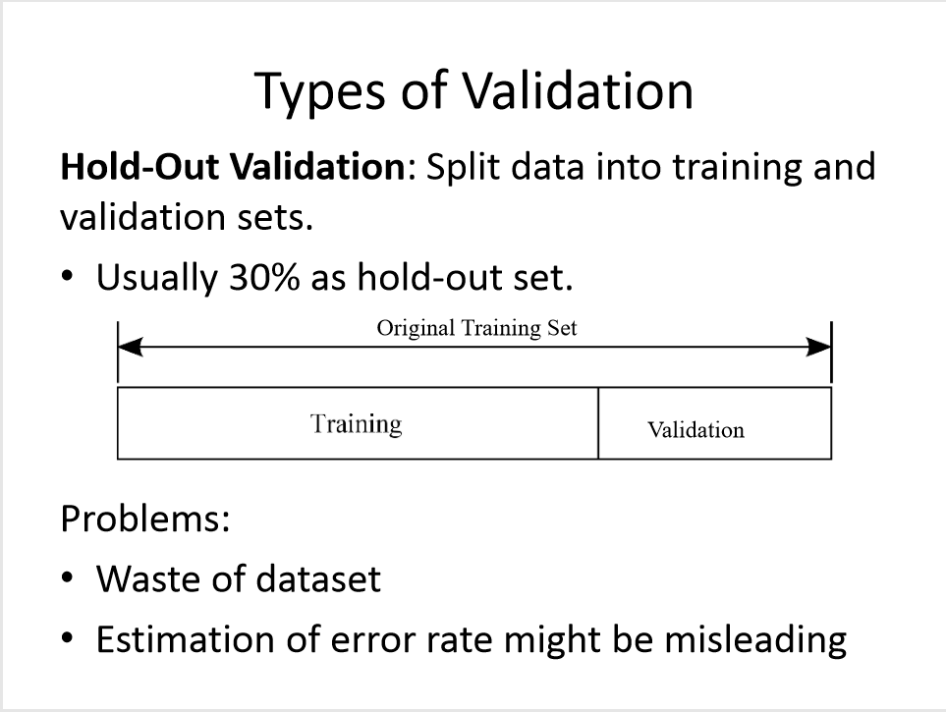

Slide 23
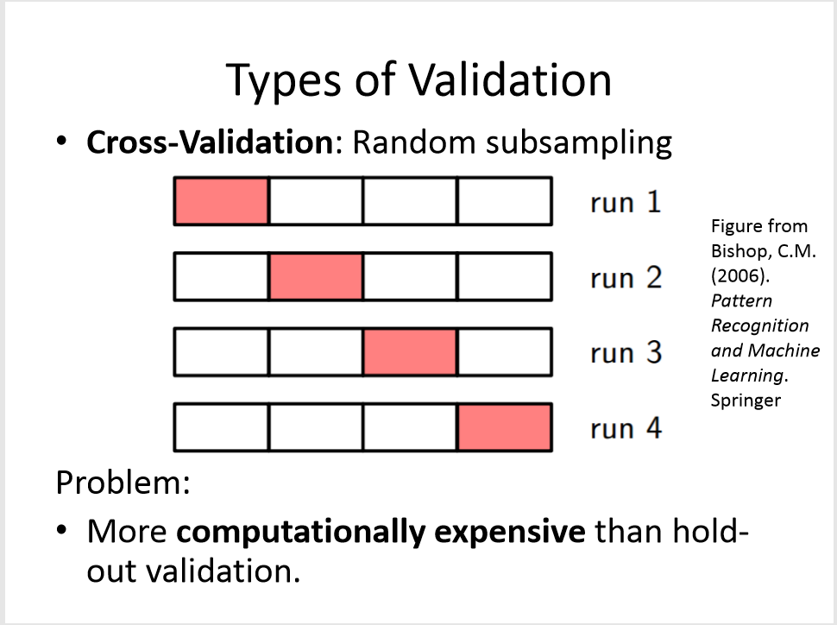

Slide 24
Minimum cross-validation error
Each split improved the model quality, up to a point
As overfitting became a problem, the model from the main set stopped working for the validation set
Model quality became worse with more splits
At what point was the cross-validation a minimum?

Slide 25
Pruning a tree
Set the cost complexity parameter to the CP of the record with the lowest cross-validation error
min(churn.rp$cptable[,"xerror"]) # What is the minimum cross-validation error value?
which.min(churn.rp$cptable[,"xerror"]) # Which record has the minimum cross-validation error?
churn.cp = churn.rp$cptable[8,"CP"] # 8 is the return from which.min()
prune.tree <- prune(churn.rp, cp = churn.cp) # Prune the tree by using the CP

Slide 26
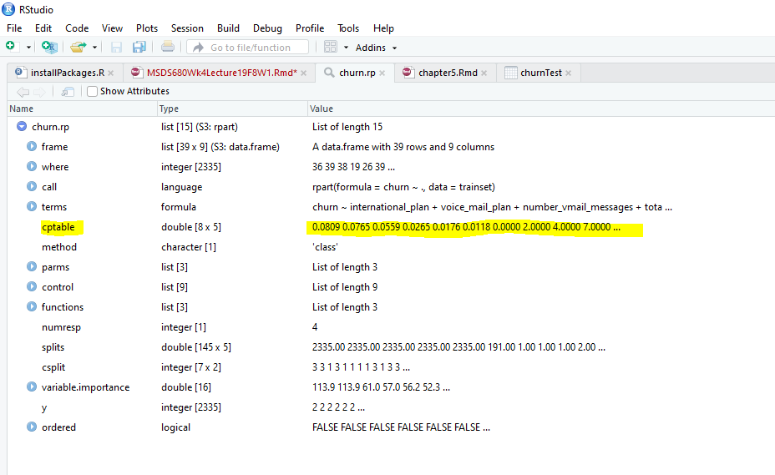
min(churn.rp$cptable[,"xerror"]) # What is the minimum cross-validation error value?

Slide 27
Random Forest
Ensemble method
A forest of decision trees
Which performs best?
Bootstrap is a statistical resampling method. The sample points are drawn randomly with replacement.
Bagging (Bootstrap aggregating)
Notes:
In bagging, repeated sample is drawn with replacements from the same data set (multiple copies created from the original training data set). A classifier (e.g. tree), then, learns from each bootstrap sample or a separate decision tree fits each copy. After that all classifiers are aggregated (e.g. average for regression tree, and majority vote for classification tree) to create a single predictive model for classifying sample points from the test set.
Bagging can be applied to any type of method but it is usually used with decision trees. Some advantages include avoiding overfitting, and reducing variance. In addition, it is easy to train the classifier in parallel. Bagging is suitable for unstable learners (e.g. small change in the training sets results in large variation in the classification such as decision tree and neural network) [Langseth, 2012].

Slide 28
Exercise
Wine data: https://archive.ics.uci.edu/ml/machine-learning-databases/wine/
Objective is to predict wines quality ranking from the its chemical properties. This provide guidance to vineyards regarding quality of wine and price expected without heavy reliance on the tasters.
Predict the wine quality using decision tree. What is the result? What is the accuracy of your tree model? Plot and interpret the tree. Summarize your finding.
Predict the wine quality using random forest. What is the result compared to decision tree? Conclude your findings.
See Chiu “Machine Learning with R Cookbook” Chapter 5
https://www.packtpub.com/big-data-and-business-intelligence/machine-learning-r-cookbook-second-edition $10 for the e-book

Slide 29
Project
German credit data: https://archive.ics.uci.edu/ml/datasets/Statlog+(German+Credit+Data)
Objective is to minimize loss from the bank’s perspective.
Bank (by loan manager) needs to decide who will get loan approval based on the applicants’ demographic and socio-economic profiles. The data set consists of 20 variables and classification on applicant whether he/she has good or bad credit risk. The predictive model will provide guidance in making loan approval decision on prospective applicants based on clients’ profiles.
From the given data set, perform the task using decision tree. What are your findings? Plot and interpret the tree.
Prune the tree from the previous result. Does the pruned tree show any performance improvement? What attributes are found in the pruned tree? Conclude your finding.
From the given data set, perform the task using random forest. Summarize your finding. Compare results of decision tree and random forest.

Slide 30
Questions?

