Slide 1
PIZZAZ.com data analysis
Prepared by Joanne Musa

Slide 2
Outcomes
DETERMINE BEST PREDICTORS FOR “LIKE” to optimally match couples
DETERMINE A BEST EQUATION TO PREDICT “LIKE”
DETERMINE IF AGE DIFFERENCE IS SIGNIFICANT
DETERMINE IF RACE IS SIGNIFICANT

Slide 3
DESCRIPTIVE STATISTICS
MEAN AGE OF MALES AND FEMALES IS ABOUT 26 YEARS OLD
THE MEAN AGE DIFFERENCE OF DATING COUPLES IS ABOUT 3.8 YEARS AND TYPICAL VARIATION OF ABOUT 3.2 YEARS.
MALES AND FEMALES HAVE VERY SIMILAR MEAN scores FOR almost ALL VARIABLES
OF THE 63 SUCCESS DATES (BOTH MALE AND FEMALE MUTUALLY WANTED TO SEE EACH OTHER AGAIN), ATTRACTIVE, SINCERE, INTELLIGENT, AND FUN HAD THE HIGHEST MEAN SCORES
THE HIGHEST CORRELATED VARIABLES to Like are attractive and fun
119 dates are of the same race, 151 dates are of different races, 6 dates are inconsistent with same race due to missing values

Slide 4
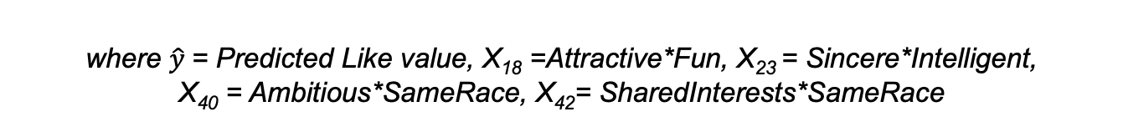
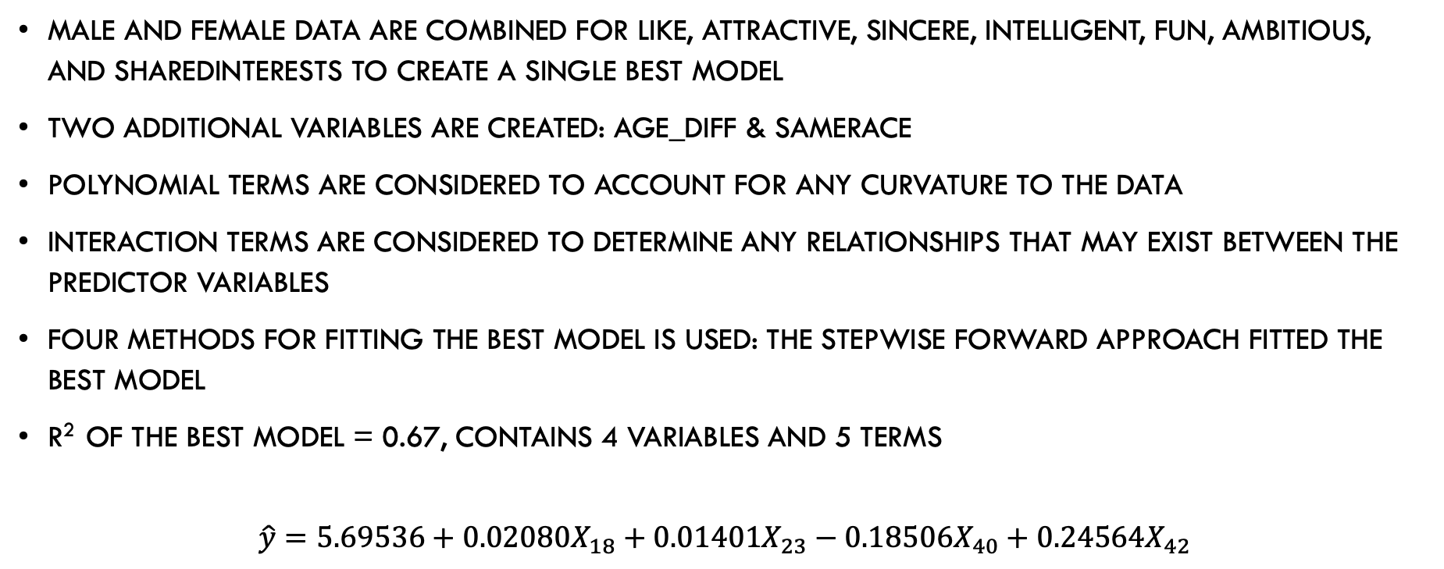
BUILDING THE BEST MODEL
MALE AND FEMALE DATA are COMBINED FOR LIKE, ATTRACTIVE, SINCERE, Intelligent, FUN, AMBITIOUS, AND SHAREDINTERESTS TO CREATE A SINGLE BEST MODEL
Two additional variables are created: Age_diff & samerace
POLYNOMIAL terms ARE CONSIDERED TO ACCOUNT FOR ANY CURVATURE TO THE DATA
INTERACTION TERMS Are considered to determine ANY RELATIONSHIPS THAT MAY EXIST BETWEEN THE PREDICTOR VARIABLES
Four methods for fitting the best model is used: THE STEPWISE FORWARD APPROACH FITTED THE BEST MODEL
R² of the best model = 0.67, contains 4 variables and 5 terms
$$\hat{y}=5.69536+0.02080X_{18}+0.01401X_{23}−0.18506X_{40}+0.24564X_{42}$$
where $\hat{y}$= Predicted Like value, X₁₈ =Attractive*Fun, X₂₃ = Sincere*Intelligent,
X₄₀ = Ambitious*SameRace, X₄₂= SharedInterests*SameRace

Slide 5
DIAGNOSTICS
DATA ERRORS: NO DATA ENTRY ERRORS APPARENT, SAMPLE SIZE = 276, MISSING DATA ARE LISTED (TABLE 3)
OUTLIERS: JACKKNIFE RESIDUALS & BOXPLOT METHODS EMPLOYED
BOXPLOT: OBSERVATIONS 116, 151, 252, 260 ARE IDENTIFIED AS OUTLIERS
JACKKNIFE RESIDUALS: OBSERVATIONS 50, 62, 97, 116, 133, 151, 252, 260 ARE IDENTIFIED AS OUTLIERS
high outliers: observations 62, 97, and 133 are high outliers identified by jackknife residuals only; investigation of these observations may be considered due to concerns of inflated scores
ASSUMPTIONS: NORMALITY, E(E_{O}) = 0, HOMOGENEITY, AND INDEPENDENCE ARE ALL SATISTIFIED
COLLINEARITY: NO COLLINEARITY PROBLEMS WITH THE BEST MODEL

Slide 6
RELIABILITY
SPLIT SAMPLE ANAYSIS (CROSS VALIDATION) is used to assess reliability of the model.
Results of this process confirmed that the Best MODEL IS RELIABLE

Slide 7
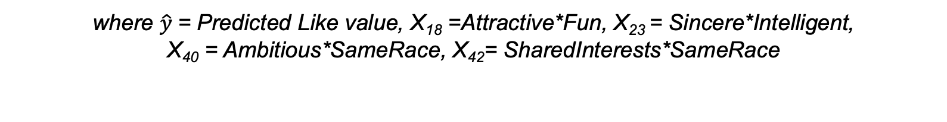
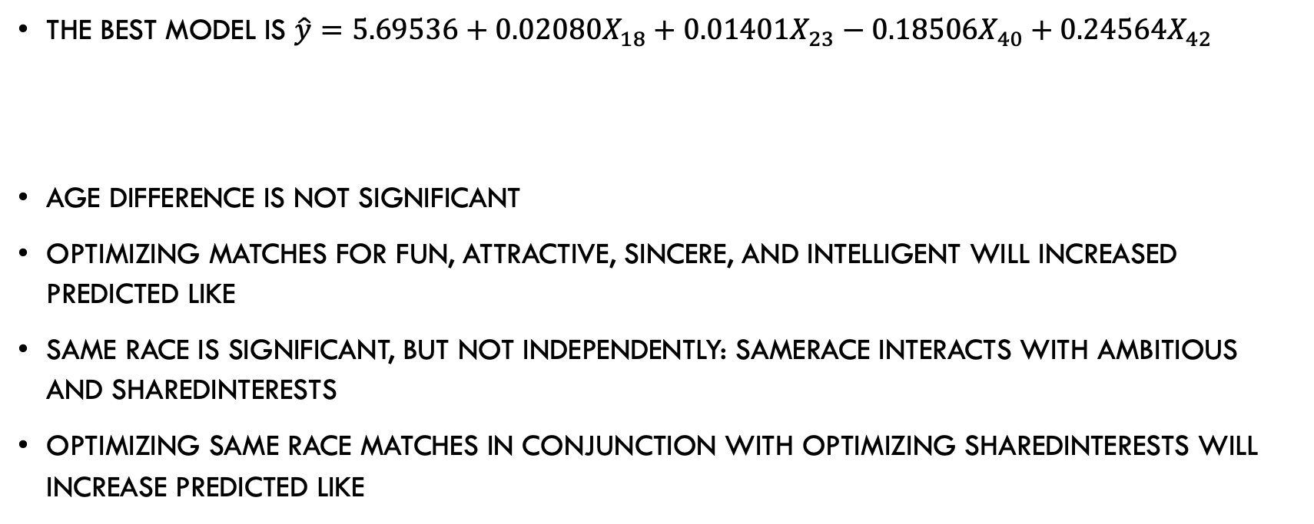
Conclusion
The best model is $\hat{y}=5.69536+0.02080X_{18}+0.01401X_{23}−0.18506X_{40}+0.24564X_{42}$
Age difference is not significant
Optimizing matches for fun, attractive, sincere, and intelligent will increased predicted like
Same Race is significant, but not independently: SameRace interacts with ambitious and sharedinterests
Optimizing same race matches in conjunction with optimizing sharedinterests will increase predicted like
where $\hat{y}$= Predicted Like value, X₁₈ =Attractive*Fun, X₂₃ = Sincere*Intelligent,
X₄₀ = Ambitious*SameRace, X₄₂= SharedInterests*SameRace

