Slide 1
CSE 557 Final Project: Parallelization of Ray Tracing
Jamin Valick

Slide 2
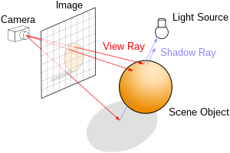
Ray Tracing

Slide 3
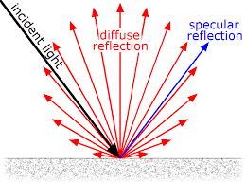
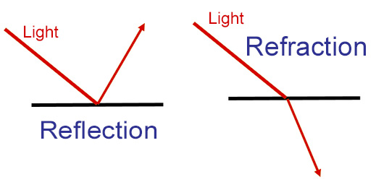
Algorithm
For every pixel:
Test intersection (most of the math)
Get ambient color and texture color (optional) of intersected object
Get diffuse and specular color of intersected object
Get color of reflected and refracted ray with recursion

Slide 4
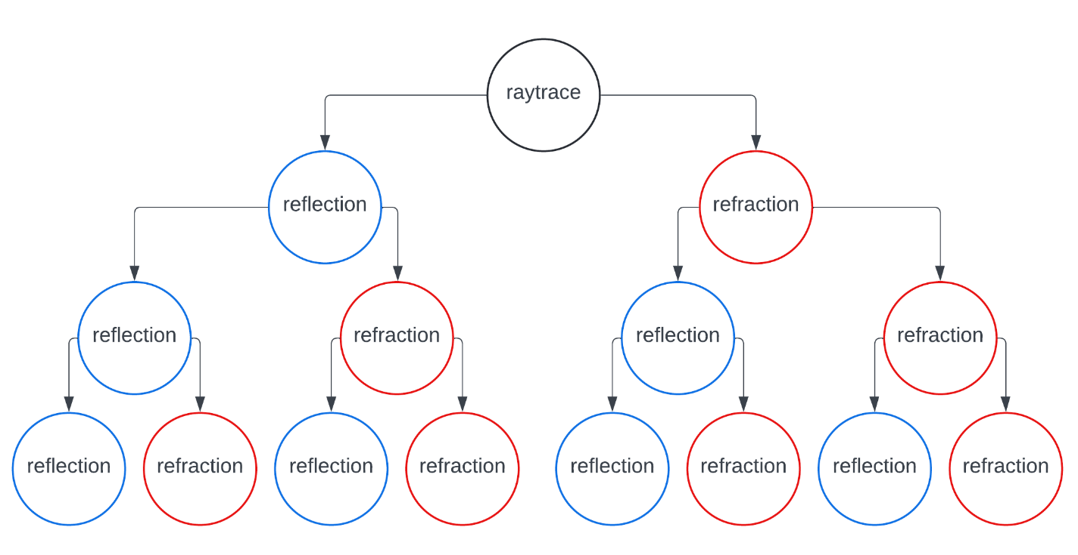

Slide 5
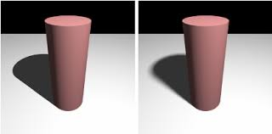
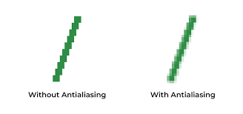
Increasing Samples
Taking multiple samples per pixel and averaging the colors reduces aliasing
Taking multiple shadow rays for each pixel adds soft shadows and smoothing
Side Effects:
Increases work and runtime
Adds noise

Slide 6
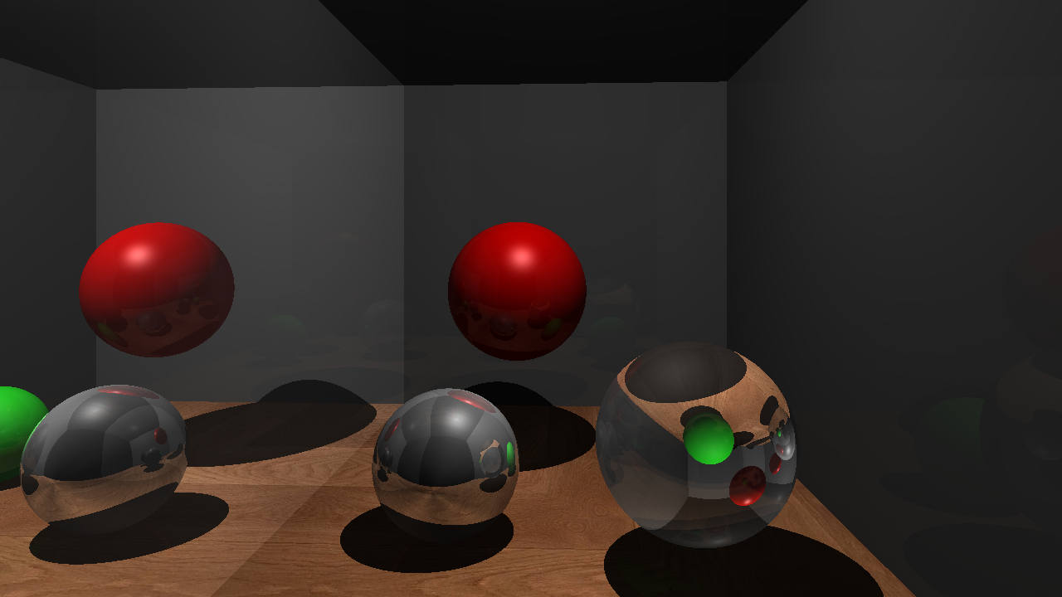
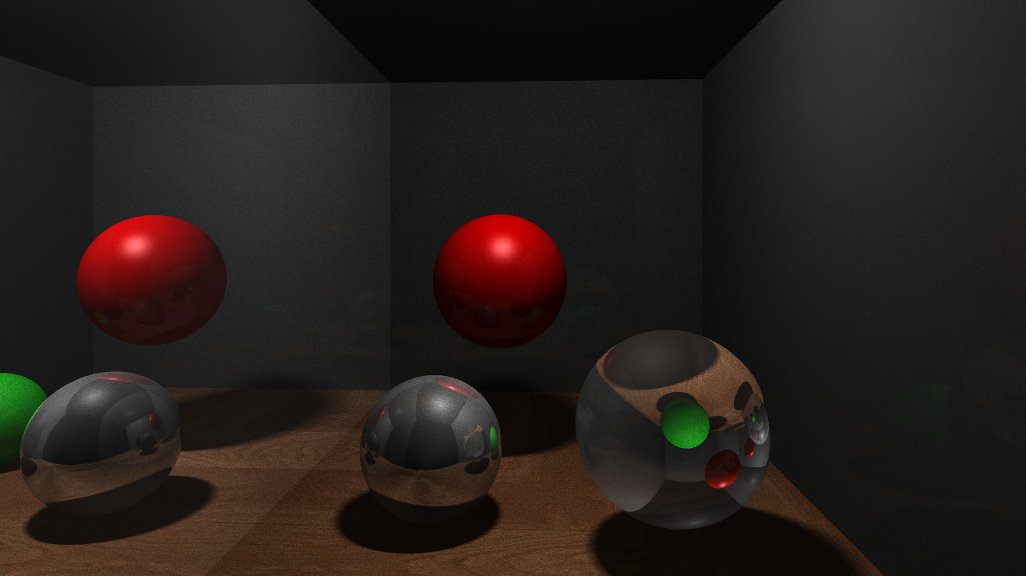
1 sample and 1 shadow ray per pixel
8 samples and 8 shadow rays per pixel

Slide 7
Parallelization Opportunities
for (int y = 0; y < SCR_HEIGHT; y++)
for (int x = 0; x < SCR_WIDTH; x++)
for (int sample = 0; sample < SAMPLES_PER_PIXEL; sample++)
currentColor = myScene->rayTrace(eye, direction, 0);

