Slide 1
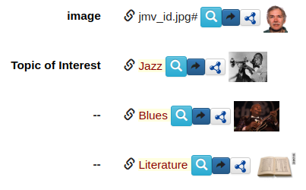
semantic_forms - http://semantic-forms.cc:9112/
social LOD network + data management
built on a web framework,
itself built on SPARQL
data aggregation: semantic cache
Simple Open Source solution (13,000 lines)
  zip distribution; only dependancy Java 8
Scala language, Scala XHTML as template language
Triple store: Apache Jena TDB
Web developer friendly API (plain JSON)
Browser
LOD
RDF, OWL
(LDP)
JavaScript code
HTML, JSON-LD
SPARQL
SPARQL clients
access control,
history,
cache

