Slide 1
Chapter 6: ER – Entity Relationship Diagram
Major components of ER diagram
Practices
Yan Huang - ER

Slide 2
ER
1976 proposed by Peter Chen
ER diagram is widely used in database design
  Represent conceptual level of a database system
  Describe things and their relationships in high level
Yan Huang - ER

Slide 3
Basic Concepts
Entity set – an abstraction of similar things, e.g. cars, students
  An entity set contains many entities
Attributes: common properties of the entities in a entity sets
Relationship – specify the relations among entities from two or more entity sets
Yan Huang - ER

Slide 4

An Example
Yan Huang - ER

Slide 5
Relationship
A relationship may be thought as a set as well
  For binary relationship, it enumerates the pairs of entities that relate to each other
  For example, entity set M = {Mike, Jack, Tom} entity set F = {Mary, Kate}. The relationship set married between M and F may be {<Mike,Mary>,<Tom, Kate>}
Yan Huang - ER

Slide 6
Relationship
A relationship set is a mathematical relation among n ≥ 2 entities, each taken from entity sets
{(e₁, e₂, … e_{n}) | e₁ ∈ E₁, e₂ ∈ E₂, …, e_{n} ∈ E_{n}}
where (e₁, e₂, …, e_{n}) is a relationship
  Example:
  (Hayes, A-102) ∈ depositor
Yan Huang - ER

Slide 7

Relationship Example
Yan Huang - ER

Slide 8

Attribute of A Relationship Set
Yan Huang - ER

Slide 9
Relationship
The degree of a relationship = the number of entity sets that participate in the relationship
  Mostly binary relationships
  Sometimes more
Mapping cardinality of a relationship
  1 –1
  1 – many
  many – 1
  Many-many
Yan Huang - ER

Slide 10

One-One and One-Many
Yan Huang - ER

Slide 11

Many-one and many-many
Yan Huang - ER

Slide 12

1- many
Yan Huang - ER

Slide 13
Many - 1
Yan Huang - ER

Slide 14
Many - many
Yan Huang - ER

Slide 15

Alternative Cardinality Specification
Yan Huang -CSCE4350 - ER

Slide 16
Note on Mapping Cardinality
Both many and 1 include 0
  Meaning some entity may not participate in the relationship
Yan Huang - ER

Slide 17

Total Participation
When we require all entities to participate in the relationship (total participation), we use double lines to specify
Every loan has to have at least one customer
Yan Huang - ER

Slide 18

Self Relationship
Sometimes entities in a entity set may relate to other entities in the same set. Thus self relationship
Here employees mange some other employees
The labels “manger” and “worker” are called roles the self relationship
Yan Huang - ER

Slide 19
More examples on self-relationship
People to people
  Parent – children
  Manager – employee
  Husband – wife
Word to word
  Root – synonym
Yan Huang - ER

Slide 20
Attributes
Both entity sets and relationships can have attributes
Attributes may be
  Composite
  Multi-valued (double ellipse)
  Derive (dashed ellipse)
Yan Huang 350 - ER

Slide 21

Another Example
Yan Huang - ER

Slide 22
Keys
A super key of an entity set is a set of one or more attributes whose values uniquely determine each entity.
A candidate key of an entity set is a minimal super key
Although several candidate keys may exist, one of the candidate keys is selected to be the primary key.
Yan Huang - ER

Slide 23
Key Examples
Suggest super keys for the following entity?
What are the candidate keys?
Primary key?
author
name
death
birthday
description
Yan Huang - ER

Slide 24

Ternary Relationship
Yan Huang - - ER

Slide 25
Can We Decompose a Ternary Relationship?
Some relationships that appear to be non-binary may be better represented using binary relationships
  E.g. A ternary relationship parents, relating a child to his/her father and mother, is best replaced by two binary relationships, father and mother
    Using two binary relationships allows partial information (e.g. only mother being know)
  But there are some relationships that are naturally non-binary
    E.g. works-on, why?
Yan Huang - ER

Slide 26
Converting Ternary to binary
In general, any non-binary relationship can be represented using binary relationships by creating an artificial entity set.
  Replace R between entity sets A, B and C by an entity set E, and three relationship sets:
1. R_{A}, relating E and A 2.R_{B}, relating E and B
3. R_{C}, relating E and C
  Create a special identifying attribute for E
  Add any attributes of R to E
  For each relationship (a_{i} , b_{i} , c_{i}) in R, create
1. a new entity e_{i} in the entity set E 2. add (e_{i} , a_{i} ) to R_{A}
3. add (e_{i} , b_{i} ) to R_{B} 4. add (e_{i} , c_{i} ) to R_{C}
Yan Huang - ER

Slide 27

Converting Ternary to binary
Yan Huang - ER

Slide 28
Design an ER Diagram
Design a database for an on-line reservation system for microscopes in material science lab
There are two types of users: microscope administrators and microscope end users
Each microscope is located in a specific lab
Each request is assigned to an administrator who can authorize or deny the request
Using of some microscope requires the presence of an administrator
Time is divided into 1 hour slots. Each reservation can only take one or more time slots
Yan Huang - ER

Slide 29
Weak Entity Set
Some entity sets in real world naturally depend on some other entity set
  They can be uniquely identified only if combined with another entity set
Example:
  section1, section2, … become unique only if you put them into a context, e.g. csce4350
Yan Huang - ER

Slide 30

Weak Entity Set Notations
Double rectangles for weak entity set
Double diamond for weak entity relationship
Dashed underscore for discriminator
Yan Huang - ER

Slide 31
Specialization
A lower-level entity set inherits all the attributes and relationship participation of the higher-level entity set to which it is linked.
A lower-level entity set may have additional attributes and participate in additional relationships
Yan Huang - ER

Slide 32

Yan Huang - ER

Slide 33
Specification
Disjoint
Completeness constraint (use double lines)
  total : an entity must belong to one of the lower-level entity sets
  partial: an entity need not belong to one of the lower-level entity sets
Yan Huang - ER

Slide 34
Design Considerations
Use of entity sets vs. attributes
  Whether we want to keep additional information
Use of entity sets vs. relationship sets
  Actions among entities are usually represented by relationships
Binary versus n-ary relationship sets
  N-nary relationships are usually more natural for actions among entity sets
Weak entity set vs. strong entity set
Generalization
Yan Huang - ER

Slide 35

Notations
Yan Huang - ER

Slide 36
Notations
Yan Huang - ER

Slide 37
ER Practice Again
Design an ER diagram for an online music store. The database will contain at least the following concepts: songs, artists, bands, albums, and genres.
State your design assumptions you make to support design decisions. Be sure your assumptions are reasonable.
Yan Huang - ER

Slide 38
Best Practice Guide for ER Design
Use of entity sets vs. attributes
Use of entity sets vs. relationship sets
Binary versus n-ary relationship sets
Weak entity set vs. strong entity set
  Choose the natural one
Generalization
  If specialized entities need to keep additional information and participate in additional relationships
Yan Huang CE4350 - ER

Slide 39
ER for Banking Enterprise
Description handhout
Yan Huang - ER

Slide 40
Read ER Diagrams
Following are some ER diagrams grabbed from the web
Read to understand/criticize
Yan Huang - ER

Slide 41
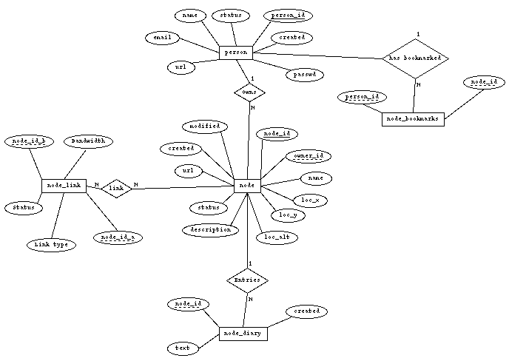
?
?
?
?
?
?
?
?
?
Yan Huang - ER

Slide 42
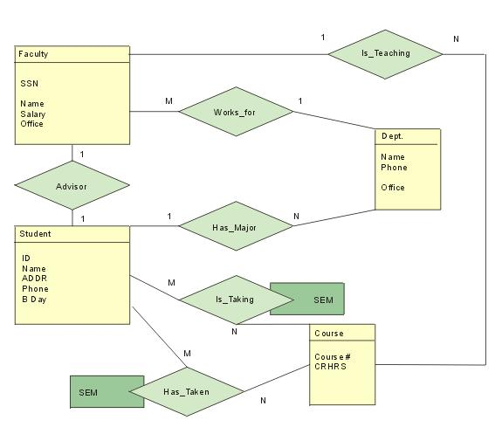
?
?
?
?
?
Yan Huang -CSCE4350 - ER

Slide 43
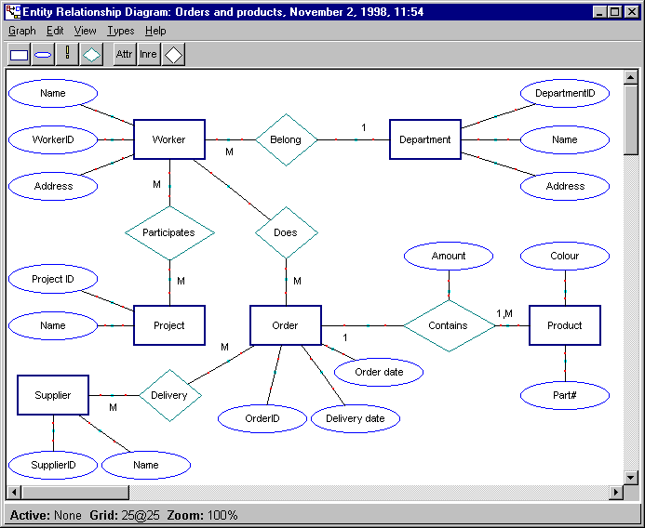
?
Yan Huang -CSCE4350 - ER

Slide 44
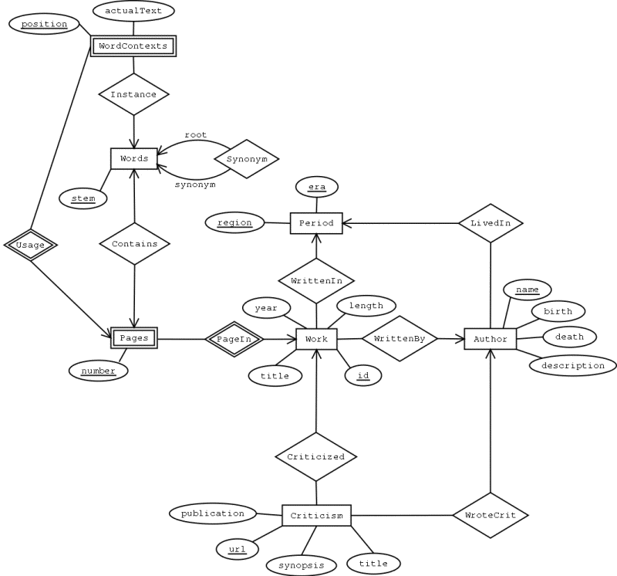
Yan Huang -CSCE4350 - ER

