Slide 1
The (min,max) notation
(0,1)
(1,1)
Employee
Manages
Department
(1,1)
(1,N)
Employee
Department
Works-for

Slide 2
SUMMARY OF ER-DIAGRAM
NOTATION FOR ER SCHEMAS
Symbol
Meaning
ENTITY TYPE
WEAK ENTITY TYPE
RELATIONSHIP TYPE
IDENTIFYING RELATIONSHIP TYPE
ATTRIBUTE
KEY ATTRIBUTE
MULTIVALUED ATTRIBUTE
COMPOSITE ATTRIBUTE
DERIVED ATTRIBUTE
TOTAL PARTICIPATION OF E₂ IN R
CARDINALITY RATIO 1:N FOR E₁:E₂ IN R
STRUCTURAL CONSTRAINT (min, max) ON PARTICIPATION OF E IN R
E₁
R
E₂
E₁
R
N
E₂
R
(min,max)
E

Slide 3
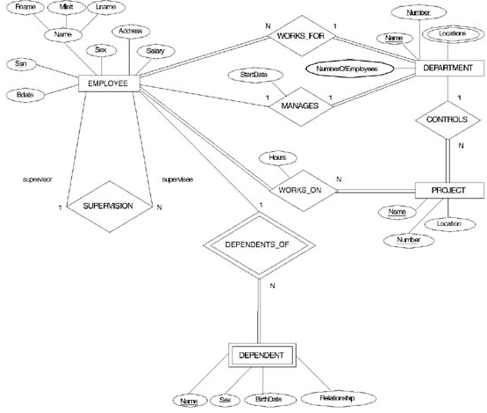
ER DIAGRAM – Entity Types are:
EMPLOYEE, DEPARTMENT, PROJECT, DEPENDENT

Slide 4
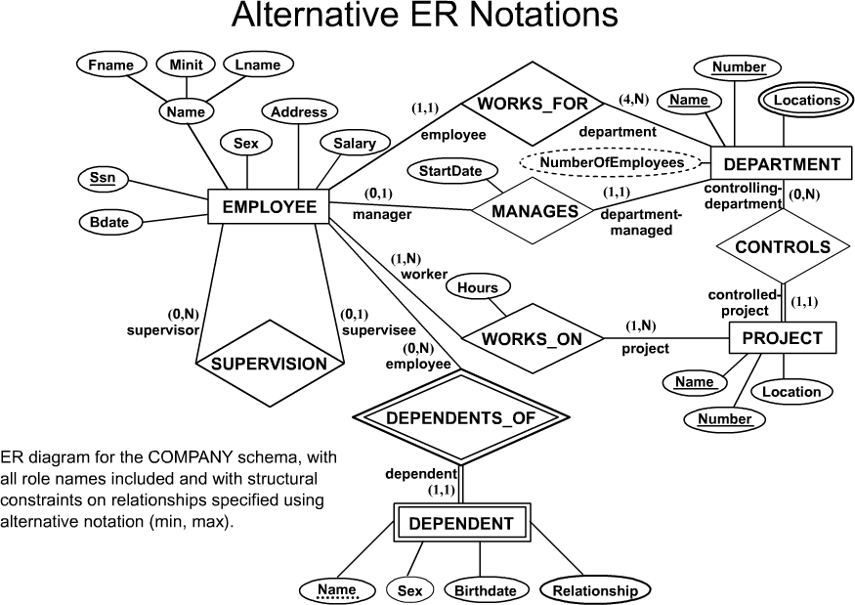
COMPANY ER Schema Diagram using (min, max) notation

Slide 5
Designing an ER Diagram
Consider the following set of requirements for a University database. Design an ER diagram for this application:
The university keeps track of each student's name, student number, social security number, current address and phone number, permanent address and phone number, birthdate, sex, class (freshman, graduate), major department, minor department (if any), degree program (B.A., B.S., ... Ph.D.). Some user applications need to refer to the city, state, and zip code of the student's permanent address and to the student's last name. Both social security number and student number are unique for each student. All students will have at least a major department.
Each department is described by a name, department code, office number, office phone, and college. Both the name and code have unique values for each department.
Each course has a course name, description, course number, number of credits, level and offering department. The course number is unique for each course.
Each section has an instructor, semester, year, course, and section number. The section number distinguishes sections of the same course that are taught during the same semester/year; its value is an integer (1, 2, 3, ... up to the number of sections taught during each semester).
A grade report must be generated for each student that lists the section, letter grade, and numeric grade (0,1,2,3, or 4) for each student and calculates his or her average GPA.

Slide 6
University ER Diagram
Degree
Major In
DName
DCode
OfficeNumber
Name
StudentID
SSN
Birth date
Department
OfficePhone
Sex
Student
Minor In
College
Class
Address
Offer
City
State
Zip
Grade_Report
CName
CourseDesc
Letter Grade
Instructor
Year
Course
GPA
CNumber
Belong_To
Credits
Numeric Grade
Section
SectionNumber
Semester

Slide 7
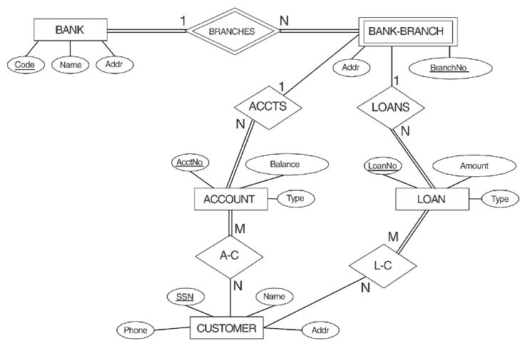
ER DIAGRAM FOR A BANK
DATABASE
© The Benjamin/Cummings Publishing Company, Inc. 1994, Elmasri/Navathe, Fundamentals of Database Systems, Second Edition

Slide 8
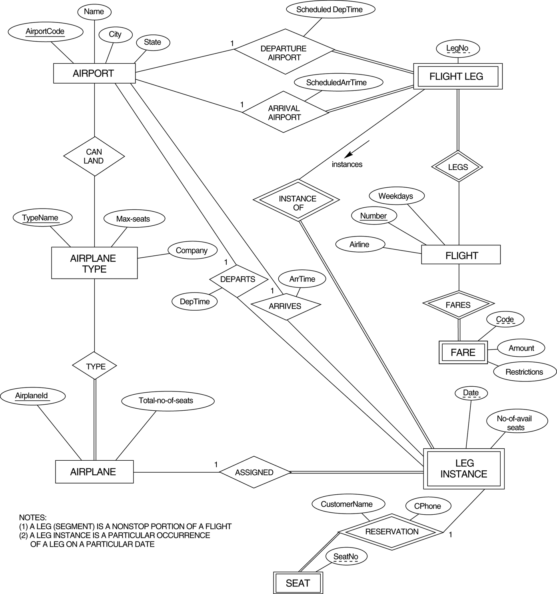
FIGURE 3.17
An ER diagram for an AIRLINE database schema.

