Slide 1
Chapter 2: Entity-Relationship Model

Slide 2
Entity Relationship Model
The E-R data model is based on a perception of a real world that consists of basic objects called entities and of relationships among these objects.
It was developed to facilitate database design by allowing the specification of an enterprise schema, which represents the overall logical structure of a database.
E-R data model is one of several semantic data models; the semantic aspect of the model lies in the attempt to represent the meaning of the data.

Slide 3
Entity Relationship Model
A database can be modeled as:
a collection of entities,
relationship among entities.
An entity is an object that exists and is distinguishable from other objects.
Example: specific person, company, event, plant
Entities have attributes. Attributes are descriptive properties possessed by each member of an entity set.
Example: people have names and addresses
An entity set is a set of entities of the same type that share the same properties, or attributes.
Example: set of all persons, companies, trees, holidays
An entity is represented by a set of attributes.

Slide 4
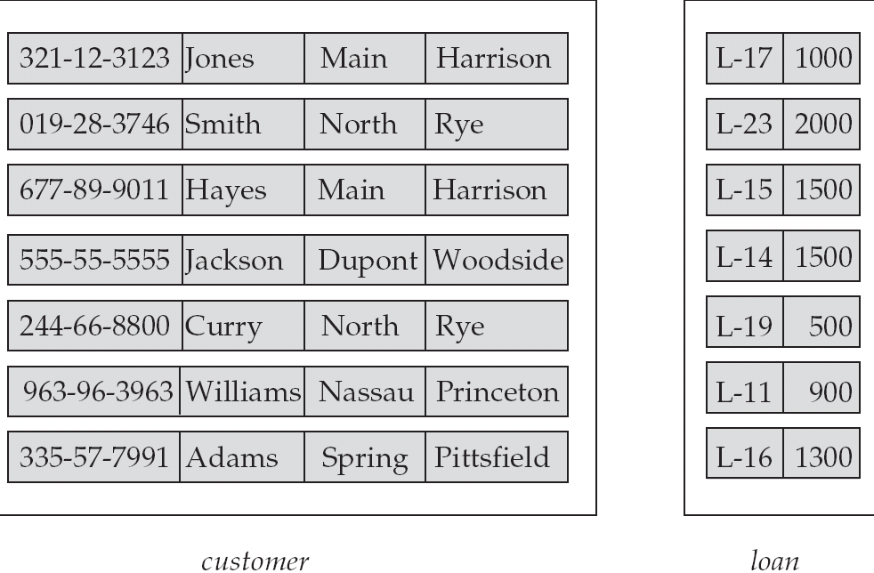
Entity Sets customer and loan
customer_id customer_ customer_ customer_ loan_ amount name street city number

Slide 5
Attributes
An entity is represented by a set of attributes, that is descriptive properties possessed by all members of an entity set.
Domain – the set of permitted values for each attribute
Attribute types:
Simple and composite attributes.
Single-valued and multi-valued attributes
Derived attributes
Can be computed from other attributes
Example: age, given date_of_birth
Example:
customer = (customer_id, customer_name, customer_street, customer_city ) loan = (loan_number, amount )

Slide 6
Simple and composite attributes:-
- Simple attributes are not divided into subparts.
- Composite attributes can be divided further.
For e.g. Name could be structured as composite attribute consisting of first-name and last-name.
Composite attributes helps to group together related attributes, making the modeling cleaner.
Single- valued and multi-valued attributes:-
- Mostly all attributes are single valued.
- An attribute that has a set of values for a specific entity is called multi valued attribute.
E.g. Dependant name for an employee.
Derived attributes:- Can be computed from other attributes
E.g. Age, given date_of_birth.

Slide 7
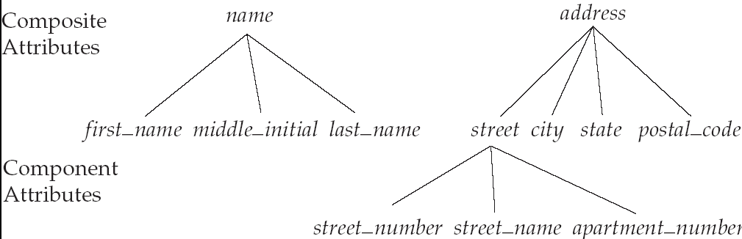
Composite Attributes

Slide 8
Relationship Sets
A relationship is an association among several entities
Example: Hayes depositor A-102 customer entity relationship set account entity
A relationship set is a mathematical relation among n ≥ 2 entities, each taken from entity sets
{(e₁, e₂, … e_{n}) | e₁ ∈ E₁, e₂ ∈ E₂, …, e_{n} ∈ E_{n}} where (e₁, e₂, …, e_{n}) is a relationship
Example:
(Hayes, A-102) ∈ depositor

Slide 9
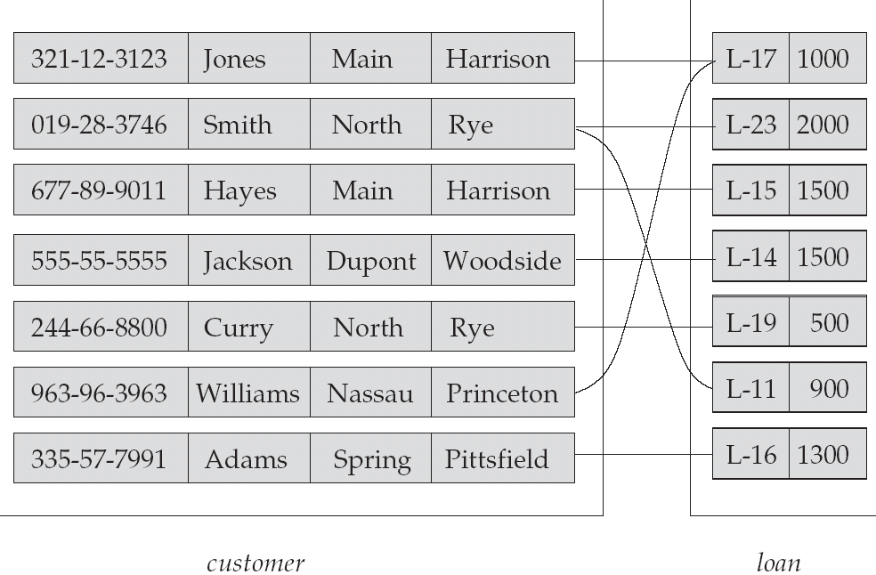
Relationship Set borrower

Slide 10
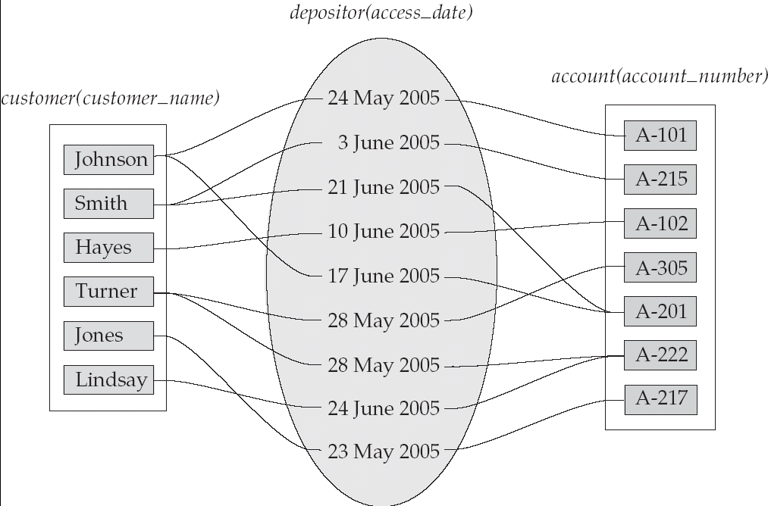
Relationship Sets (Cont.)
An attribute can also be property of a relationship set.
For instance, the depositor relationship set between entity sets customer and account may have the attribute access-date

Slide 11
Degree of a Relationship Set
Refers to number of entity sets that participate in a relationship set.
Relationship sets that involve two entity sets are binary (or degree two). Generally, most relationship sets in a database system are binary.
Relationship sets may involve more than two entity sets.
Relationships between more than two entity sets are rare. Most relationships are binary. (More on this later.)
Example: Suppose employees of a bank may have jobs (responsibilities) at multiple branches, with different jobs at different branches. Then there is a ternary relationship set between entity sets employee, job, and branch

Slide 12
Mapping Cardinality Constraints
Mapping cardinalities and existence dependencies are the two most important types of constraints.
Mapping Cardinalities, or cardinality ratios, express the number of entities to which another entity can be associated via a relationship set.
Most useful in describing binary relationship sets.
For a binary relationship set R between entity sets A and B, the mapping cardinality must be one of the following:
One to one – An entity in A is associated with at most one entity in B and an entity in B is associated with at most one entity in A.
One to many - An entity in A is associated with any number of entities in B and an entity in B, however, can be associated with at most one entity in A.
Many to one – An entity in A is associated with at most one entity in B, and an entity in B can be associated with any number of entities in A.
Many to many - An entity in A is associated with any number of entities in B and an entity in B can be associated with any number of entities in A.

Slide 13
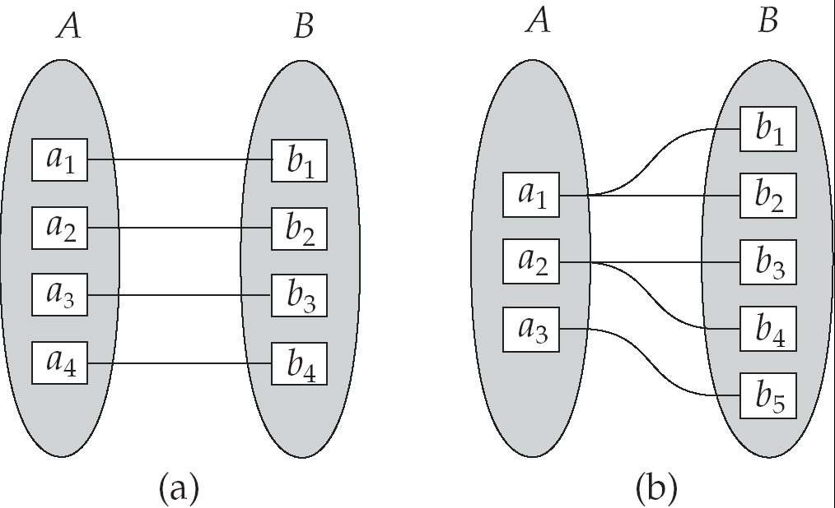
Mapping Cardinalities
One to one
One to many
Note: Some elements in A and B may not be mapped to any
elements in the other set

Slide 14
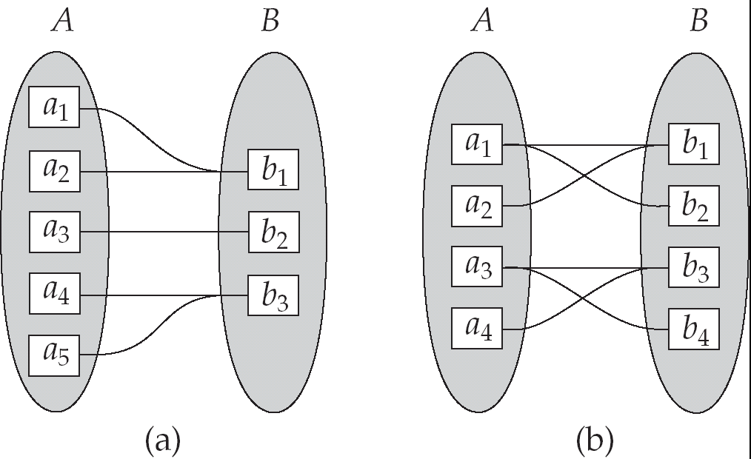
Mapping Cardinalities
Many to one
Many to many
Note: Some elements in A and B may not be mapped to any
elements in the other set

Slide 15
Existence Dependencies
If existence of entity x depends on the existence of entity y, then x is said to be existence dependent on y.
Operationally, if y is deleted, so is x. Entity y is said to be a dominant entity, and x is said to be a subordinate entity.
E.g. the entity set loan and payment that keeps information about all the payments that were made in connection to a particular loan.
The participation of an entity set E in a relationship set R is said to be total if every entity in E participates in at least one relationship in R. If only some entities in E participate in relationships in R, the participation of entity set E in relationship R is said to be partial.
Total participation is closely related to existence dependency.
Case1- Entity set:- Loan, payment and Relationship set loan-payment.
Case 2- Entity set:- Loan, customer and Relationship set borrower.

Slide 16
Keys
A super key of an entity set is a set of one or more attributes that taken collectively allows us to identify uniquely an entity set.
E.g.1) {social-security}
2) {social-security} + {customer-name}
3) {social-security} + {customer-name} + { customer-street}
A candidate key of an entity set is a minimal super key
Customer_id is candidate key of customer
account_number is candidate key of account
E.g.1) {social-security}
2) {customer-name} + { customer-street}
Although several candidate keys may exist, one of the candidate keys is selected to be the primary key.

Slide 17
Keys for Relationship Sets
The combination of primary keys of the participating entity sets forms a super key of a relationship set.
(customer_id, account_number) is the super key of depositor
NOTE: this means a pair of entity sets can have at most one relationship in a particular relationship set.
Example: if we wish to track all access_dates to each account by each customer, we cannot assume a relationship for each access. We can use a multivalued attribute though
Must consider the mapping cardinality of the relationship set when deciding what are the candidate keys
Need to consider semantics of relationship set in selecting the primary key in case of more than one candidate key

Slide 18
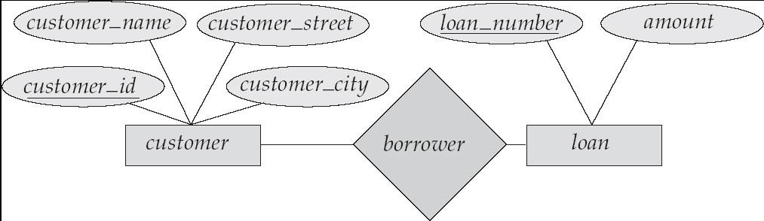
E-R Diagrams
Rectangles represent entity sets.
Diamonds represent relationship sets.
Lines link attributes to entity sets and entity sets to relationship sets.
Ellipses represent attributes
Double ellipses represent multivalued attributes.
Dashed ellipses denote derived attributes.
Underline indicates primary key attributes (will study later)

Slide 19
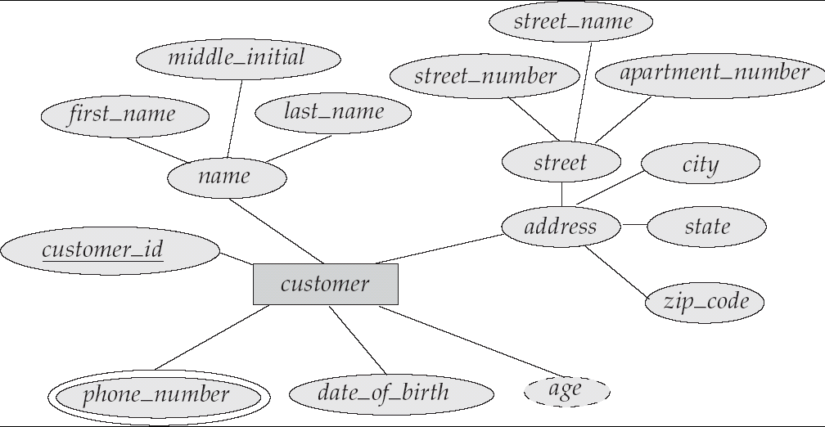
E-R Diagram With Composite, Multivalued, and Derived Attributes

Slide 20
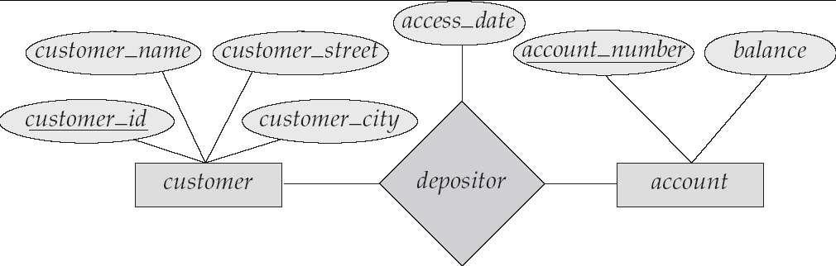
Relationship Sets with Attributes

Slide 21
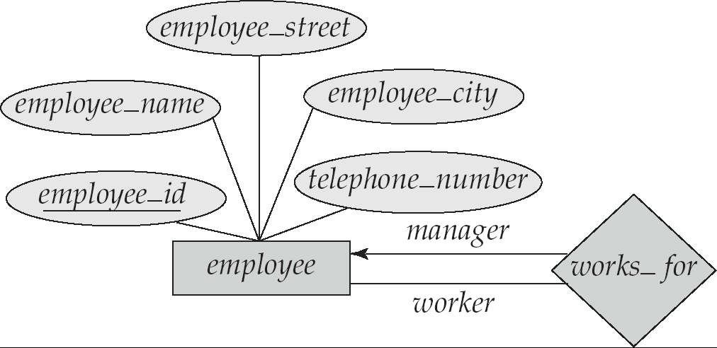
Roles
Entity sets of a relationship need not be distinct
The labels “manager” and “worker” are called roles; they specify how employee entities interact via the works_for relationship set.
Roles are indicated in E-R diagrams by labeling the lines that connect diamonds to rectangles.
Role labels are optional, and are used to clarify semantics of the relationship

Slide 22
Cardinality Constraints
We express cardinality constraints by drawing either a directed line (→), signifying “one,” or an undirected line (—), signifying “many,” between the relationship set and the entity set.
One-to-one relationship:
A customer is associated with at most one loan via the relationship borrower
A loan is associated with at most one customer via borrower

Slide 23
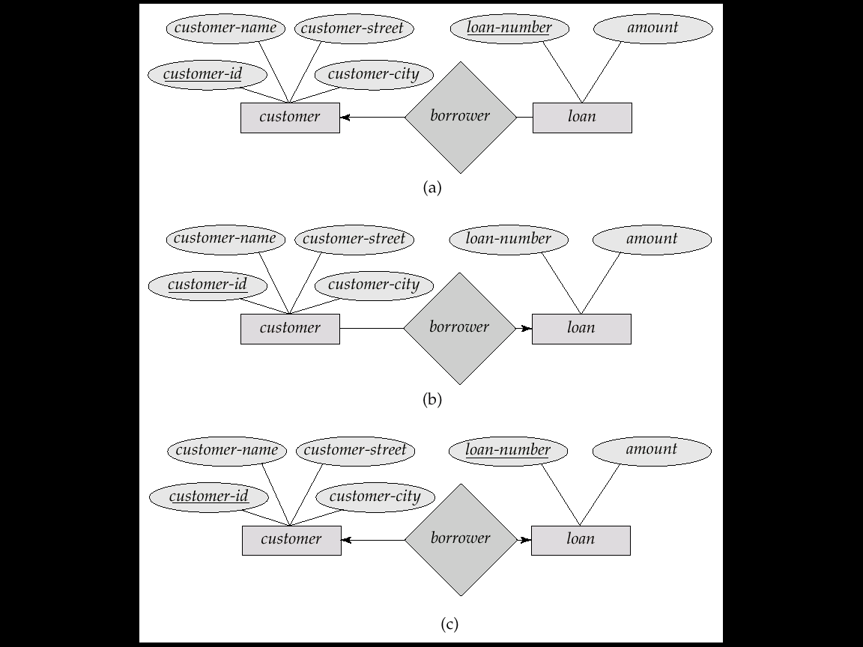
One-To-Many Relationship
In the one-to-many relationship a loan is associated with at most one customer via borrower, a customer is associated with several (including 0) loans via borrower

Slide 24
Many-To-One Relationships
In a many-to-one relationship a loan is associated with several (including 0) customers via borrower, a customer is associated with at most one loan via borrower

Slide 25
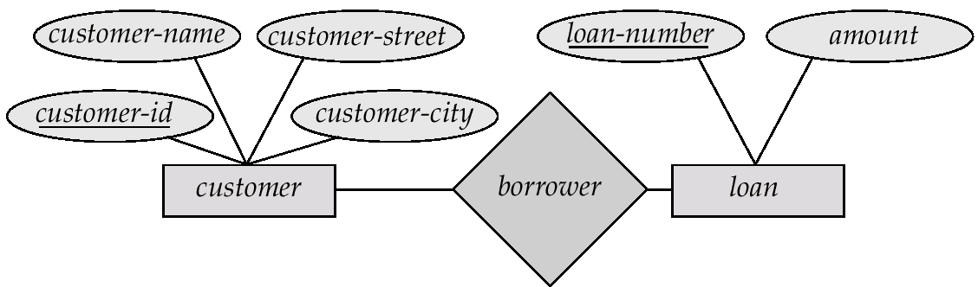
Many-To-Many Relationship
A customer is associated with several (possibly 0) loans via borrower
A loan is associated with several (possibly 0) customers via borrower

Slide 26
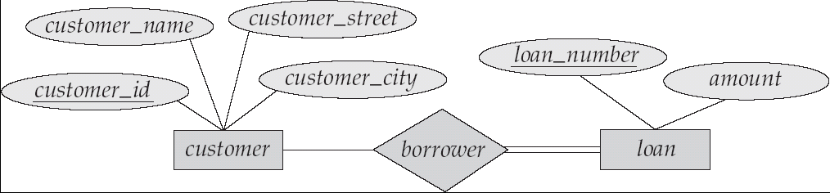
Participation of an Entity Set in a Relationship Set
Total participation (indicated by double line): every entity in the entity set participates in at least one relationship in the relationship set
E.g. participation of loan in borrower is total
every loan must have a customer associated to it via borrower
Partial participation: some entities may not participate in any relationship in the relationship set
Example: participation of customer in borrower is partial

Slide 27
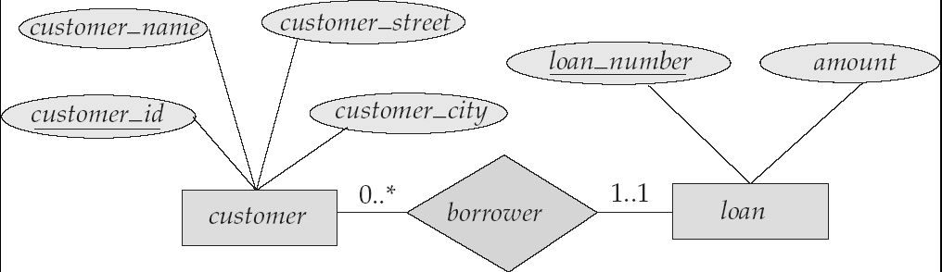
Alternative Notation for Cardinality Limits
Cardinality limits can also express participation constraints

Slide 28
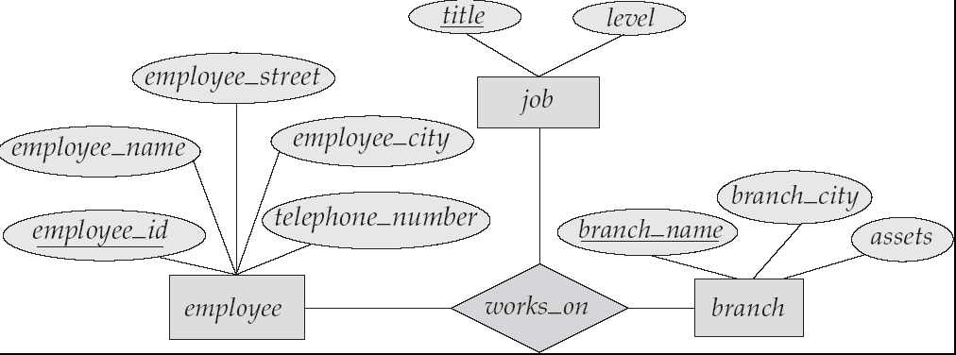
E-R Diagram with a Ternary Relationship

Slide 29
Cardinality Constraints on Ternary Relationship
We allow at most one arrow out of a ternary (or greater degree) relationship to indicate a cardinality constraint
E.g. an arrow from works_on to job indicates each employee works on at most one job at any branch.
If there is more than one arrow, there are two ways of defining the meaning.
E.g a ternary relationship R between A, B and C with arrows to B and C could mean
1. each A entity is associated with a unique entity from B and C or
2. each pair of entities from (A, B) is associated with a unique C entity, and each pair (A, C) is associated with a unique B
Each alternative has been used in different formalisms
To avoid confusion we outlaw more than one arrow

Slide 30
Design Issues
Use of entity sets vs. attributes Choice mainly depends on the structure of the enterprise being modeled, and on the semantics associated with the attribute in question.
Use of entity sets vs. relationship sets Possible guideline is to designate a relationship set to describe an action that occurs between entities
Binary versus n-ary relationship sets Although it is possible to replace any nonbinary (n-ary, for n > 2) relationship set by a number of distinct binary relationship sets, a n-ary relationship set shows more clearly that several entities participate in a single relationship.
Placement of relationship attributes

Slide 31
Binary Vs. Non-Binary Relationships
Some relationships that appear to be non-binary may be better represented using binary relationships
E.g. A ternary relationship parents, relating a child to his/her father and mother, is best replaced by two binary relationships, father and mother
Using two binary relationships allows partial information (e.g. only mother being know)
But there are some relationships that are naturally non-binary
Example: works_on

Slide 32
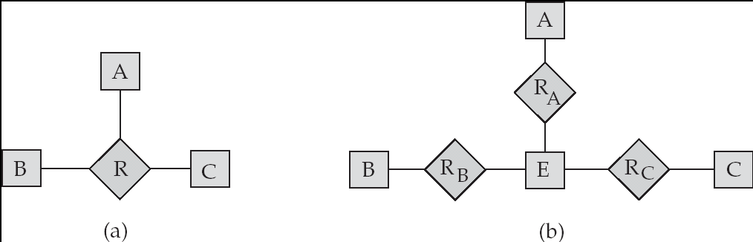
Converting Non-Binary Relationships to Binary Form
In general, any non-binary relationship can be represented using binary relationships by creating an artificial entity set.
Replace R between entity sets A, B and C by an entity set E, and three relationship sets:
1. R_{A}, relating E and A 2.R_{B}, relating E and B
3. R_{C}, relating E and C
Create a special identifying attribute for E
Add any attributes of R to E
For each relationship (a_{i} , b_{i} , c_{i}) in R, create
1. a new entity e_{i} in the entity set E 2. add (e_{i} , a_{i} ) to R_{A}
3. add (e_{i} , b_{i} ) to R_{B} 4. add (e_{i} , c_{i} ) to R_{C}

Slide 33
Converting Non-Binary Relationships (Cont.)
Also need to translate constraints
Translating all constraints may not be possible
There may be instances in the translated schema that cannot correspond to any instance of R
Exercise: add constraints to the relationships R_{A}, R_{B} and R_{C} to ensure that a newly created entity corresponds to exactly one entity in each of entity sets A, B and C
We can avoid creating an identifying attribute by making E a weak entity set (described shortly) identified by the three relationship sets

Slide 34
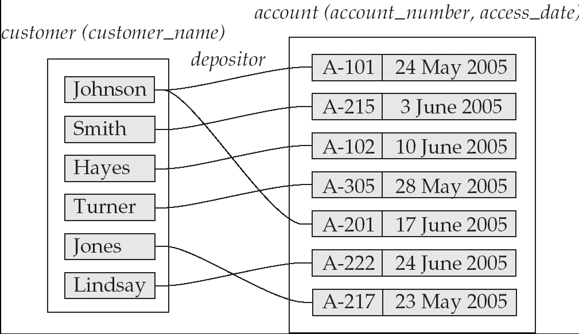
Mapping Cardinalities affect ER Design
Can make access-date an attribute of account, instead of a relationship attribute, if each account can have only one customer
That is, the relationship from account to customer is many to one, or equivalently, customer to account is one to many

Slide 35
How about doing an ER design interactively on the board? Suggest an application to be modeled.

Slide 36
Weak Entity Sets
An entity set that does not have a primary key is referred to as a weak entity set.
The existence of a weak entity set depends on the existence of a identifying entity set
it must relate to the identifying entity set via a total, one-to-many relationship set from the identifying to the weak entity set
Identifying relationship depicted using a double diamond
The discriminator (or partial key) of a weak entity set is the set of attributes that distinguishes among all the entities of a weak entity set.
The primary key of a weak entity set is formed by the primary key of the strong entity set on which the weak entity set is existence dependent, plus the weak entity set’s discriminator.

Slide 37
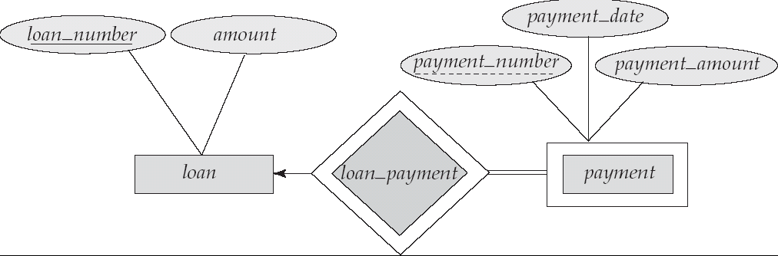
Weak Entity Sets (Cont.)
We depict a weak entity set by double rectangles.
We underline the discriminator of a weak entity set with a dashed line.
payment_number – discriminator of the payment entity set
Primary key for payment – (loan_number, payment_number)

Slide 38
Weak Entity Sets (Cont.)
Note: the primary key of the strong entity set is not explicitly stored with the weak entity set, since it is implicit in the identifying relationship.
If loan_number were explicitly stored, payment could be made a strong entity, but then the relationship between payment and loan would be duplicated by an implicit relationship defined by the attribute loan_number common to payment and loan

Slide 39
More Weak Entity Set Examples
In a university, a course is a strong entity and a course_offering can be modeled as a weak entity
The discriminator of course_offering would be semester (including year) and section_number (if there is more than one section)
If we model course_offering as a strong entity we would model course_number as an attribute.
Then the relationship with course would be implicit in the course_number attribute

Slide 40
Extended E-R Features: Specialization
Top-down design process; we designate subgroupings within an entity set that are distinctive from other entities in the set.
These subgroupings become lower-level entity sets that have attributes or participate in relationships that do not apply to the higher-level entity set.
Depicted by a triangle component labeled ISA (E.g. customer “is a” person).
Attribute inheritance – a lower-level entity set inherits all the attributes and relationship participation of the higher-level entity set to which it is linked.

Slide 41
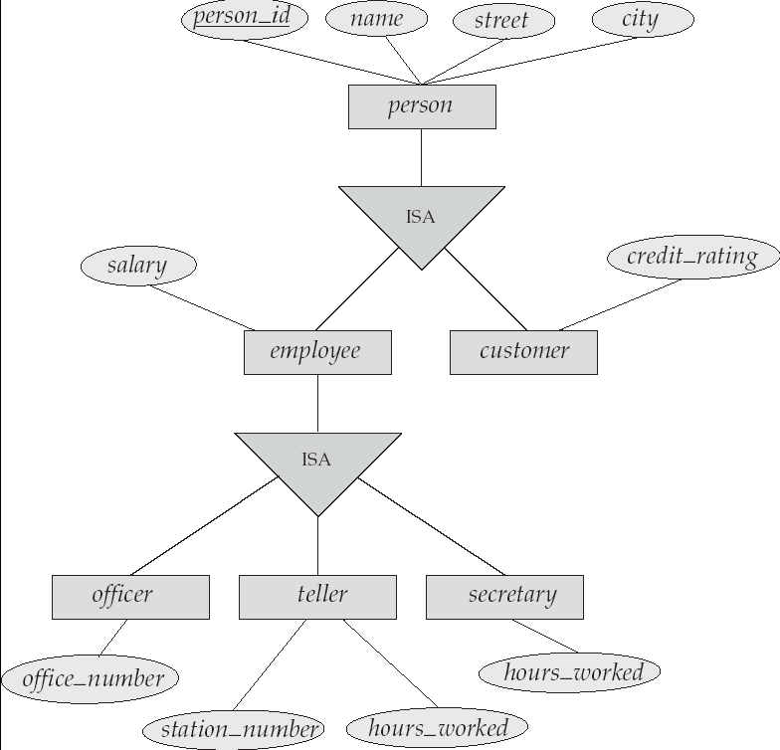
Specialization Example

Slide 42
Extended ER Features: Generalization
A bottom-up design process – combine a number of entity sets that share the same features into a higher-level entity set.
Specialization and generalization are simple inversions of each other; they are represented in an E-R diagram in the same way.
The terms specialization and generalization are used interchangeably.

Slide 43
Specialization and Generalization (Cont.)
Can have multiple specializations of an entity set based on different features.
E.g. permanent_employee vs. temporary_employee, in addition to officer vs. secretary vs. teller
Each particular employee would be
a member of one of permanent_employee or temporary_employee,
and also a member of one of officer, secretary, or teller
The ISA relationship also referred to as superclass - subclass relationship

Slide 44
Design Constraints on a Specialization/Generalization
Constraint on which entities can be members of a given lower-level entity set.
condition-defined
Example: all customers over 65 years are members of senior-citizen entity set; senior-citizen ISA person.
user-defined
Constraint on whether or not entities may belong to more than one lower-level entity set within a single generalization.
Disjoint
an entity can belong to only one lower-level entity set
Noted in E-R diagram by writing disjoint next to the ISA triangle
Overlapping
an entity can belong to more than one lower-level entity set

Slide 45
Design Constraints on a Specialization/Generalization (Cont.)
Completeness constraint -- specifies whether or not an entity in the higher-level entity set must belong to at least one of the lower-level entity sets within a generalization.
total : an entity must belong to one of the lower-level entity sets
partial: an entity need not belong to one of the lower-level entity sets

Slide 46
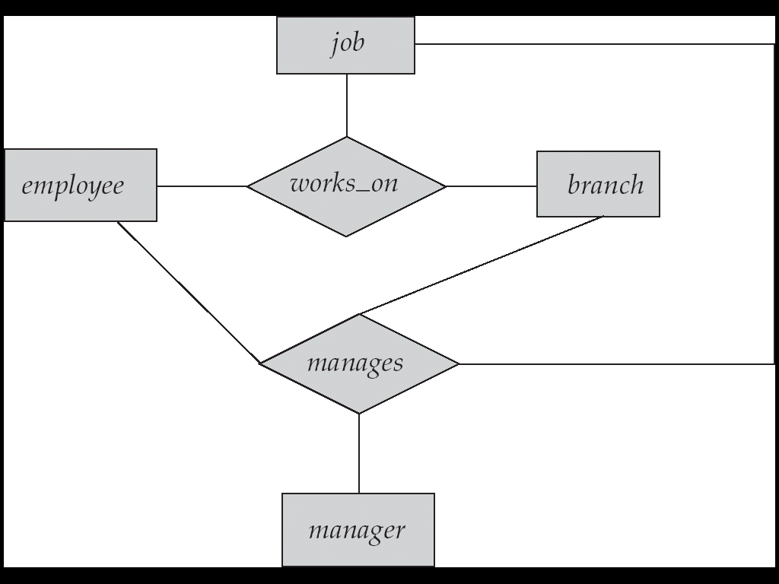
Aggregation
Consider the ternary relationship works_on, which we saw earlier
Suppose we want to record managers for tasks performed by an employee at a branch

Slide 47
Aggregation (Cont.)
Relationship sets works_on and manages represent overlapping information
Every manages relationship corresponds to a works_on relationship
However, some works_on relationships may not correspond to any manages relationships
So we can’t discard the works_on relationship
Eliminate this redundancy via aggregation
Treat relationship as an abstract entity
Allows relationships between relationships
Abstraction of relationship into new entity
Without introducing redundancy, the following diagram represents:
An employee works on a particular job at a particular branch
An employee, branch, job combination may have an associated manager

Slide 48
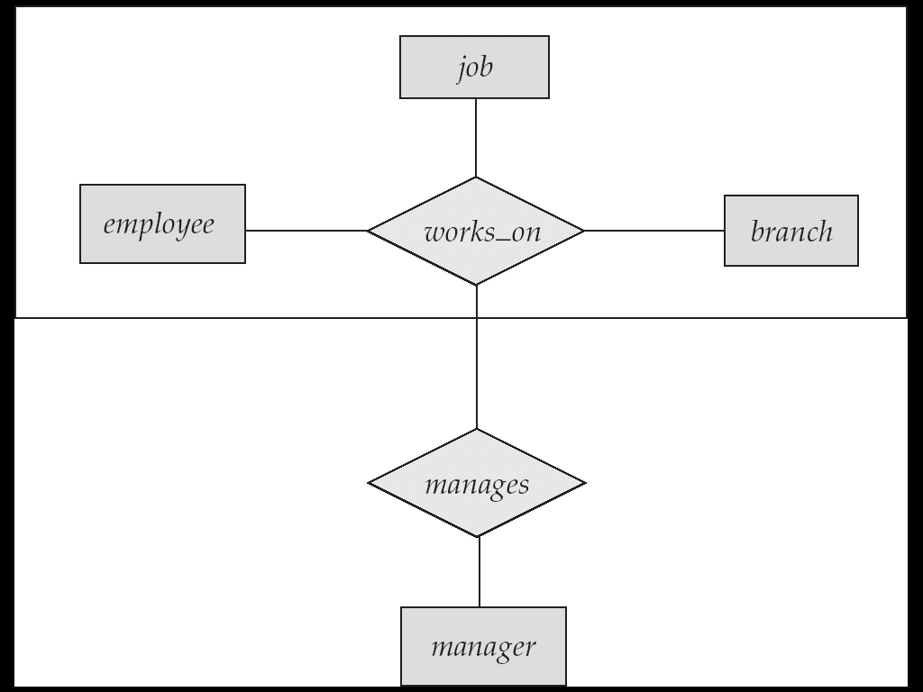
E-R Diagram With Aggregation

Slide 49
E-R Design Decisions
The use of an attribute or entity set to represent an object.
Whether a real-world concept is best expressed by an entity set or a relationship set.
The use of a ternary relationship versus a pair of binary relationships.
The use of a strong or weak entity set.
The use of specialization/generalization – contributes to modularity in the design.
The use of aggregation – can treat the aggregate entity set as a single unit without concern for the details of its internal structure.

Slide 50
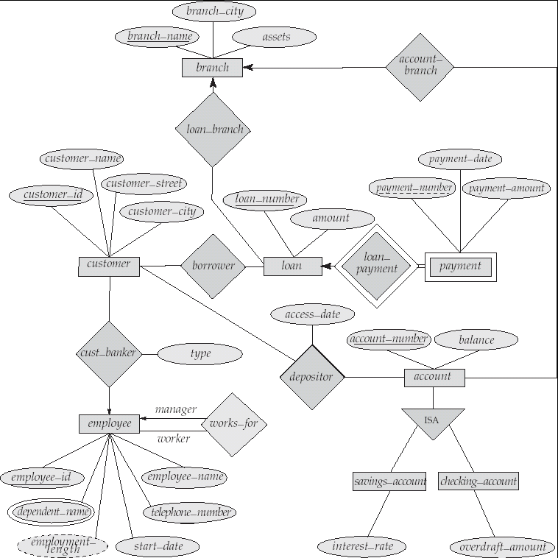
E-R Diagram for a Banking Enterprise

Slide 51
How about doing another ER design interactively on the board?

Slide 52
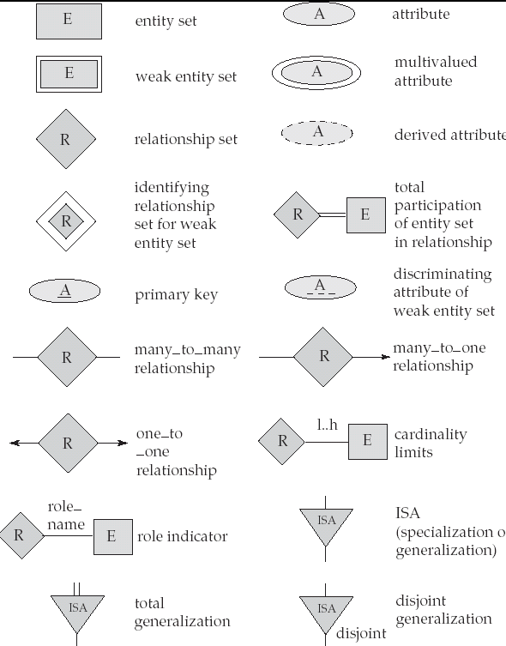
Summary of Symbols Used in E-R Notation

Slide 53
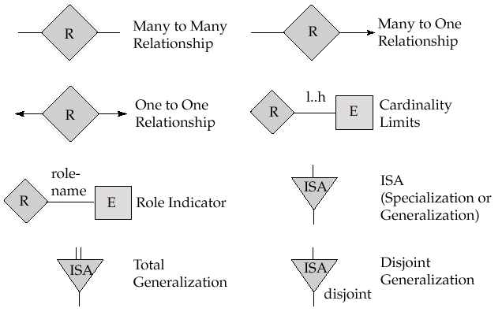
Summary of Symbols (Cont.)

Slide 54
Reduction to Relation Schemas
Primary keys allow entity sets and relationship sets to be expressed uniformly as relation schemas that represent the contents of the database.
A database which conforms to an E-R diagram can be represented by a collection of schemas.
For each entity set and relationship set there is a unique schema that is assigned the name of the corresponding entity set or relationship set.
Each schema has a number of columns (generally corresponding to attributes), which have unique names.

Slide 55
Representing Entity Sets as Schemas
A strong entity set reduces to a schema with the same attributes.
A weak entity set becomes a table that includes a column for the primary key of the identifying strong entity set
payment =
( loan_number, payment_number, payment_date, payment_amount )

Slide 56
Representing Relationship Sets as Schemas
A many-to-many relationship set is represented as a schema with attributes for the primary keys of the two participating entity sets, and any descriptive attributes of the relationship set.
Example: schema for relationship set borrower
borrower = (customer_id, loan_number )

Slide 57
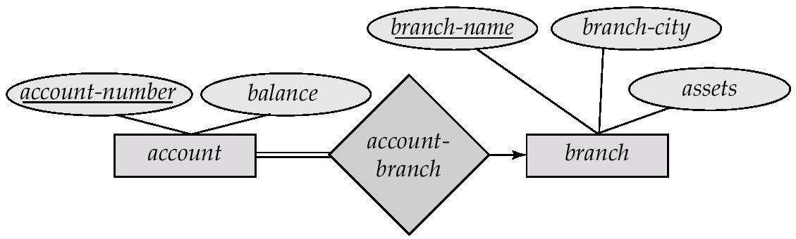
Redundancy of Schemas
Many-to-one and one-to-many relationship sets that are total on the many-side can be represented by adding an extra attribute to the “many” side, containing the primary key of the “one” side
Example: Instead of creating a schema for relationship set account_branch, add an attribute branch_name to the schema arising from entity set account

Slide 58
Redundancy of Schemas (Cont.)
For one-to-one relationship sets, either side can be chosen to act as the “many” side
That is, extra attribute can be added to either of the tables corresponding to the two entity sets
If participation is partial on the “many” side, replacing a schema by an extra attribute in the schema corresponding to the “many” side could result in null values
The schema corresponding to a relationship set linking a weak entity set to its identifying strong entity set is redundant.
Example: The payment schema already contains the attributes that would appear in the loan_payment schema (i.e., loan_number and payment_number).

Slide 59
Composite and Multivalued Attributes
Composite attributes are flattened out by creating a separate attribute for each component attribute
Example: given entity set customer with composite attribute name with component attributes first_name and last_name the schema corresponding to the entity set has two attributes name.first_name and name.last_name
A multivalued attribute M of an entity E is represented by a separate schema EM
Schema EM has attributes corresponding to the primary key of E and an attribute corresponding to multivalued attribute M
Example: Multivalued attribute dependent_names of employee is represented by a schema: employee_dependent_names = ( employee_id, dname)
Each value of the multivalued attribute maps to a separate tuple of the relation on schema EM
For example, an employee entity with primary key 123-45-6789 and dependents Jack and Jane maps to two tuples: (123-45-6789 , Jack) and (123-45-6789 , Jane)

Slide 60
Representing Specialization via Schemas
Method 1:
Form a schema for the higher-level entity
Form a schema for each lower-level entity set, include primary key of higher-level entity set and local attributes schema attributes person name, street, city customer name, credit_rating employee name, salary
Drawback: getting information about, an employee requires accessing two relations, the one corresponding to the low-level schema and the one corresponding to the high-level schema

Slide 61
Representing Specialization as Schemas (Cont.)
Method 2:
Form a schema for each entity set with all local and inherited attributes
schema attributes person name, street, city customer name, street, city, credit_rating employee name, street, city, salary
If specialization is total, the schema for the generalized entity set (person) not required to store information
Can be defined as a “view” relation containing union of specialization relations
But explicit schema may still be needed for foreign key constraints
Drawback: street and city may be stored redundantly for people who are both customers and employees

Slide 62
Schemas Corresponding to Aggregation
To represent aggregation, create a schema containing
primary key of the aggregated relationship,
the primary key of the associated entity set
any descriptive attributes

Slide 63
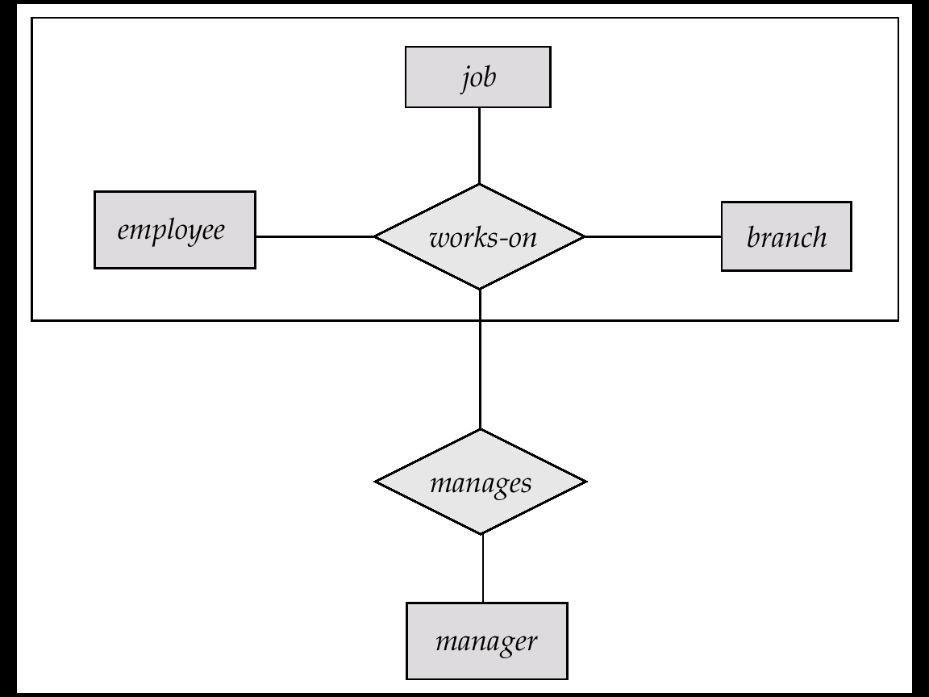
Schemas Corresponding to Aggregation (Cont.)
For example, to represent aggregation manages between relationship works_on and entity set manager, create a schema
manages (employee_id, branch_name, title, manager_name)
Schema works_on is redundant provided we are willing to store null values for attribute manager_name in relation on schema manages

Slide 64
UML
UML: Unified Modeling Language
UML has many components to graphically model different aspects of an entire software system
UML Class Diagrams correspond to E-R Diagram, but several differences.

Slide 65
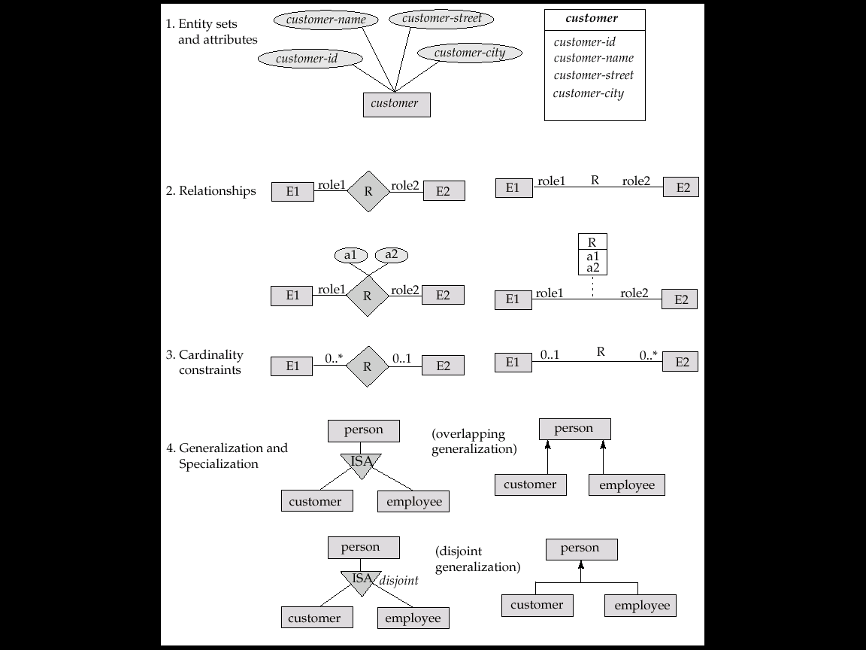
Summary of UML Class Diagram Notation

Slide 66
UML Class Diagrams (Cont.)
Entity sets are shown as boxes, and attributes are shown within the box, rather than as separate ellipses in E-R diagrams.
Binary relationship sets are represented in UML by just drawing a line connecting the entity sets. The relationship set name is written adjacent to the line.
The role played by an entity set in a relationship set may also be specified by writing the role name on the line, adjacent to the entity set.
The relationship set name may alternatively be written in a box, along with attributes of the relationship set, and the box is connected, using a dotted line, to the line depicting the relationship set.
Non-binary relationships drawn using diamonds, just as in ER diagrams

Slide 67
UML Class Diagram Notation (Cont.)
overlapping
disjoint
*Note reversal of position in cardinality constraint depiction
*Generalization can use merged or separate arrows independent
of disjoint/overlapping

Slide 68
UML Class Diagrams (Contd.)
Cardinality constraints are specified in the form l..h, where l denotes the minimum and h the maximum number of relationships an entity can participate in.
Beware: the positioning of the constraints is exactly the reverse of the positioning of constraints in E-R diagrams.
The constraint 0..* on the E2 side and 0..1 on the E1 side means that each E2 entity can participate in at most one relationship, whereas each E1 entity can participate in many relationships; in other words, the relationship is many to one from E2 to E1.
Single values, such as 1 or * may be written on edges; The single value 1 on an edge is treated as equivalent to 1..1, while * is equivalent to 0..*.

Slide 69
End of Chapter 2

Slide 70
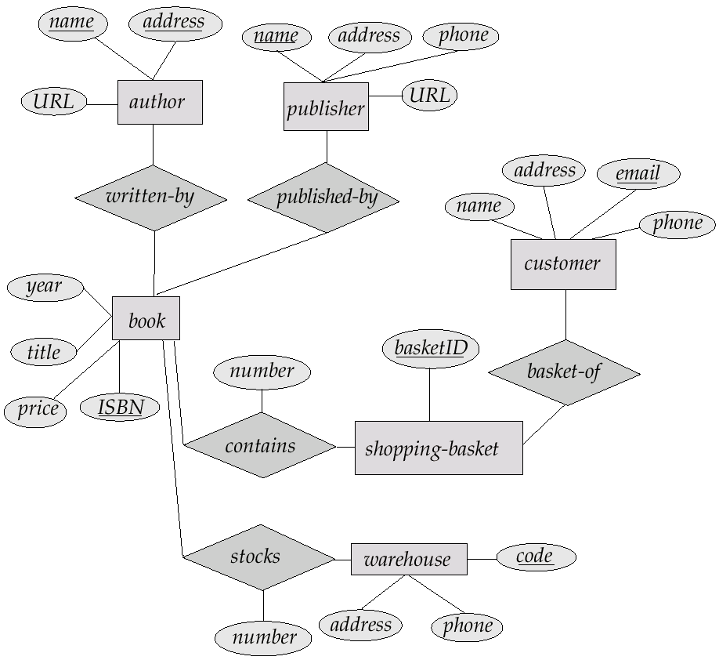
E-R Diagram for Exercise 2.10

Slide 71
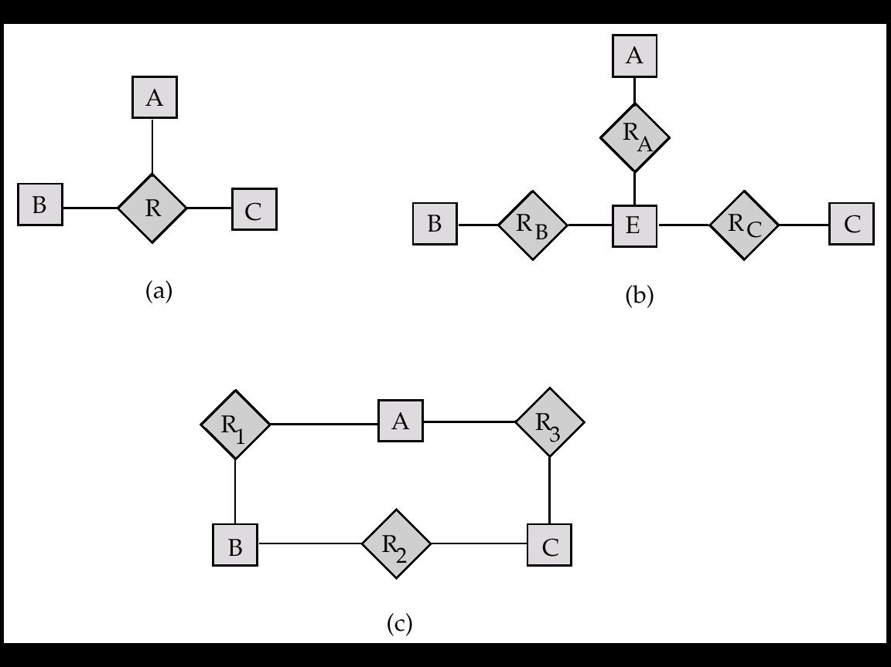
E-R Diagram for Exercise 2.15

Slide 72
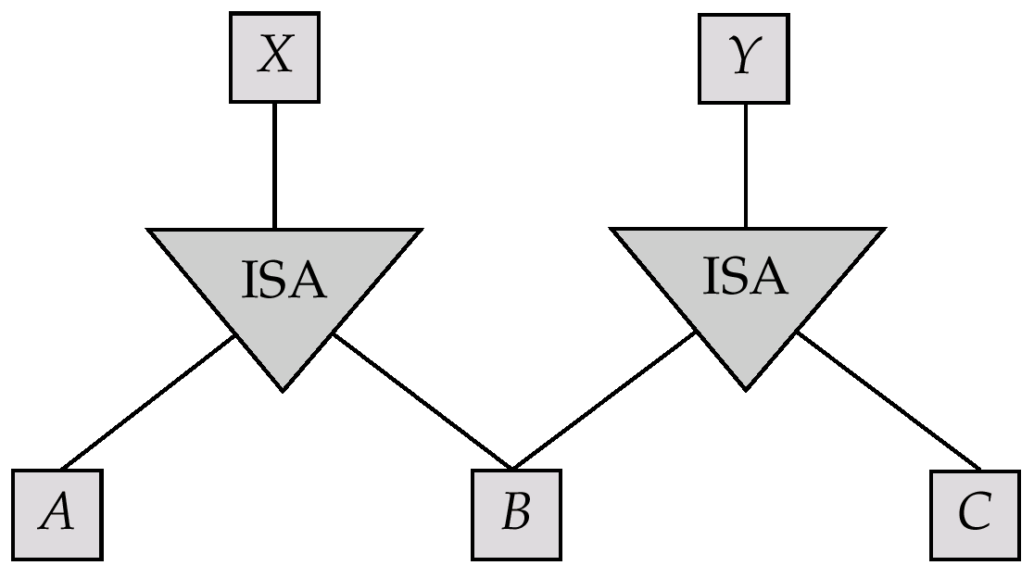
E-R Diagram for Exercise 2.22

Slide 73
E-R Diagram for Exercise 2.15

Slide 74
Existence Dependencies
If the existence of entity x depends on the existence of entity y, then x is said to be existence dependent on y.
y is a dominant entity (in example below, loan)
x is a subordinate entity (in example below, payment)
loan-payment
loan
payment
If a loan entity is deleted, then all its associated payment entities must be deleted also.

Slide 75
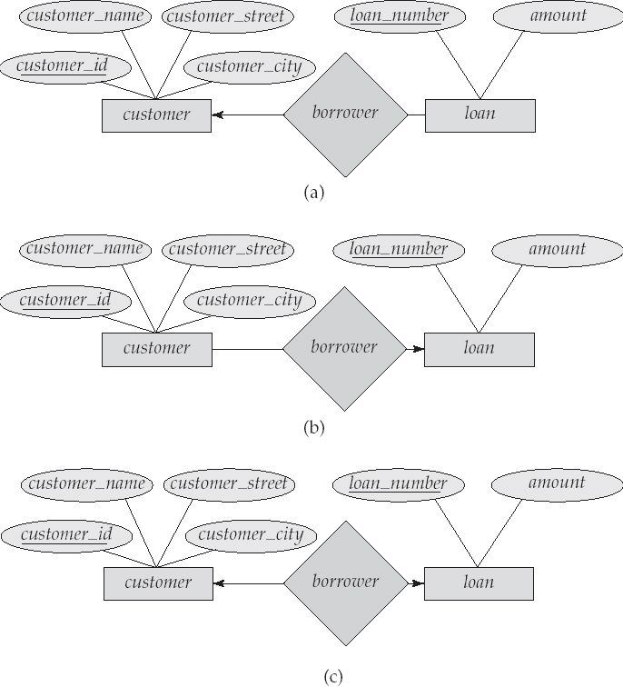
Figure 6.8

Slide 76
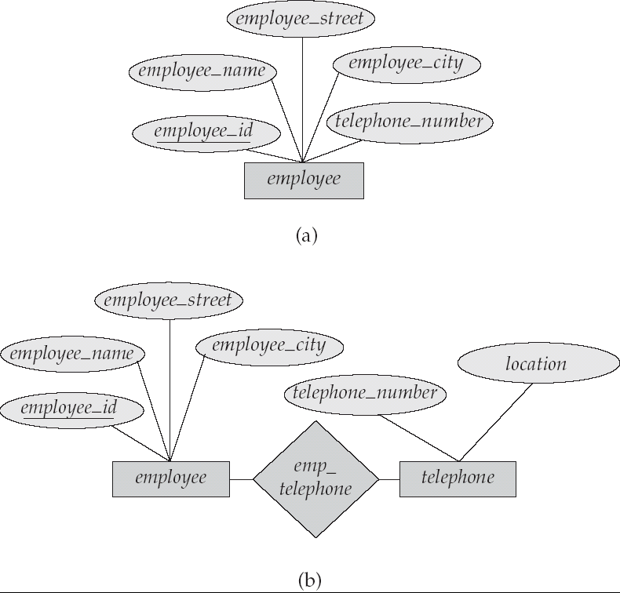
Figure 6.15

Slide 77
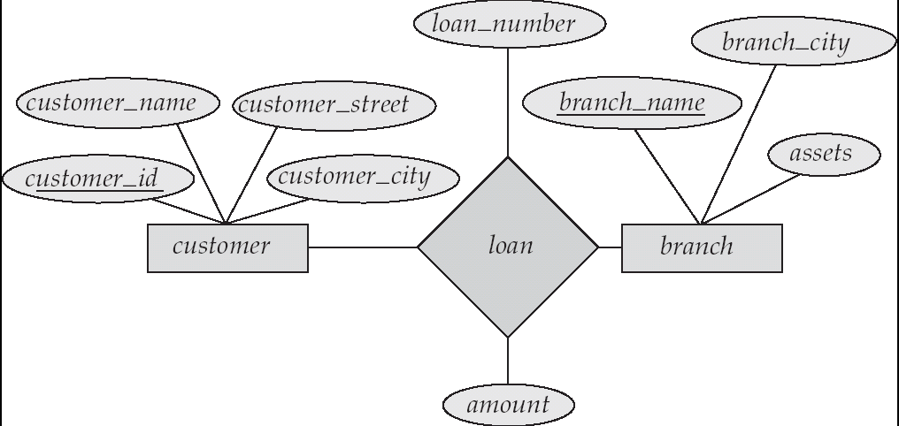
Figure 6.16

Slide 78
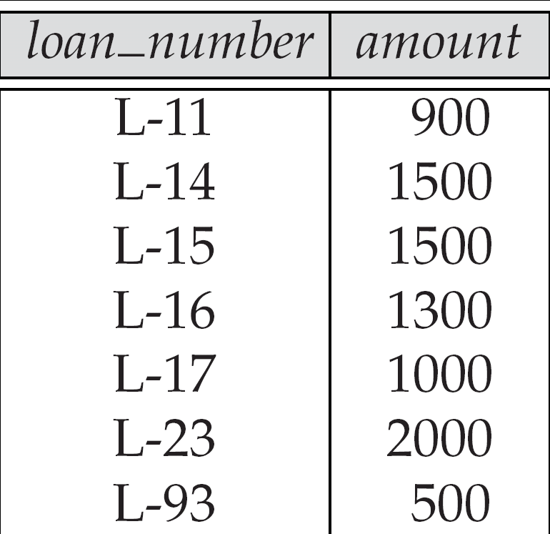
Figure 6.26

Slide 79
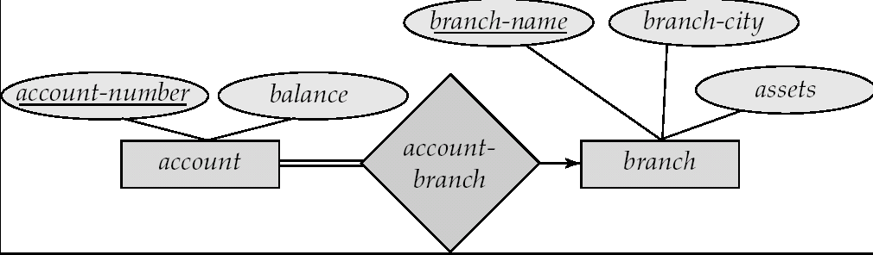
Figure 6.27

Slide 80
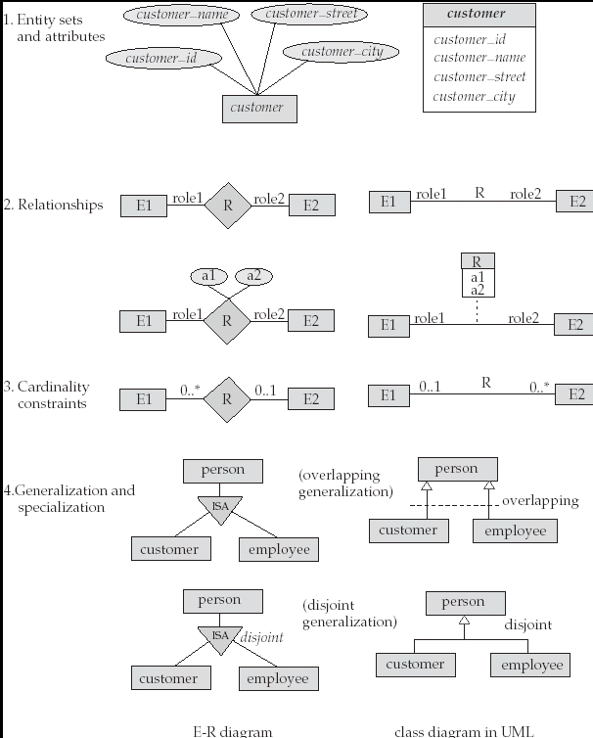
Figure 6.28

Slide 81
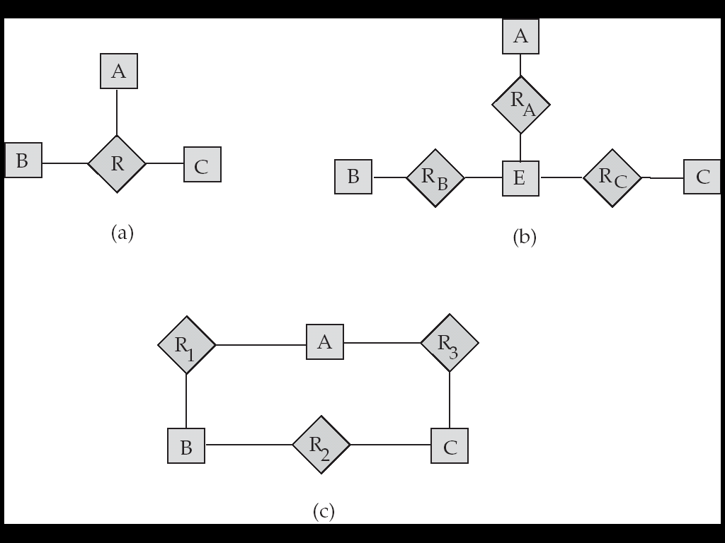
Figure 6.29

Slide 82
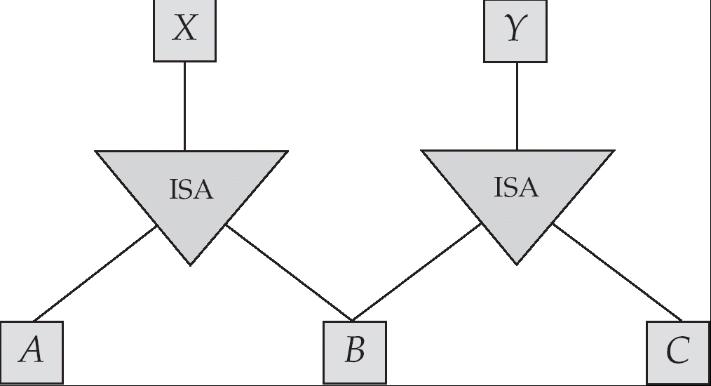
Figure 6.30

Slide 83
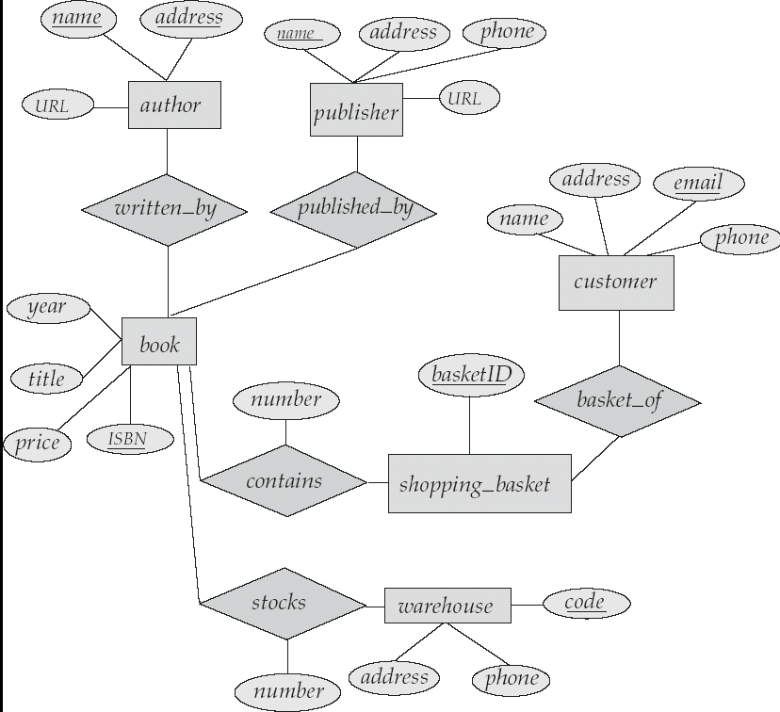
Figure 6.31

Slide 84
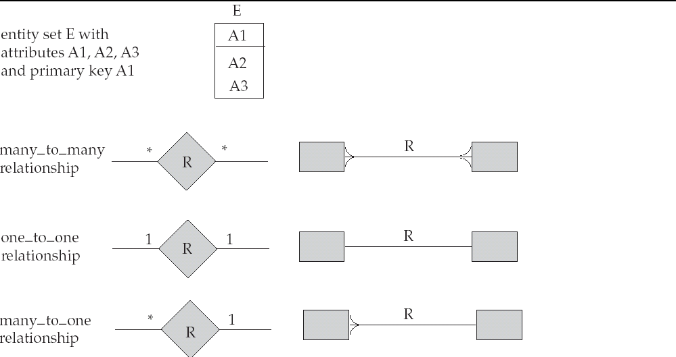
Alternative E-R Notations Figure 6.24

