Slide 1
Advanced Regression Techniques
By
James Mwakichako, Michael Baroody

Slide 2
Task
Given different aspects that affect real estate prices, we predict the final sale price of a home
This gives us insights into how companies such as Zillow estimate how much a house costs

Slide 3
Dataset
We took a Kaggle dataset which contains 1406 rows and 81 columns.
There were continuous and categorical features such as the number of floors, neighborhood where home is located, size of the house, size of the garage.
We cleaned the data and created dummy variables out of the categorical features.
We came up with 1406 rows and 272 columns

Slide 4
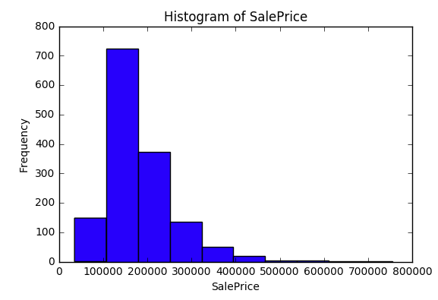
Visualization of the Class

Slide 5
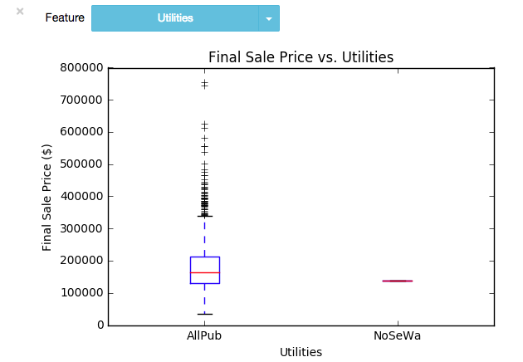
Visualization of one feature

Slide 6
Model Selection Results
We used the R-squared value because we were building regression model and it would give us somewhat a clear picture of how our model explains the data.
We performed 10-fold cross validation
Results are on the next slide

Slide 7
Model Selection Results
<here is an example table>
Model | Parameters | Performance
Baseline(linear regression) | majority class | 0.824
Ada Boost Regressor | … | 0.794
Lasso Regressor | Alpha =10.0 | 0.824
 |  | …
Gradient Boosting |  | 0.894
 |  | …
Best model and parameter setting was …

Slide 8
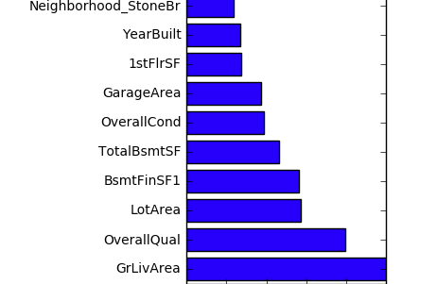
Top Features

Slide 9
Top Features
Above ground living area
Overall Quality
Lot Area
Type 1 finished square feet
Total square feet of basement area
Overall condition
Garage area

Slide 10
Interesting/unexpected cases
<Discuss a few interesting cases. Use extra slides if needed. Use images if needed. Here is an example.>

