Slide 1
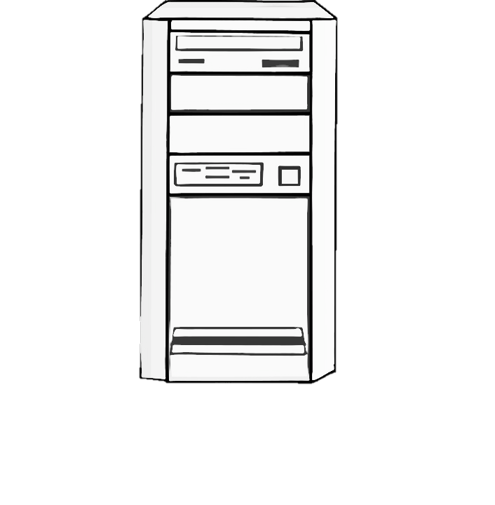


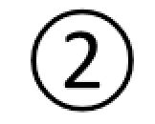


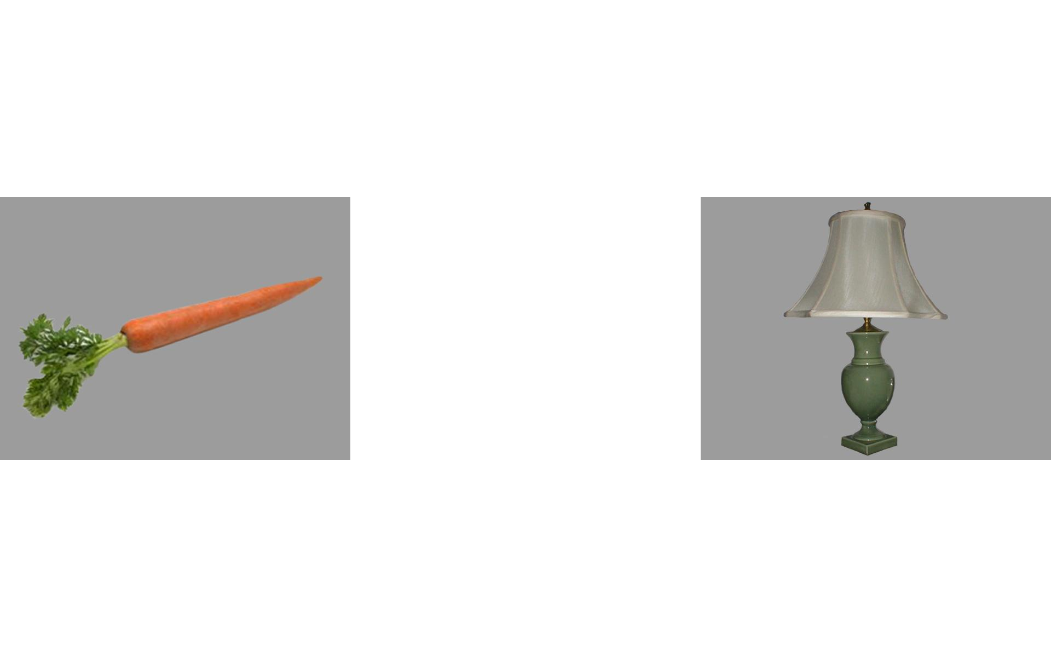
Server hosting HTML/JavaScript/CSS
Server hosting PHP script
From a web browser on the tablet, the user visits the experiment webpage hosted on a web-based server.
The webpage interacts with the participant via JavaScript code.
After the last trial, the JavaScript calls a PHP script that is also on a web-based server. This script logs the participant’s data to a tabular data file.
Tablet

