Slide 1
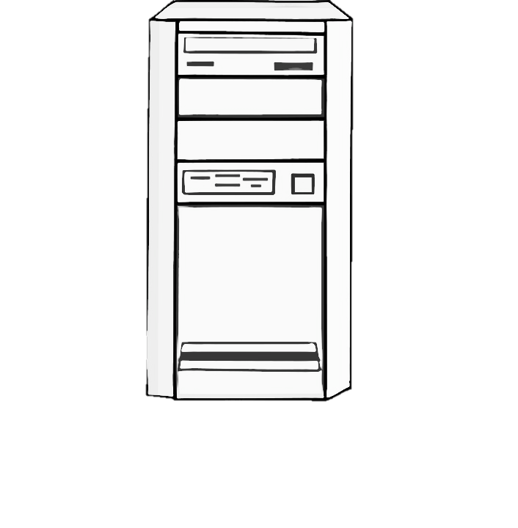


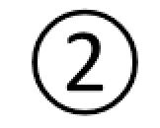



Server hosting HTML/JS/CSS
Server hosting PHP script
From a web browser on the tablet, the user visits the experiment webpage hosted on a server.
The webpage interacts with the participant via javascript code.
After the last trial, the javascript calls a PHP script that is also on a web server. This script appends the participant’s data to a tabular data file.
Tablet

