Slide 1
Command Line
Because your should!
Presented by Steven King

Slide 2

Feat Not
It’s Fun!

Slide 3
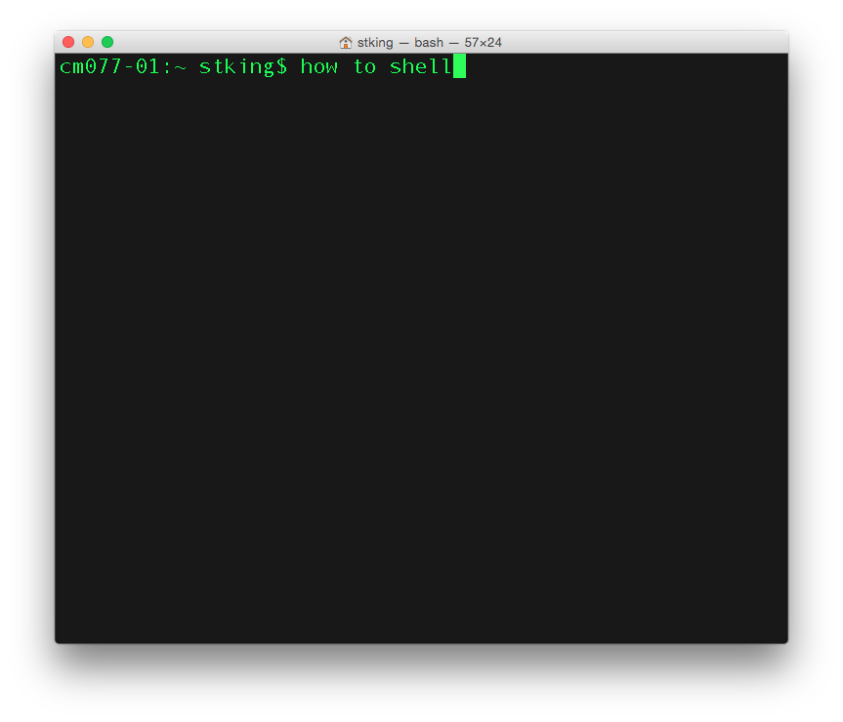
How to shell!
Type Everything I do
Memorize Commands
Commit to it!
Flash cards

Slide 4
Open Terminal
Command Space Ter Enter

Slide 5
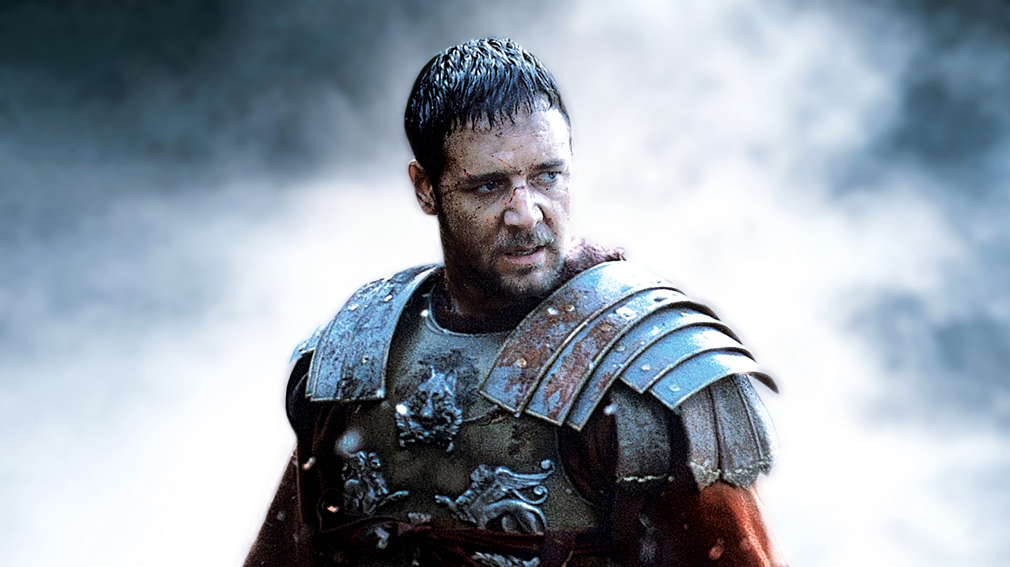
Be a
Commander

Slide 6
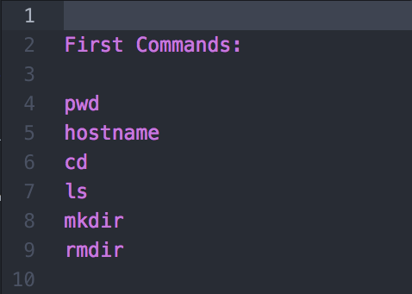
Commands

Slide 7
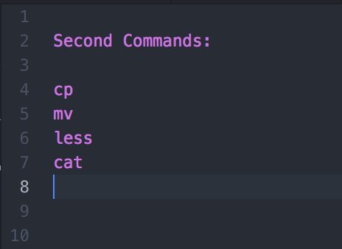
Commands

Slide 8
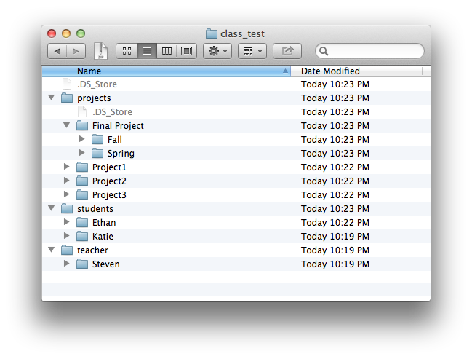
Practice
Putting into practice

Slide 9
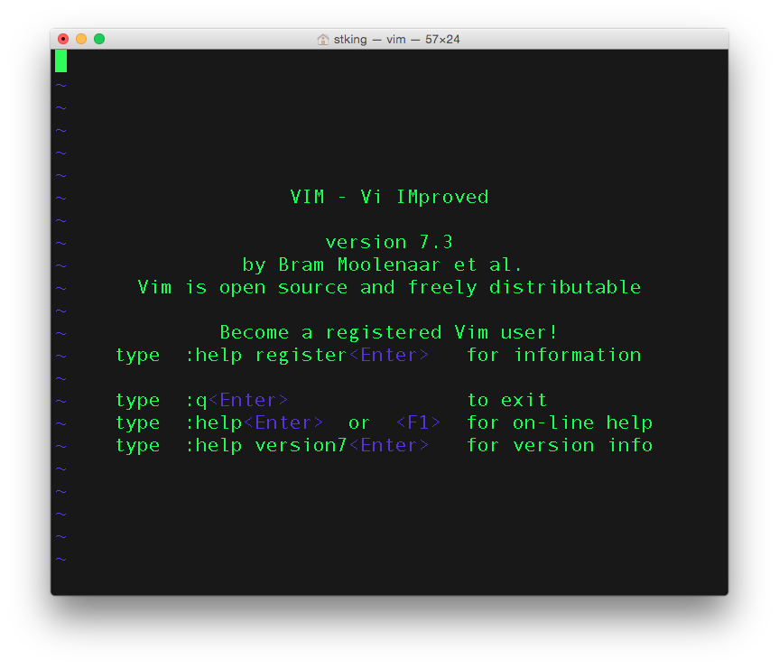
Vi or Vim
Not for everything but good for some things!

Slide 10
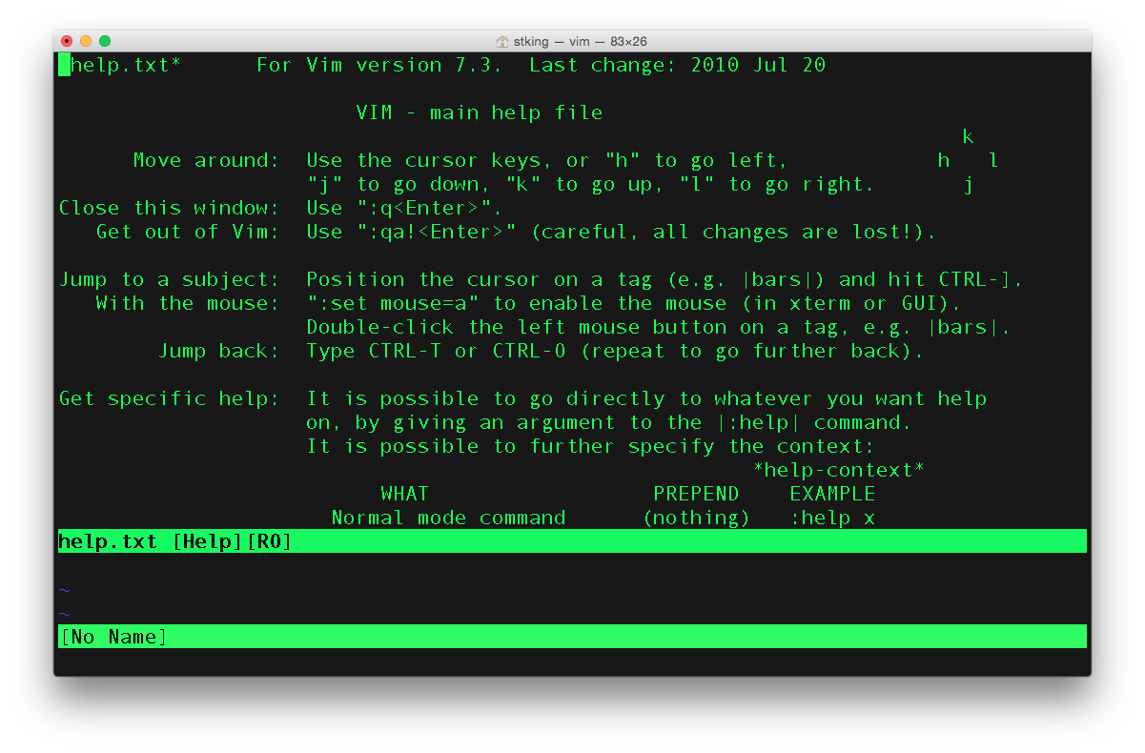
Vi Basics
vi is a text editor in Terminal
i to Insert
Escape to get out of Insert
K, h, l, j to move
:w to write
:q to quit
:wq! To do both at the same time.

Slide 11
Perform each the commands 20 times. Saying the command each time.
Copy Files, Move Dirs, Delete Dirs
Practice
Putting into practice

