Slide 1
JavaScript Programing Concepts
Part II
Arrays, Loops and ifs

Slide 2
Review
<script>code inside here</script
Functions are blocks of code to be called later
Events are actions that call functions

Slide 3
Variable Data Types
String
Number
Booleans
Arrays
Objects
Text “Hello World”
Number 5
True or False
Lists of variables (5,3,6,234)
Data Object (complex list)

Slide 4
Variable
Stores information
X = 1;

Slide 5
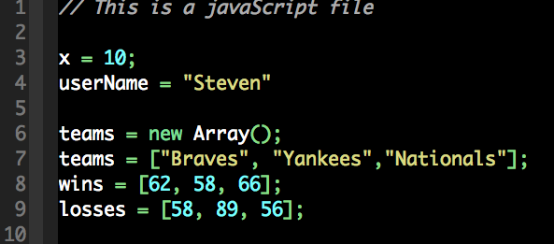
Arrays
A list of data
In other words, a list of variables or a super variable
Many ways to declare an array.
Index of 0;

Slide 6
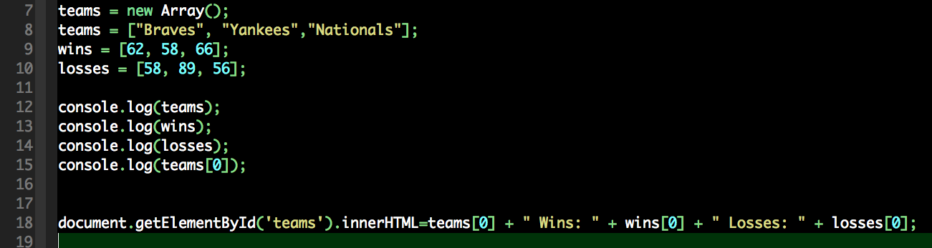
Accessing the Array
Getting the information of the list or individual parts.

Slide 7
Arrays are best served with Loops
For Loop
While Loop
for
As as Many times
As this is true
True
Do Something
While
I am true
Do
Something

Slide 8
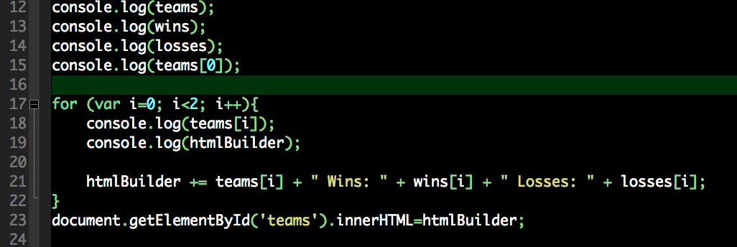
for Loop
For as many times as this is true, do that!

Slide 9
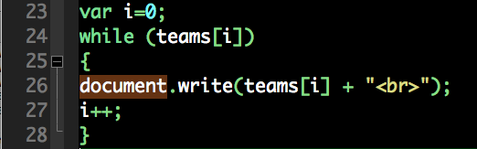
While Loop
While this is true, do that.

Slide 10
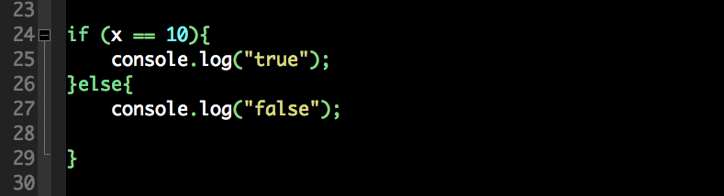
if Statements
Logic. If it is true, do this. Else, do that.

Slide 11
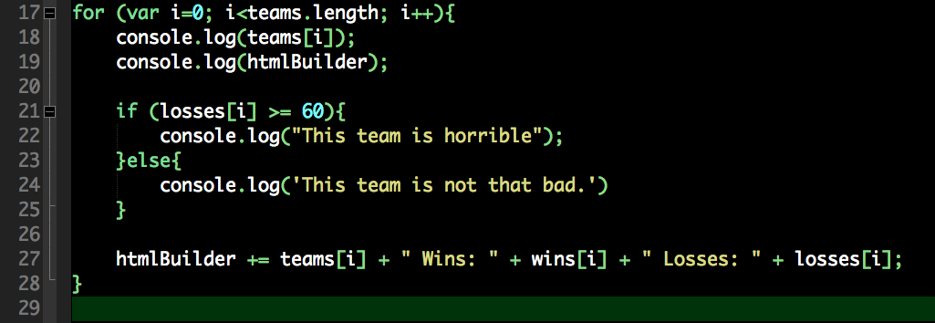
if best served in a Loop too!
Powerful!

Slide 12
Challenge!
Determine through logic which team has the most wins and log the winner in the console.
Hint: This requires a loop, use of the arrays and and if statement. I also created an additional variable.

Slide 13
Adding items to Arrays
push()
unshift()
Places it at the end of the array (position 0).
arrayName.push(34);
[5,10,22,34]
Places it at the front of the array.
arrayName.unshift(34);
[34,22,35,5]

Slide 14
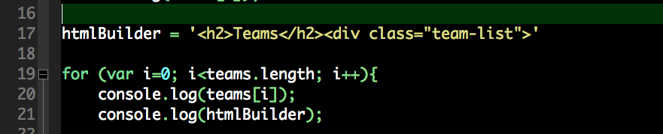
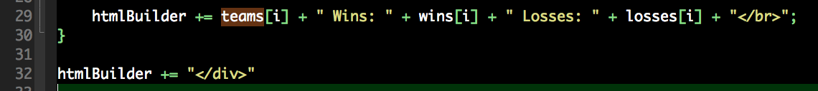
Formatting HTML in a Loop

Slide 15
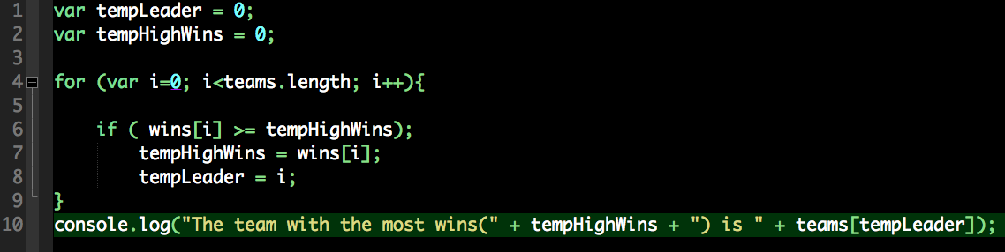
Challenge Answer

Slide 16
Removing from Arrays
shift()
pop()
Removes the first item from the array
myArray = [10,22,35]
myArray.shift()
[22,35]
Removes the last item from the array
myArray = [10,22,35]
myArray.pop()
[10,22]

Slide 17
Assignment 3
Write an HTML table with three lines and 3 columns (Team, Wins, Losses).
Highlight with a <strong> tag the team with the highest number of wins.
You can use online resources.
Hint: You have to combine the first loop with the challenge if statement. While adding the table code.

