Slide 1
Deep Learning in Genomic Sequence Benchmarking
Implementing CNNs with a Focus in Reproducibility
Jordan Winemiller
Department of Electrical Engineering & Computer Science Florida Atlanta Univeristy
February 9, 2026

Slide 2
Abstract
As deep learning becomes increasingly prevalent in genomics, maintaining reproducibility in model development and evaluation is essential. In the biosciences, particularly for large genomic sequence datasets, benchmarking has become a valuable tool for enabling repeatable sequence classification experiments. This project uses publicly available genomic sequence benchmark datasets to implement convolutional neural networks (CNNs) for regulatory element classification and to examine the practical challenges of reproducing published workflows.

Slide 3
Introduction
Genomic sequence classification has become a central task in computational biology, enabling researchers to characterize functional elements and regulatory patterns directly from DNA. Building on this momentum, the work presented here focuses on recreating previously proposed benchmarks from Genomics Benchmarks: A Collection of Datasets for Genomic Sequence Classification [2], which was designed to lower the barrier for experimenting with genomic data. These benchmarks provide a structured setting for evaluating models while promoting transparency and comparability across studies.

Slide 4
Target Audience
This work is intended for students and researchers in computational genomics, biostatistics, and computer science who seek practical, reproducible examples of applying deep learning to standardized genomic sequence benchmarks.

Slide 5
Background
Motivated by a background in biostatistics and computer science, this project aims to deepen practical experience with genomic datasets and to lay the foundation for future collaborations with faculty specializing in genomics. Recent literature has demonstrated that convolutional neural networks and related deep learning architectures can effectively learn predictive representations of genomic sequences, capturing both local motifs and higher-order patterns. In this context, the present work implements deep learning models on the established benchmark datasets and examines the practical challenges of achieving robust, repeatable results. By emphasizing reproducibility and clear experimental design, this project seeks to provide a useful reference for researchers and students who are beginning to work with deep learning methods in genomics. Implementation details and examples are available on GitHub
[6] and Google Colab.

Slide 6
Datasets
Genomic datasets are highly complex due to diverse data formats, pervasive missing values, variable sequence lengths, extreme scale, class imbalance in functional annotations, and batch effects from different sequencing technologies or experimental conditions. The data formats available in the materials are stored as genomic coordinates. Some sequences were previously mapped using the seq2loc Python package that specializes in mapping sequences for fasta files, human enhancers, and non-TATA promoters to genomic coordinates Browser Extensible Data (BED) format.

Slide 7
Datasets
The selected datasets in table 8 for benchmarking consist of two (2) of non-uniform sequence and two (2) of uniform sequence length, with one containing unbalanced classes. The first non-uniform set dummy mouse enhancers ensembl was designed as a small ’dummy’ dataset for prototyping. The second non-uniform set drosophila enhancers stark consisting of the drosophila enhancer [5]. Both uniform datasets were previously converted using seq2loc to the BED format. The first set human enhancers cohn consists of human enhancers [1]. The second set human nontata promoters of non-TATA promoters [7] has a class imbalance.
1
¹The materials include additional datasets that are available through the genomic benchmarks [6] Python package by ML-Bioinfo-CEITEC , and Hugging Face

Slide 8
Selected Datasets
Name | Number of Sequences | Number of Classes | Class Ratio² | Median Length³ | Sequence Length Range⁴
dummy mouse enhancers ensembl | 1210 | 2 | 1.0 | 2381 | 331 to 4476
drosophila enhancers stark | 6914 | 2 | 1.0 | 2142 | 236 to 3237
human enhancers cohn | 27791 | 2 | 1.0 | 500 | -
human nontata promoters | 36131 | 2 | 1.2 | 251 | -
²Ratio of the largest class
³Median length for all sequences in the dataset
⁴Minimum and maximum length for all sequences in the dataset. *Note: if blank all sequence are the length

Slide 9
Statistical Methods
The classification metrics for predictions will look at True Positive, True Negative, False Positive, False Negative, Precision, and Recall (eq. 1). These metrics will be used to measure the Accuracy (eq. 2) and F₁ Score (eq. 3) for benchmarking the models. The F₁ Score metric will be used for binary predictions. Otherwise, the F_{β} Score (eq. 4) metric will be used for any multi-class classification. In addition to these metrics, Cost Functions will be monitored during model training.

Slide 10
Statistical Methods: Calculations
TP = True Positive TN = True Negative FP = False Positive
FN = False Negative
(1)
TP
Precision =
TP + FP TN
Recall =
TN + FP
FP
TP
Accuracy =
= 1 −
(2)
TP + FP TP + FP
precision ∗ recall
F1 Score = 2 ∗
(3)
precision + recall
(1 + β²) ∗ TP
^{Fβ Score =} (TP + FN) ∗ β² + (TP + FP)
(4)

Slide 11
Model Architecture
Convolutional neural networks (CNNs) are powerful deep learning architectures that extract biologically meaningful features from genomic sequences with minimal hand-engineered input. These models excel at DNA feature extraction by automatically discovering regulatory elements such as the spacing patterns that distinguish promoters from enhancers, and demonstrate robustness across diverse species and sequence contexts [8]. The output of the CNN layer is fed to the Max pooling layer, which helps to reduce the spatial dimensions of the feature maps while retaining the most essential information by selecting the maximum value within each pooling window. This allows the network to focus on the most significant features and become less sensitive to small variations in the input sequence, making the model more robust. To normalize the inputs to the layers, a batch normalization layer is introduced before the next layer [4].

Slide 12
Model Architecture
The initial setup for this experiment is to implement two (2) deep convolutional neural networks with the Keras package.
The last dense layer in both networks will have one (1) unit for binary classification using the Sigmoid (eq. 6) activation function, and the number of classes for the units for multi-class classification using the Softmax (eq. 7) activation function.

Slide 13
Model Architecture: Activation Functions
f
+
x + |x| x if x > 0,
ReLU(x ) = x = max (0, x ) =
=
(5)
2 0 x ≤ 0
1
Sigmoid = σ(x ) =
1 + e^{−x}
(6)
_{e}z_{i}
Softmax = σ(z )_{i} =
Σ^{K} e^{zj}
(7)
j=1

Slide 14
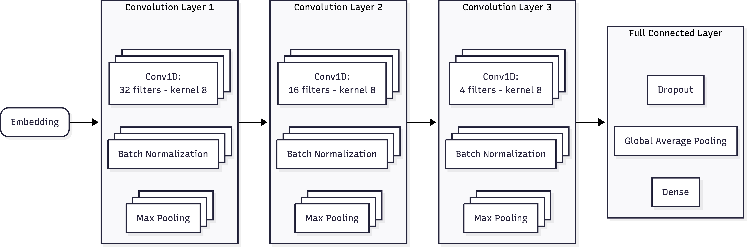
Model Architecture - Basic
The first network will consist of three (3) convolution units with a Convolutional 1D Layer for one (1) dimensional data, Batch Normalization Layer, and a Max Pooling 1D Layer with a max pooling size of two (2). The fully connected layer will consist of a Dropout Layer with 30% of the input units to be removed, a Global Average Pooling 1D Layer and a Dense Layer. The three (3) convolutional layers will all have a kernel size of 8, filters of 32, 16, and 4 in descending order, and implements the Rectified Linear Units (ReLU) (eq. 5) activation function. The figure shows the details of the first CNN architecture.

Slide 15
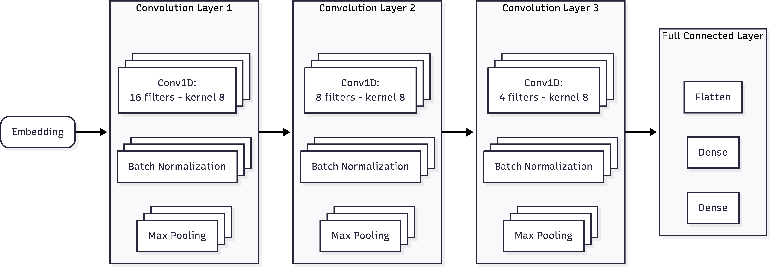
Model Architecture - Final
The second network will consist of three (3) convolution units with a Convolutional 1D Layer for the one (1) dimensional data, Batch Normalization Layer, and a Max Pooling 1D Layer with a max pooling size of two (2) as the first CNN architecture. The fully connected layer will consist of a Flatten Layer and two (2) Dense Layers. The three (3) convolutional layers will all have a kernel size of 8, filters of 16, 8, and 4 in descending order, and use the ReLU activation function. The first of the dense layers will have 512 units and use the ReLU activation function. The figure shows the details of the second CNN architecture.

Slide 16
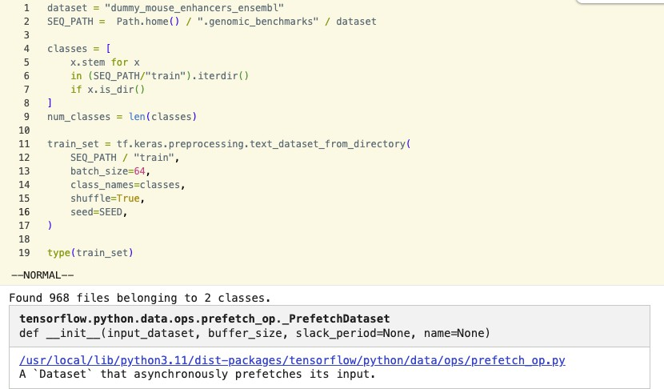
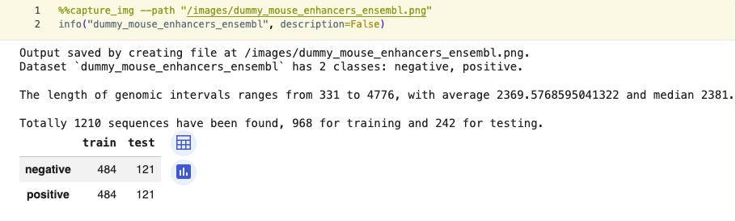
Implementation
The genomic-benchmarks Python package from ML-Bioinfo-CEITEC is a GitHub repository[6] that collects benchmarks for genomic sequence classification. The repository includes the datasets, source code, helper functions, and examples. The repository is also available via PIP installation. The original implementation of the datasets and example code do not use a validation set. Figure 1 shows the initial information prototype dataset. Figure 2 shows the type of the training dataset.
Figure: Initial Prototype Dataset
‘
Figure: Dataset Type

Slide 17
Impl: Dependencies
PIP Install
  genomic benchmarks
  mermaid-py
  jupyter capture output
Imports
  pathlib
  os
  keras
    backend
    layers
    losses
    models
    metrics
  matplotlib
  numpy
  tensorflow

Slide 18
Impl: Dataset Download
Downloading the datasets from the genomic-benchmarks Python package creates a hidden folder in your working directory with the setup in code will only download a non-existent dataset. The info command will produce information about the dataset from the metadata.yaml file that accompanies each dataset.
s e l e c t e d d a t a s e t l i s t = [
” dummy mouse enhancers ensembl ” , ” d r o s o p h i l a e n h a n c e r s s t a r k ” ,
” human enhancers cohn ” ,
” h u m a n n o n ta ta p ro m o te r s ” ,
]
f o r d a t a s e t i n s e l e c t e d d a t a s e t l i s t :
i f not i s d o w n l o a d e d ( d a t a s e t ) : d o w n l o a d d a ta s e t ( d a t a s e t )
p r i n t ( i n f o ( d a ta s e t , d e s c r i p t i o n=True ) )
p r i n t ( ”\n” )

Slide 19
Impl: Transforming the Data
The dataset needed to be transformed using a one-hot encoding for each class. This process vectorized the text. The vectorization process codes 1 and 2 show the methods used to facilitate the data transformation.
1: Vectorization Layer
c h a r s p l i t f n = lambda x : t f . s t r i n g s . u n i c o d e s p l i t ( x , i n p u t e n c o d i n g=”UTF−8” )
v e c t o r i z e l a y e r = k e r a s . l a y e r s . T e x t V e c t o r i z a t i o n (
output mode=” i n t ” ,
s p l i t=c h a r s p l i t f n ,
2: Vectorize Text
d e f v e c t o r i z e t e x t ( te x t , l a b e l ) :
””” Re tu r n s a v e c t o r r e p r e s e n t a t i o n o f th e t e x t .
: param t e x t : The t e x t to v e c t o r i z e
: param l a b e l : The l a b e l o f th e t e x t
: r e t u r n : A v e c t o r r e p r e s e n t a t i o n o f th e t e x t ”””
t e x t = t f . expand dims ( te x t , a x i s =−1)
r e tu r n v e c t o r i z e l a y e r ( t e x t ) −2 , l a b e l
)
v e c t o r i z e l a y e r . adapt ( t r a i n s e t . map ( lambda x , y : x ) ) v o c a b s i z e = l e n ( v e c t o r i z e l a y e r . g e t v o c a b u l a r y ( ) )
v e c t o r i z e l a y e r . g e t v o c a b u l a r y ( )

Slide 20
Impl: Metrics
Providing transparent evidence of the model’s performance is the cornerstone of benchmarking. The implementation for capturing these important metrics and providing visual evidence of the CNN model for training and evaluation and new unseen test data. The graphs produced will contain the accuracy, cost functions (i.e., learning curve), and F₁ score for training. The method also provides metrics for the models evaluation of the testing dataset.

Slide 21
Complications
There were complications due to when genomic-benchmarks Python package was design and built. The authors built the source code with the helper functions to work with up to python3.10. There are a few dependencies in the source code that could not be used.
Including tensorflow-addons for F₁ score due to the Keras package version (which is addressed in the next section), torchtext for tokenization methods in the source code, which does not have a compatible torch version that can be installed in Google Colab.

Slide 22
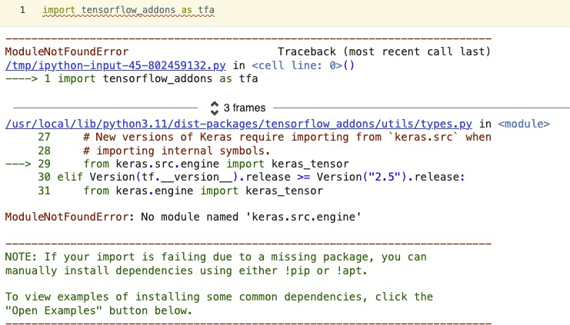
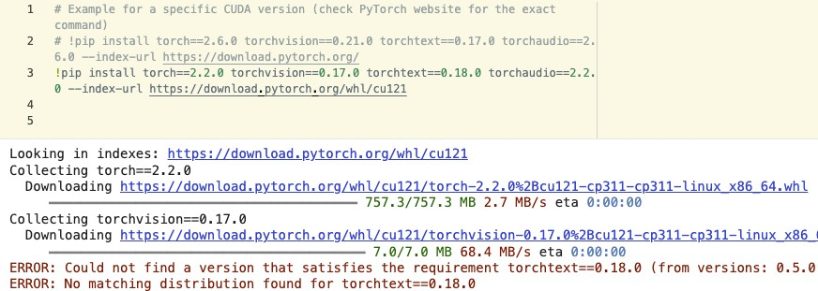
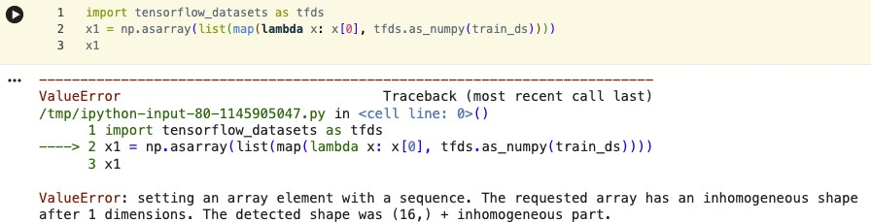
Complications Cont.
There were other complications due to the data being not uniform in length, adding complexity of using native numpy arrays. There was another issue with how the one-hot encoding source code was working and being utilized in the model (which is addressed in the next section). Figures 3, 4, 5 show the complications.
Figure: Tensorflow-addons Package Figure: Torchtext Package Issue Issue
Figure: Numpy Data Shape Issue

Slide 23
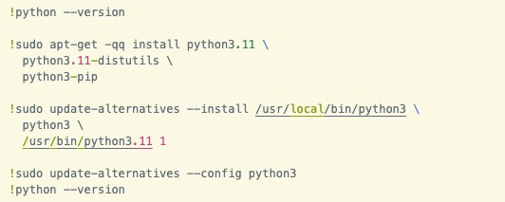
Mitigation Attempts
Attempted: Working through the source code and complications, I decided to lower the python version to the lowest available in the google Colab environment. Initially, there was an attempt to switch the version shown in figure 6.
Figure: Python3.11 Installation
This was abandoned due to time constraints. After this change was made, the first model was able to produce results with minimal additional workarounds.

Slide 24
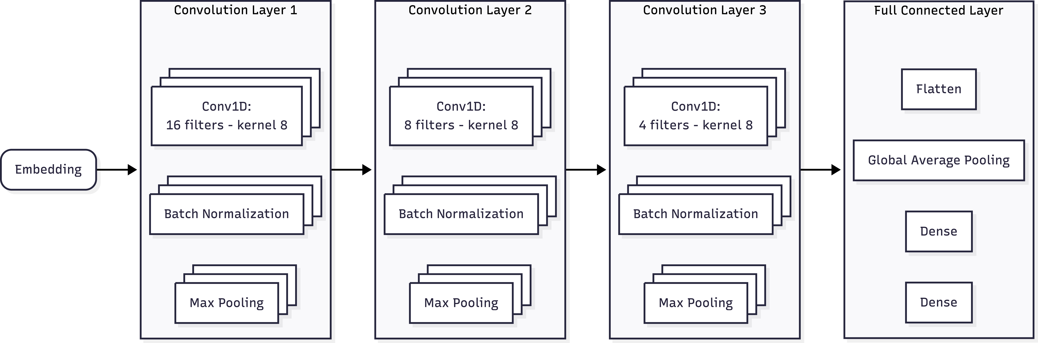
Mitigation Attempts Cont.
Fixed: The second model required additional new layers to be added to the architecture to handle the output dimension from the last Convolutional Layer to the Flatten Layer. A Global Average Pooling Layer was added to the CNN architecture. Figure 7 shows the updated architecture for the second model.
Figure: Second Model Architecture Update

Slide 25
Mitigation Attempts Cont.
Fixed: The F₁ Score that is implemented in the genomic-benchmarks Python package requires a version of Keras that is not supported in the available version of Google Colab. A Python function was written for the implementation of the F₁ Score metric for the evaluation of the model.

Slide 26
Results: Utility Code
To facilitate the execution for training and testing the models on multiple datasets; utility code was built to allow for a repeatable setup. This allows for an update for training and test datasets in the notebook. This was required because the variables existing in a global scope.
The models were trained and evaluated using the method to populate a dictionary with model metrics after the models were compiled, trained and evaluated.
Repeating the setup with the above utilities for training and evaluation of the models on each dataset
was reduced to the code 3.
3: Example Training and Evaluation Run.
d a ta s e t n u m b e r = 0
d a t a s e t = u p d a t e t r a i n t e s t s e t s ( 0 )
model 0 = t r a i n a n d e v a l u a t e m o d e l s ( d a ta s e t , epochs )

Slide 27
Results: Models
The models for these experiments were built with the Keras Python package using the architectures mentioned in the model architecture. All of the experiments ran for 10 epochs. The baseline and final model were built using training and evaluation method in the paper.

Slide 28
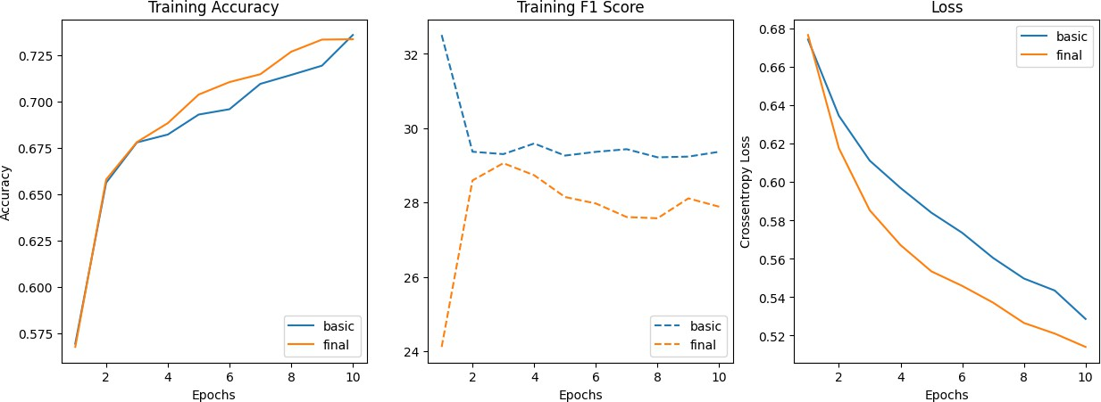
Results: Models - Dummy Mouse Enhancers Enseml
The models were trained on 968 sequences for 10 epochs. Then, tested on 242 sequences. The results of the training are shown figure below.
The total loss, accuracy, and F1 score evaluation metrics are shown in table. Note: this is dataset index 0.
Model Name | Total Loss | Accuracy | ^{F}1 ^{Score}
Basic | 0.5797 | 66.82% | 33.13
Final | 0.9998 | 50.64% | 0.76

Slide 29
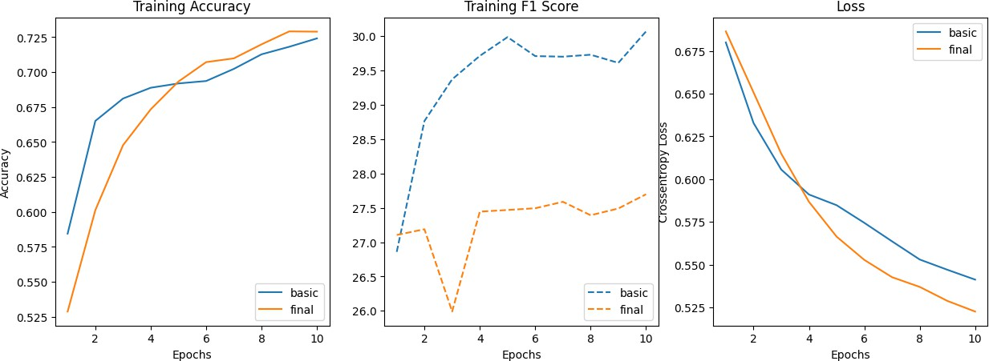
Results: Models - Drosophila Enhancers Stark
The models were trained on 5,184 sequences for 10 epochs. Then, tested on 1,730 sequences. The results of the training are shown figure below.
The total loss, accuracy, and F1 score evaluation metrics are shown in table. Note: this is dataset index 1.
Model Name | Total Loss | Accuracy | ^{F}1 ^{Score}
Basic | 1.3692 | 49.94% | 40.93
Final | 0.8922 | 50.46% | 0.82

Slide 30
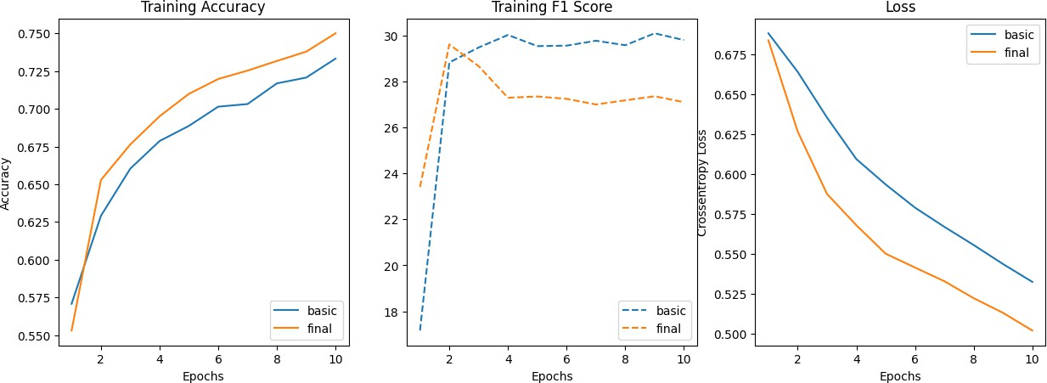
Results: Models - Human Enhancers Cohn
The models were trained on 20,843 sequences for 10 epochs. Then, tested on 6,948 sequences. The results of the training are shown figure below.
The total loss, accuracy, and F1 score evaluation metrics are shown in table. Note: this is dataset index 2.
Model Name | Total Loss | Accuracy | ^{F}1 ^{Score}
Basic | 0.7929 | 52.60% | 40.45
Final | 0.6263 | 65.09% | 14.97

Slide 31
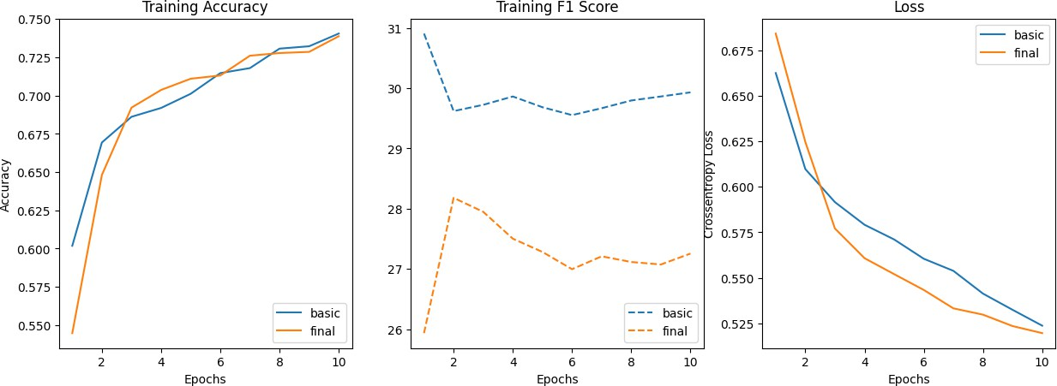
Results: Models - Human Non-TATA Promoters
The models were trained on 27,097 sequences for 10 epochs. Then, tested on 9,034 sequences. The results of the training are shown figure below.
The total loss, accuracy, and F1 score evaluation metrics are shown in table. Note: this is dataset index 3.
Model Name | Total Loss | Accuracy | ^{F}1 ^{Score}
Basic | 0.5817 | 71.56% | 23.30
Final | 0.6068 | 66.36% | 20.33

Slide 32
Results: Benchmark Analysis
In benchmarking the models on the selected datasets, the models showed difficulties in obtaining any significant training loss or accuracy. Upon evaluation of the models, the accuracy appears to predict classes at random expected with the human non-TATA promoters, but that dataset had imbalance favoring the predicted class. The F₁ scores for evaluation performed better on the baseline model, which could be due in part to the additional global average pooling layer that had to be added to the model architecture. The original final model architecture was compiled using Pytorch, but that should not account for the amount of lack of performance.

Slide 33
Future Improvements
There are a few improvements beyond the updates required for newer versions of the packages used in the experiments. Future experiments would benefit from the addition of validation sets to test for overfitting during training. Moving the activation layer for the CNN units to after the batch normalization layer. Increasing the number of epochs for training iterations. Using built-in optimizers to allow for control of the learning rates and built-in data encoding for input layers to understand the number of parameters in the models.
Other improvements consists of testing different model architectures, using data augmentation, and handling of sparse data.

Slide 34
Conclusions
Although initial attempts to reproduce the previous results with the deep learning models did not produce the expected results, mainly due to the implementation obstacles. The undertaking of a project to become familiar with genomic data and developing Convolutional Neural Networks through updating and working through the proposed architectures; there is an excitement to continue exploring more deep learning opportunities in the field of genomics.

Slide 35
Miscellaneous
Code used to create the report is in GitHub [3] The diagrams use mermaid-py for this project

Slide 36
Data Availability
All datasets are available for GitHub [6], and all code covered in this article can be found at [3] or at Google Colab.

Slide 37
References I
D. Cohn, O. Zuk, and T. Kaplan. Enhancer identification using transfer and adversarial deep learning of dna sequences. bioRxiv, 2018.
K. Greˇsov´a, V. Martinek, D. C^{ˇ}ech´ak, P. S^{ˇ}imeˇcek, and P. Alexiou. Genomic benchmarks: a collection of datasets for genomic sequence classification. BMC Genomic Data, 24(1):25, 2023.
jmwinemiller. cap-6619-project.
https://github.com/jmwinemiller/cap-6619-project, 2026.
S. K S and M. S. Nair. Dnacoder: a cnn-lstm attention-based network for genomic sequence data compression. Neural Computing and Applications, 36:18363–18376, 07 2024.
E. Kvon, T. Kazmar, G. Stampfel, J. Y´an˜ez-Cuna, M. Pagani, K. Schernhuber,
B. Dickson, and A. Stark. Genome-scale functional characterization of drosophila developmental enhancers in vivo. Nature, 512, 06 2014.

Slide 38
References II
ML-Bioinfo-CEITEC. genomic benchmarks.
https://github.com/ML-Bioinfo-CEITEC/genomic_benchmarks, 2025.
R. Umarov and V. Solovyev. Recognition of prokaryotic and eukaryotic promoters using convolutional deep learning neural networks. PLOS ONE, 12, 02 2017.
Y.-z. Zhang and S. Imoto. Genome analysis through image processing with deep learning models. Journal of Human Genetics, 69, 07 2024.

