Slide 1
CS6135 VLSI-PDA
Homework 4 - Global Placement

Slide 2
Related Files
Global Placement
Initial phase assigning rough locations to circuit elements.
./include/GlobalPlacer.h, ./src/GlobalPlacer.cpp (Global Placement)
./include/ExampleFunction.h, ./src/ExampleFunction.cpp (Objective function and its gradient)
./include/NumericalOptimizer.h (Gradient solver)
…

Slide 3
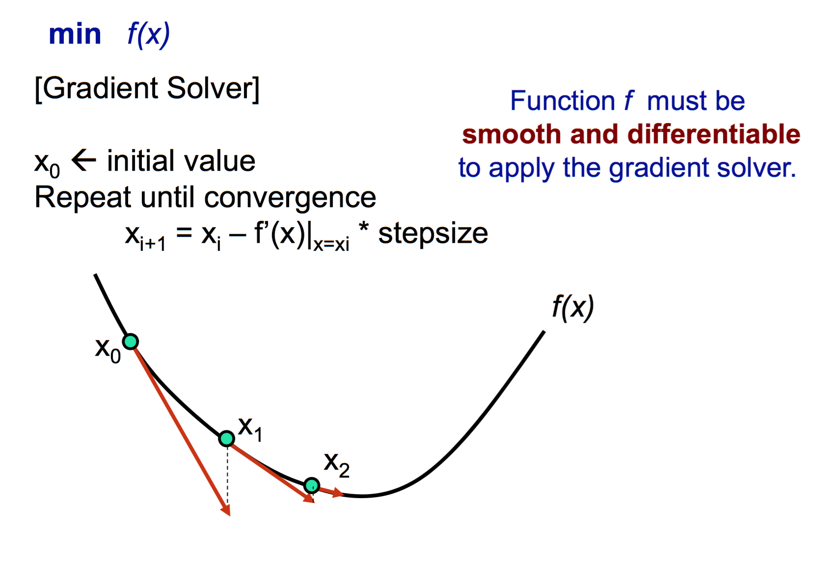
Gradient Solver
Source: Y.-W. Chang

Slide 4
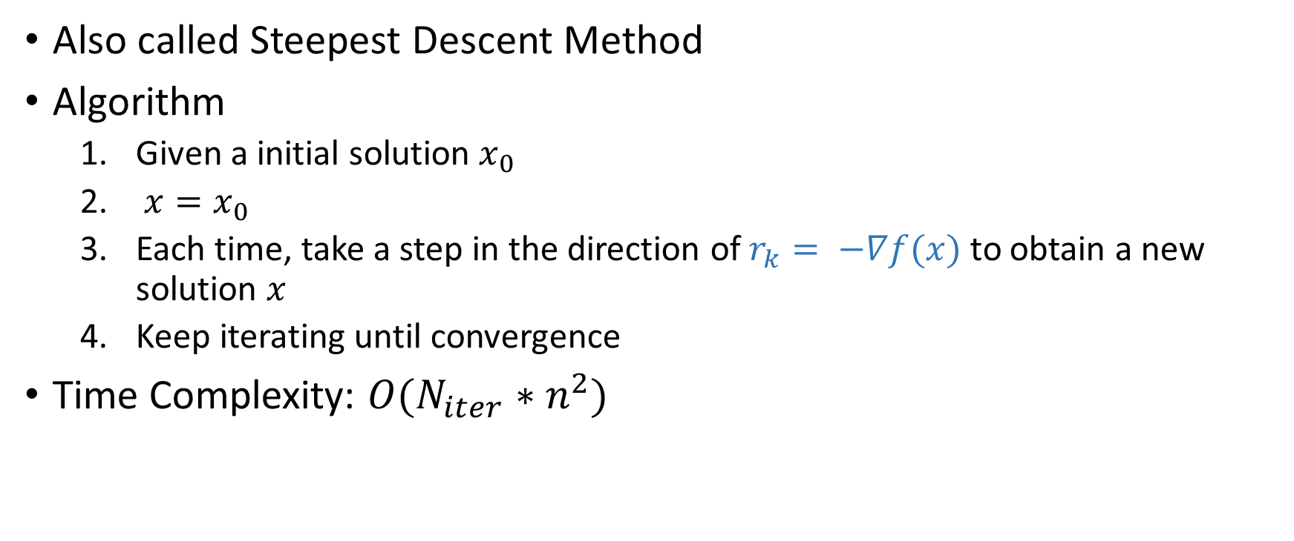
Gradient Descent Method (1/2)
Also called Steepest Descent Method
Algorithm
Given a initial solution $x_{0}$
$x=x_{0}$
Each time, take a step in the direction of $r_{k}= −∇f(x)$ to obtain a new solution $x$
Keep iterating until convergence
Time Complexity: $O(N_{iter}∗n^{2})$

Slide 5
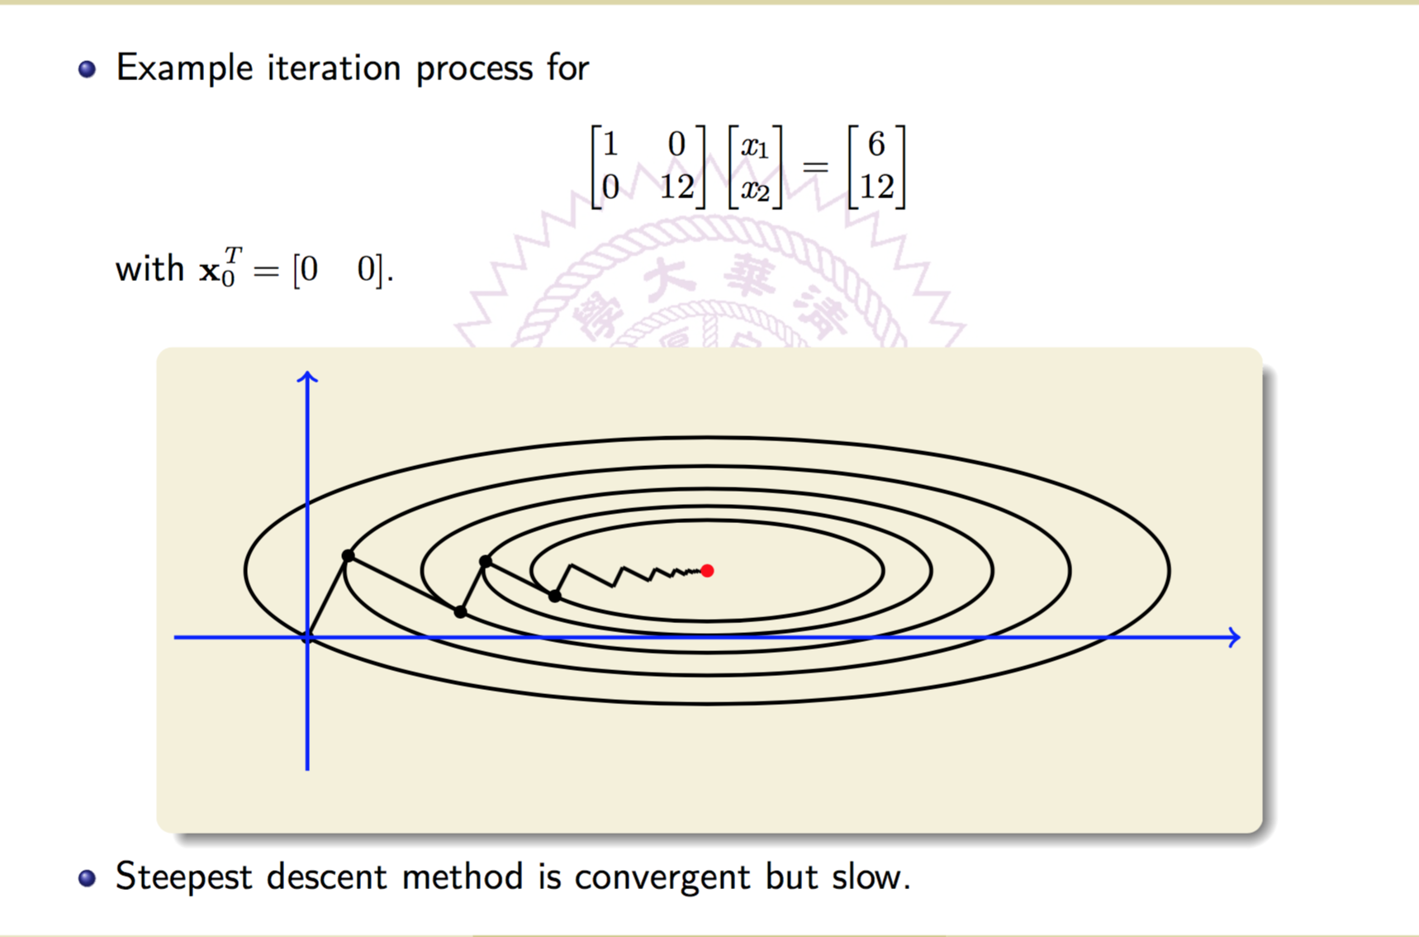
Gradient Descent Method (2/2)
Source: M.-C. Chang

Slide 6
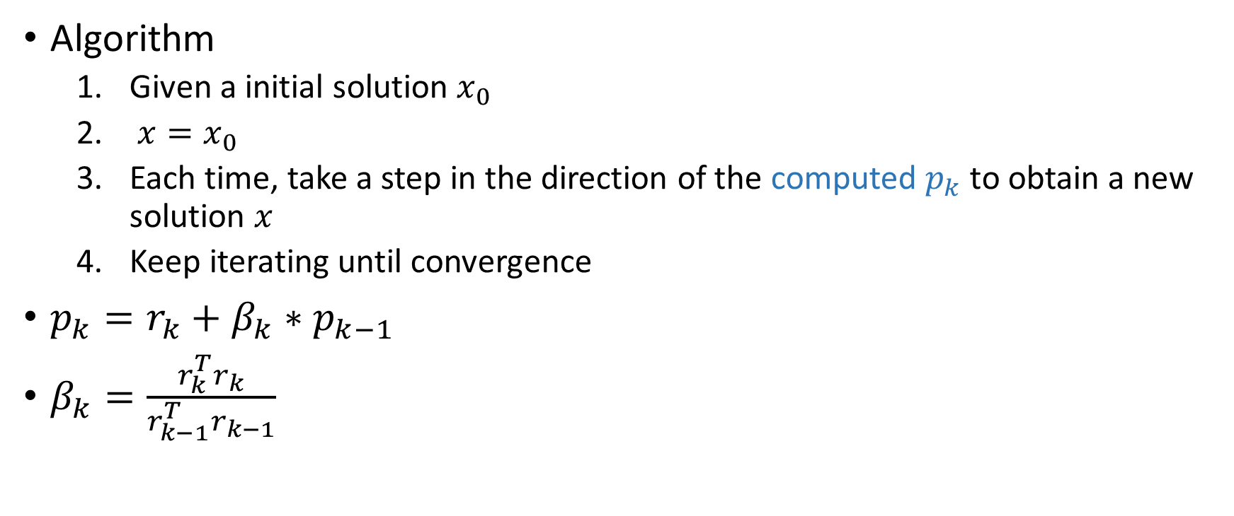
Conjugate Gradient Method (1/3)
Algorithm
Given a initial solution $x_{0}$
$x=x_{0}$
Each time, take a step in the direction of the computed $p_{k}$ to obtain a new solution $x$
Keep iterating until convergence
$p_{k}=r_{k}+β_{k}∗p_{k−1}$
$β_{k}=\frac{r_{k}^{T}r_{k}}{r_{k−1}^{T}r_{k−1}}$

Slide 7
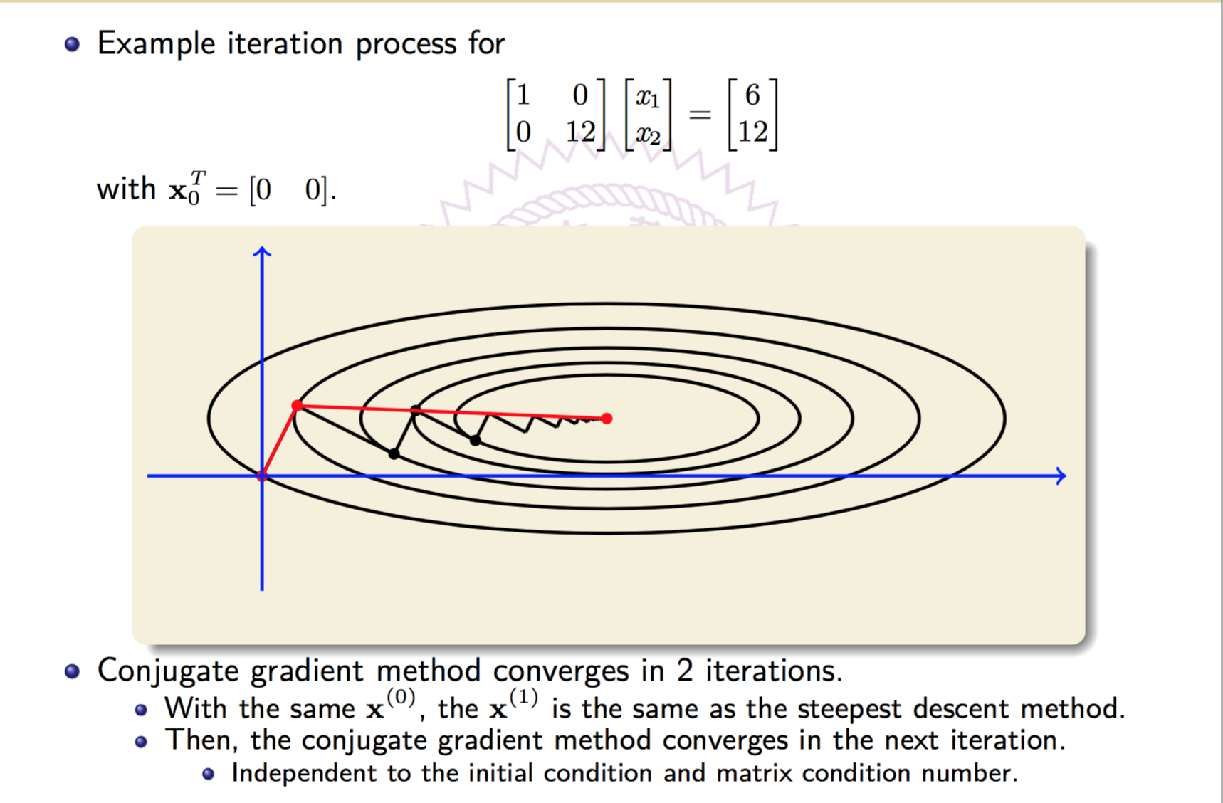
Conjugate Gradient Method (2/2)
Source: M.-C. Chang

Slide 8
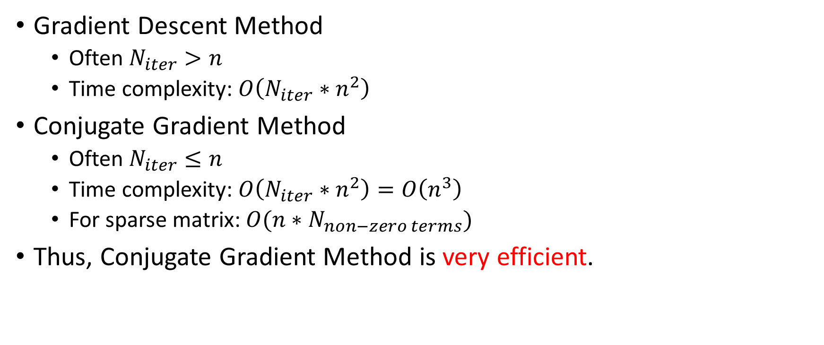
Comparison
Gradient Descent Method
Often $N_{iter}>n$
Time complexity: $O\left(N_{iter}∗n^{2}\right)$
Conjugate Gradient Method
Often $N_{iter}≤n$
Time complexity: $O\left(N_{iter}∗n^{2}\right)=O\left(n^{3}\right)$
For sparse matrix: $O(n∗N_{non−zero terms})$
Thus, Conjugate Gradient Method is very efficient.

Slide 9
Homework 4
tar -zxvf HW4.tar.gz
The gradient solver sample code is in Example.cpp
make example
./bin/example

Slide 10
Keys of Gradient Solver
Find a local minimum of a function
Objective function
Gradient functions
Initial vector
Number of iterations (Tradeoff between quality & runtime)
Step size bound
Too small: Require lots of iterations to converge
Too large: May even can not converge

Slide 11
Keys of Gradient Solver
Find a local minimum of a function
Objective function
Gradient functions
Initial vector
Number of iterations (Tradeoff between quality & runtime)
Step size bound
Too small: Require lots of iterations to converge
Too large: May even can not converge

Slide 12
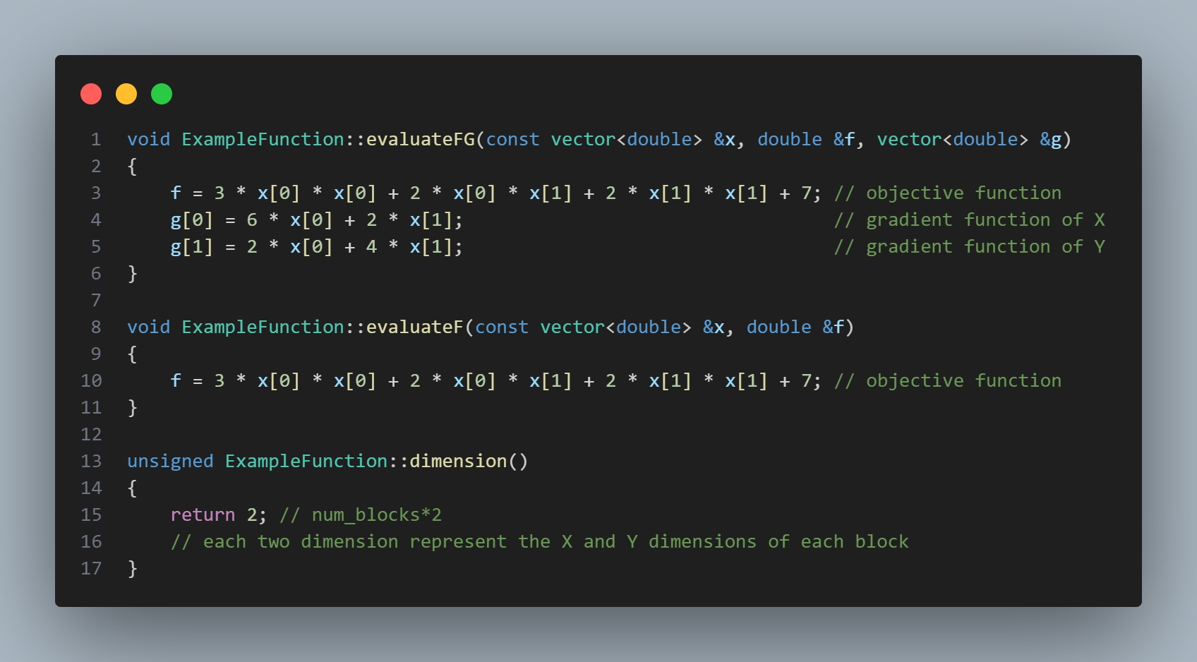
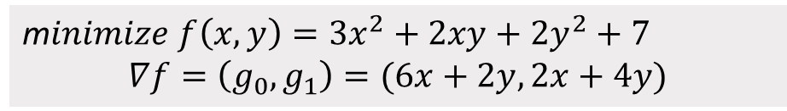
Example.cpp (1/5)
m$inimize f\left(x,y\right)=3x^{2}+2xy+2y^{2}+7$
$$∇f=\left(g_{0},g_{1}\right)=(6x+2y, 2x+4y)$$

Slide 13
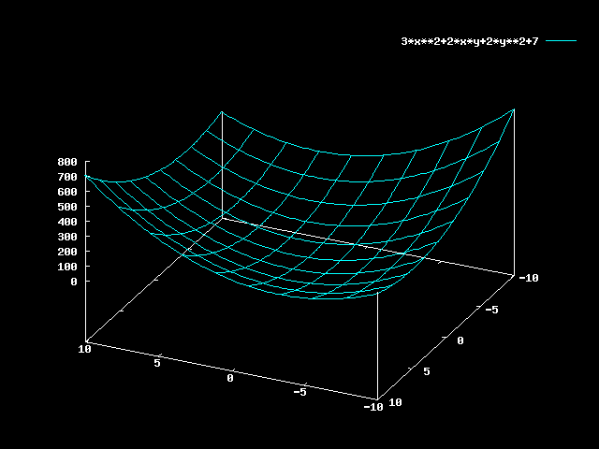
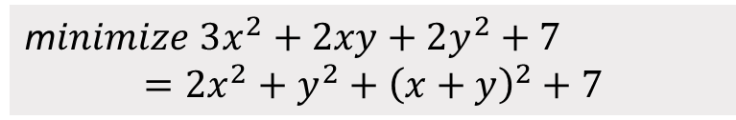
Example.cpp (2/5)
m$inimize 3x^{2}+2xy+2y^{2}+7$ $$=2x^{2}+y^{2}+{\left(x+y\right)}^{2}+7$$
When $x=y=0$, the original expression has a minimum value of 7.

Slide 14
Example.cpp (3/5)

Slide 15
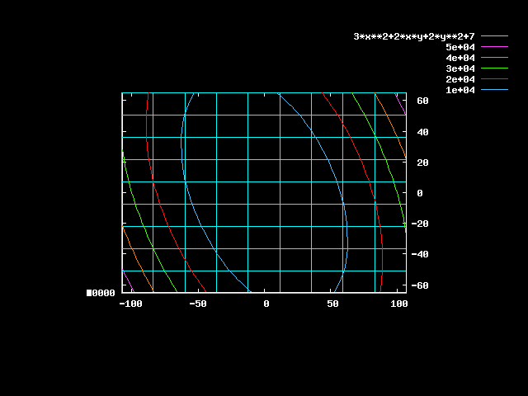
Example.cpp (4/5)

Slide 16

Example.cpp (5/5)
m$inimize 3x^{2}+2xy+2y^{2}+7=2x^{2}+y^{2}+{\left(x+y\right)}^{2}+7$
Objective function
Absolute value of gradient functions ($\sqrt{\sum_{i}{g_{i}^{2}}}$)
[vlsipda@ic26 HW4]$ ./hw4 -aux testcases/ibm01/ibm01-cu85.aux
Objective = 65097 ||grad|| = 1000
Objective = 60367 ||grad|| = 964.002
Objective = 55816.9 ||grad|| = 928.013
………
Objective = 7.00378 ||grad|| = 0.305804
Objective = 7.00193 ||grad|| = 0.184733
Current solution:
x[0] = 0.000796515
x[1] = 0.0306817
Objective: 7.00193
[vlsipda@ic26 HW4]$
Iterations
Final solution

Slide 17
Keys of Gradient Solver
Find a local minima of a function
Objective function
Gradient functions
Initial vector
Number of iterations (Tradeoff between quality & runtime)
Step size bound
Too small: Require lots of iterations to converge
Too large: May even can not converge

Slide 18
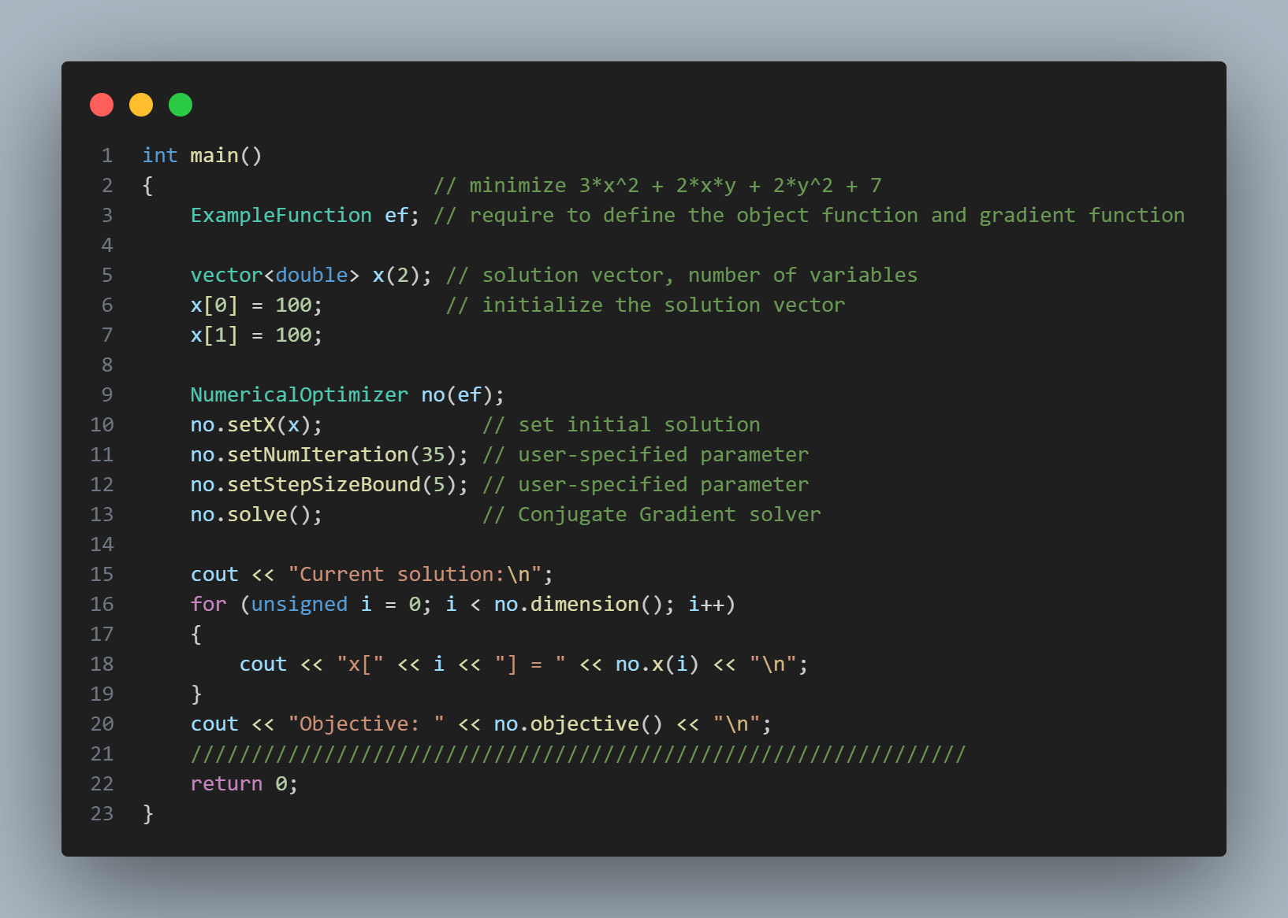
Example.cpp

Slide 19
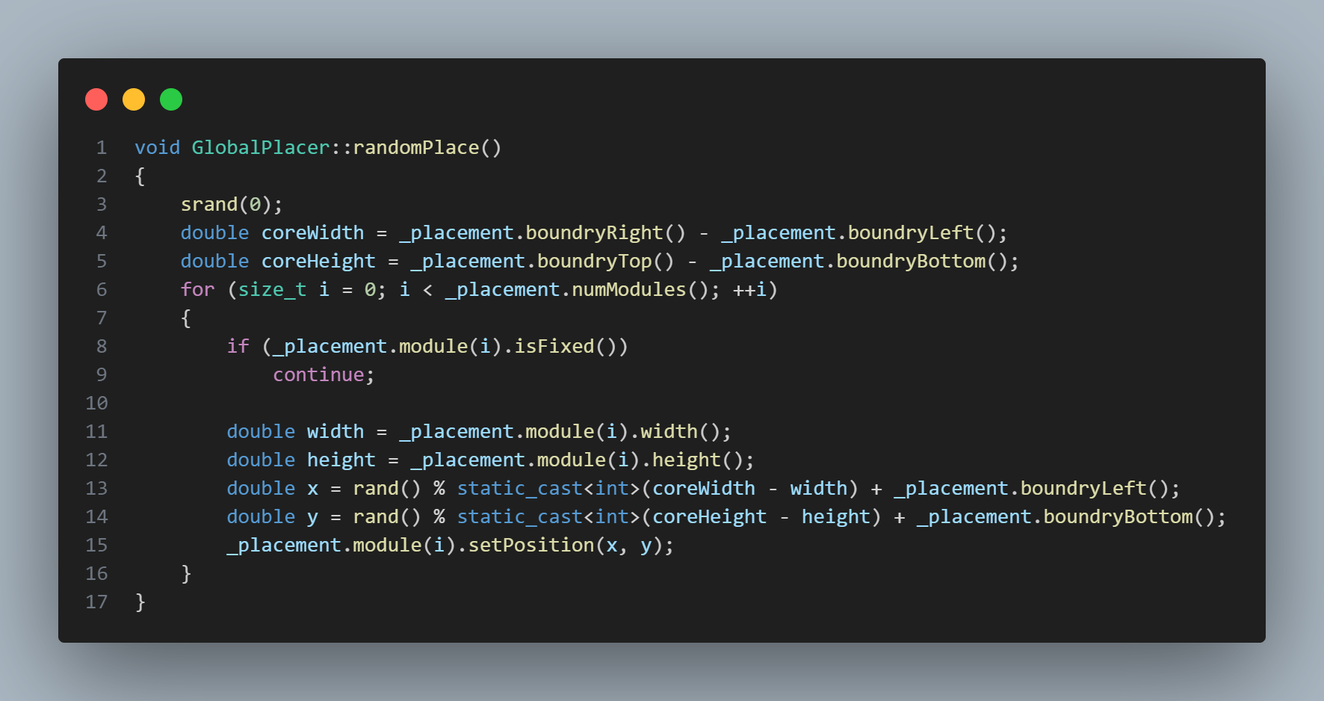
TODO (1/5)
You can refer to GlobalPlacer::randomPlace() implemented by TA

Slide 20

TODO (2/5)
First, type in the following commands
make test public1
You’ll see the following messages on the screen

Slide 21

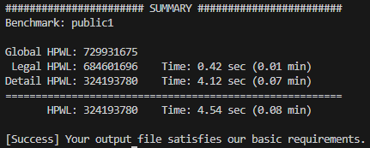
TODO (3/5)
Second, in GlobalPlacer.cpp, uncomment line 60.
Rebuild and execute again.
You’ll see the following messages on the screen.

Slide 22
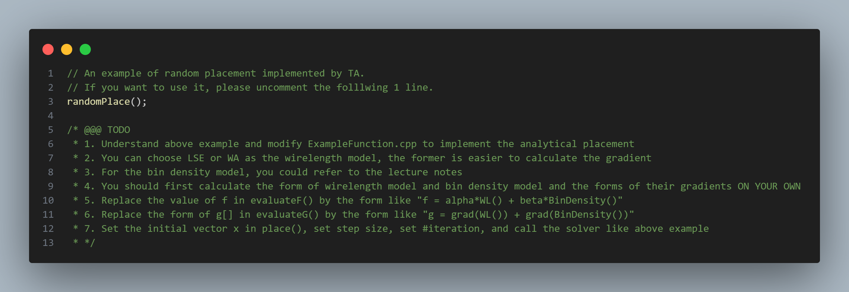
TODO (4/5)
Follow the hints in GlobalPlacer::place()

Slide 23
TODO (5/5)
Modify place() in GlobalPlacer.cpp
The upper part is an example which is the same as example.cpp
Modify evaluateFG(), evaluateF(), dimension(),… in ExampleFunction.cpp
This homework tests the following abilities
Calculus (if you use analytical approaches)
Code Reading

